Slide 1
PROGRESS IN THE DEVELOPMENT OF NANO-STRUCTURED STEELS
A.F.ROWCLIFFE (ORNL)
ARIES PROJECT MEETING
GERMANTOWN
MAY 21st-22nd 2013

Slide 2
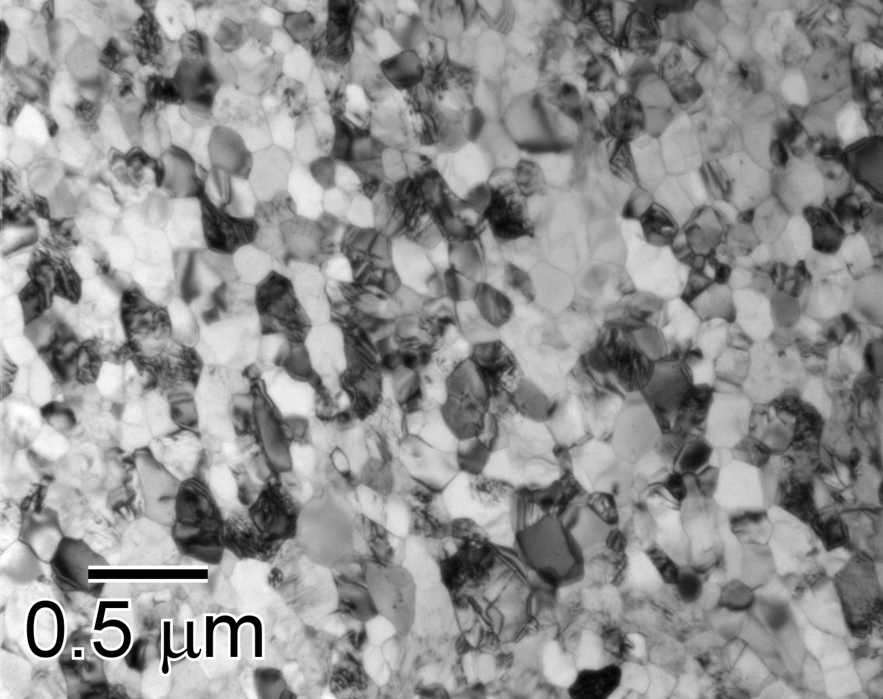
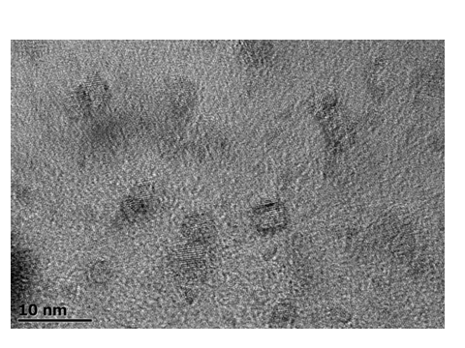
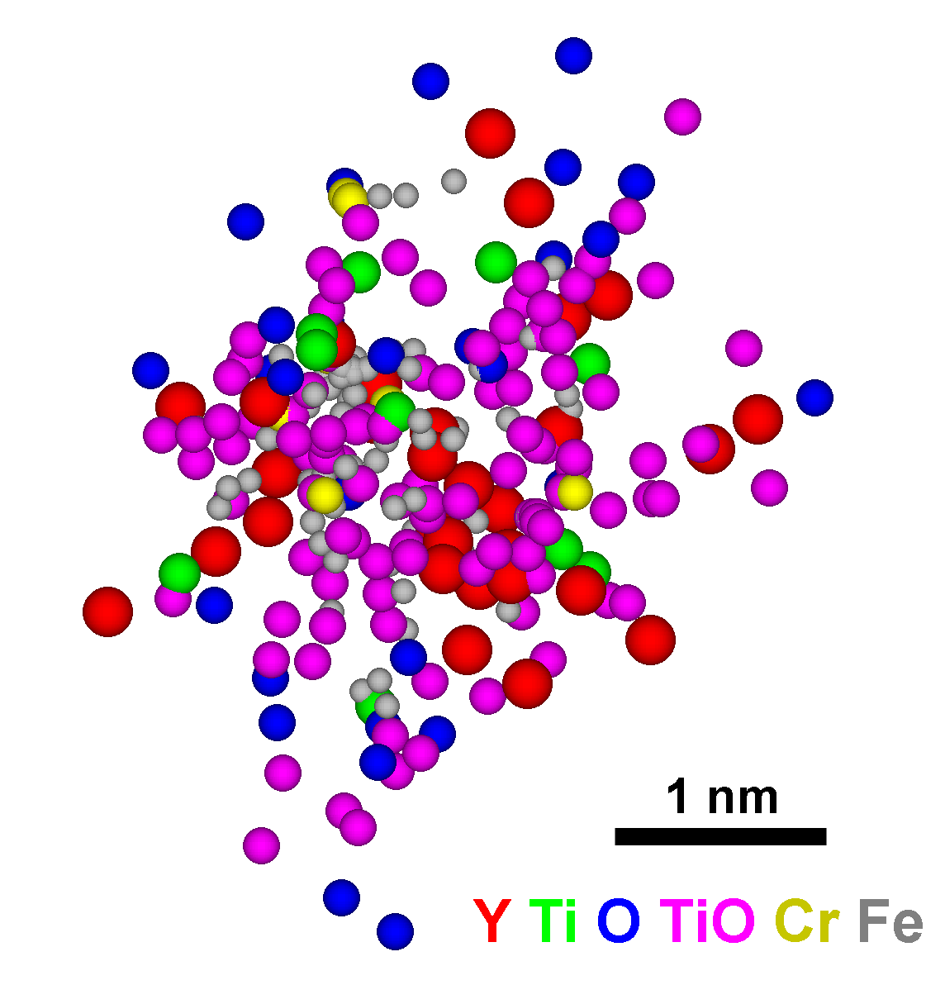
Nanostructured Ferritic Alloys (NFAs)
BF-TEM of 14YWT SM10 Heat
N_{v} = 1-7 x 10²³ m⁻³
<r> = 1.8 (⁺/- 0.4) nm
HR-TEM
<Grain size> = 136 (+/- 14) nm
Compared to the RAFS ( F82H,EUROFER) the NFAs have the potential to expand operating temperature windows up to ~800C while accommodating much higher levels of displacement damage and helium concentrations
The microstructural nano-features provide strong barriers to dislocation movement conferring high tensile strength combined with good fracture resistance and outstanding high temperature creep resistance
The combined particle-matrix interfaces and nano-grain interfaces comprise a high surface area:volume ratio (~6 x 10⁷ m²/m³) and provide a very effective trapping environment at all temperatures for helium atoms and for the recombination of point defects.
2

Slide 3
DEVELOPMENT OF 14YWT UTILIZED 1-2 KG BATCHES OF ALLOY POWDERS TO ESTABLISH CRITICAL RELATIONSHIPS BETWEEN PROCESSING PARAMETERS AND MICROSTRUCTURES/PROPERTIES
Y₂O₃
HIP near net shape final product

Slide 4
NE-FUNDED INITIATIVE IN 2011TO DEVELOP A BEST-PRACTICE FABRICATION TECHNOLOGY FOR 14YWT
OBJECTIVE:
DEFINE A BEST PRACTICE PROCESSING ROUTE FOR CONSISTENT AND REPRODUCIBLE COMPOSITION AND MICROSTUCTURAL CONTROL, PREDICTABLE MECHANICAL PROPERTIES WITH POTENTIAL FOR SCALE-UP
COLLABORATION:
LED BY LANL ( Malloy)
ORNL (Hoelzer)
UCSB (Odette)
UC-BERKELEY /UT ( Wirth)
CRUCIBLE RESEARCH/ATI POWDER ( Stewart)
SOUTH DAKOTA SCHOOL OF MINES ( West)

Slide 5
PROJECT HAS SUCESSFULLY DEMONSTRATED REPRODUCIBLE CONTROL OF COMPOSITION/IMPURITIES , MICROSTRUCTURES AND MECHANCIAL PROPERTIES BASED ON 22KG BATCHES
GAS ATOMIZATION UTILIZED FOR POWDER PREPARATION; [O] CONTROLLED VIA FeO ADDITIONS
BALL MILLING ATMOSPHERE SUCCESSFULLY CONTROLLED FOR ADJUSTING [O] PICK-UP LEVELS AND MINIMIZING [C,N] CONCENTRATIONS
CONSOLIDATION AND HEAT TREATING CONDITIONS ADJUSTED TO PRODUCE OPTIMAL MATERIAL ( 14YWT-PM2) EXHIBITING NEAR-ISOTROPIC MICROSTRUCTURE AND GOOD BALANCE BETWEEN STRENGTH AND DUCTILITY.
SCALE-UP TO 60kg BATCHES IN PROGRESS

Slide 6
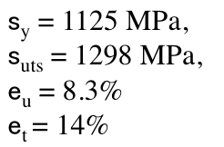

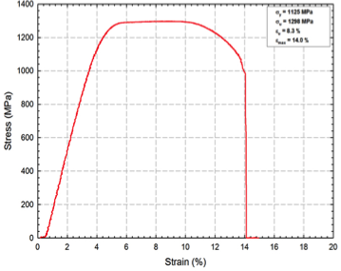
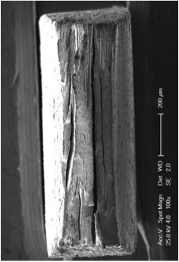
Tensile properties of 14YWT-PM2
Intermediate yield/tensile strength to balance performance & formability

Slide 7
“Best Practice” processing of 14YWT:
Tensile properties of FCRD-NFA1
Comparing L and T orientations
Trends:
Strength is lower; ductility is higher compared to previous heats
Only minor effect of anisotropy

Slide 8
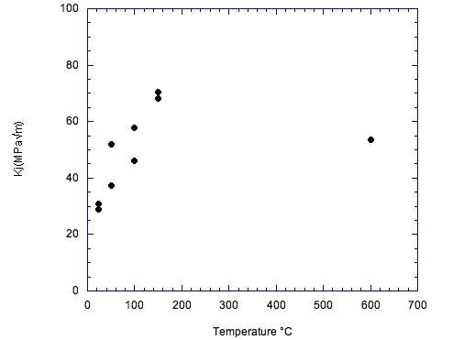
ODS 14YWT-PM2 heat:
Anisotropy problem reduced
14YWT-PM2 (Cross rolled 50%)
OW4 (HIPed)
L-T
T-L
DT – Ductile Tearing
EP – Elastic Plastic
LE – Linear Elastic
Extrusion/cross rolled (14YWT-PM2) vs. HIP (OW4) showed:
Higher fracture toughness at room temperature (25ºC)
Very low fracture toughness transition temperature (FTTT)
No effect of orientation on FTTT, i.e. no anisotropy
UCSB: FT tests

Slide 9
Creep performance of 12YWT, MA957 and 14YWT
The Larson Miller Parameter
D.T.Holzer et al.
6th GETMAT Tech Meet.
KIT,Jan 2013
Creep tests still in progress:
MA957: test at 825ºC and 70 MPa started in Oct., 2003 (INERI)
14YWT-SM10: test at 800ºC and 100 MPa started in April, 2008 (INERI)

Slide 10
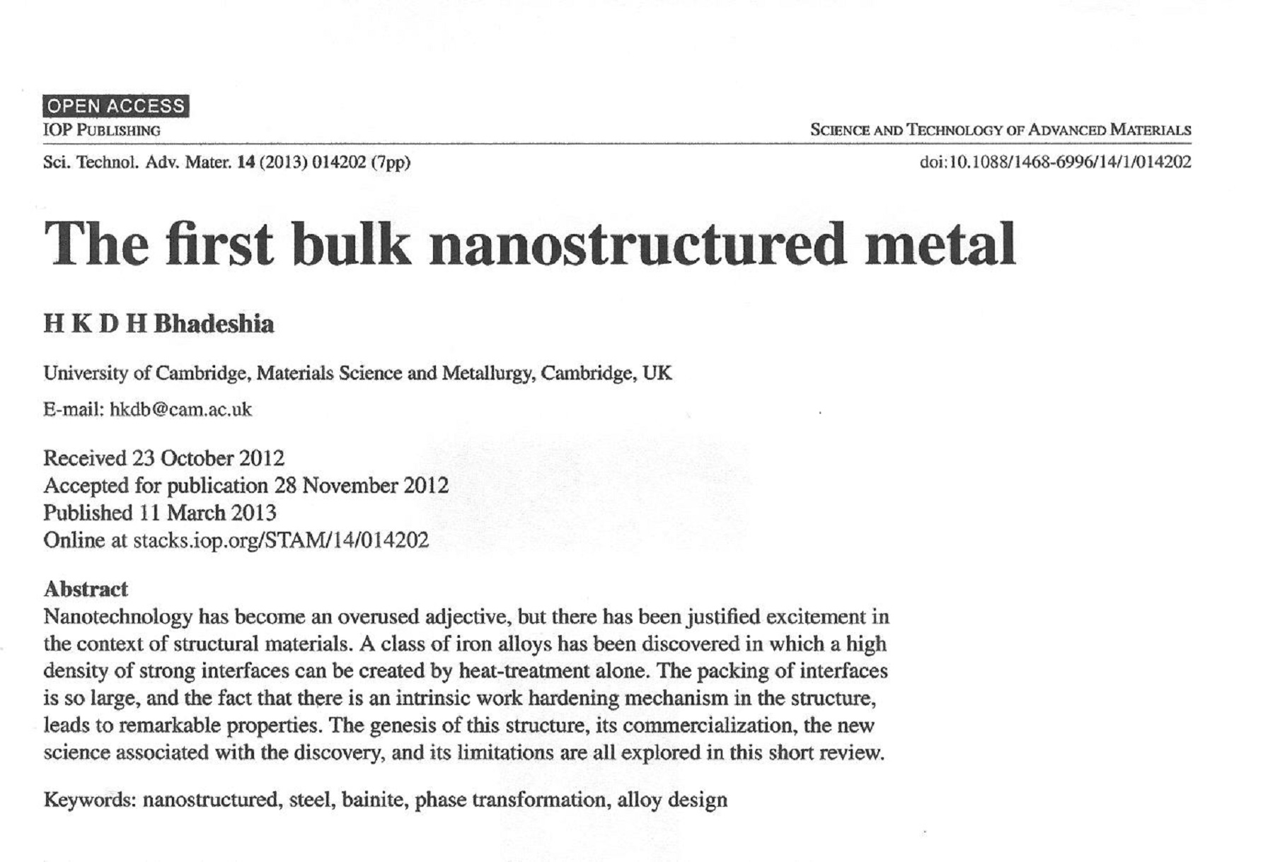

Slide 11
TEM MICROSTRUCTURE OF Fe-Cr-Si-Mn-C SUPER BAINITIC STRUCTURAL STEEL
ALTERNATING PLATELETS OF AUSTENITE AND FERRITE PRODUCED BY CONTINUOUS –COOLING TRANSFORMATION FROM AUSTENITE
INTERPHASE INTERFACIAL AREA PER UNIT VOLUME IS EXTREMELY HIGH AND COMPARABLE TO THAT OF NFA-14YWT

Slide 12
CHARACTERISTICS OF NANOSTRUCTURED BAINITIC STEEL
TYPICAL COMPOSITION WT.% : Fe-1.5Si-1.9Mn-0.2Mo-1.0Cr-0.8C
THE INTERFACIAL AREA/UNIT VOLUME S_{v} IS LARGE ENOUGH THAT THE GOVERNING LENGTH SCALE ( PRINCIPAL DETERMINANT OF STRENGTH , DUCTILITY) L= 2/ S_{v} IS OF THE ORDER 20-50nm
-YIELD STRENGTHS ~2000MPa
-TOTAL ELONG. ~5-25%
- FRACTURE TOUGHNESS ~30-40MPa.m^{-1/2}
THE EFFECTIVE GRAIN SIZE IS THE PLATELET THICKNESS; THE AUSTENITE PLATELETS PROVIDE STRAIN HARDENING CAPACITY AND CRACK TIP BLUNTING AND IMPROVED TOUGHNESS

Slide 13
POTENTIAL OF BAINITIC STRUCTURAL STEELS FOR FUSION APPLICATIONS
CURRENT BAINITIC STEELS SUCH AS THE 3Cr-WV REDUCED ACTIVATION STRUCTURAL STEELS ARE CHARACTERIZED BY PLATELET THICKNESSES IN THE 250-400nm RANGE AND LOWER STRENGTH ( 600-750MPa) AND HIGHER TOUGHNESS COMPARED TO THE NANOSTRUCTURED STEELS
THE AUSTENITE TO BAINITE TRANSFORMATION IS PARTICULARLY AMENABLE TO CONTROL VIA COMPOSITION CHANGE( Si,Mn,C,Cr,W) AND BY EITHER CONTINUOUS COOLING OR ISOTHERMAL HEAT TREATMENTS
THE EXTENSIVE KNOWLEDGE BASE ON BAINITE TRANSFORMATION COULD PROVIDE A FRAMEWORK FOR THE POSSIBLE DEVELOPMENT OF BULK NANOSTRUCTURED ALLOYS WITH FUSION-SPECIFIC ATTRIBUTES ( CORROSION RESISTANCE, WELDING/ JOINING,RADIATION DAMAGE TOLERANCE)

Slide 15
Some Key Results
Y phase separates in atomized powders requiring milling for mixing and NF formation
Improved milling impurity (N, O) control showed the critical importance of O balance in forming NF and achieving excellent balance of properties
Baseline large batch of ATI powders contained low O
Powder subsequently milled with FeO to optimize O level
Led to OW4 HIPed at 1150°C (UCSB) and PM2 extruded at 850°C (ORNL)
PM2 was the final small precursor to the larger “best practice” heat (FCRD-NFA1) tentatively selected in part due to fine and uniform grain structures and balanced intermediate strength

Slide 16
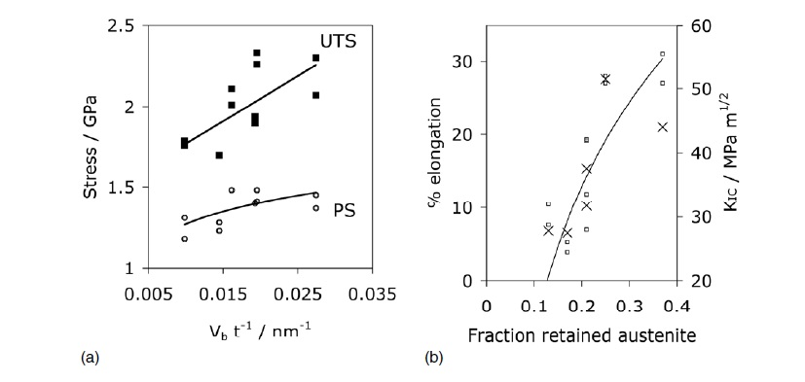
MECHANICAL BEHAVIOR OF Fe-Si-Mn –Cr NANOSTRUCTURED SUPER BAINITIC STEEL
(a) STRENGTH INCREASES WITH VOLUME FRACTION OF FERRTIE AND WITH DECREASING PLATELET THICKNESS
(b) DUCTILITY AND TOUGHNESS INCREASES WITH VOLUME FRACTION OF AUSTENITE PLATELETS

Slide 18
NFAs have outstanding strength and creep properties
12YWT: First discovery of NC by 3DAP in 1999 (ORNL)
MA957: Patented by INCO (1978); NC discovered by 3-DAP in 2003 (ORNL)
14YWT: Developed at ORNL; initial project started in 2001
MA957 and 12YWT are not commercially available
12YWT was produced only once as a small heat by Kobe Steel, Ltd.
Production of MA957 was discontinued by INCO
M.A.Sokolov, D.T.Hoelzer, L.Tan (ORNL)

Slide 19
FRACTURE TOUGHNESS-STRENGTH PROPERTIES
UNIQUE NANO-SCALE MICROSTRUCTURE OF THE LOW ACTIVATION NFA 14YWT CHALLENGES THE HIGH STRENGTH-LOW TOUGHNESS PARADIGM FOR STRUCTURAL ALLOYS
D.T.Hoelzer ORNL, unpublished work

Slide 20
Neutron irradiation of 14YWT and 14WT at 300ºC, 580ºC, and 670ºC to ~1.5 dpa (HFIR Rabbit capsules)
D.A. McClintock et al., JNM 386-388 (2009)

Slide 22
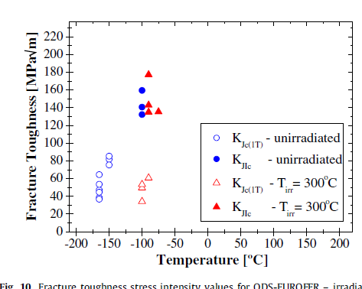
No DBTT shift was observed in 14YWT after irradiation at 300ºC to ~ 1.5 dpa compared to 85ºC shift in Eurofer-ODS
Eurofer-ODS
D.A. McClintock, et al., JNM 392 (2009)

Slide 23
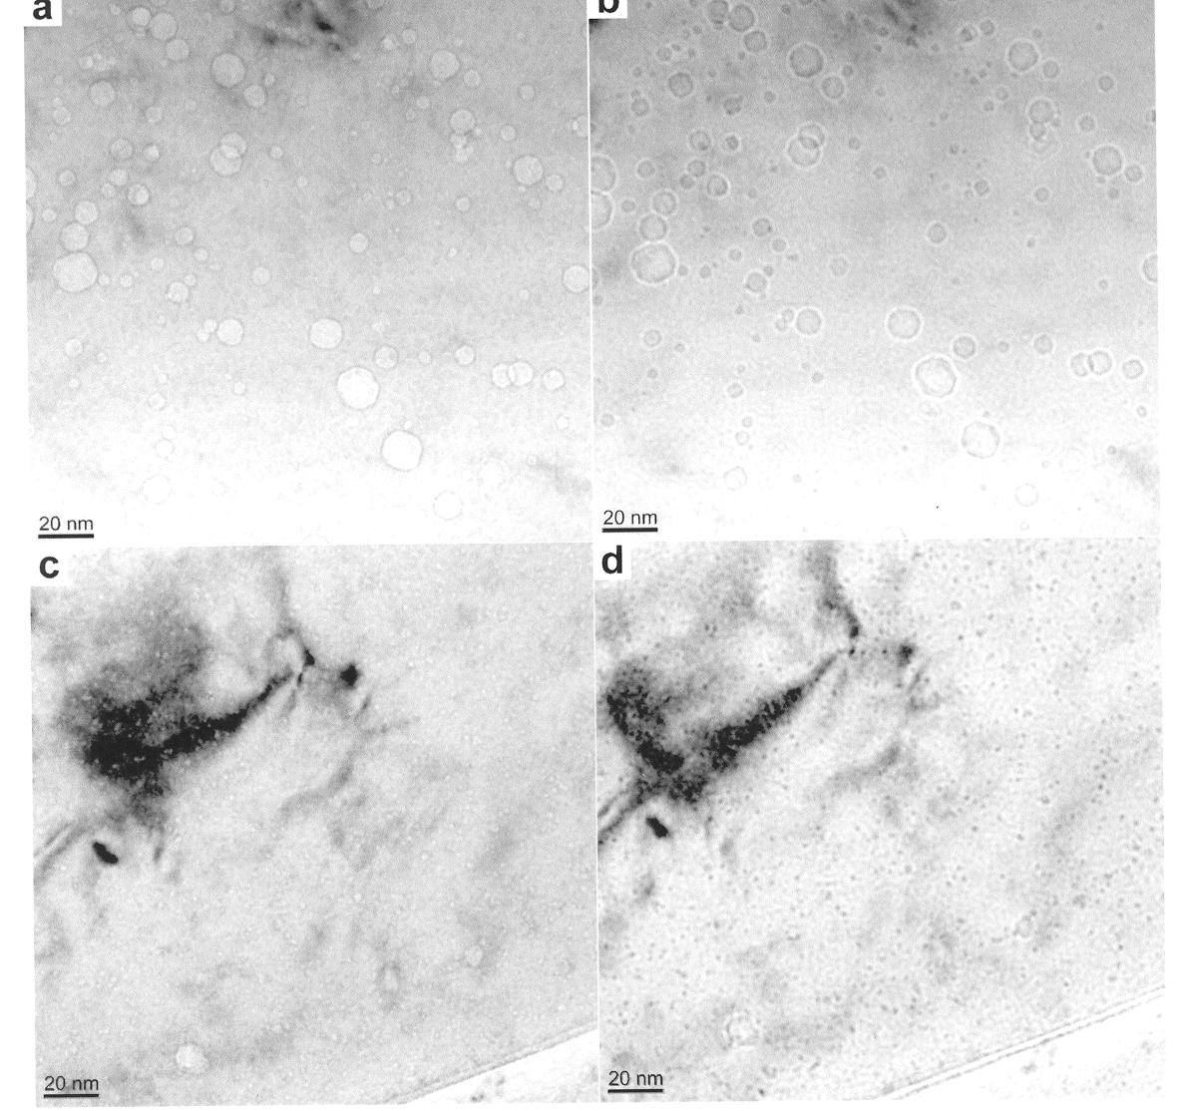
HELIUM MANAGEMENT IN ADVANCED STRUCTURAL ALLOYS
TEM images of Eurofer 97 (TMS), (a, b), and MA957 (NFA) (c,d)
Neutron irradiated to 25dpa at 500C and simultaneously implanted with ~1450 appm He
G.R.Odette et al., Fusion Materials Semi-Annual Report, DOE/ER-0313/51

Slide 24
HELIUM MANAGEMENT IN ADVANCED STRUCTURAL ALLOYS
High helium content (1450appm) promotes the formation of a large population of voids in neutron irradiated Eurofer 97
Same quantity of helium is trapped by ~2nm clusters/particles in MA957 with no void formation
Swelling rate theory extrapolations indicate that NFA will remain damage-tolerant to much higher levels of dpa and helium
Extrapolations for the TMS indicate continuing growth of voids with eventual transition to a linear (with dose) swelling regime

Slide 25
NFAs WITH IMPROVED FRACTURE RESISTANCE
NFAs based on 12-14% Cr tend to exhibit reduced grain boundary fracture resistance with increasing temperature > 400C
New approaches to NFA fabrication involve controlled phase transformation during high temperature rolling to strengthen grain boundaries while retaining the nano-scale microstructure for high strength and radiation damage resistance
New compositions are based on Fe-9Cr-2W-0.4Ti-0.2V- 0.3 Y2O3
Initial results from a joint ORNL-KAERI project funded by Office of Nuclear Science and Technology show promise.

Slide 26
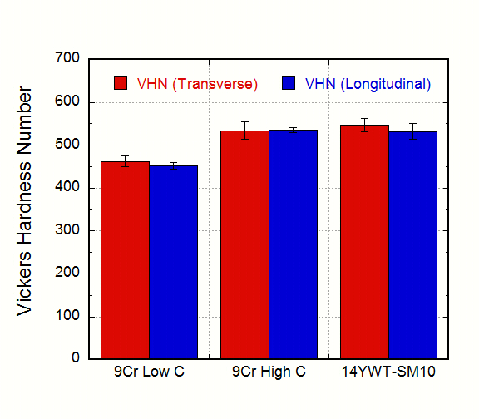
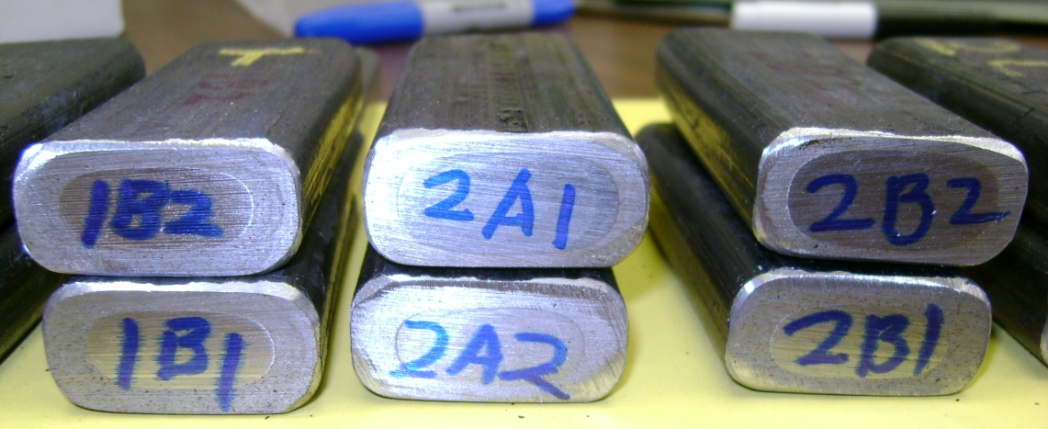
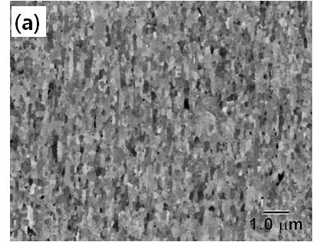
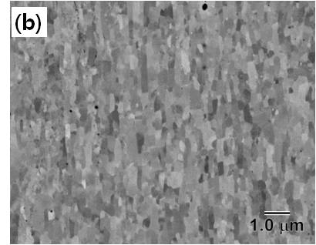
MICROSTRUCTURE OF NEW NFAs
PM2
PM1
9YWTV-PM1
Fe-9Cr-2W-0.4Ti-0.2V-0.12C-0.3Y₂O₃
9YWTV-PM2
Fe-9Cr-2W-0.4Ti-0.2V-0.05C+0.3Y₂O₃

Slide 27
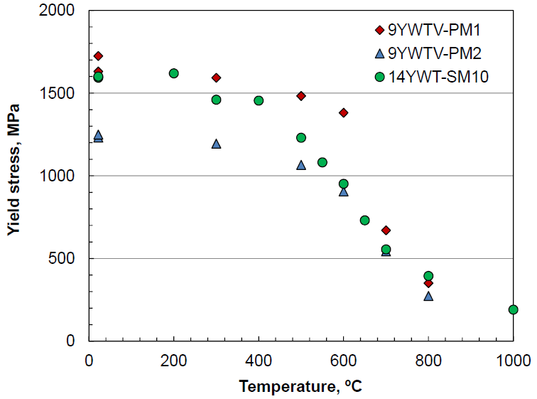
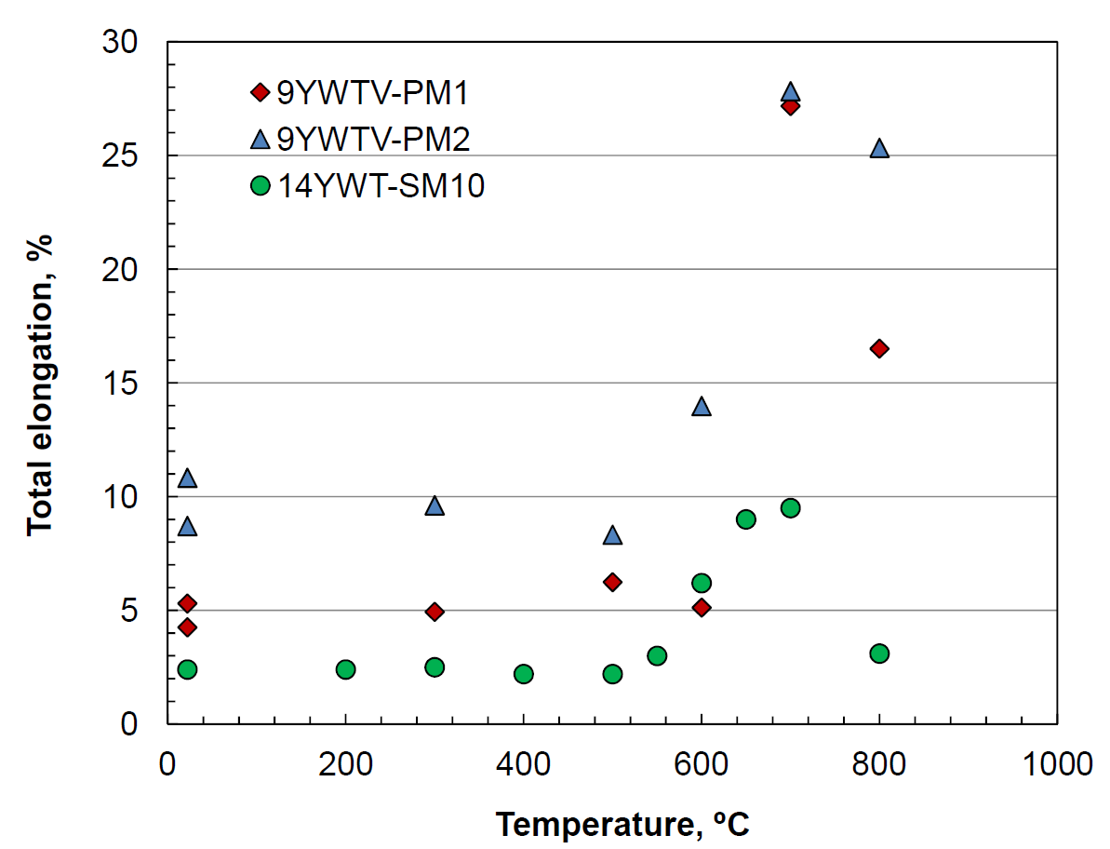
Strength & Ductility of 9Cr NFAs
New base NFAs retain YS higher than 500 MPa at 700°C.
Improved ductility for both new NFAs compared to 14YWT

Slide 28
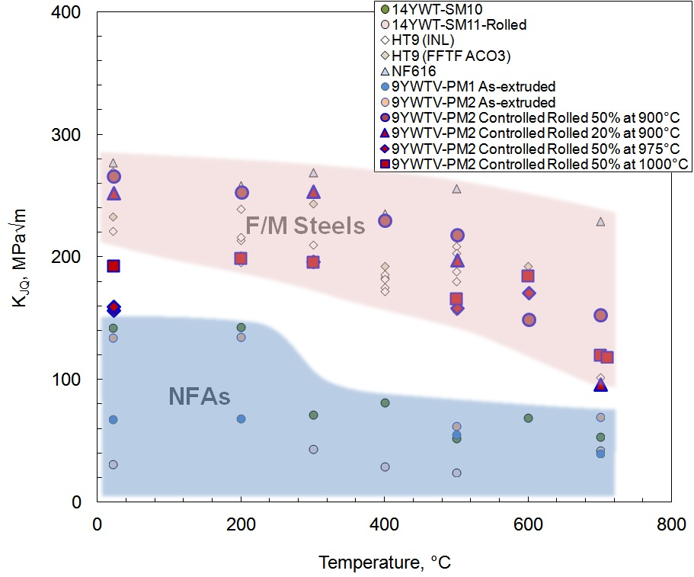
Effect of Controlled Rolling 9YWTV-PM on High Temperature Fracture Resistance
Improvement of fracture toughness in controlled rolled 9YWTV-PM2 is significant.
The 9YWTV-PM2 controlled rolled at 900°C for 50% reduction resulted in the best fracture toughness among NFAs, which is as high as those of non-ODS F/M steels.
Potential avenue for NFAs based on 9Cr with improved high temperature fracture resistance

Slide 30
Creep performance of NFAs
Ruptured after ~38,555 h
Klueh et al, J. Nucl. Mat., (2005)
I-NERI FY01-04
Creep test on ruptured MA957 started in Oct., 2003 (INE
Creep test on 14YWT-SM10 started in April, 2008

