Slide 1
Updates on ARIES-ACT1 Power Core Configuration and System Integration
X.R. Wang, M. S. Tillack, S. Malang,
C. Koehly, F. Najmabadi and the ARIES Team
ARIES-Pathways Project Meeting
UC San Diego
January 22-23, 2013

Slide 2
Tasks and Assignments from Last ARIES Project Meeting
  Layout of the vacuum pumping ducts
  PF coil sets
  Shield blocks in the front of the port
  Integration of lower hybrid CD launcher into the ACT1 power core sector
  Integration of the LiPb manifolds
  Toroidal electrical connection of vertical stability shells

Slide 3
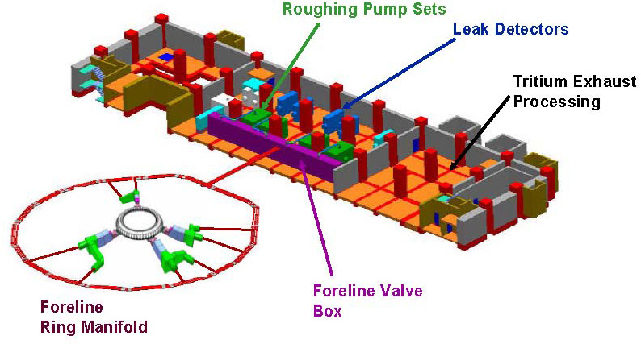
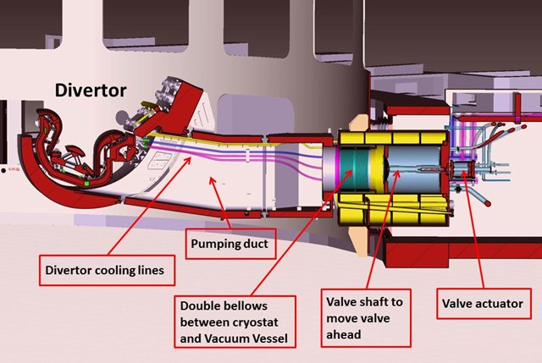
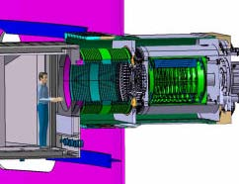
ITER Torus Pumping System
ITER has three high vacuum systems:
Torus(primary vacuum system): 1350 m³, 8 cryopumps, 4 torus pumping ducts
Cryostat: 8400 m³, 4 cryopumps
NBI: 570 m³, 2 cryopumps
54 divertor cassettes
Pumping slots
Cryopumps, pump ducts and divertor cassette
ITER 1:1 scale prototype
torus cryopump
Cartoon (not to scale) of the torus pumping system showing the
cryopumps and divertor ring and foreline manifold connection to the roughing pumps.
Notes:
This viewgraph summarizes how ITER vacuum system was designed and what we can learn from ITER.

Slide 4
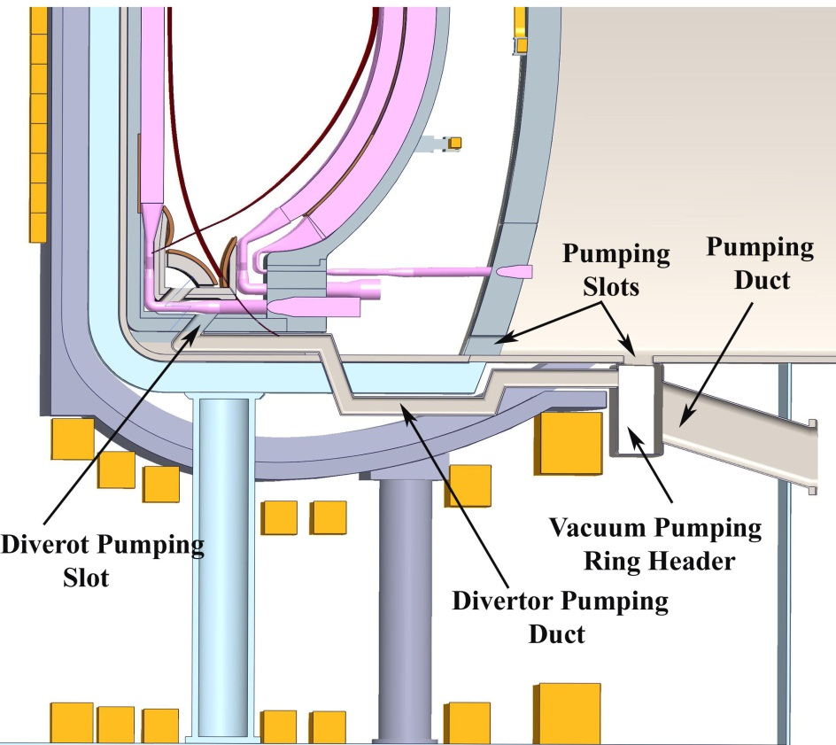
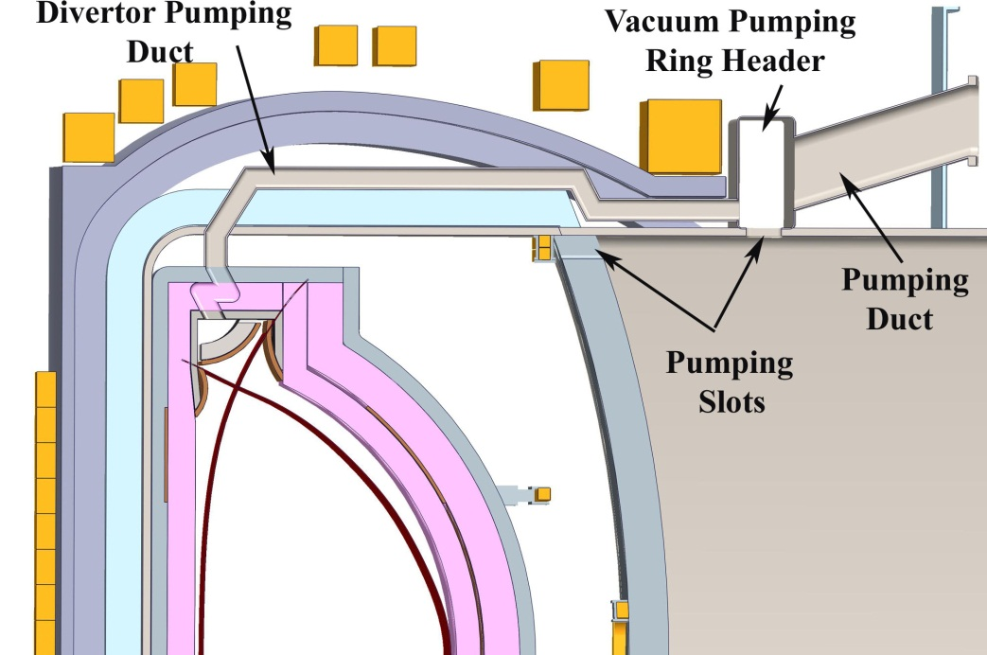
Layout of the ACT1 Vacuum Pumping Ducts
(Option 1)
Cut line
Divertor
pumping
slot
Cut lines
Cross-section above middle plane
Cross-section below middle plane
The ACT1 vacuum pumping system consists of 32 divertor pumping ducts, 2 vacuum pumping ring headers and 8 cryo-pumps located at the outside of cryostat (the same numbers as the ITER).
The dimensions of vacuum pumping ducts:
  32 Divertor pumping ducts: 0.48 m (tor.) x 0.25 m (rad.)
  2 Pumping ring headers: 1.2 m (pol.) x 0.7 m (rad.)
  8 pumping ducts: 0.9 m (pol..) x 1.4 m (pol.)
The divertor pumping ducts between the bottom plate of the structural ring and the VV need to be cut and removed for installation of rail system and sector maintenance.
Notes:
The left side figure is the cross-section of the ACT1 above the middle plane showing the layout of the vacuum pumping ducts, and the right side figure is the cross-section of the ACT1 below the middle plane.

Slide 5
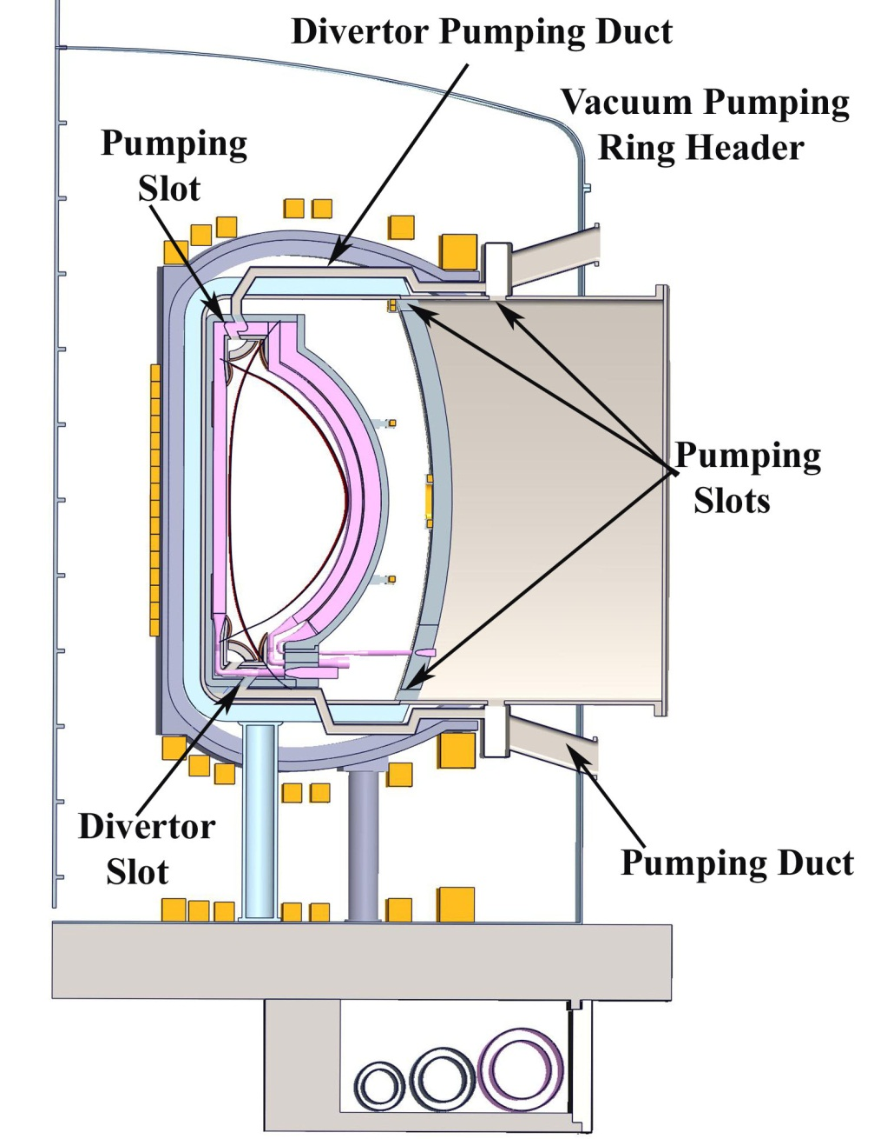
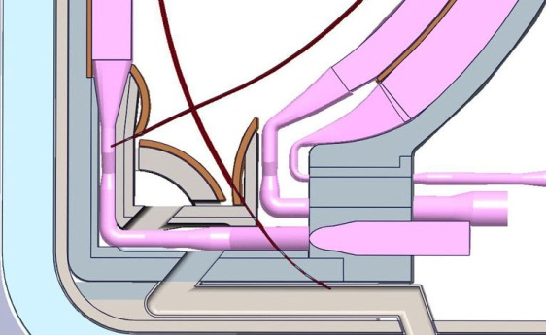
Updates on the ARIES-ACT1 Overall Power Core Configuration
Modified layout of the vacuum pumping ducts
Redefined PF coil sets (iterating with Chuck)
Integrated inboard and outboard blanket manifolds to the power core, and an extra steel plates (8-10 cm) added to the divertor structure and structural ring for shielding.
Modified the shield blocks thickness from 22 cm to 47 cm
Redeined the cryostat and the coolant ring headers under ground
Adding ~10 cm steel to divertor structure and
structural ring

Slide 6
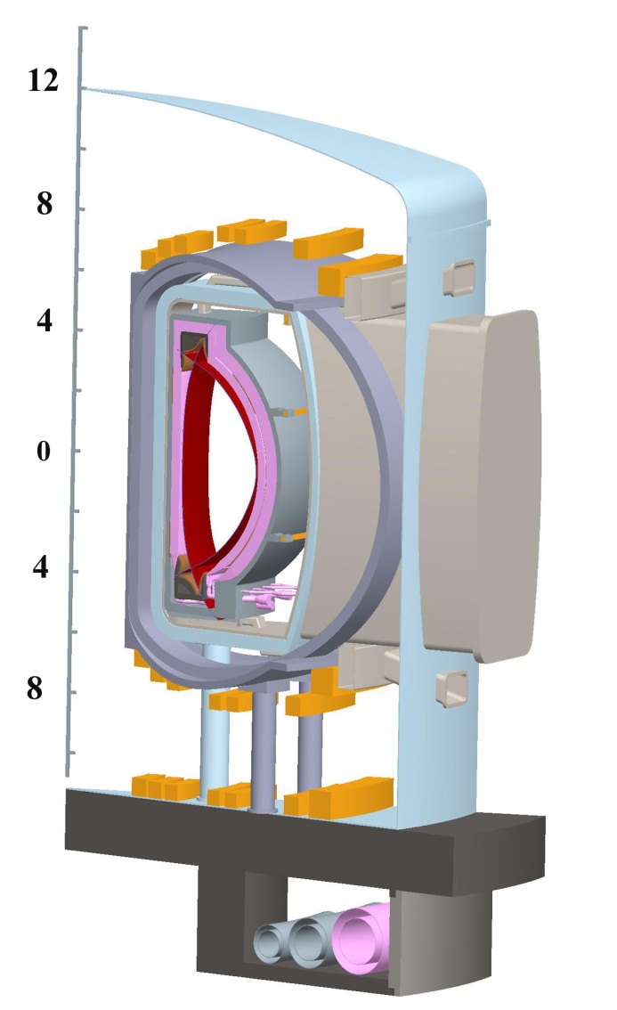
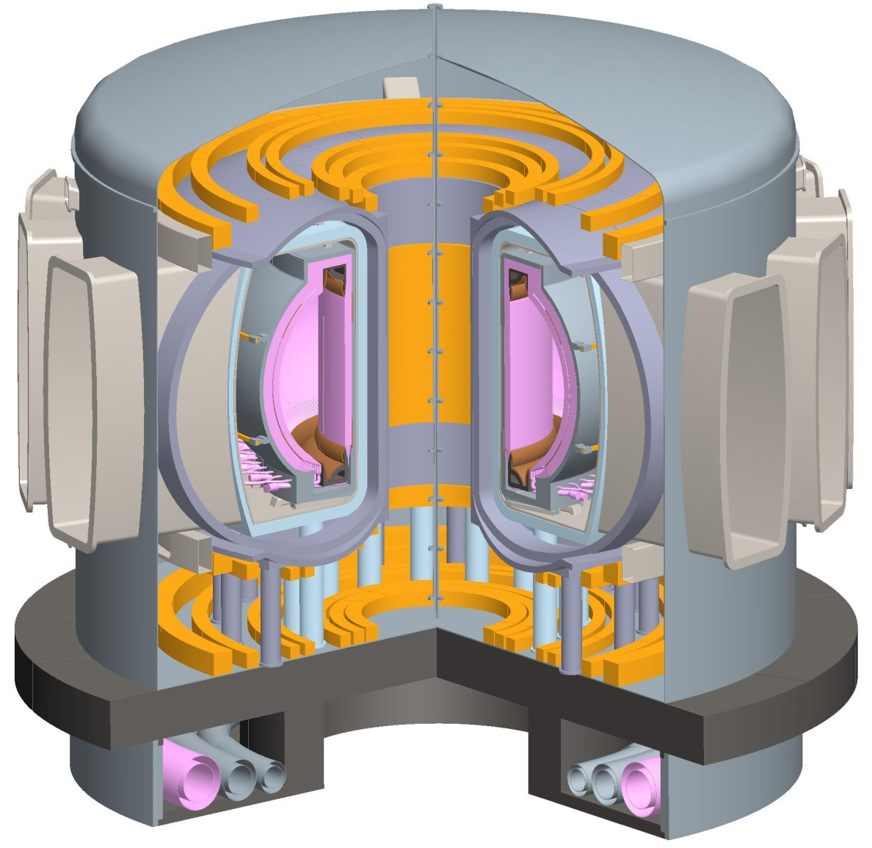
Updates of the ARIES-ACT1 Overall Power Core Configuration
Divertor
Pumping Duct
Vacuum Pumping Ring Header
Pumping Ducts
Pumping Duct
Vacuum Pumping
Ring Header
2 vacuum pumping ring headers located at top and bottom of the port
16 x2 divertor pumping ducts connecting to the pumping ring headers
8 vacuum pumping ducts (4 at the top and 4 at the bottom), and 8 cryopumps.

Slide 7
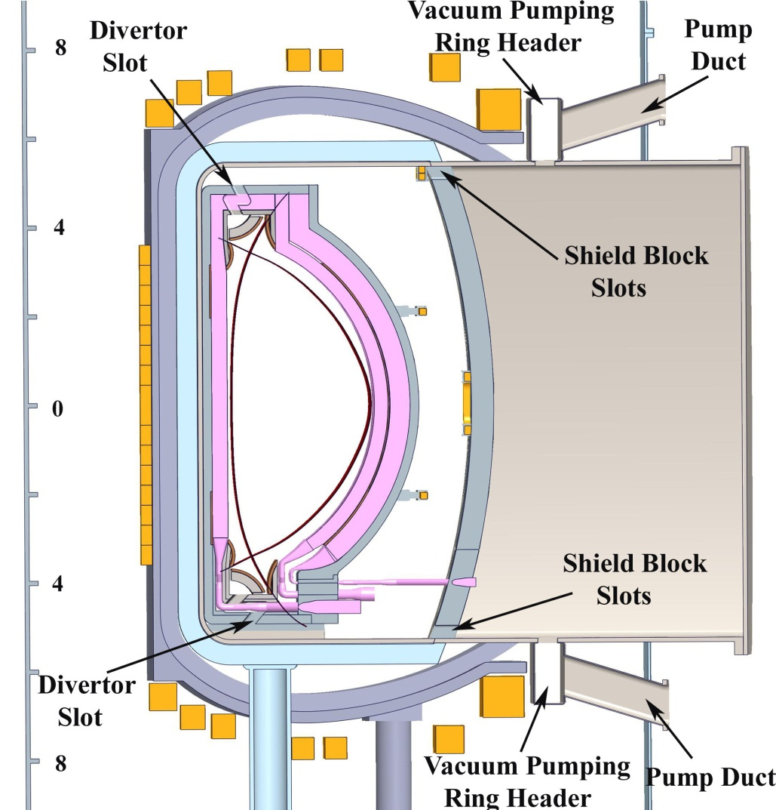
Layout of the ACT1 Vacuum Pumping Ducts
(Option 2: ARIES-AT Pumping Approach)
No divertor pumping ducts.
No needs for cutting and removing the divertor pumping ducts during maintenance.

Slide 8
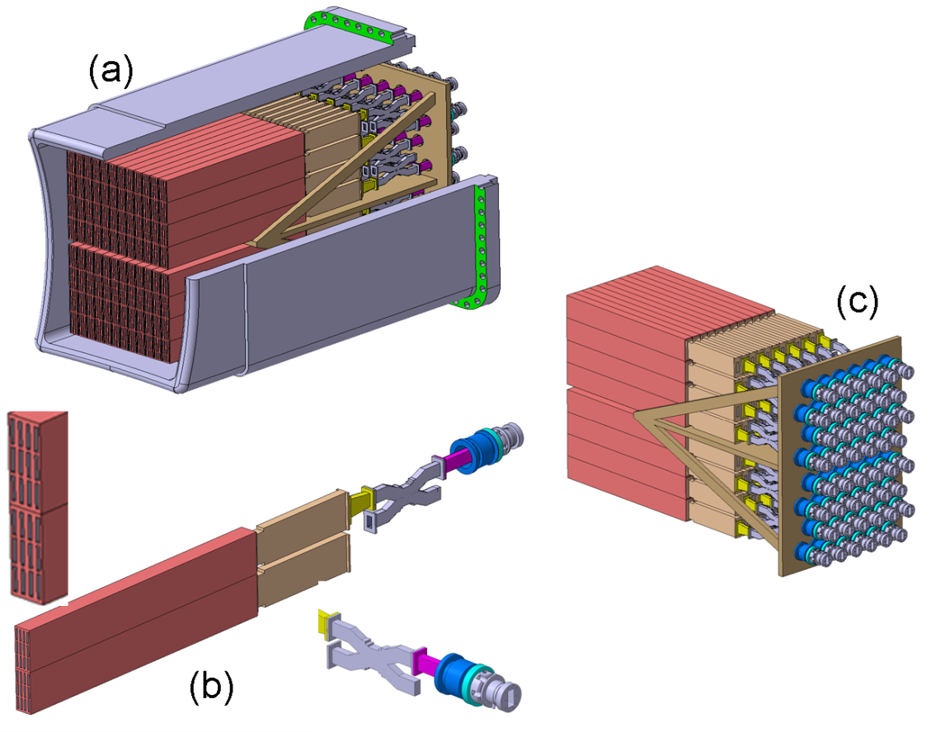
ITER Lower Hybrid Current Drive Launcher
The ITER LH CD system is designed to deliver a power of 20 MW at 5 GHz using a single port.
The power density in the waveguide is 33 MW/m².
Overall dimensions on facing plasma side (FW): 1.5 m(toroidal) x 1.9 m (poloidal).
ITER LH launcher, 48 modules
1 module with 24 active WGs
48 RF windows
Notes:
This viewgraph shows ITER CD launcher system and it is going to be considered as our reference design to be integrated into ACT1 power core.

Slide 9
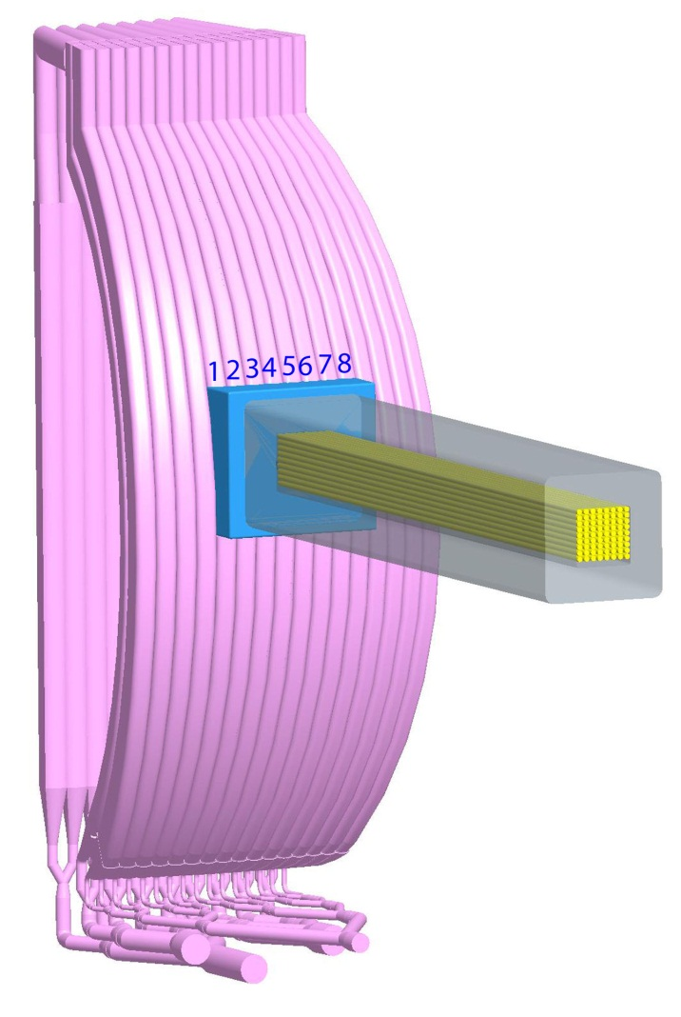
Opening of the Outboard Blankets for the Launcher System
The toroidal width of the OB-I sector at the mid-plane is ~3.2 m, composed of 16 modules with ~0.2 m for each blanket module.
The opening of the sector for installation of the CD launcher system:
  Toroidal width: 1.6 m (in order to cover 8 of 16 outboard blanket modules)
  Poloidal length: 1.9 m
ITER LH launcher with dimensions of 1.5 m (toroidal) x 1.9 m (poloidal). Adding a 5 cm steel to the frame on two side will make the launcher system well matching the ACT1 blankets.
Local shield
RF feeding
inputs

Slide 10
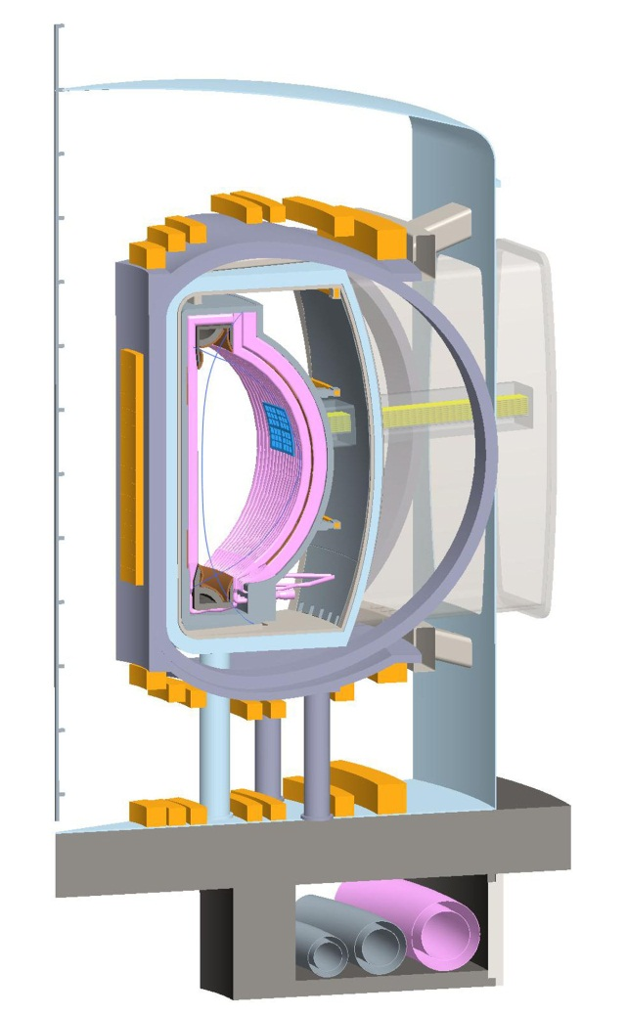
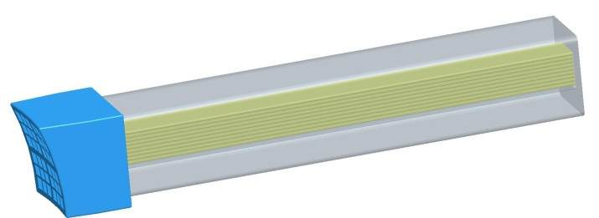
Integration of the LH CD Launcher in the ARIES-ACT1 Sector
Launcher assembly
ACT1 power core with integration of the launcher
Two LH CD launchers are integrated into the ACT1 power core (at 11.25 and 191.25 toroidal degree)
All the RF feeding inputs will connect to the RF generator locating the outside of bio-shield.
A local shield (roughly ~50 cm thick) must be placed around the RF feeds.

Slide 11
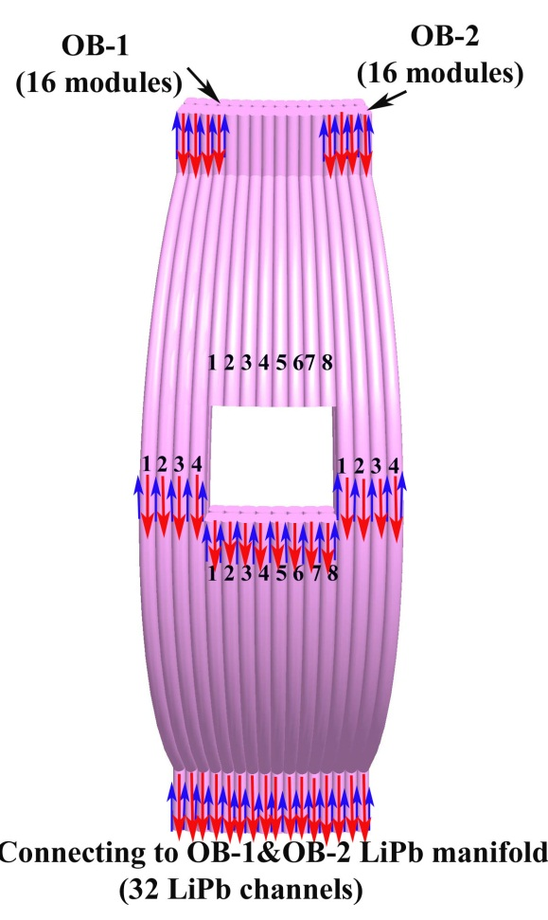
Cooling Scheme for the Sectors with LH Launcher Installed
The temperature rise in the different modules will be made identical to the coolant in the “normal” modules by adjusting the flow rate corresponding to the heat generated in the modules.
In the outer 16 modules (8 OB-I and 8 OB-II modules) at the two sides of the launcher, the flow rate is identical to the flow rates in the normal sectors.
In the lower halve of the blanket modules (8 OB-I and 8 OB-II modules), the flow rate is reduced to ~50% of the normal flow rate in a normal module.
The Li-Pb coolant will be fed by the bottom manifolds, flow up to the mid-plane, then make U-bend, and flow into the center duct to the bottom manifolds.
How will the upper halve of the blanket modules (total of 16) be cooled?

Slide 12
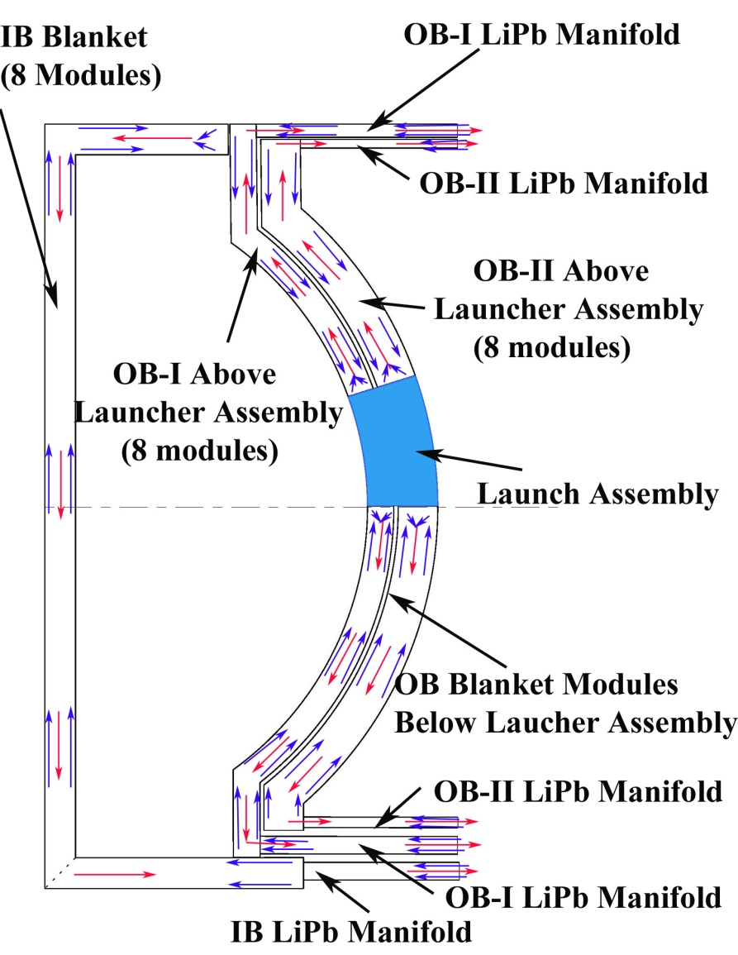
Cooling Scheme of Blanket Modules Above the Launcher Assembly (Option 1)
There are 16 blanket modules above the launcher and they will be cooled from top LiPb manifolds.
It requires to adjust the mass flow rate of the blanket modules to maintain the same coolant temperature rise as the normal blanket modules.
It also requires 2 LiPb manifolds at the top to feed the coolant.
The blanket modules including the FW cooling channels do not need to be re-designed.

Slide 13
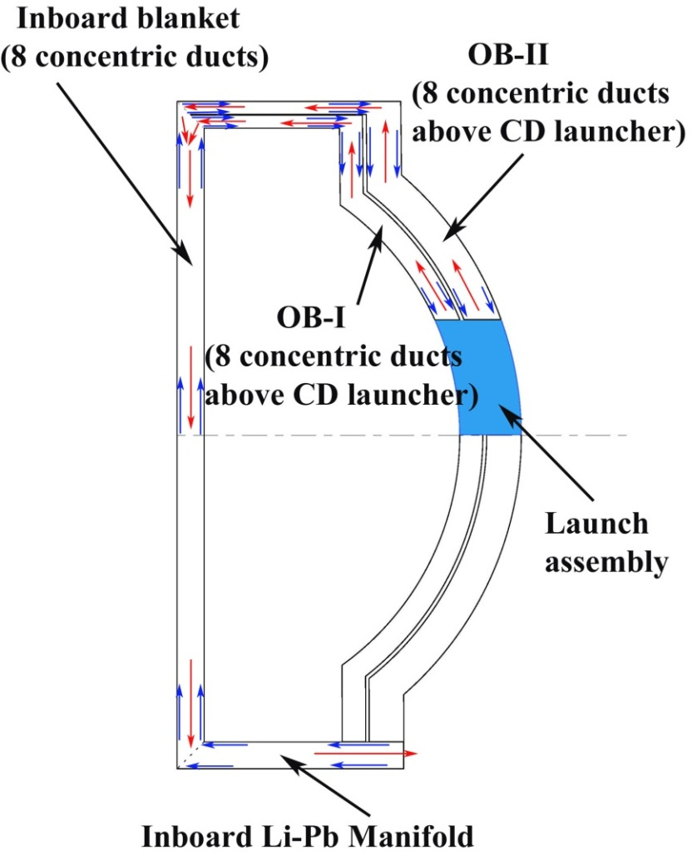
Cooling Scheme of Blanket Modules Above and the Launcher Assembly (Option 2)
The 16 blanket modules above the launcher will be cooled from top with the coolant flow of the IB blanket.
This requires the coolant splitting and connecting between IB and OB blankets at the top and it must be possible to separate the IB and OB blanket segments in the hot cell by cutting these connectors (no detailed design)
The total thermal power of the normal IB/OB sector, Q_{IB}=~20 MW, Q_{OB}=~66 MW and the thermal power of 16 OB blanket modules above the launcher is ~25% of the normal OB.
The total power of the IB blankets of a sector with launcher will be increased to Q_{L}=~36.5 MW, and the flow rate for the IB blanket sector and 16 OB blanket modules above the launcher has to be increased by ~80%.
The inboard blanket modules need to be re-designed for FW temperature control.

Slide 14
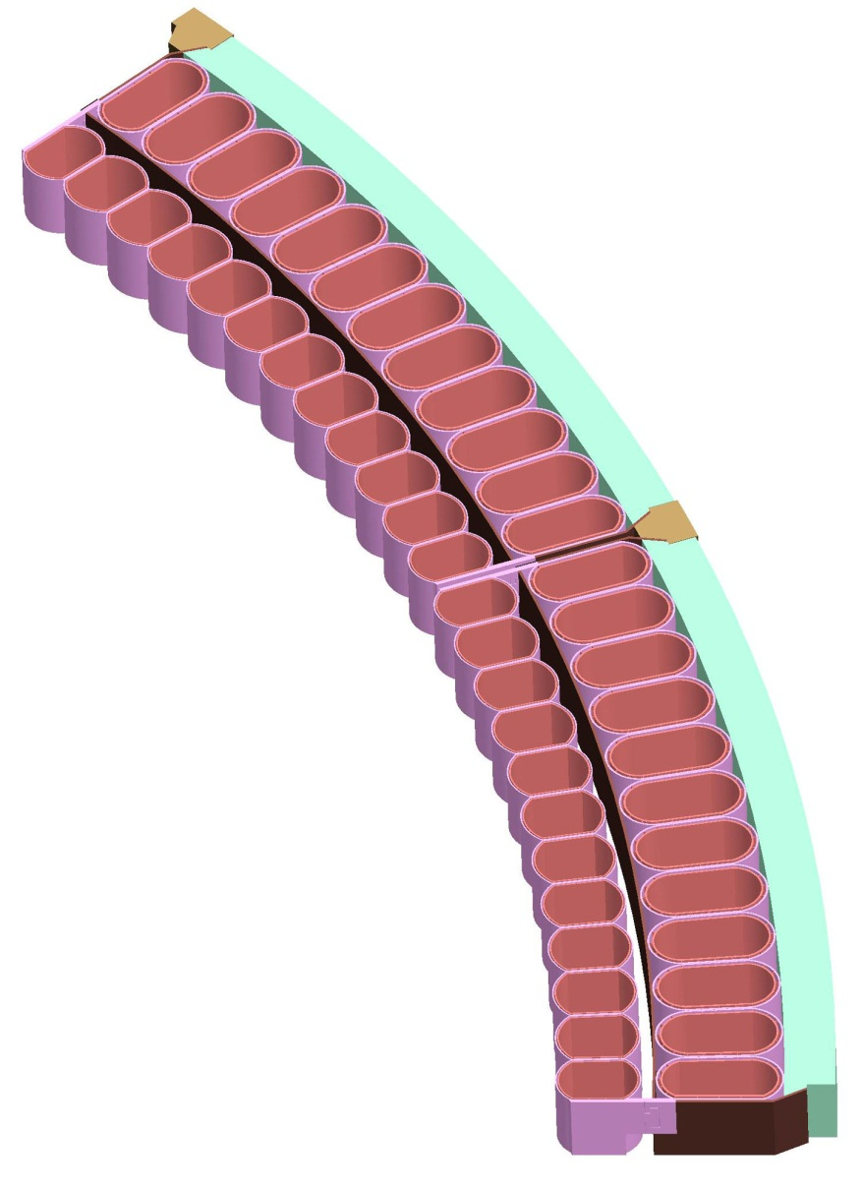
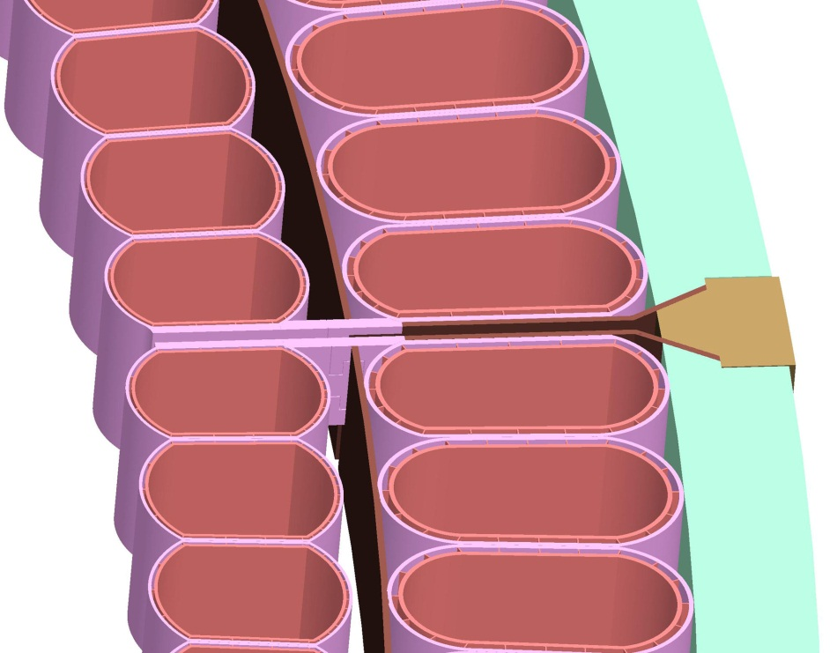
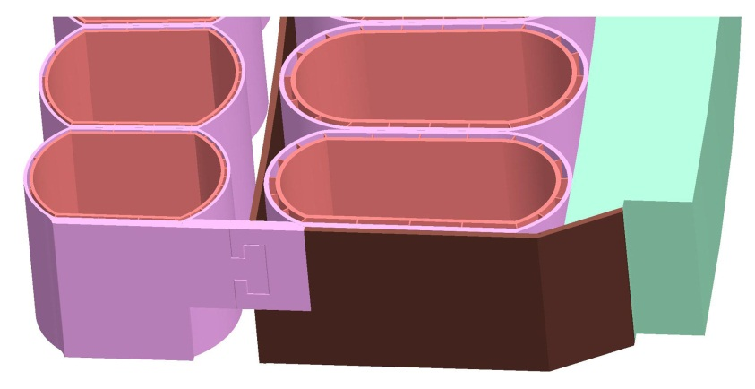
Toroidal Electrical Connections of the Vertical Stability Shells (presented in 1/23/2012 at ARIES Meeting)
Shield block(W)
Joints for electric contact (pressure-jointed or sliding joint like ARIES-ST)
Connections/disconnections behind the HT shield
Shield block
(W or WC)
OB-I
OB-II
Vertical Stability Shell
(4 cm W)
Structural Ring
Layout of the stability shell connection between neighboring sectors
Mechanical connector
Shell lead
Notes:
We discussed the toroidal electrical connection between the neighboring sector at the ARIES Meeting in 1/23/2012. This layout showed the design idea proposed by Farrokh. The shell leads will be connected to provide a closed electric loop and enough electric conductance. A pressure-joint to make the electric connection.

Slide 15
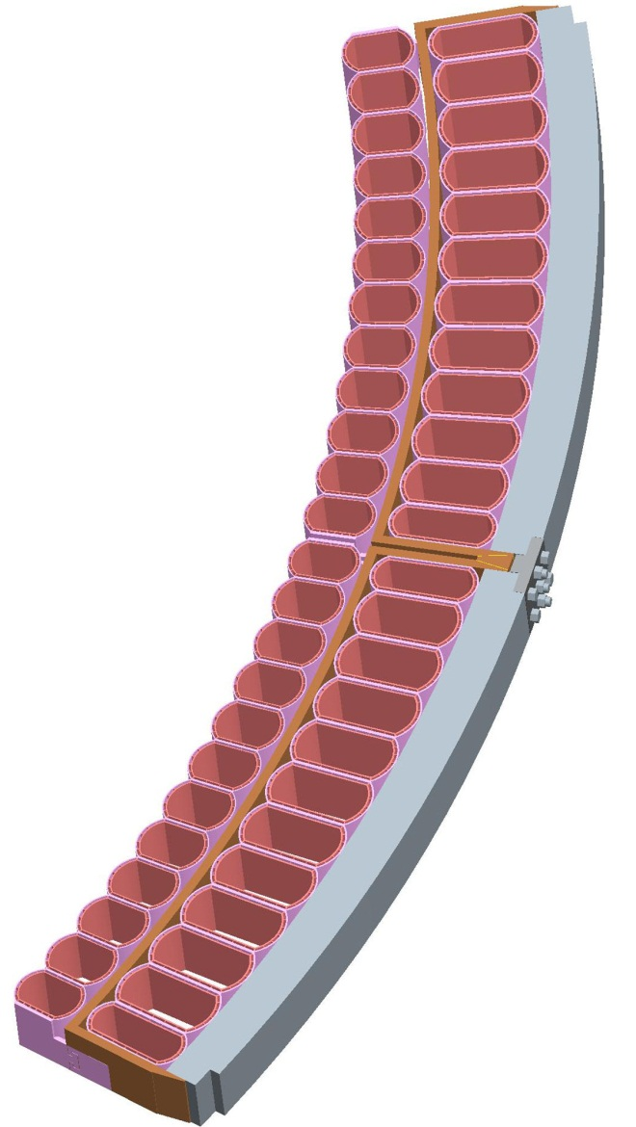
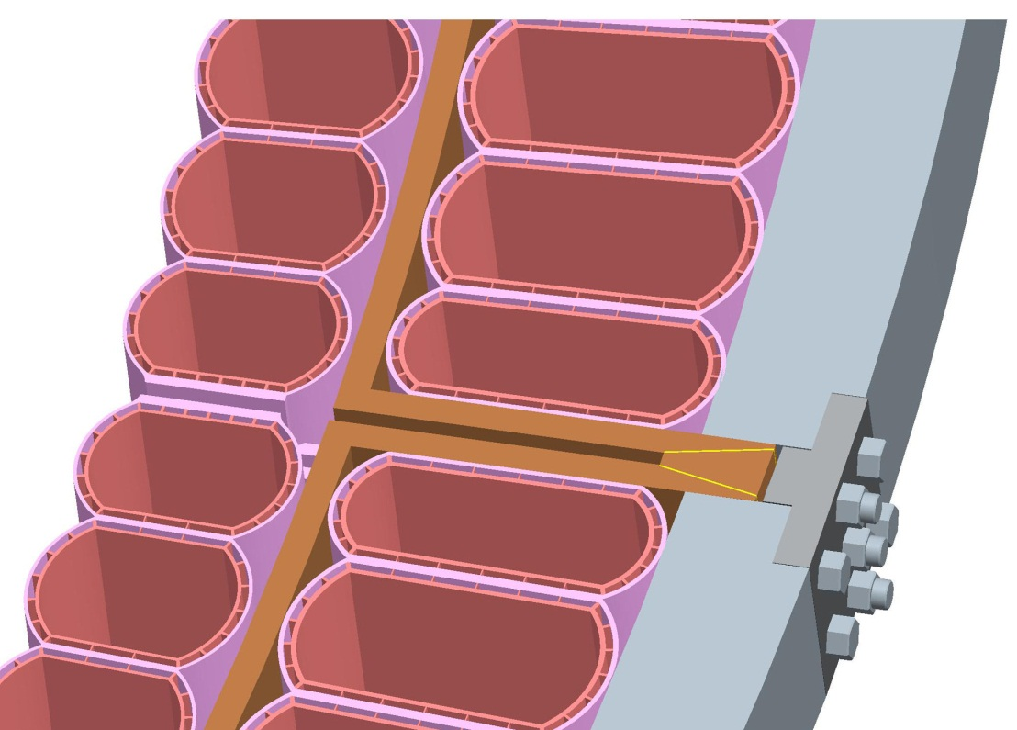
Toroidal Electrical Connections of the Vertical Stability Shells (Adding details)
Wedge Shaped WC or W Block
Vertical Stability shell
(4 cm W)
Vertical Stability
shell (4 cm W)
Cu Interlayer
Inserting a wedge-shaped conducting block into the gap
Applying mechanically high contact pressure to ensure sufficiently high electrical conductance by strong screws at the backside of the structural ring.
Using W or WC as material for wedge-shaped block in order to combine high electric conductance, allowing high temperature operation, and excellent neutron shielding to minimize gap streaming.
Layout of the stability shell connection between neighboring sectors

Slide 16
Summery
ARIES-ACT1 power core configuration has been updated, including
  New PF coil sets
  Layout of vacuum pumping ducts
  Launcher system
  LiPb manifolds (Christina)
All CAD figures on the ARIES Web site will be updated soon.

