Slide 1
PROGRESS ON LOW ACTIVATION STRUCTURAL STEELS
RECENT RESULTS ON NANOSTRUCTURED FERRITIC ALLOYS
A.F.ROWCLIFFE (ORNL)
ARIES PROJECT MEETING
U.C.S.D.
Jan 22nd. – Jan 23rd 2013

Slide 2
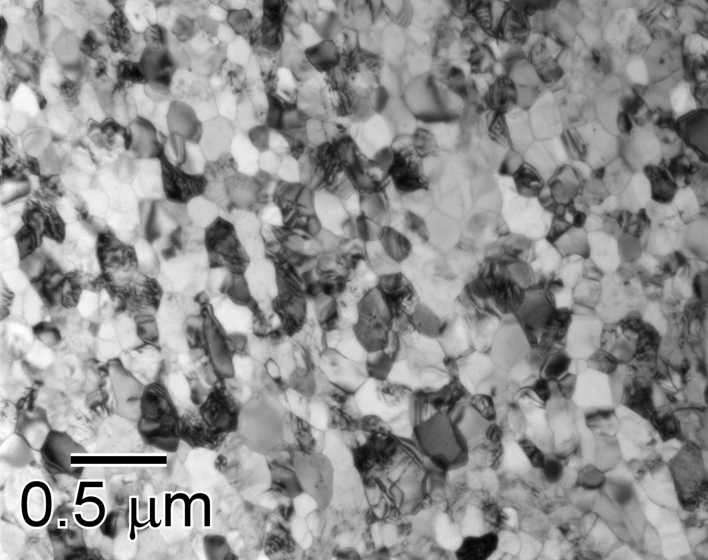
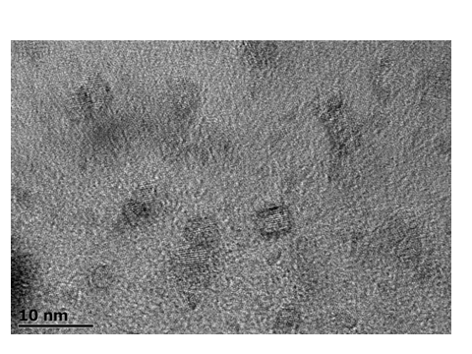
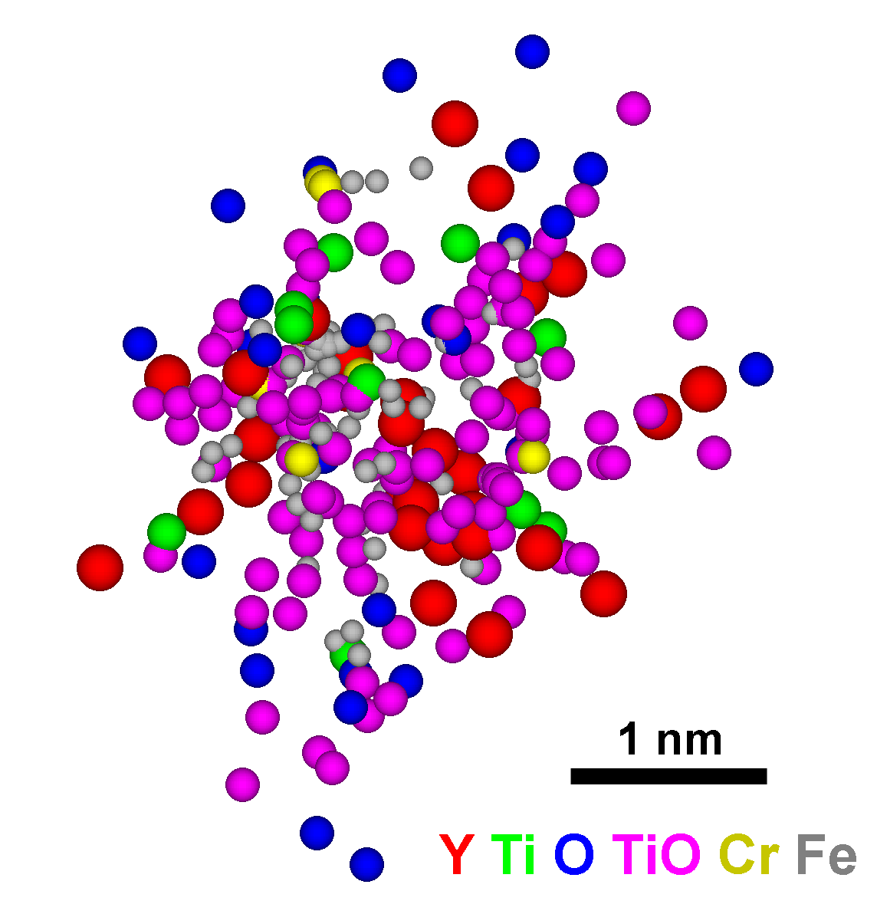
Nanostructured Ferritic Alloys (NFAs)
BF-TEM of 14YWT SM10 Heat
N_{v} = 1-7 x 10²³ m⁻³
<r> = 1.8 (⁺/- 0.4) nm
HR-TEM
<Grain size> = 136 (+/- 14) nm
Nanograin structure & high density of nanoclusters.
High energy mechanical alloying plus high power consolidation
Very large interfacial area (NC-matrix and grain boundaries) enhances recombination of point defects as well as accommodation of helium atoms or bubbles in irradiation.
In ferritic phase, the nanograins & NCs are exceptionally stable up to very high temperatures.
2

Slide 3
NFAs have outstanding strength and creep properties
12YWT: First discovery of NC by 3DAP in 1999 (ORNL)
MA957: Patented by INCO (1978); NC discovered by 3-DAP in 2003 (ORNL)
14YWT: Developed at ORNL; initial project started in 2001
MA957 and 12YWT are not commercially available
12YWT was produced only once as a small heat by Kobe Steel, Ltd.
Production of MA957 was discontinued by INCO
M.A.Sokolov, D.T.Hoelzer, L.Tan (ORNL)

Slide 4
FRACTURE TOUGHNESS-STRENGTH PROPERTIES
UNIQUE NANO-SCALE MICROSTRUCTURE OF THE LOW ACTIVATION NFA 14YWT CHALLENGES THE HIGH STRENGTH-LOW TOUGHNESS PARADIGM FOR STRUCTURAL ALLOYS
D.T.Hoelzer ORNL, unpublished work

Slide 5
Neutron irradiation of 14YWT and 14WT at 300ºC, 580ºC, and 670ºC to ~1.5 dpa (HFIR Rabbit capsules)
D.A. McClintock et al., JNM 386-388 (2009)

Slide 6
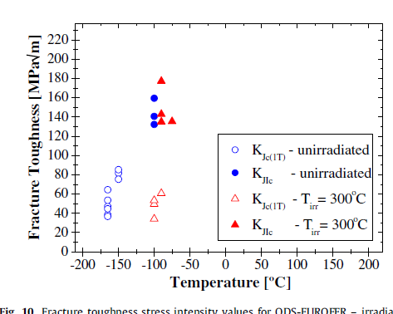
No DBTT shift was observed in 14YWT after irradiation at 300ºC to ~ 1.5 dpa compared to 85ºC shift in Eurofer-ODS
Eurofer-ODS
D.A. McClintock, et al., JNM 392 (2009)

Slide 7
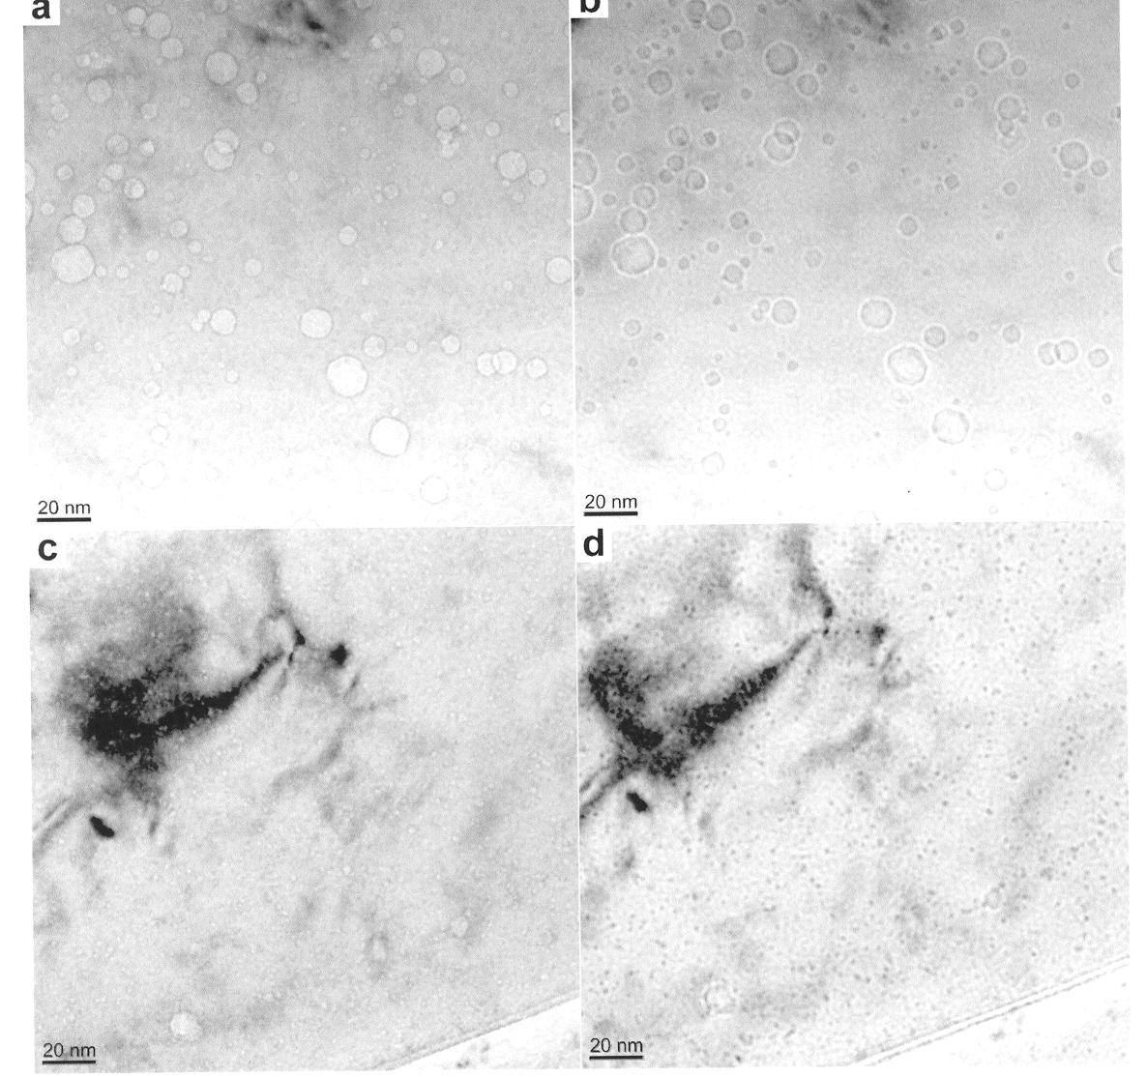
HELIUM MANAGEMENT IN ADVANCED STRUCTURAL ALLOYS
TEM images of Eurofer 97 (TMS), (a, b), and MA957 (NFA) (c,d)
Neutron irradiated to 25dpa at 500C and simultaneously implanted with ~1450 appm He
G.R.Odette et al., Fusion Materials Semi-Annual Report, DOE/ER-0313/51

Slide 8
HELIUM MANAGEMENT IN ADVANCED STRUCTURAL ALLOYS
High helium content (1450appm) promotes the formation of a large population of voids in neutron irradiated Eurofer 97
Same quantity of helium is trapped by ~2nm clusters/particles in MA957 with no void formation
Swelling rate theory extrapolations indicate that NFA will remain damage-tolerant to much higher levels of dpa and helium
Extrapolations for the TMS indicate continuing growth of voids with eventual transition to a linear (with dose) swelling regime

Slide 9
NFAs WITH IMPROVED FRACTURE RESISTANCE
NFAs based on 12-14% Cr tend to exhibit reduced grain boundary fracture resistance with increasing temperature > 400C
New approaches to NFA fabrication involve controlled phase transformation during high temperature rolling to strengthen grain boundaries while retaining the nano-scale microstructure for high strength and radiation damage resistance
New compositions are based on Fe-9Cr-2W-0.4Ti-0.2V- 0.3 Y2O3
Initial results from a joint ORNL-KAERI project funded by Office of Nuclear Science and Technology show promise.

Slide 10
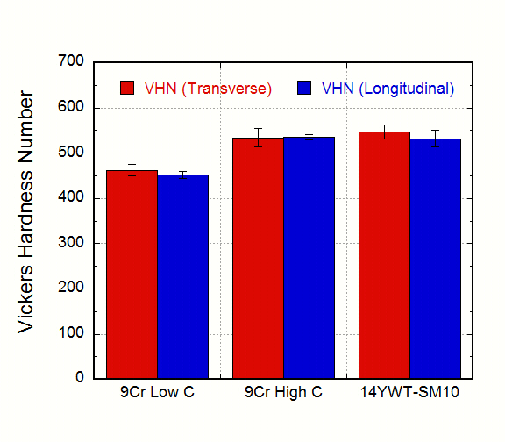
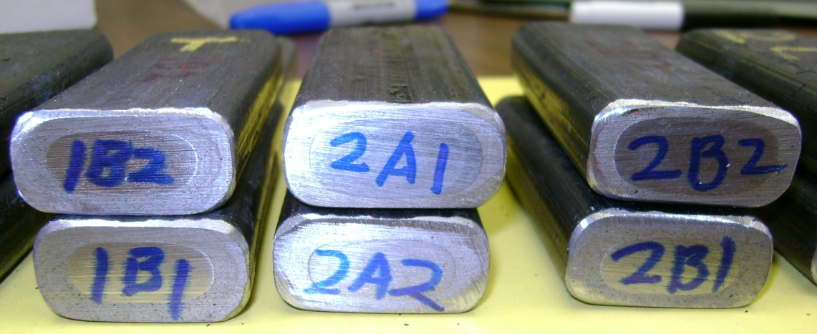
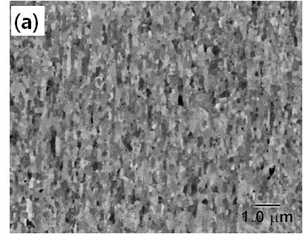
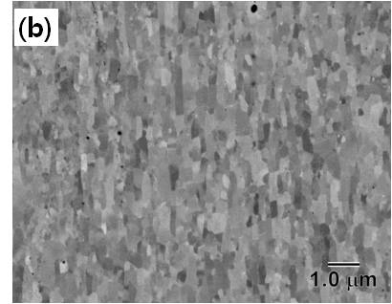
MICROSTRUCTURE OF NEW NFAs
PM2
PM1
9YWTV-PM1
Fe-9Cr-2W-0.4Ti-0.2V-0.12C-0.3Y₂O₃
9YWTV-PM2
Fe-9Cr-2W-0.4Ti-0.2V-0.05C+0.3Y₂O₃

Slide 11
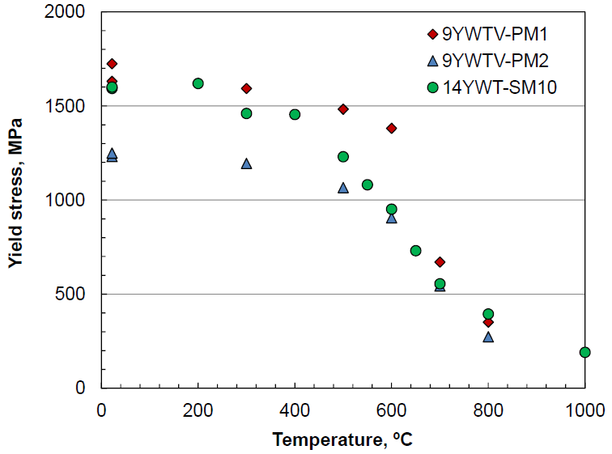
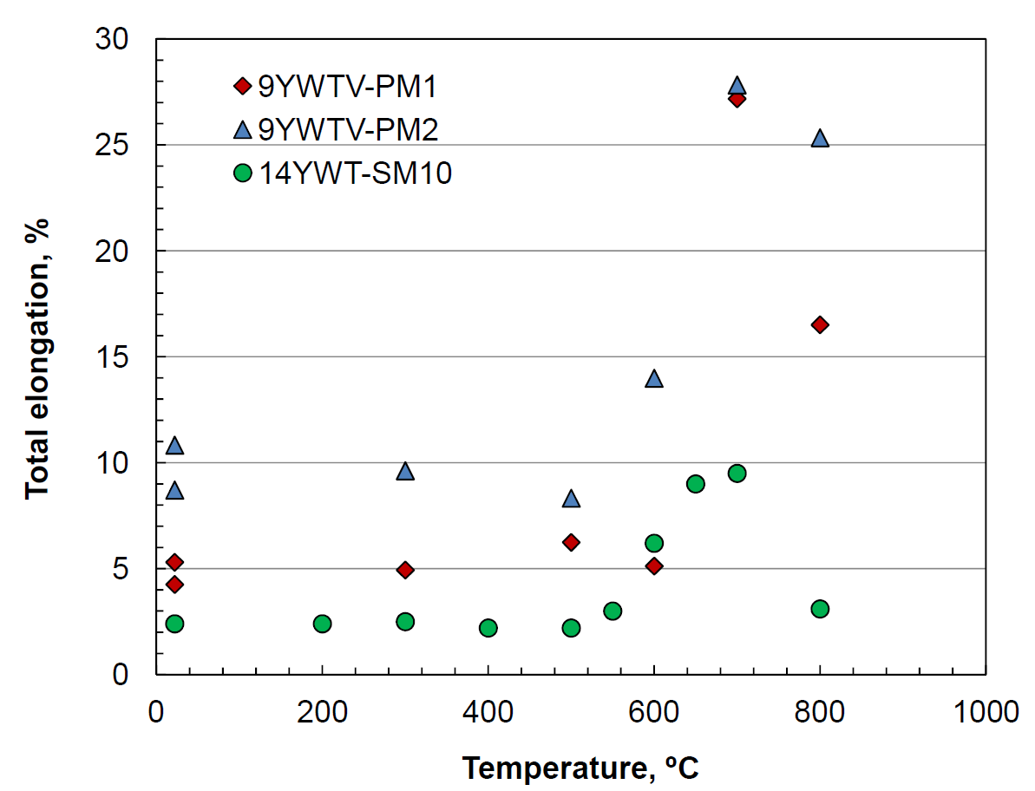
Strength & Ductility of 9Cr NFAs
New base NFAs retain YS higher than 500 MPa at 700°C.
Improved ductility for both new NFAs compared to 14YWT

Slide 12
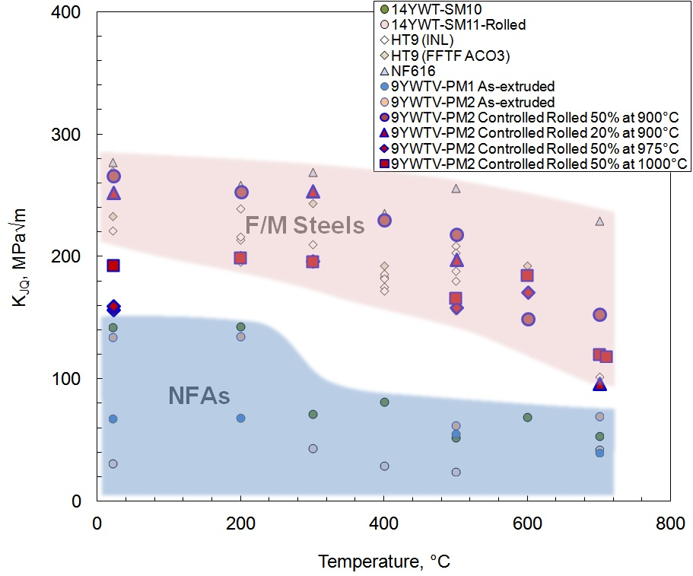
Effect of Controlled Rolling 9YWTV-PM on High Temperature Fracture Resistance
Improvement of fracture toughness in controlled rolled 9YWTV-PM2 is significant.
The 9YWTV-PM2 controlled rolled at 900°C for 50% reduction resulted in the best fracture toughness among NFAs, which is as high as those of non-ODS F/M steels.
Potential avenue for NFAs based on 9Cr with improved high temperature fracture resistance

Slide 14
Creep performance of NFAs
Ruptured after ~38,555 h
Klueh et al, J. Nucl. Mat., (2005)
I-NERI FY01-04
Creep test on ruptured MA957 started in Oct., 2003 (INE
Creep test on 14YWT-SM10 started in April, 2008

