Slide 1
ARIES-ACT1 SCLL Blanket and Manifolding
Christina Koehly
ARIES Project Meeting
UCSD, January 22, 2013

Slide 2
ARIES-ACT1 – SCLL Blanket and Manifolding
Object:
Development of a more detailed design of the blanket and manifold/ flow distribution system for the SCLL blankets
Main focus on fabrication, manufacturing and re/assembling during maintenance as well as MHD issues
A basic design proposal from Siegfried Malang for a MHD improved flow (Y-shaped pipe connections up to one (IB) or max. two (OB) access pipes) as well as Xueren Wangs power core design from October 2012 has been taken as start point

Slide 3
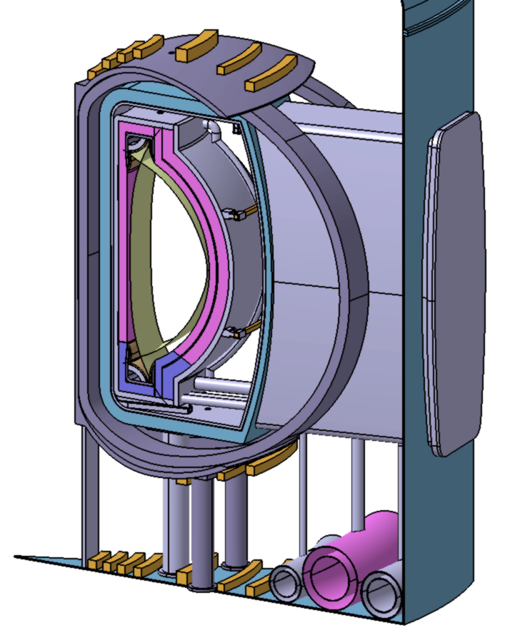
ARIES-ACT1-Power Core, Xueren Wang Oct. 2012
OB1 blanket
OB2 blanket
IB blanket
IB manifold
OB1 manifold
OB2 manifold

Slide 4
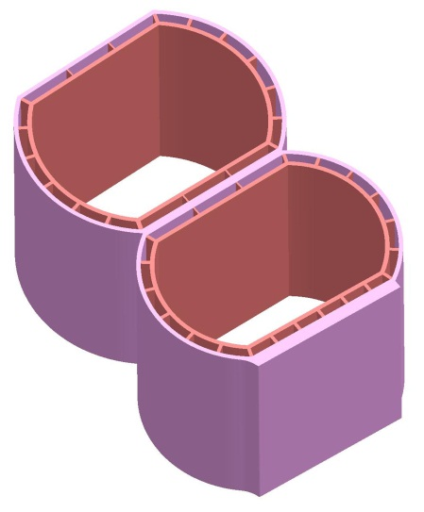
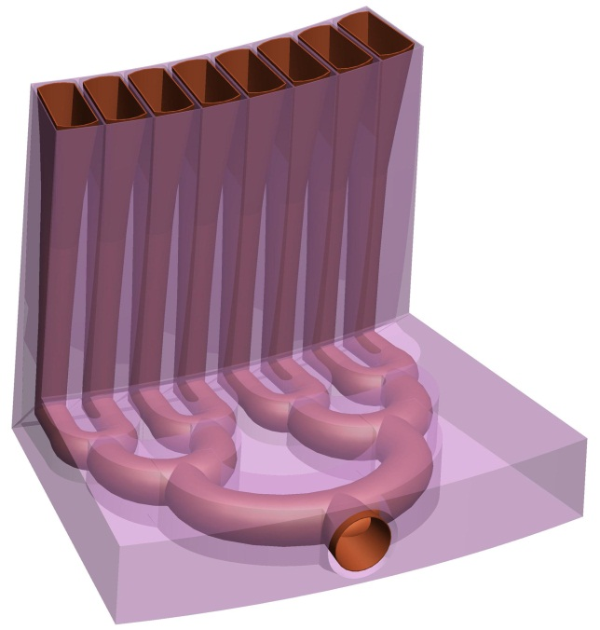
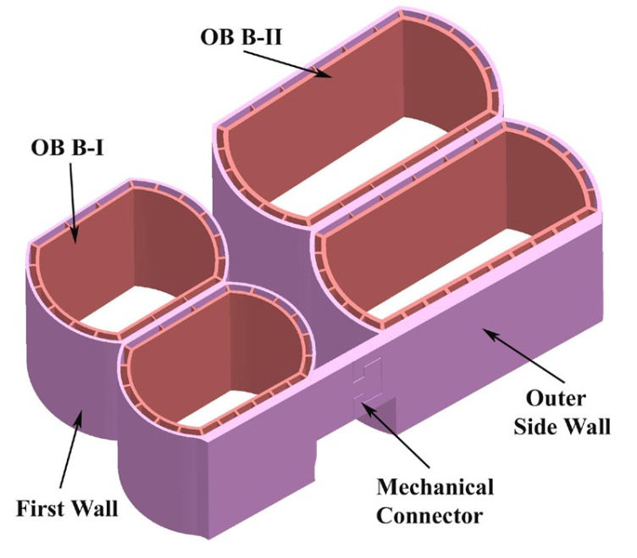
ARIES-ACT1, Xueren Wang and Siegfried Malang
Principle configuration of OB2 blanket
First design concept of IB blanket manifold
Principle configuration of OB blanket
Y-shaped pipe connections
Example for IB

Slide 5
ARIES-ACT1 – SCLL Blanket and Manifolding
Complexity:
Material manufacturing: SiCf/SiC
Manufacturing of concentric SiCf/SiC pipes (inner and outer pipe with fins) as one part is possible
More expensive, but would avoid cross-flows within the concentric pipes between inlet and outlet flow (good for MHD)
Statements of manufacturing possibility for long (several meters) and 3D parts not yet available
Manufacturing of concentric SiCf/SiC pipes as separate parts
Easier and cheaper, but small amounts of cross-flows between inner and outer pipes, because inner pipe not leak-tight connected
Increase of assembling complexity, because of difficulties in assembling Y-shaped concentric pipes
Complicated shapes of the outer pipe and complex bonding areas would be the consequence
Joining/cutting technologies for Sicf/SiC pipes (leak-tight and inside the reactor)
Joining technologies are still under development and not yet completely verified for Fusion purposes
Available first experimental results are not suitable to transfer it to applications for inside the reactor
No detailed statements about sizes of possible joining/cutting machines are available
Difficult to estimate the needed space inside the reactor!

Slide 6
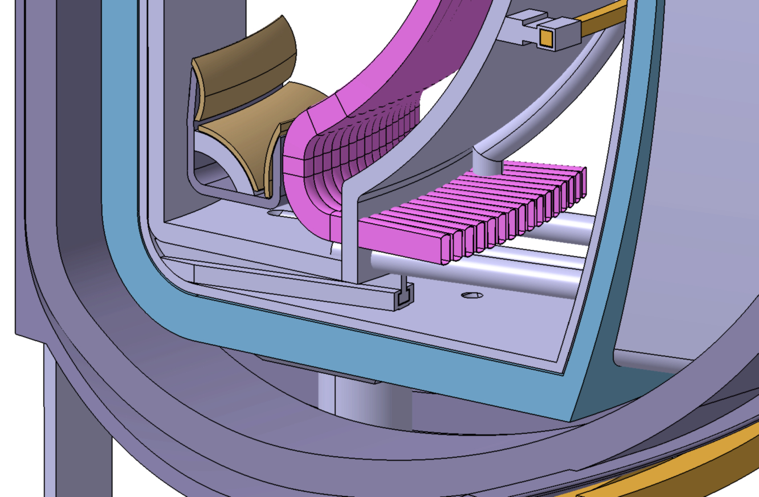
ARIES-ACT1 – Manifold V1a
Construction of rectangular OBI channels till the outside of the structural ring
No more ring shield existing!

Slide 7
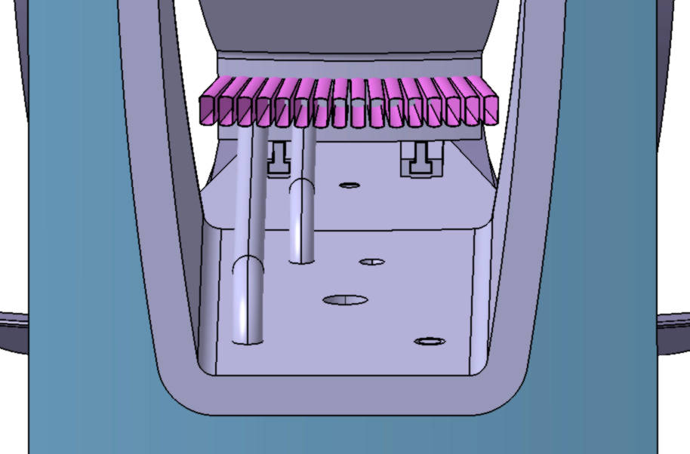
ARIES-ACT1 – Manifold V1a
Port view
No more ring shield existing!

Slide 8
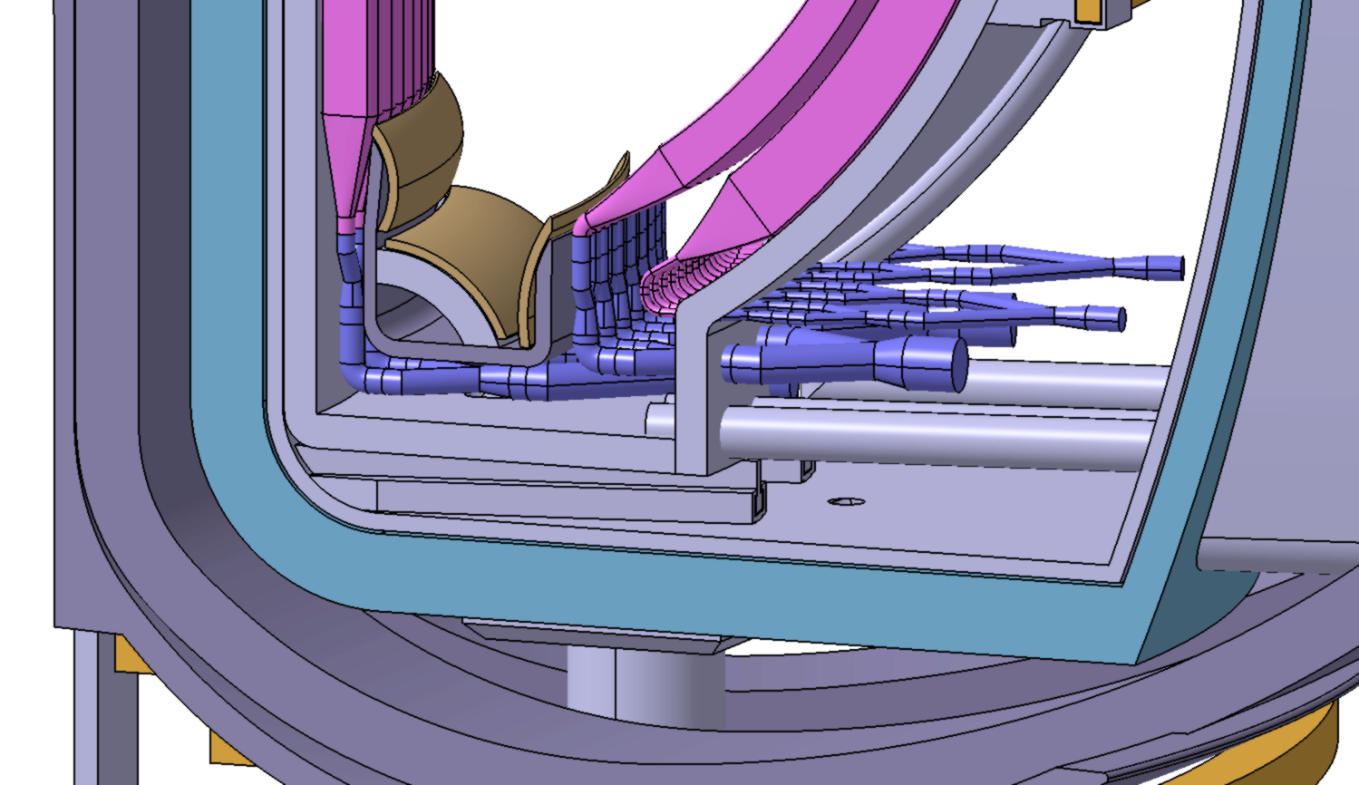
ARIES-ACT1 – Manifold V1b
Rectangular IB/ OB channels changing to circular pipes inside the structural ring, joined to 1 (IB) or 2 (OB) access pipes
Too much empty space between pipes (no shielding)!

Slide 9
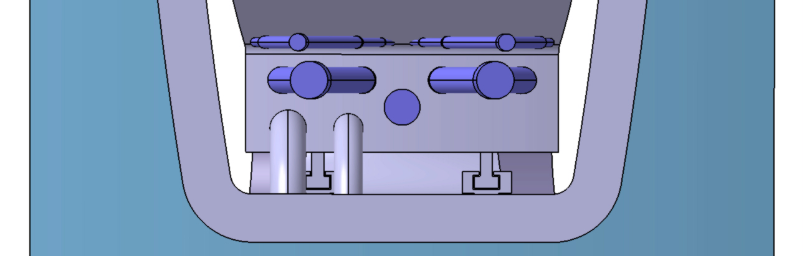
ARIES-ACT1 – Manifold V1b
Port view
Upper Pipes: OBII
Lower Pipe: IB
Middle Pipes: OBI

Slide 10
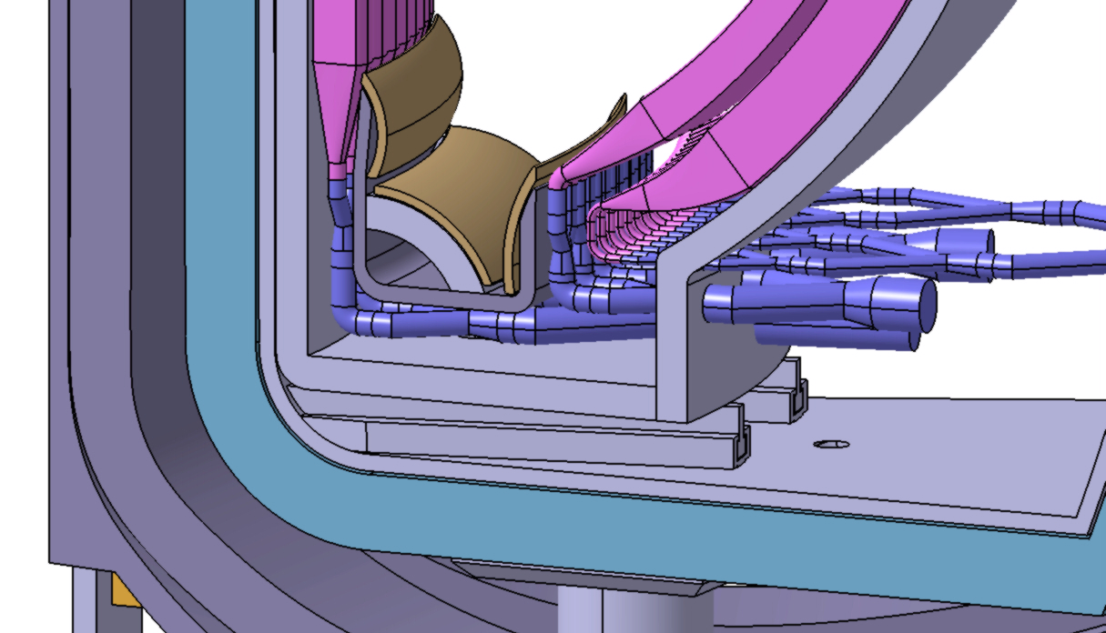
ARIES-ACT1 – Manifold V2
Adaption of manifold contour of OBII closer to OBI (to avoid empty space), OBII joined to 1 access pipe (enough space available)
Still too much empty space between pipes and structural ring!

Slide 11
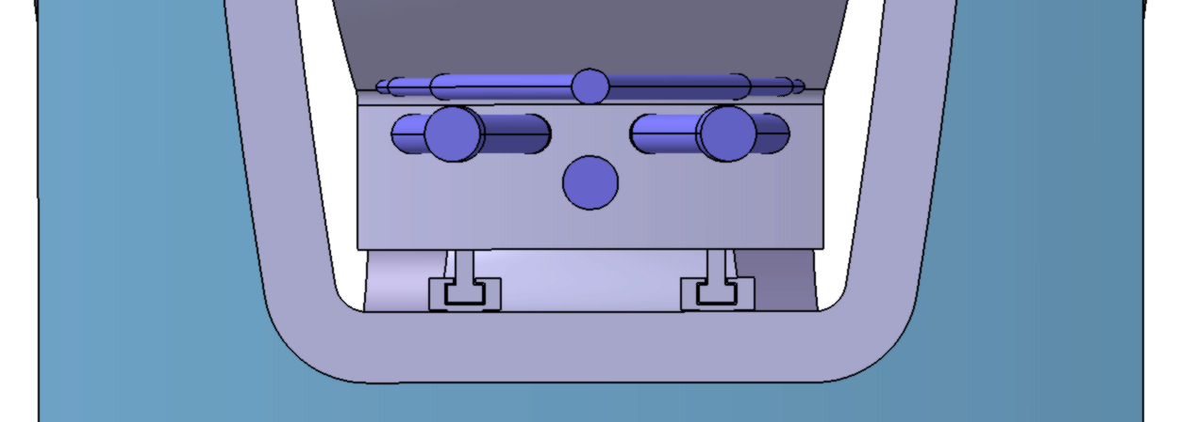
ARIES-ACT1 – Manifold V2
Port view:
Upper Pipe: OBII => joint to one pipe (enough space)
Middle Pipes: OBI
Lower Pipe: IB

Slide 12
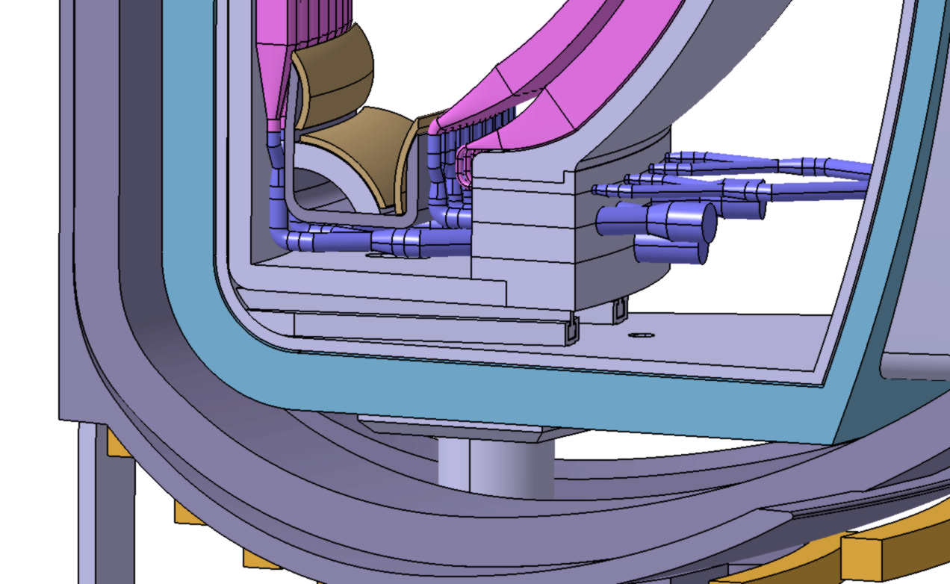
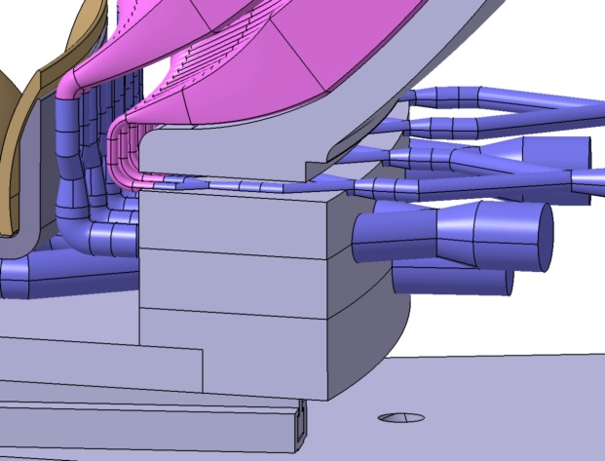
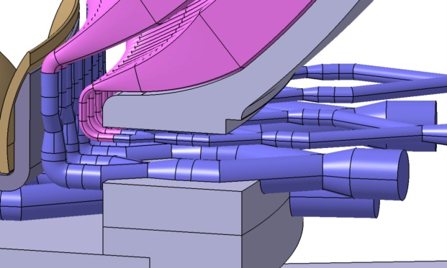
ARIES-ACT1 – Manifold V3
Structural ring thickened at position of lead-through, divided into several blocks, where the pipes are embedded (not structural, structural ring still remained)
Shape of joined pipes remained inside structural ring block
Better shielding, cutting of only few pipes inside the reactor for maintenance
Dis-/Assembly of embedded pipes in Hot Cells
Cooling of divided blocks more difficult => separate cooling pipes necessary!

Slide 13
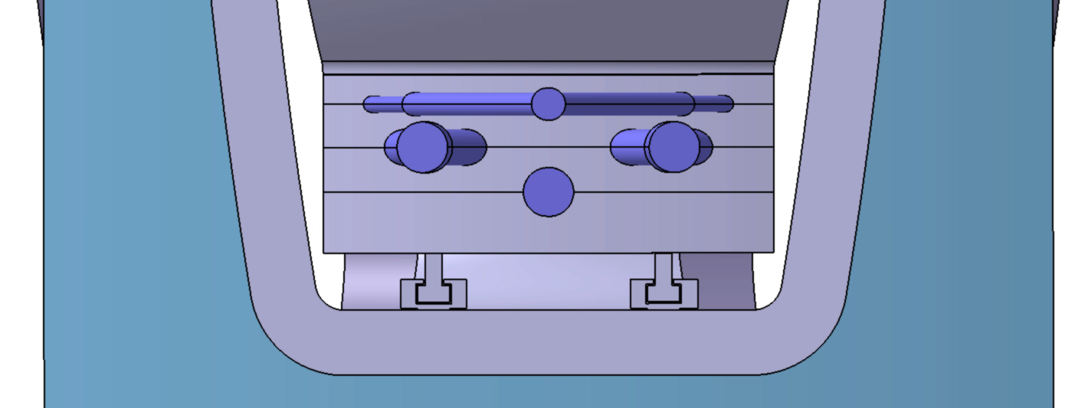
ARIES-ACT1 – Manifold V3
Port view:
Structural ring thickened! => Distance between edge of sector and port reduced from 155mm to 78mm!
=> But maintenance through port still possible!

Slide 14
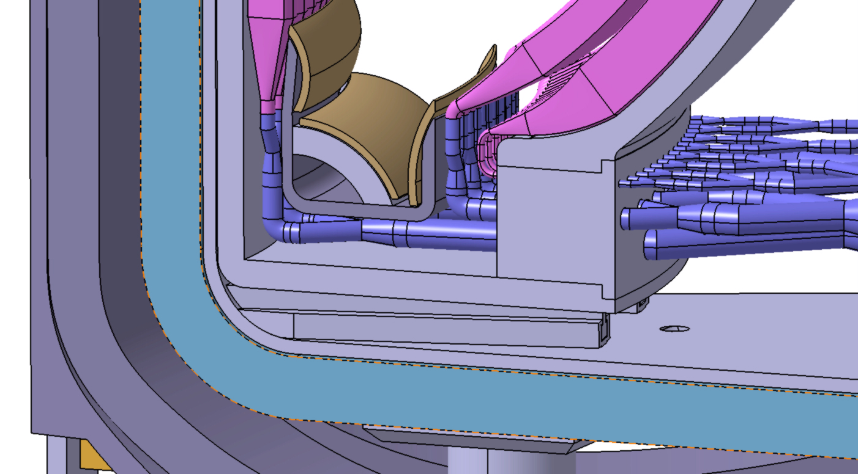
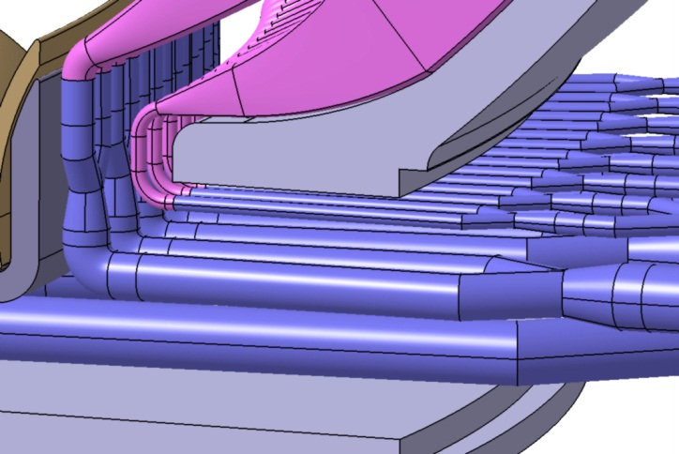
ARIES-ACT1 – Manifold V4
Structural ring thickened at position of lead-through as V3, but divided into only one block, pipes are going straight through the block => longer pipes, manifolding starts later (outside of ring block)!
Good shielding block, but many pipes have to be cut inside the reactor close to the block to maintain the blanket! => possible?
Cooling of additional ring block easier, only one additional pipe is necessary!

Slide 15
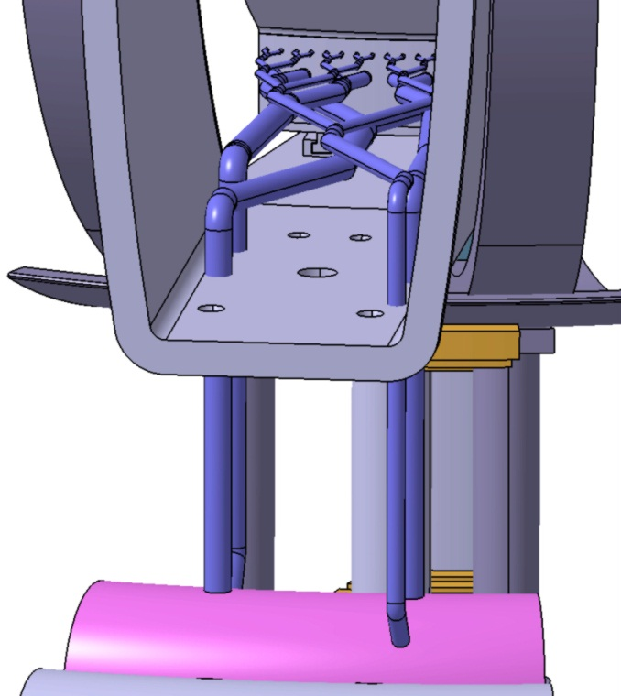
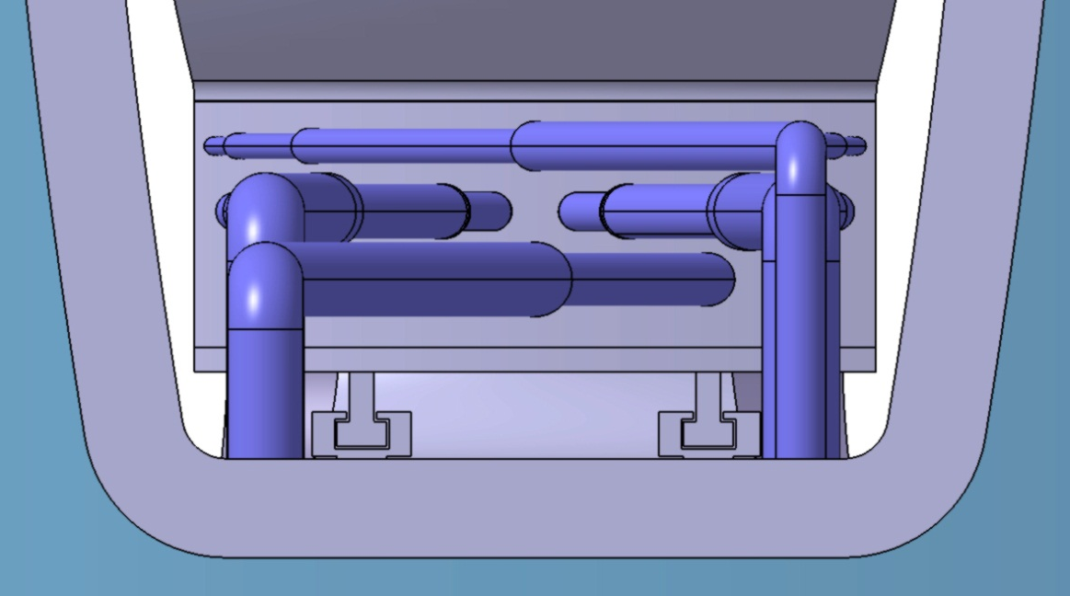
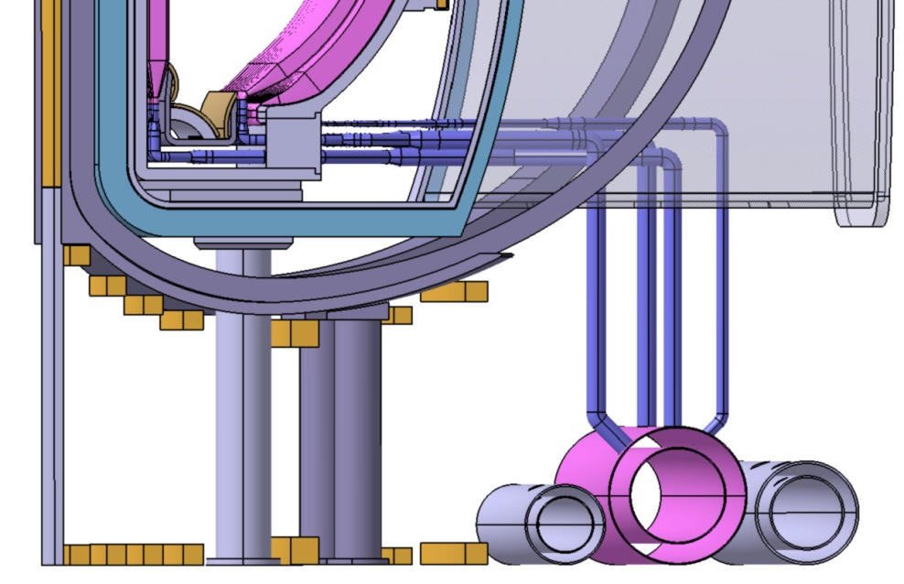
ARIES-ACT1 – Manifold V4
Port view:
Structural Ring thickened as in V3
Extension of pipes till ring header
Symmetry of pipe joints are kept
Center space kept free for vacuum pipe

Slide 16
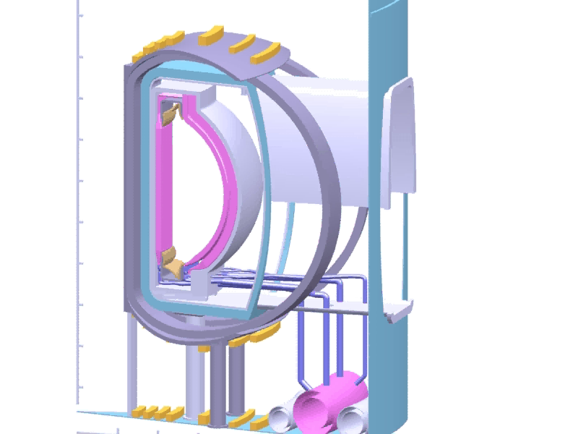
ARIES-ACT1 – Manifold V3, Disassembly Simulation

Slide 17
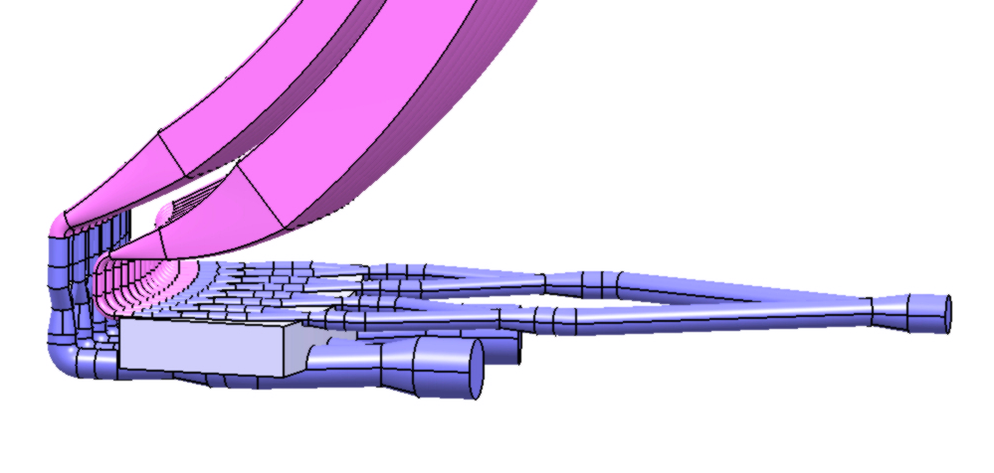
ARIES-ACT1 – Manifold V3, Disassembly Simulation
OB1 and OB 2 can not be moved from the last block
Additional 4cm gap between OB1 and OB2 needed for disassembling the last block!

Slide 18

ARIES-ACT1 – Manifold V4, Disassembly Simulation

Slide 19
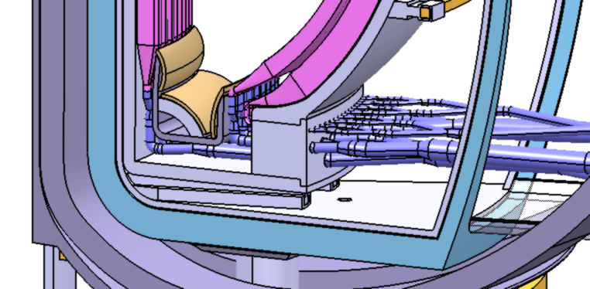
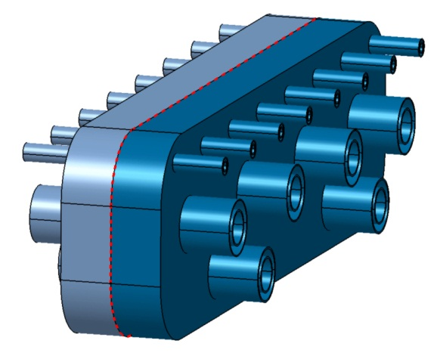
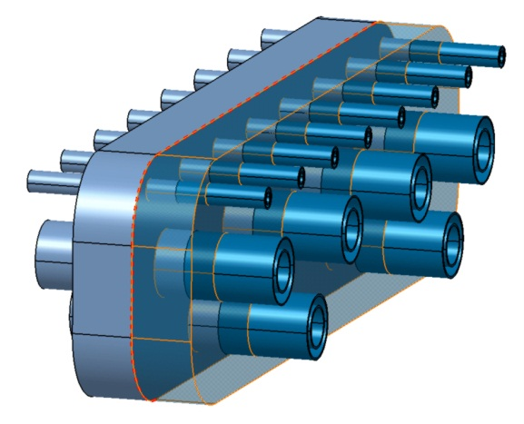
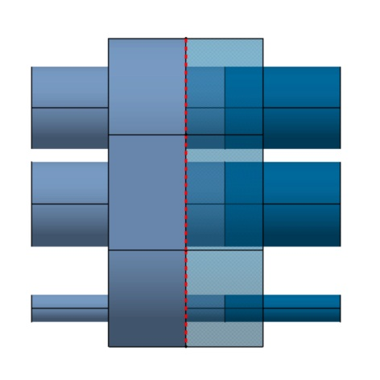
ARIES-ACT1 – Manifold V4, Disassembly Simulation
Many pipes have to be cut inside reactor for disassembly
possible?
Adding of one “joining area”

Slide 20

ARIES-ACT1 – Summary
Manifold V3 |  | Manifold V4
Pro | Con | Pro | Con
Better shielding |  | Better shielding
Cutting of only few pipes inside the reactor for maintenance |  | Could be avoided by an additional “joining area” like two half of a block, where on each side the pipes are connected, joining and cutting inside the reactor takes place only one time around the two half of blocks | Cutting of many pipes inside the reactor for maintenance => possible (space, available tools,…)?
Dis-/Assembly of embedded pipes in Hot Cells | Dis-/Assembly need an additional 4cm gap between OB1 and OB2! | Dis-/Assembly of embedded pipes in Hot Cells | Cutting of many pipes in Hot Cells => possible?
 | Cooling of divided blocks more difficult => separate cooling pipes for each piece of block necessary! | Cooling of additional block easier, only one additional pipe is necessary!

Slide 21
ARIES-ACT1 – Summary 2
Several design options has been worked out
Manifolding V3 and V4 seems the most promising
Because of open questions at Manifolding V4, Manifolding V3 should be preferred for a further detailed design
Additional space of 4cm between OB1 and OB2 is required for this solution
Way of pipe manufacturing should be discussed (inner/outer pipe as one or two parts?)

Slide 22
Thank you for your attention!

Slide 23
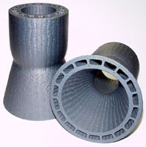
Example for SiCf/SiC composite structure
Silicon-carbide-fiber-reinforced silicon carbide matrix composites with woven cooling tubes.
http://www.grc.nasa.gov/WWW/RT/RT2001/5000/5130jaskowiak.html

