Slide 1
3D Finite Element Analysis for Ribbed Structure Vacuum Vessel
By: Hamed Hosseini
Advisor: Prof. Farrokh Najmabadi

Slide 2
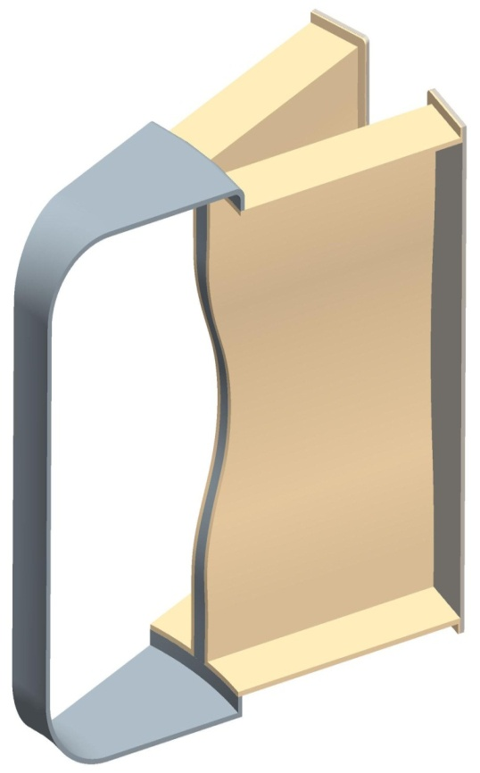
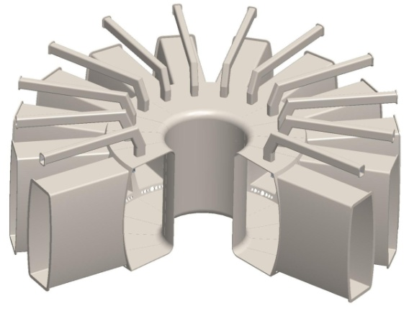
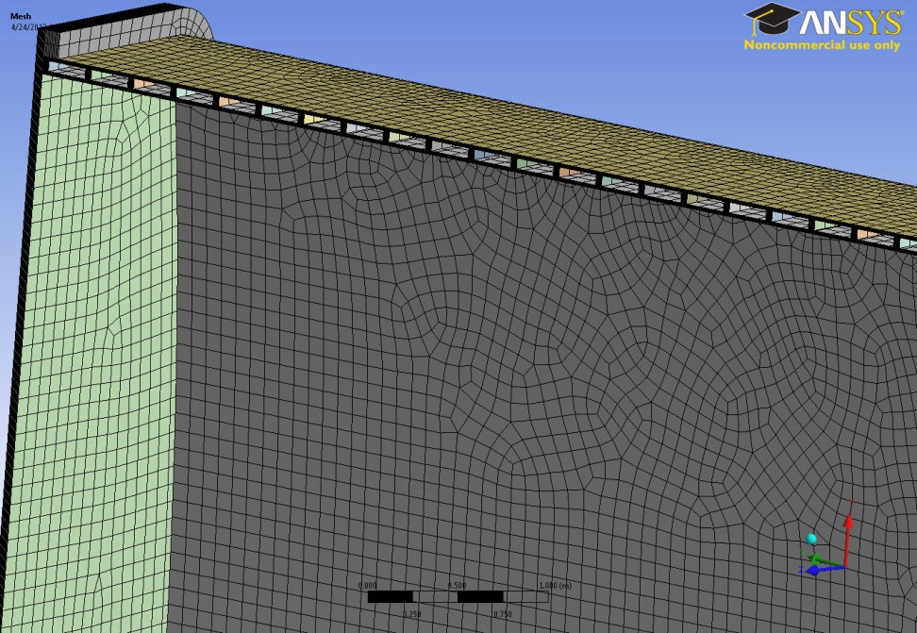
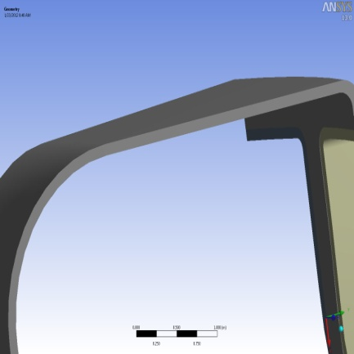
Introduction & Motivation
Vacuum Vessel
1/16 of Sectors (Symmetry )
Geometry of the vacuum vessel is taken from CAD, considering the very thin vacuum vessel (5 cm) and 10 cm thick at the beginning
Primary stress is performed by ANSYS Workbench to see if the thinner wall can accommodate the normal pressure loads and overpressure loads ( Motivation: How thin it can be based on the stress analysis).
Double wall ribbed structure as a way to increase the strength of structure , reducing stress intensity and cooling the system is designed and analyzed.
11 (m)
10 (m)
5(cm), 10(cm)
Double Wall Ribbed Structure
Solid Single Wall
Material : SST 316, Yield Stress: 140 MPa, and Working Temperature: 550 K

Slide 3
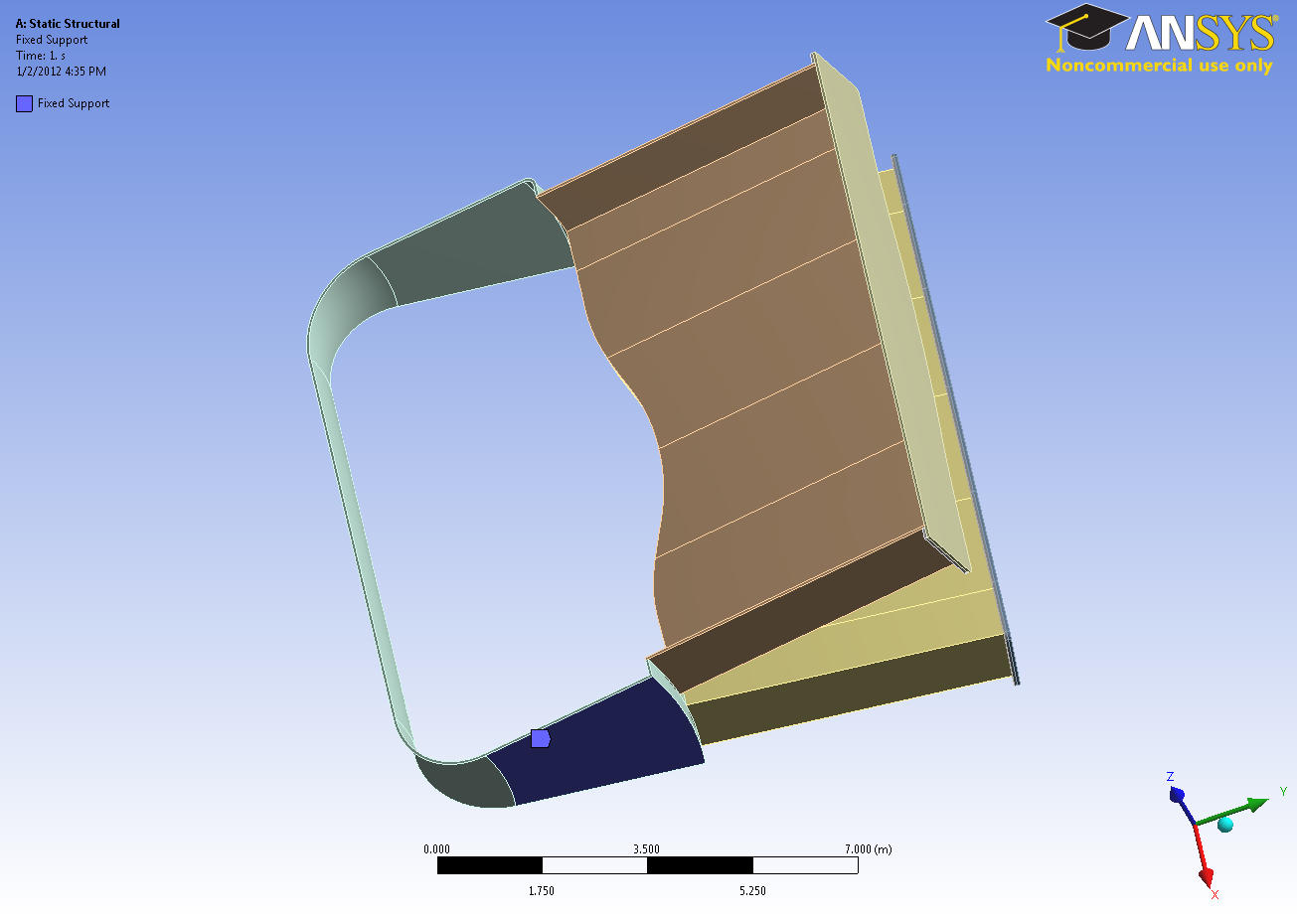
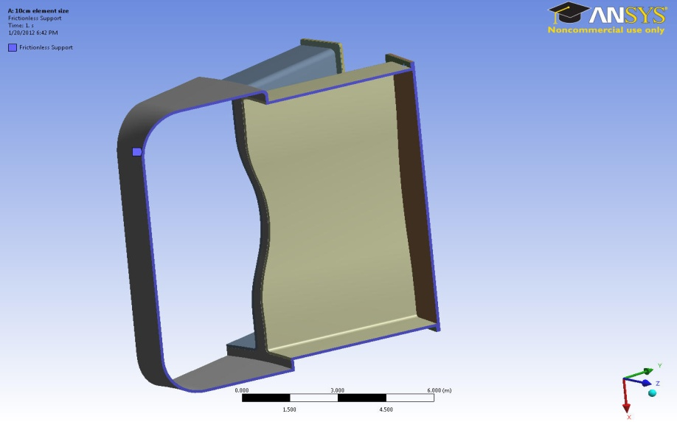
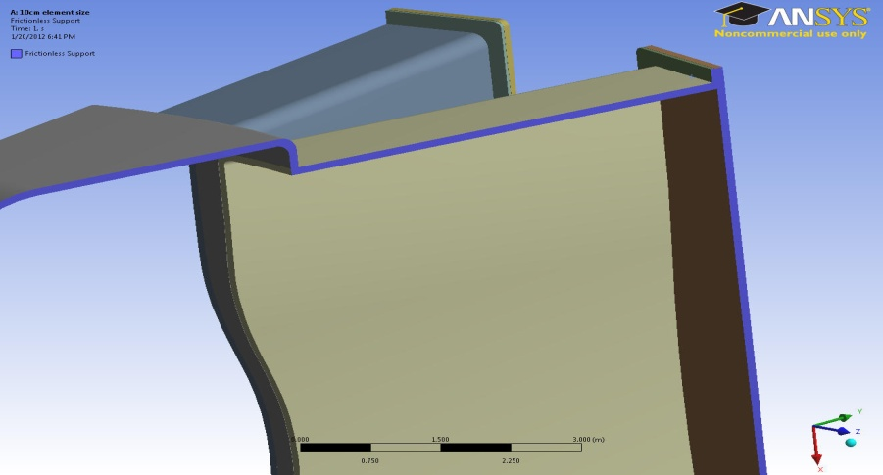
Boundary Condition
Fixed Bottom
Symmetry (Frictionless)

Slide 4
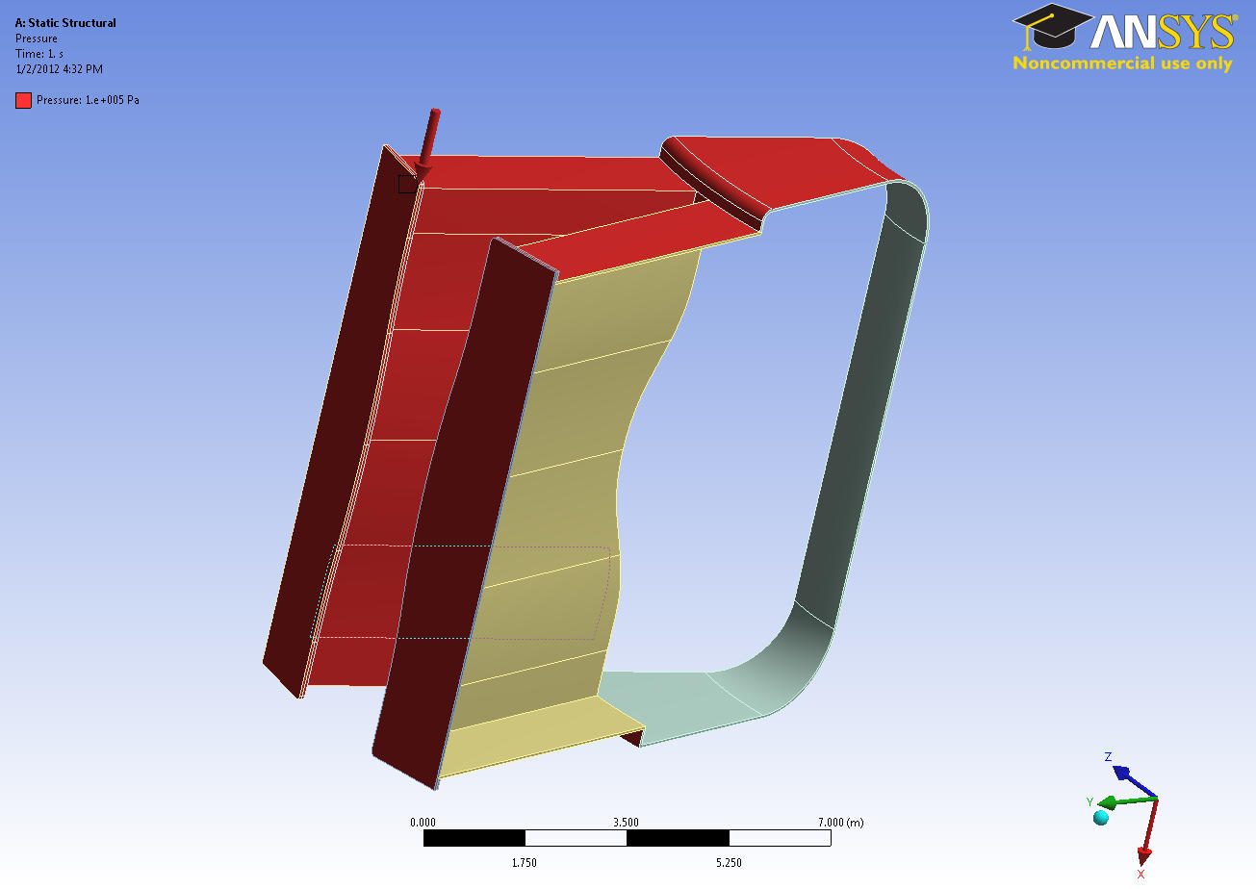
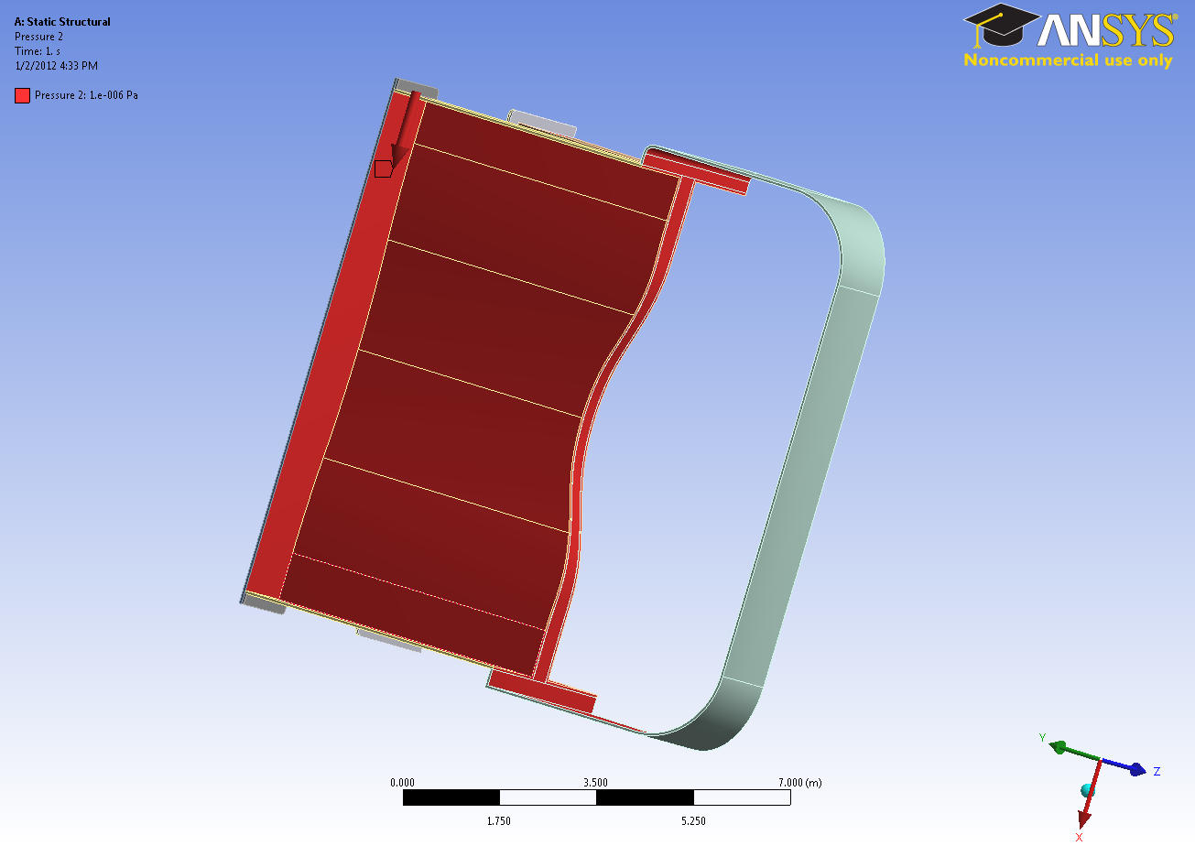
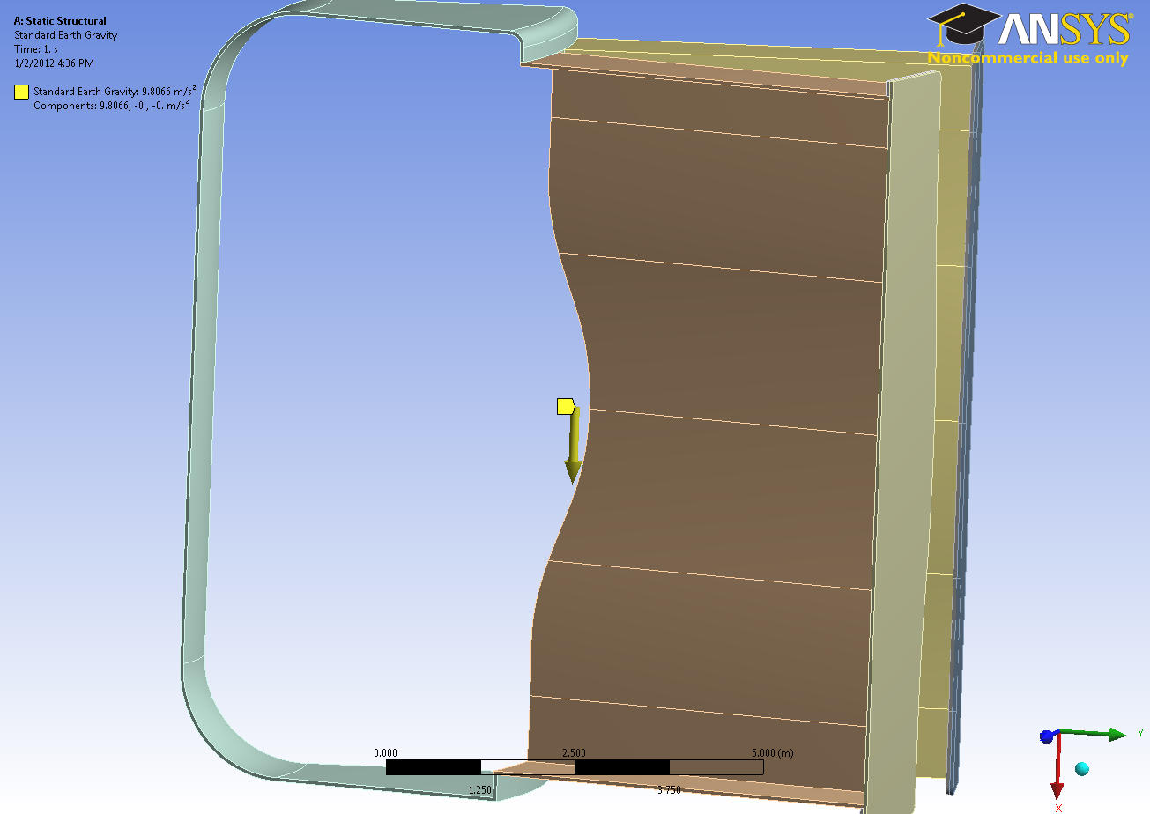
Loads
Outside Pressure (1 atm)
Inside Pressure ( zero)
Gravity

Slide 5
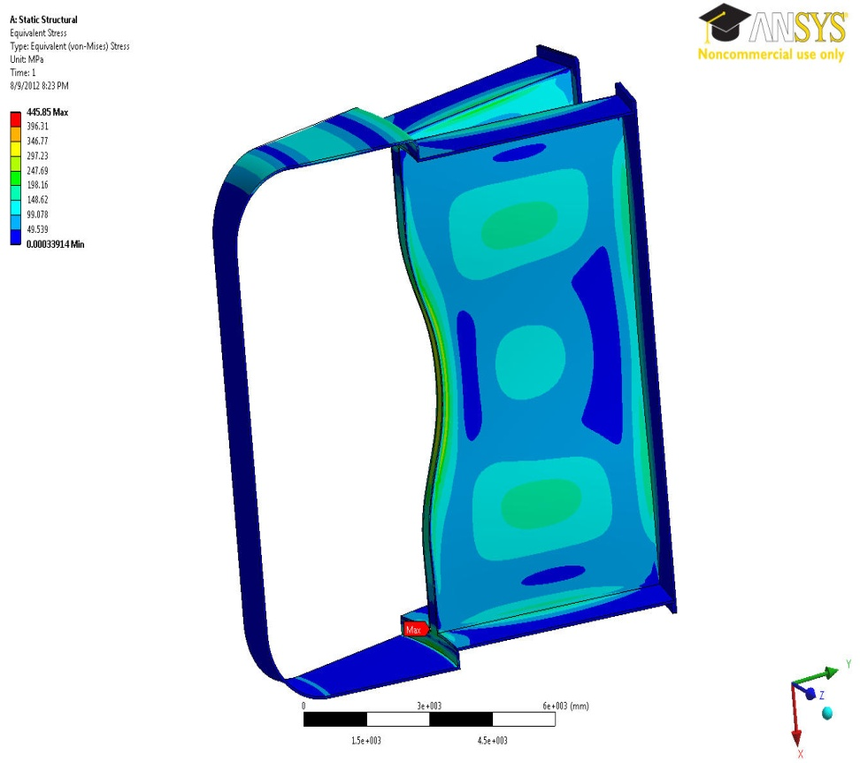
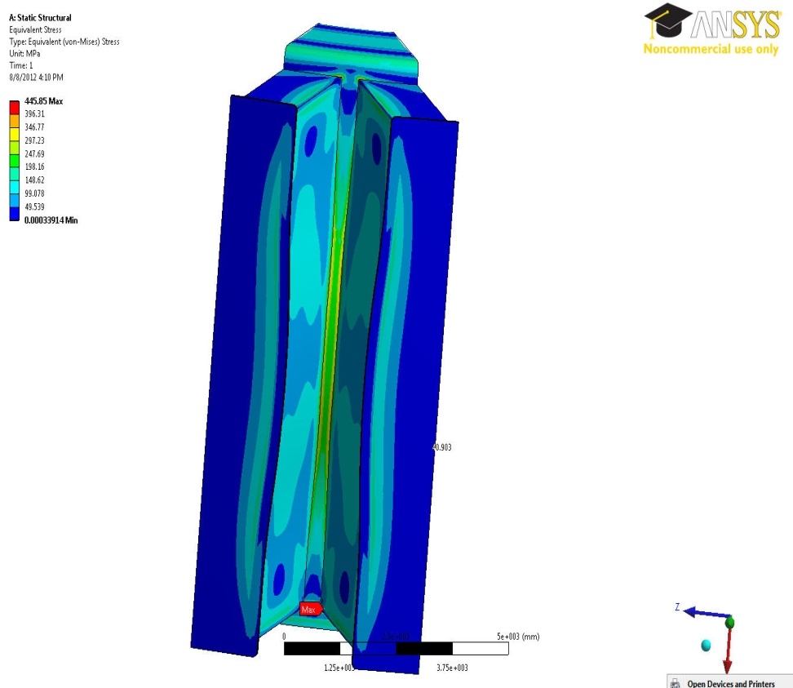
Solid Single Wall VV
Very Thin VV (5-cm)
Very Thin VV (5-cm)
197 MPa
300 MPa
166 MPa
There are lots of over stressed areas > 140 MPa

Slide 6
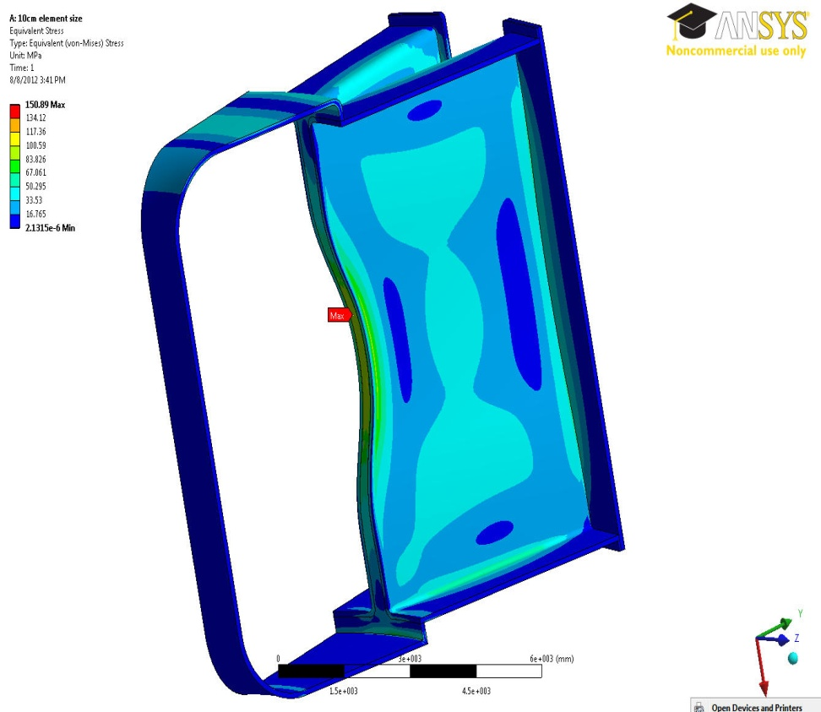
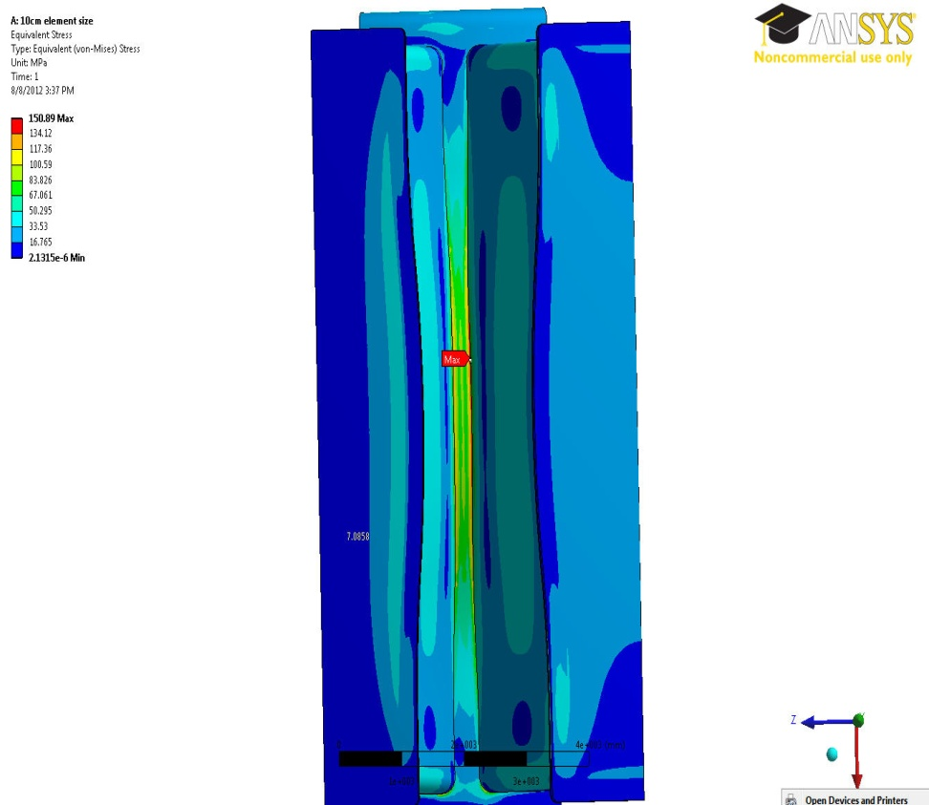
Solid Single Wall VV
Thick VV (10-cm)
Thick VV (10-cm)
40 MPa
123 MPa
100 MPa
Almost all the areas are less than the yield point < 140 MPa

Slide 7
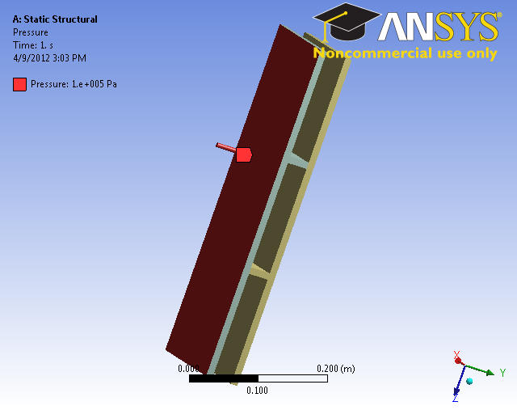
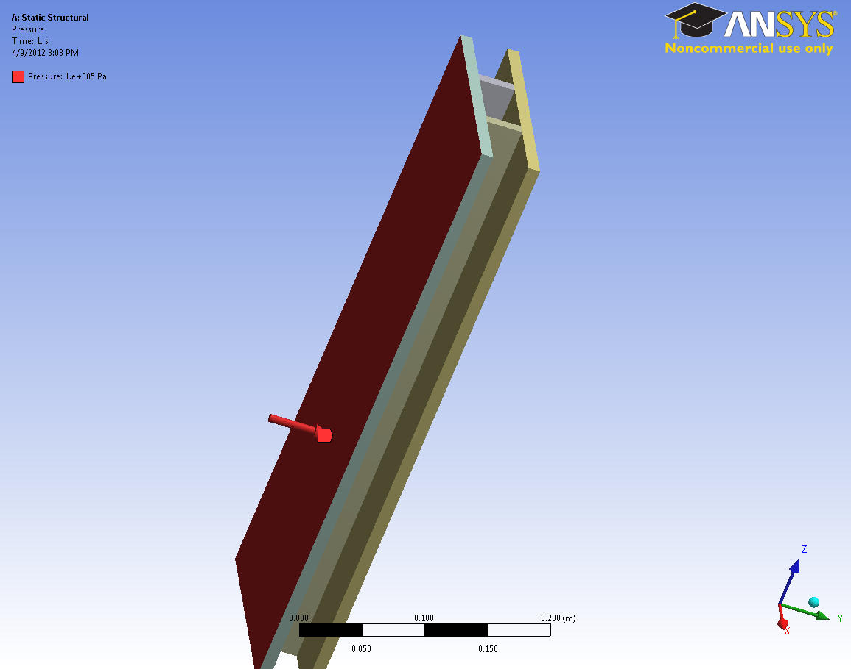
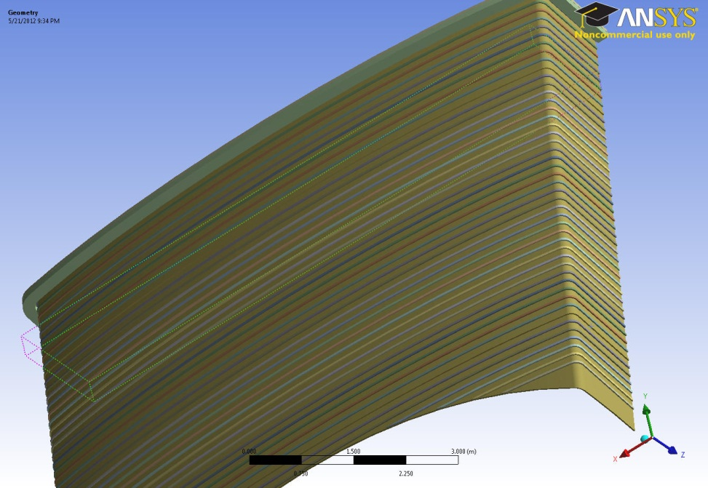
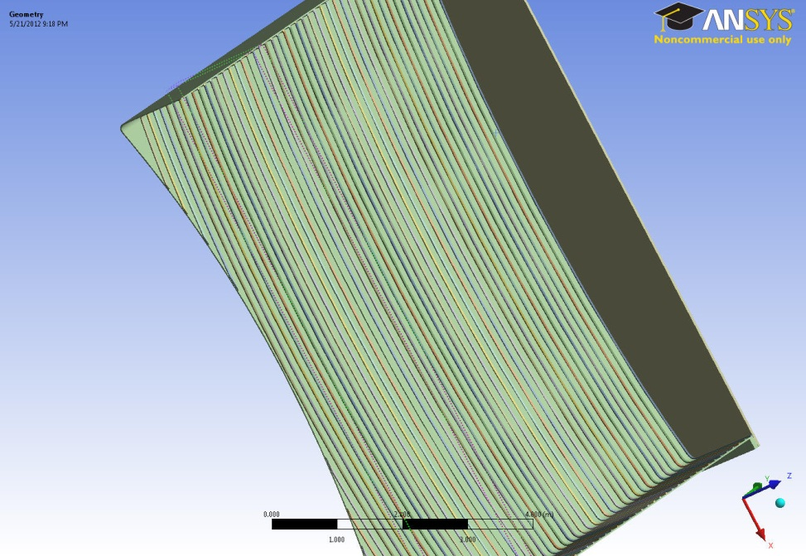
Double Wall Ribbed Structure/ Sandwich Panels
In the solid single wall, material should be added to those areas with high stress intensity to get the stress lower than the yield point
Ribbed structure as a way to add material , increases the strength of structure which helps to reduce the stress intensity with a little increase in mass
Ribbed structure is very similar to the sandwich panel technique
Sandwich plate which is composed of three layers with two thin flat panel upper and lower and a core in between is a very efficient way of providing high bending stiffness and high strength at low weight ( Libove, Hubka 1951)
It provides sufficient space for the He coolant to follow between the ribs
Ribs attached to
the Inner Sheet
Ribs attached to the
outer Sheet

Slide 8
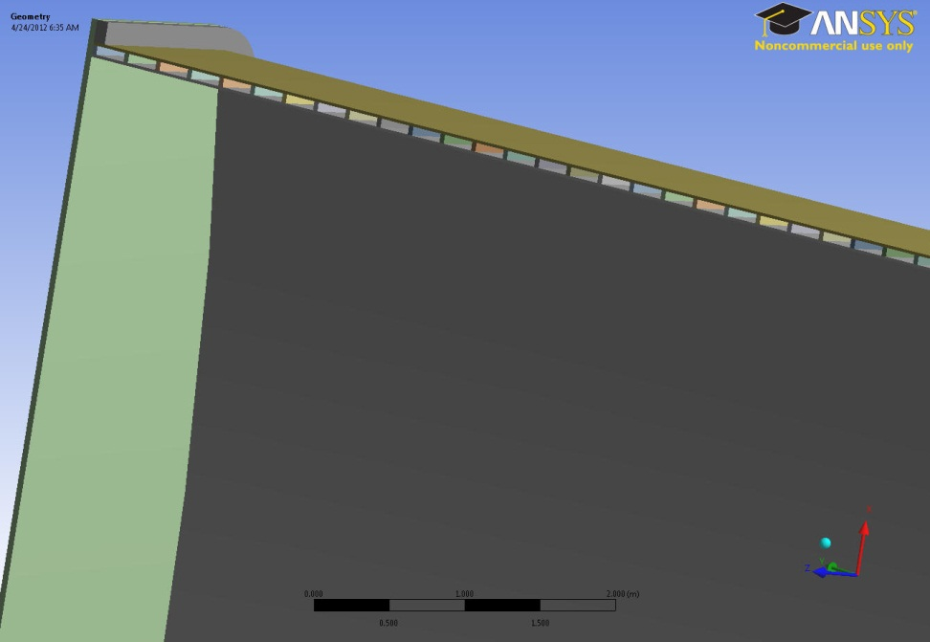
Rib Configuration
Vertical Ribs or Horizontal Ribs?
Total Thickness of the Double Wall Ribbed Structure?
Thickness of Each Wall (Sheets)?
Thickness of Ribs?
Distance Between Ribs?
Total Number of Ribs?

Slide 9
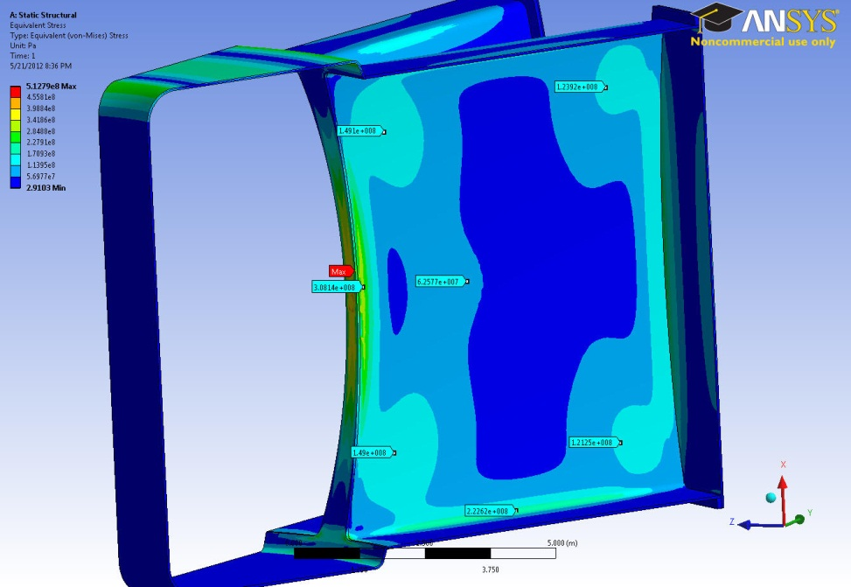
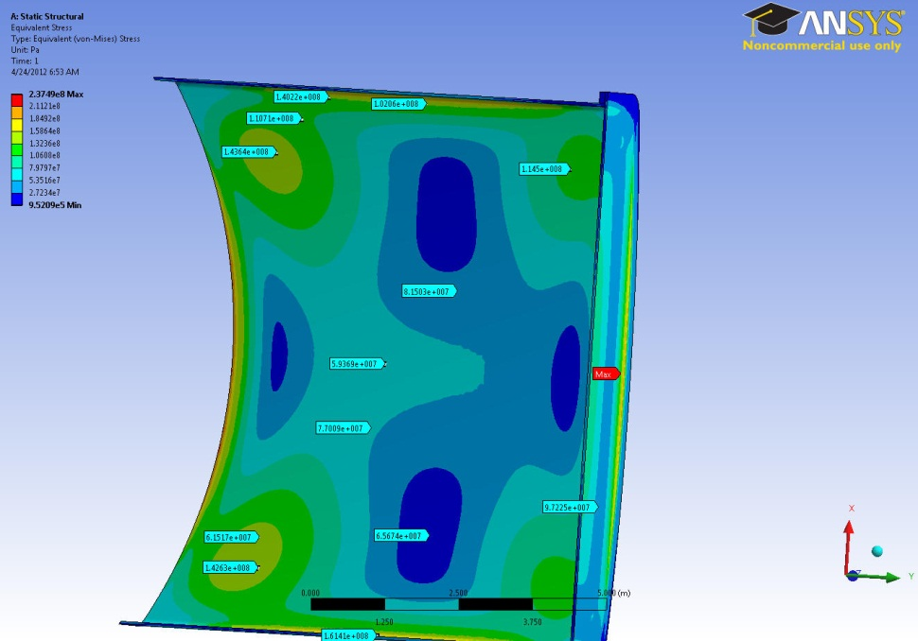
Port Ribbed Structure Study
Very Thin VV (5-cm)
Fixed BC/5-cm Thick Port
143 MPa
116 MPa
149 MPa
123 MPa
Fixed BC
149 MPa
123 MPa
143 MPa
116 MPa
Less than 5% difference between similar points

Slide 10
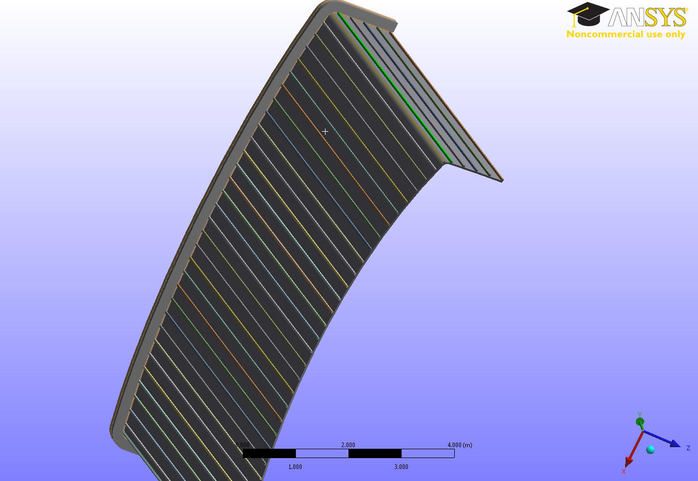
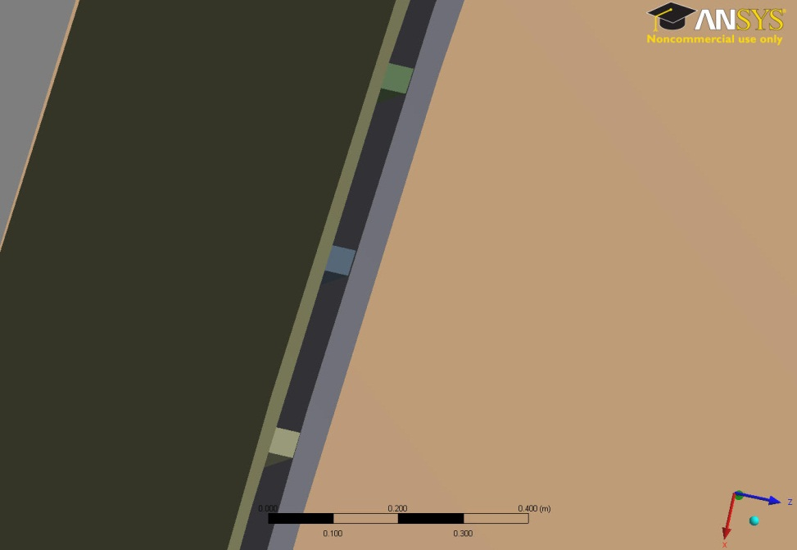
Horizontal/ Vertical Ribbed Structure?
2cm
4cm
Fixed BC
Frictionless BC (Symmetry)
4cm
25cm
4cm

Slide 11
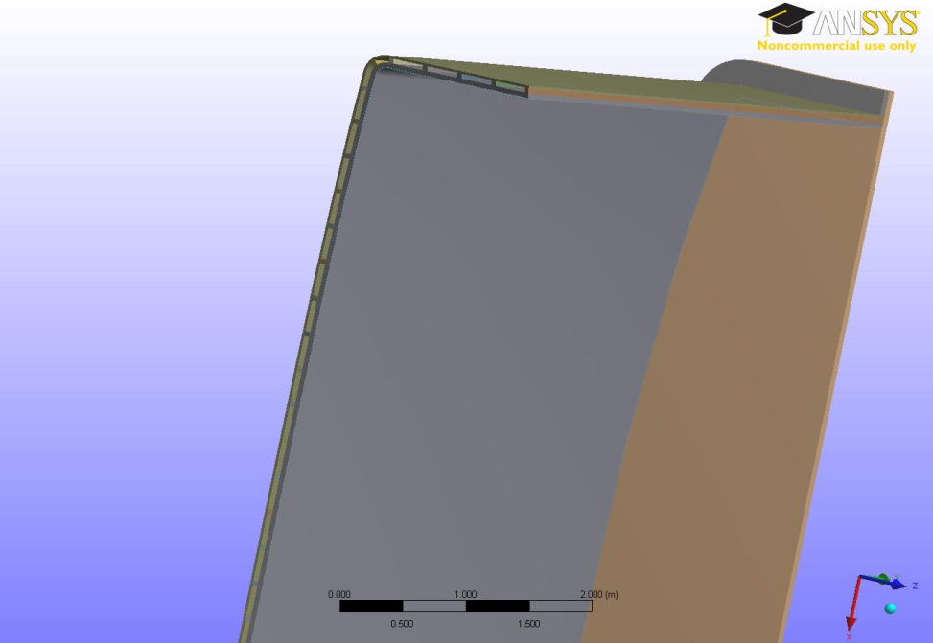
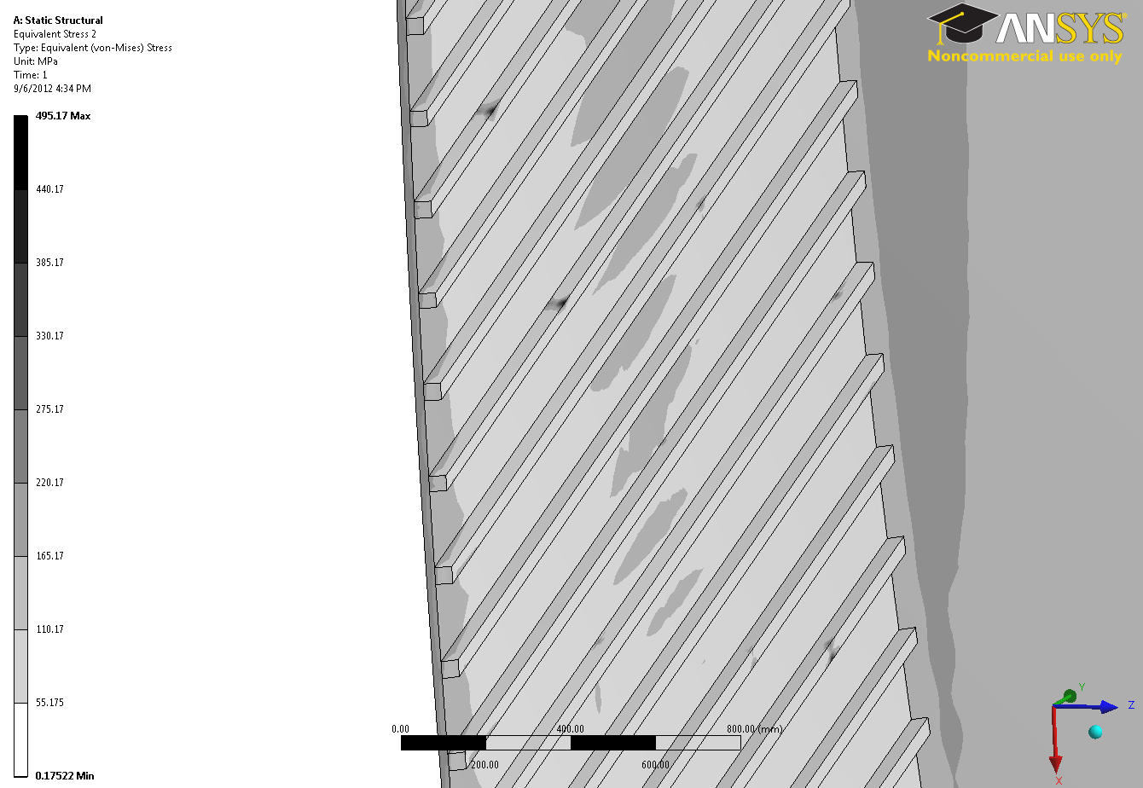
Over Stressed Spots
Boundary Conditions
Over Stressed Spots on Ribs
400 MPa
Fixed BC
Frictionless BC (Symmetry)

Slide 12
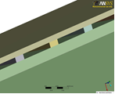
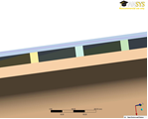
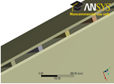
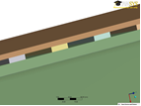
Vertical Ribbed Structure
Variety of vertical Ribbed Structures has been designed and analyzed
(different Sheet thicknesses, Rib thicknesses, gap between sheets, distance between sheets)

Slide 13
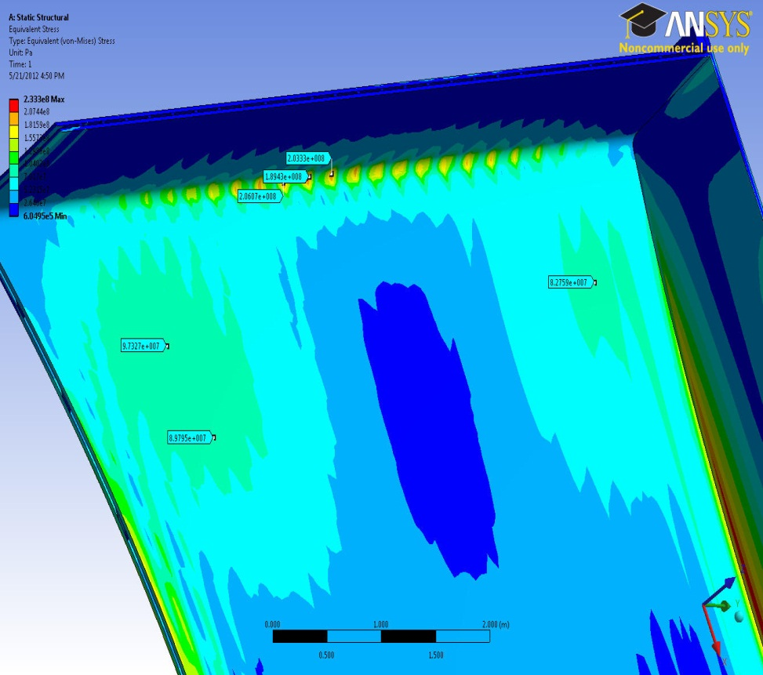
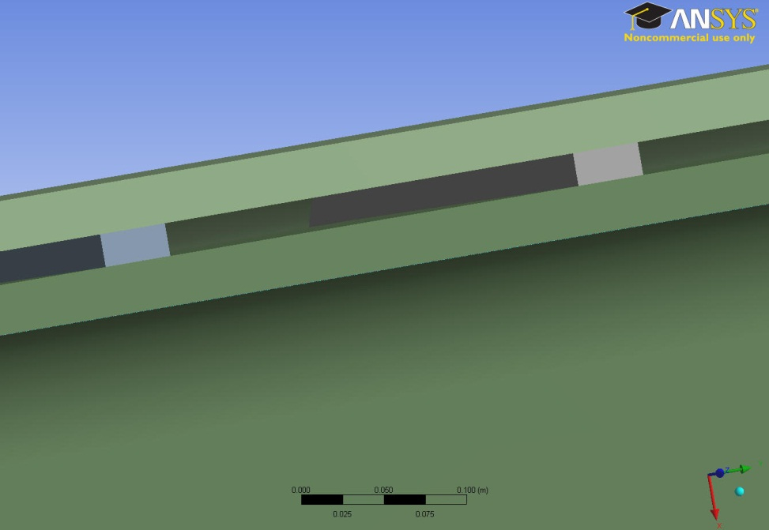
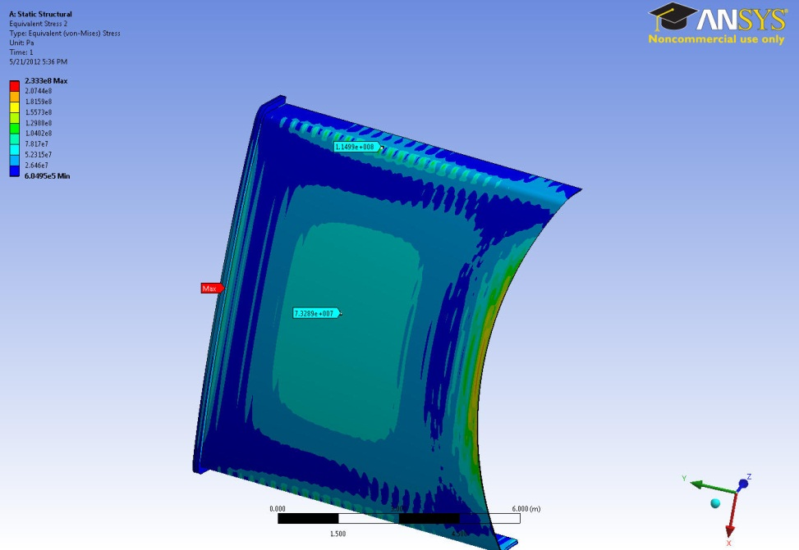
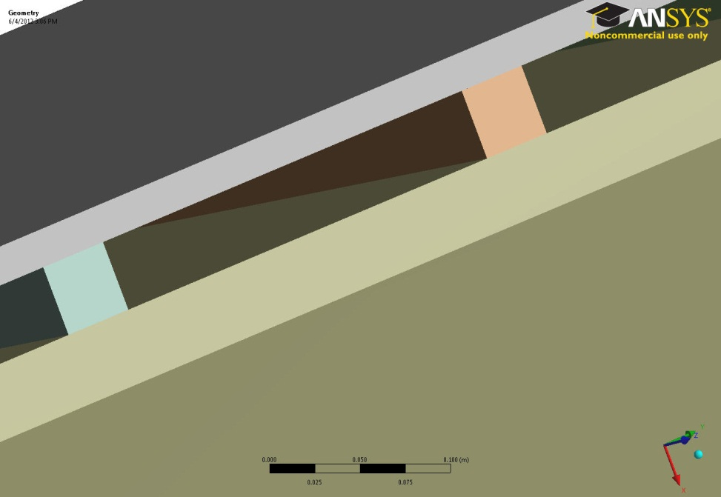
Sheet (Wall) Thickness?
Inner Sheet Over Stressed
Outer Sheet Safe
Adding 1cm to the Inner Sheet
Removing 1cm from Outer Sheet
3cm
3cm
200 MPa
2cm
4cm
74 MPa
Reasonable stress happens for inner sheet thickness above 3cm
Outer sheet has less stress intensity than the Inner Sheet
The high stress regions happen inside the inner sheet
Outer sheet can be designed with thinner thickness than the inner sheet

Slide 14
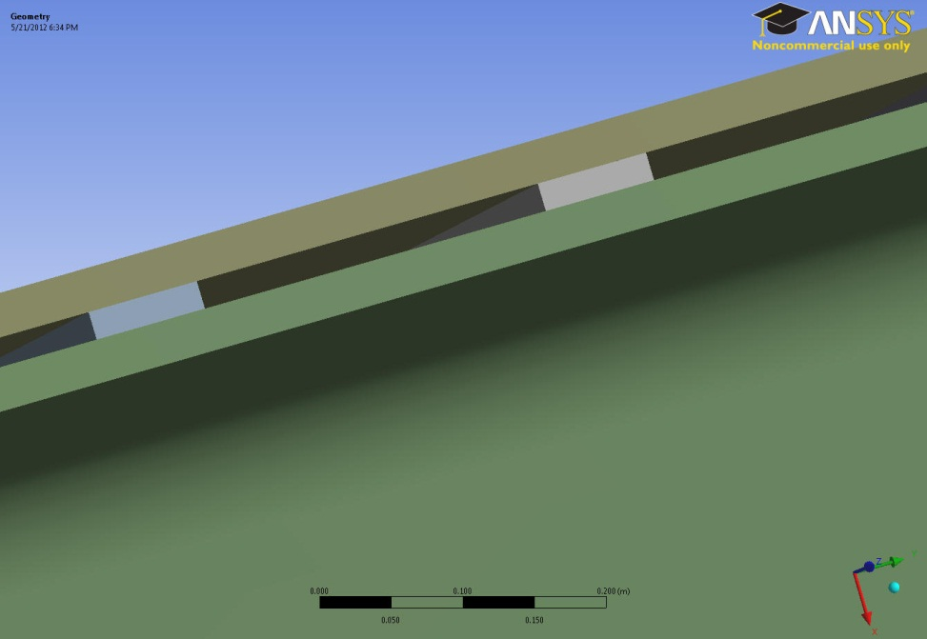
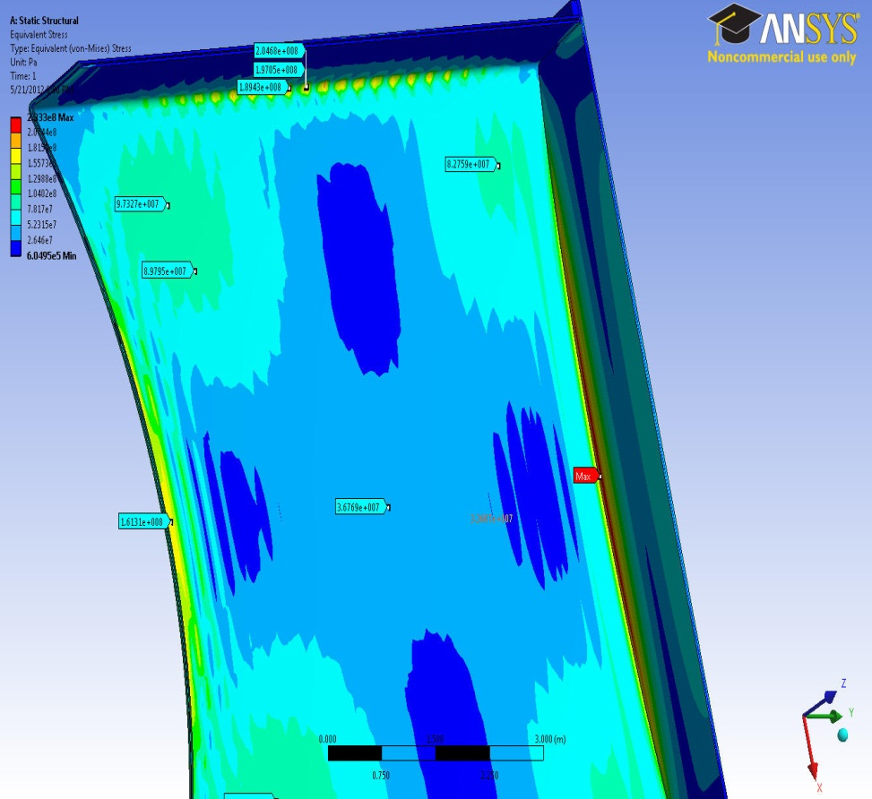
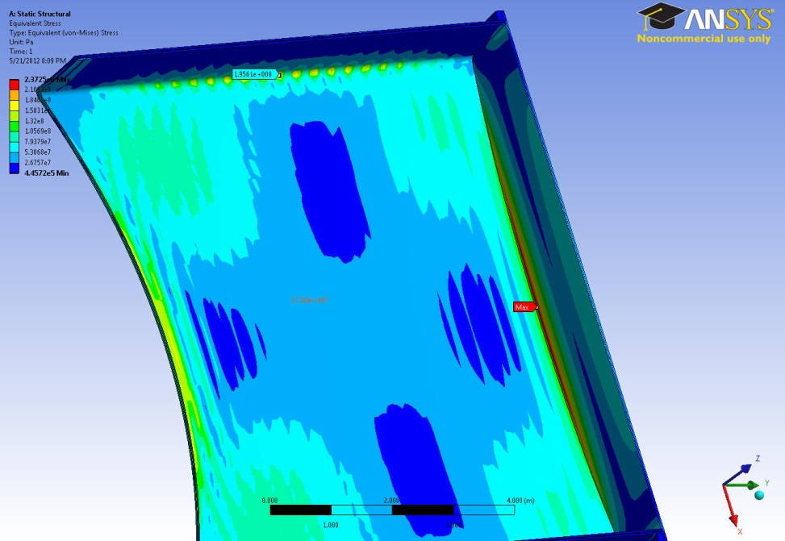
Rib Thickness ?
2cm x 4cm Rib
2cm x 8cm Rib
2cm
2cm
4cm
8cm
3cm
3cm
200 MPa
194 MPa
Reasonable stress intensity happens for Ribs around 4cm thickness and above
Rib Length
Weak Parameter, less than 5%

Slide 15
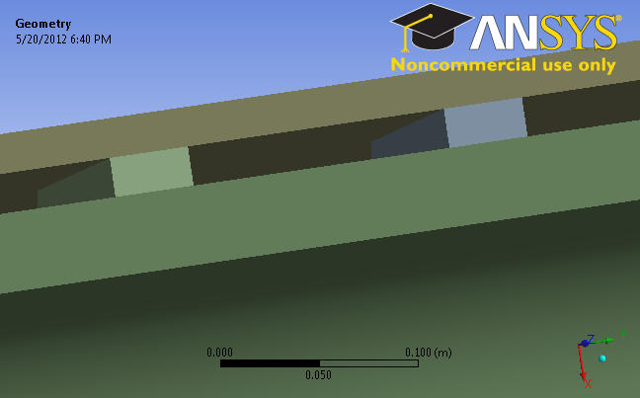
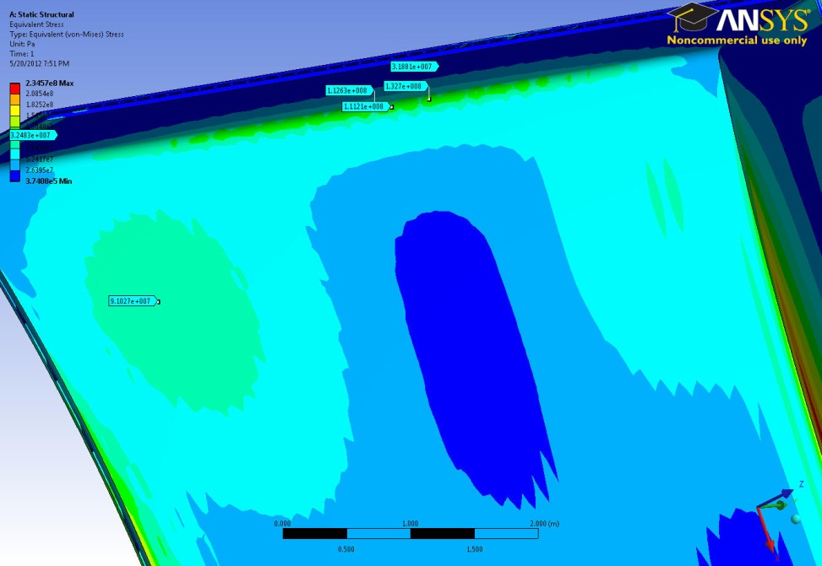
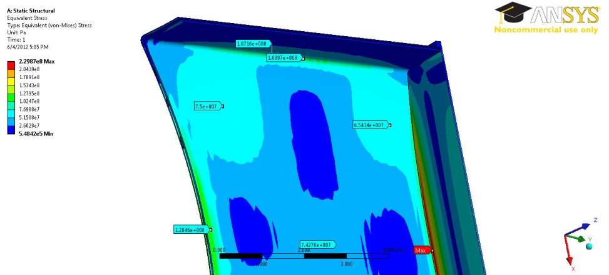
Gap/Distance Between Ribs?
Ratio Gap/Distance: 2/13
Ratio Gap/Distance: 4/20
2cm
4cm
13cm
20cm
130 MPa
110 MPa
Reasonable stress happens for the distance between Ribs less than 25cm
Bigger gap combined with larger distance between ribs gives better stress results
4cm gap combined with 20cm distance between ribs gives better stress distribution comparing the 2cm gap with 13cm distance between ribs
Larger distance between ribs : Less number of ribs, more space for coolant, less computational time, faster convergence

Slide 16
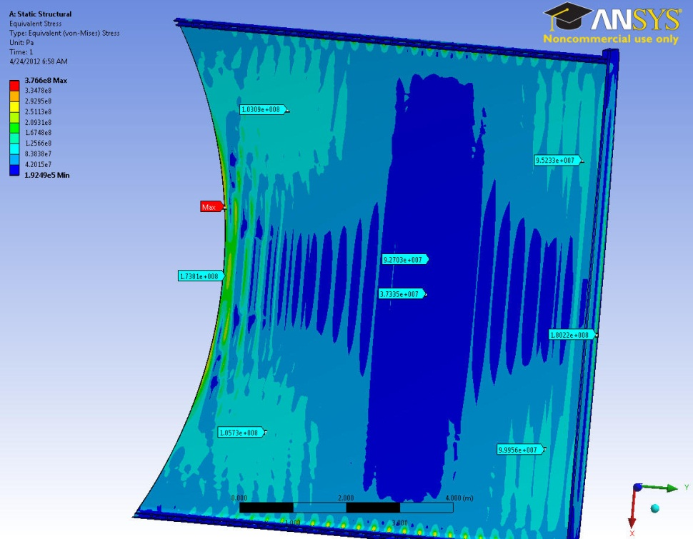
Comparison
Double wall (Vertical Ribbed)
Very Thin Solid Single wall (5-cm)
143 MPa
100 MPa
142 MPa
100 MPa
90 MPa
116 MPa
Ribbed structure as a way to add material , increases the strength of structure which helps to reduce the stress intensity
In the vertical ribbed structure, the stress amount gets 25-30% lower than its counterpart area on the very thin solid single wall VV (5-cm)

Slide 17
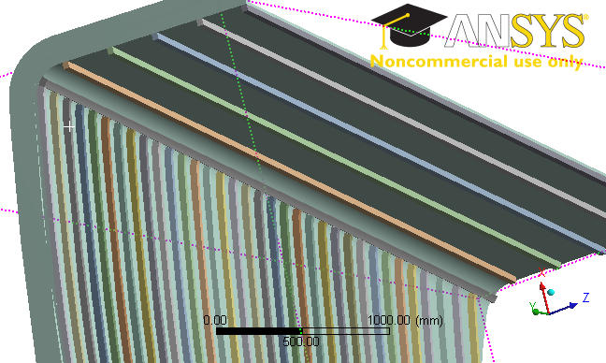
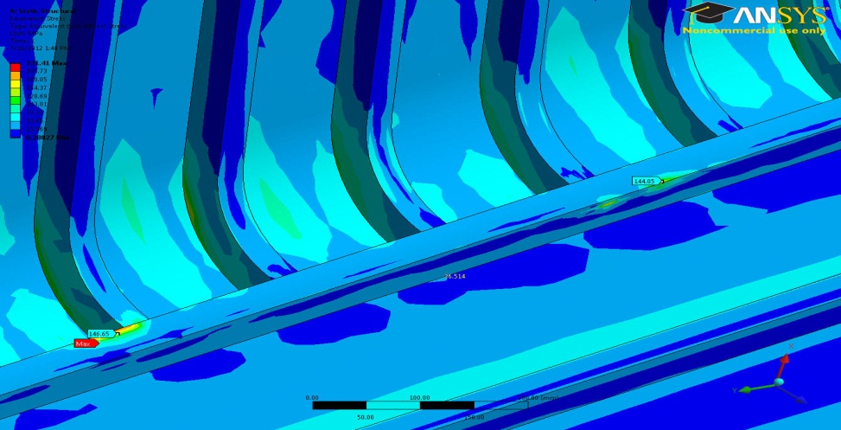
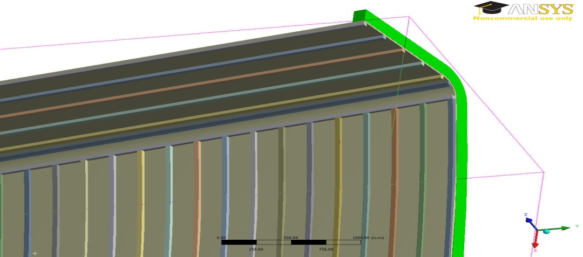
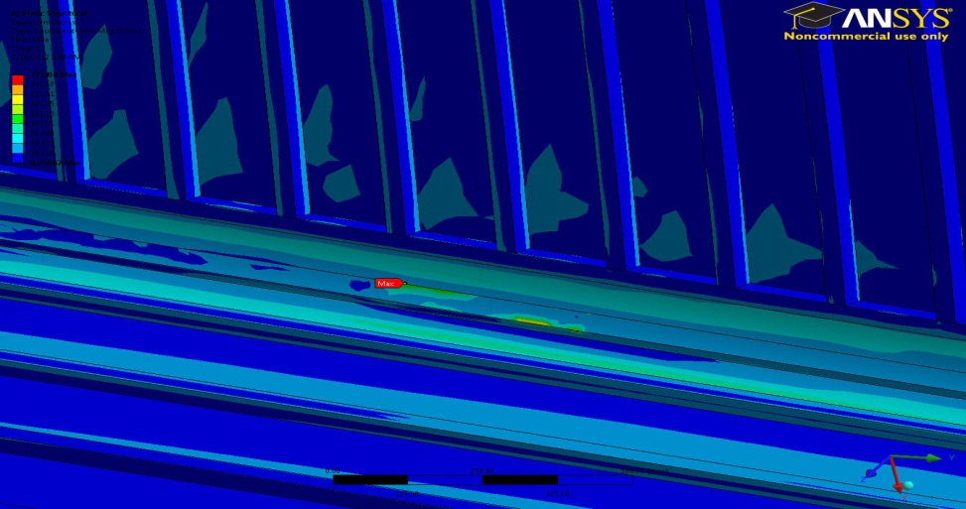
Mixed Ribbed Structure (Transition)
150 Mpa
Mixed ribbed structure: Horizontal ribs on the top and bottom port wings are required to lead the He coolant throughout the port to the inboard
Horizontal rib at the corner: Transition rib gets over stressed spot at contact regions

Slide 18
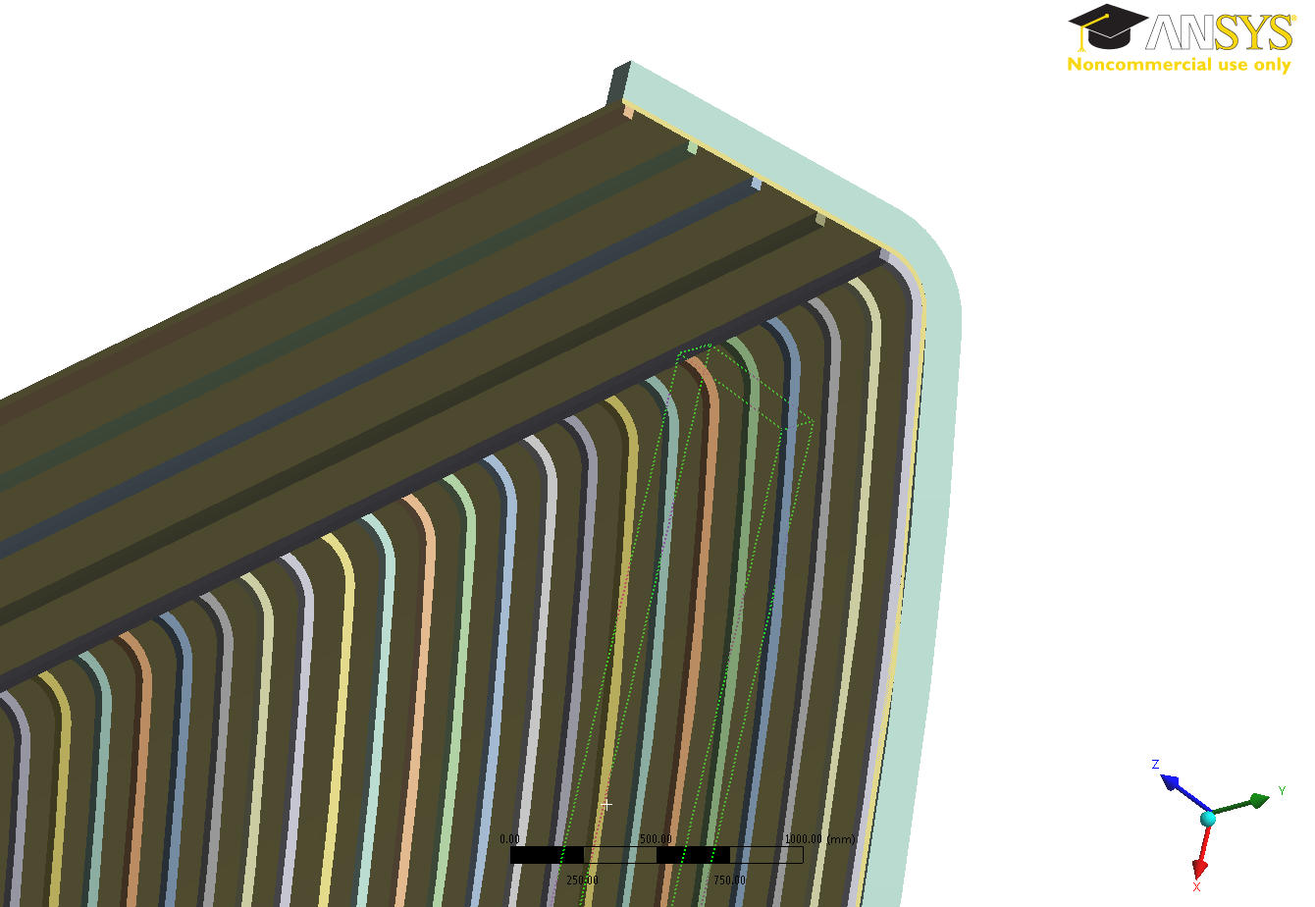
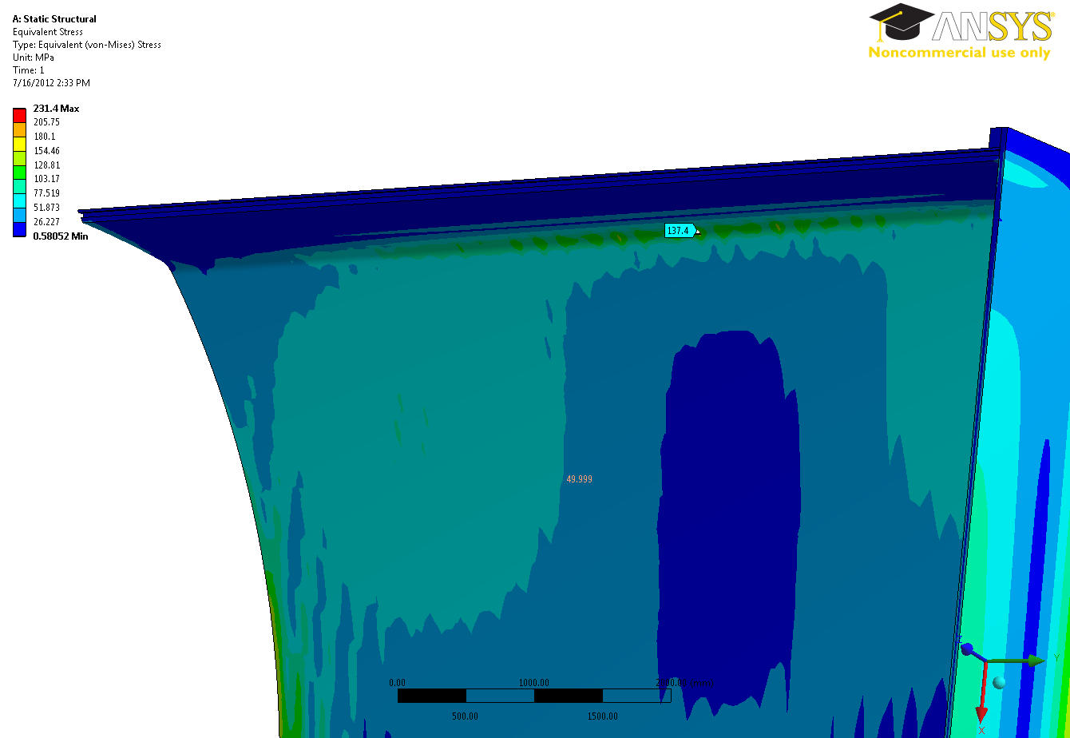
No Horizontal Rib at the Corner
Vertical ribs cover the corner
Solid sheet gets the yield point : 140 MPa
140Mpa

Slide 19
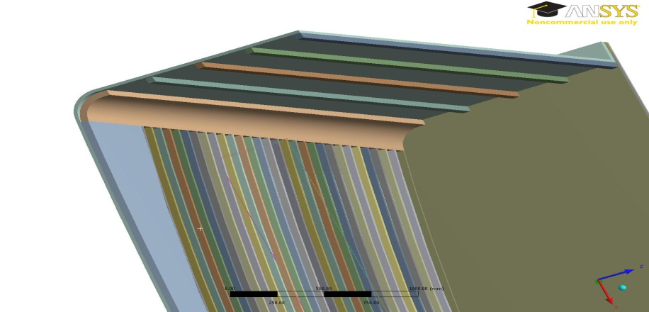
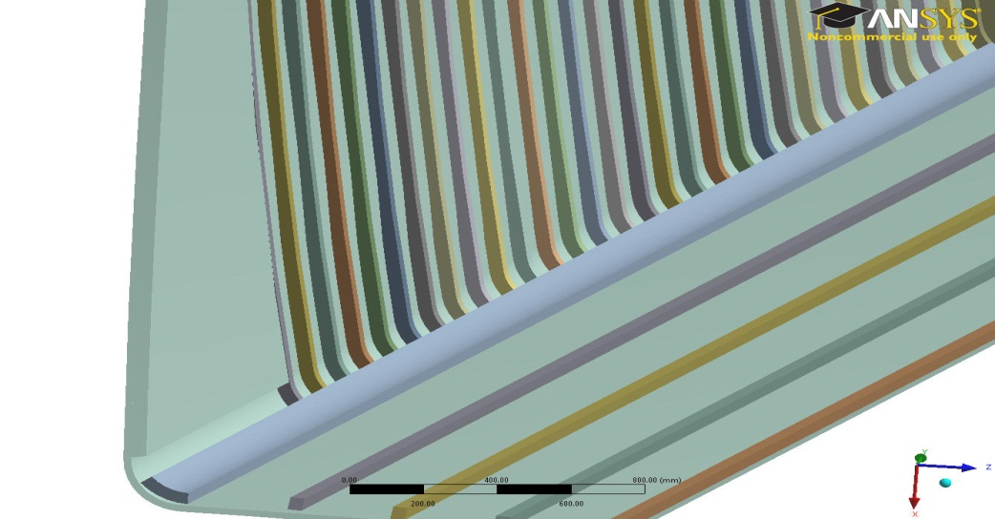
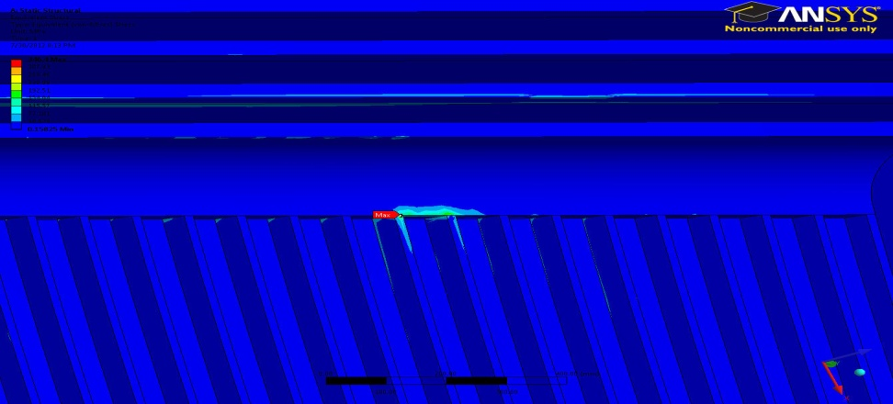
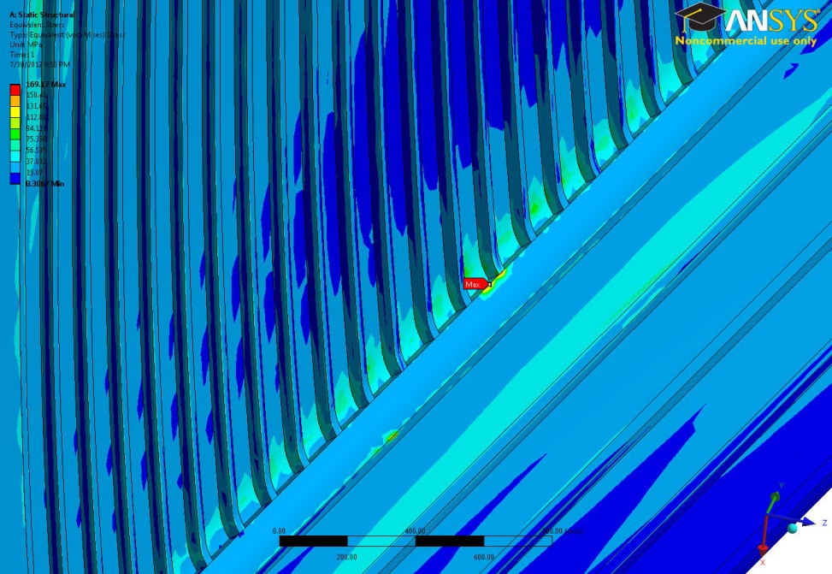
Totally/Partially Solid Corner
Totally solid corner
Partially solid corner
300 MPa
170 MPa
Top over stressed spots at contact points
Top needs to be partially solid Corner
Bottom over stressed spots at contact points
Bottom needs to be totally solid corner

Slide 20



Safe Outer/Inner Sheets
Bottom totally solid corner
74Mpa
Top partially solid corner
108Mpa
94Mpa
102Mpa

Slide 21


Stress Distribution
Safe Vertical/Horizontal Ribs
Outer Sheet
64MPa
100MPa
74 MPa

Slide 22
Final Port Design Parameters
(Mixed Ribbed Structure)
Design Parameter | Size
Distance between vertical ribs | 18-19cm
Distance between horizontal ribs | 25cm
Rib thickness | 4cm x 4cm
Gap between inner and outer sheets | 4cm
Outer wall (Sheet) thickness | 2cm
Inner wall (Sheet) thickness | 4cm

Slide 23



Whole Vacuum Vessel
Door Ribbed Structure
Not identical on the top and bottom
(Stress Reasons)
All with ribbed structure (Inboard, Ports and doors)
All the ribbed configurations are made based on the stress distribution results

Slide 24




Inboard
26cm
24cm
2cm
4cm
Ribs with constant cross section : 4cm x 6 cm
Matching between inboard & outboard rib channels
4cm

Slide 25



Solid wall Stress Distribution
96MPa
90MPa
95MPa
100MPa
86MPa
All regions are less than 119MPa
113MPa

Slide 26



Ribbed Structure Stress Distribution
All the ribs are less than 100MPa

Slide 27
Summary & Future Work
A preliminary structural analysis of the vacuum vessel was performed and the locations of high stresses were identified on the solid single wall vacuum vessel
Sandwich Panels theory was used to model the double wall ribbed structure
Sandwich panel/ Double wall ribbed structure as a way to add little material on the structure to increase the bending stiffness and eventually decreasing the stress intensity was considered
Double wall ribbed structure provides us with sufficient space for the He coolant
Mixed ribbed structure configuration was analyzed and designed
Double wall ribbed structure was analyzed and designed for the whole vacuum vessel including the inboard
Matching between coolant channels for the inboard and outboard was considered
Waiting for the disruption load data from UW to add it to the current load for further analysis.
Thermo-Mechanical analysis based on the nuclear heating data from UW

