Slide 1
Nuclear Fusion Power Plant Reliability Processes and Application to ARIES ACT He-cooled W-alloy Divertor Concept – Pt 2
Thomas L. Weaver: Platform Systems and Subsystems; BR&T
James B. Robinson: Reliability, Maintainability, and Testability; BCA
I-Li Lu: Applied Mathematics and Statistics; BR&T
Ali Yousefiani: Metallics, BR&T
David E. Schwab: Metals, BR&T
Jim Engel, Kent Rengel, and Isaac Yalda: NDE Programs; BR&T

Slide 2
Divertor Reliability – M & P View
Defining a Fusion RAMI Process
Aerospace RAMI Background
Adaptation to Fusion
Process Demonstration on a Reactor Divertor
Process for Divertor
Reliability Issues
Results
Conclusion

Slide 3
Divertor Review Outline
ARIES-ACT1 Power Plant Overview
Material Environmental Durability Challenges
ARIES-ACT1 He-Cooled W-Based Divertors
Configurations and Typical Requirements
Plate Divertor Concept
Design Concept Review
Geometry
Materials
Fabrication and Processing
Suitable NDE Methods and Capabilities and Considerations for the Divertors
Preliminary Requirements and Candidate NDE Methods
Divertor Features Requiring NDE
Braze Joint Ultrasonic Inspection
Slot Tip Crack Inspection using an Eddy Current Technique
NDE Technique Development and Advanced NDE Technologies
Recommendations for the Current Concept
Design
Fabrication
NDE
Outline of Boeing Concept Proposal

Slide 4
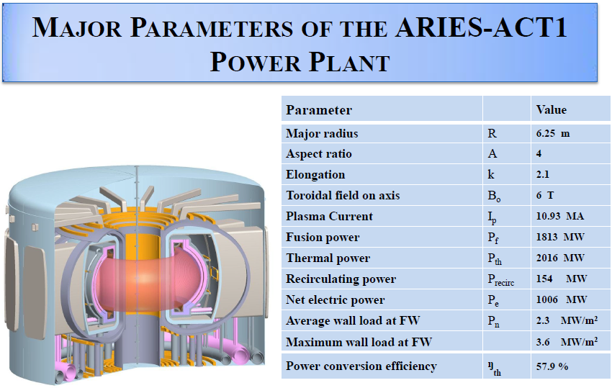
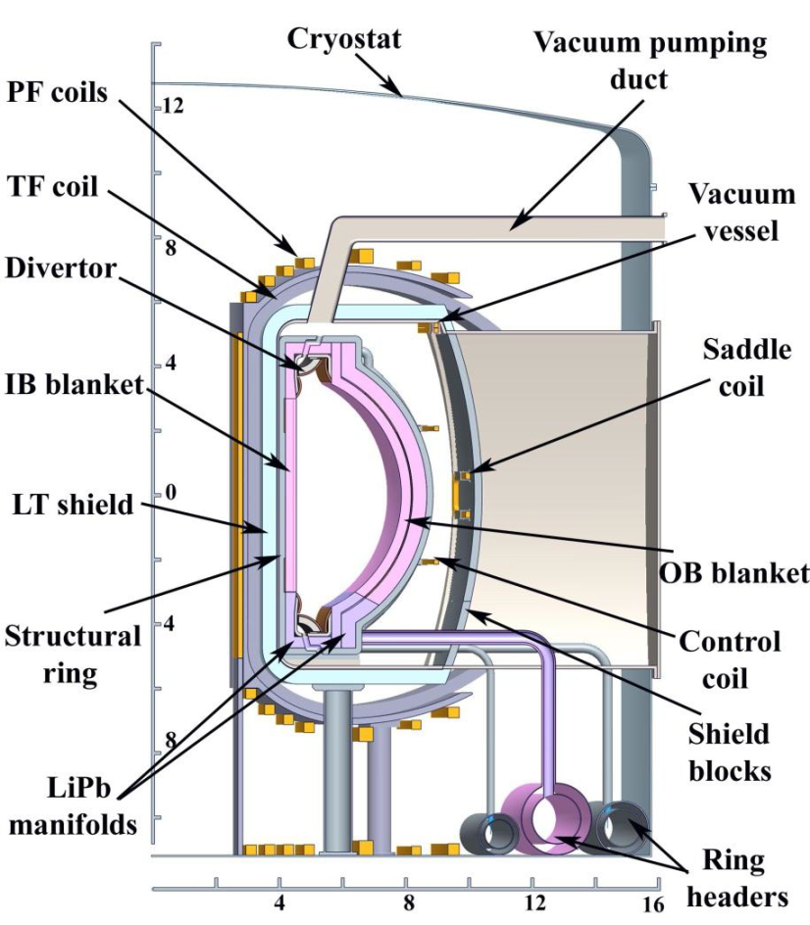
ARIES-ACT 1 Power Plant Overview
FW/Blankets | LiPb cooled SiC/SiC structure T_{Inlet}/T_{Outlet} = 740/1030°C
Structural ring or HT Shield | He-cooled ODS steel structure T_{Inlet}/T_{Outlet} = 650/680°C
Upper/Lower Divertors | He-cooled W-based divertor and ODS steel cartridge T_{Inlet}/T_{Outlet} = 700/800°C
Vacuum vessel | He-cooled Bainitic FS (3Cr-3WV) operating in ~400-500°C
LT shield | Water-cooled Bainitic FS and WC operating at the room temperature

Slide 5
Material Environmental Durability Challenges
Damage Mechanisms
Radiation
Synergistic Damage Phenomena
Environmental Material Degradation
Thermal
Corrosion/ Oxidation/Erosion
Quasi-static
Fast ductile
Fast brittle
Delayed (creep)
Cyclic/Delayed
Ratcheting
Fatigue
Creep-fatigue
Irradiation-accelerated/induced
Thermally-induced/accelerated
Other environmentally assisted
Stress/Strain Induced Thermomechanical Failure
5
Notes:
Complex Failure Mechanisms at work for Various Components:
Environmental Material Degradation
Radiation (exposure to energetic neutron irradiation): structural changes from displacement and rearrangement of atoms, kinetic effects from enhanced redistribution of atoms by mobile defects with promotion of segregation and phase changes, and chemical changes from the production of new atomic species by nuclear reactions (transmutation)
Low temperature radiation hardening and embrittlement (0.001–0.1 dpa, < 0.4 T_{M})
Potential matrix and/or grain boundary embrittlement due to radiation-enhanced or –induced precipitation due to coupled solute–defect processes (1–10 dpa, 0.3-0.6 T_{M})
Plastic deformation due to irradiation creep, acting in addition to thermal creep (>10 dpa, < 0.45 T_{M})
Volumetric swelling due to void formation (>10 dpa, 0.3-0.6 T_{M})
High temperature helium embrittlement of grain boundaries, which typically is a major issue in mechanically stressed materials for transmutant helium concentration levels above 10–100 appm (>1–10 dpa, > 0.45 T_{M})
First and last of these five phenomena define the lower and upper bounds for viable operating temperatures, and the other three typically determine the maximum viable operating lifetime
Thermal (high temperature – high heat flux)
Microstructural coarsening/degradation (grain growth, overaging, etc)
Interdiffusion of species and development of detrimental new phases, especially at tight dissimilar material joints (e.g. braze joints)
Influence on hydrogen retention
Ablation or melting from transient heating events like ELMs
Corrosion/Oxidation/Erosion
Stress/Strain Induced Thermomechanical Failure
Quasi-static
Fast ductile: prompt plastic collapse and/or prompt plastic instability due to large deformation or flow localization
Fast brittle (prompt fracture (brittle or with exhaustion of ductility)
Delayed (creep): cavitation and rupture
Cyclic/Delayed
Ratcheting: progressive deformation
Fatigue: progressive cracking
Creep-fatigue
Synergistic Damage Phenomena
Irradiation-accelerated/induced (synergetic effects of high steady-state and/or transient plasma flux densities and radiation damage):
Prompt irradiation-induced plastic instability due to flow localization
Irradiation-induced prompt fracture due to hardening, loss of ductility, and embrittlement due to defect clusters, helium and phase instabilities
Irradiation-accelerated thermal creep cavitation and rupture, including helium embrittlement
Dimensional instabilities due to irradiation creep and swelling - FUZZ
Thermally-induced/accelerated:
High thermal stresses both from steady-state heat loads (< 10 MW/m2) and transient events like ELMs (< 1 GW/m2), leading to extensive surface cracking (may impact hydrogen retention level in refractory metals)
Long term sustained thermal stresses as a result of thermal expansion mismatch at dissimilar material joints (e.g. braze joints)
Other environmentally assisted:
Stress-corrosion cracking
Hydrogen damage
He embrittlement
Liquid metal induced embrittlement
Solid metal induced embrittlement
Mixed material deposition effects

Slide 6
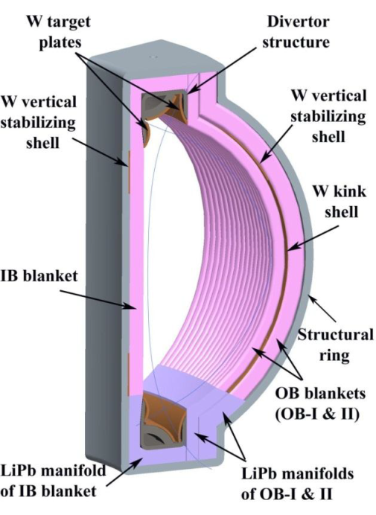
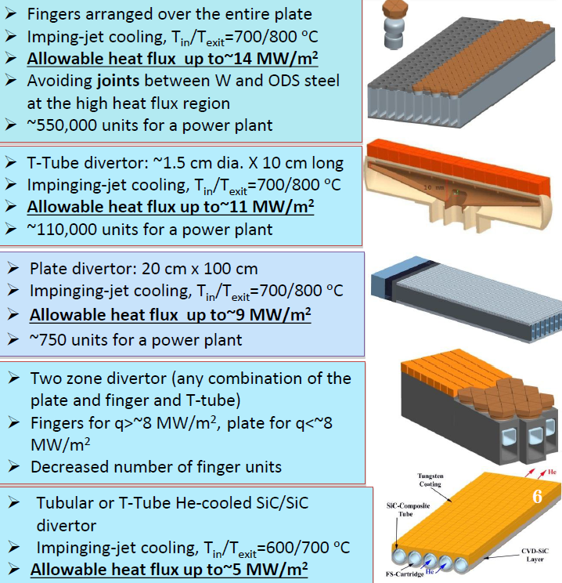
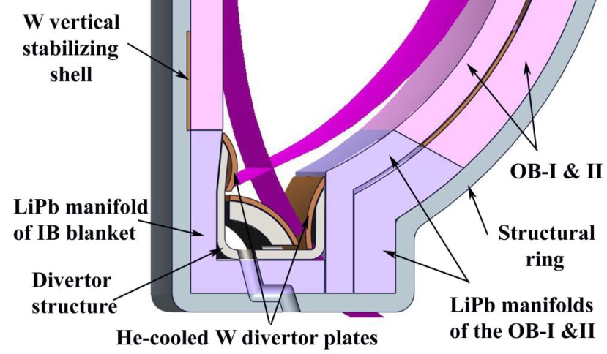
ARIES-ACT1 He-Cooled W-Based Divertors
The current tokamak design for ARIES includes a plate divertor concept that employs tungsten as a structural material. The design features steel inserts in the channels, but all other materials are CP-W or a W alloy, in order to maximize the performance of the device.
The high temperature capability of W permits a large allowable surface heat flux and makes the structure more tolerant to transients, such as those caused by ELMS, compared to other available alloy options.
6
Notes:
The divertor is one of the key components; its function is to extract heat and helium ash — both products of the fusion reaction — and other impurities from the plasma, in effect acting like a giant exhaust system. It will comprise two main parts: a supporting structure made primarily from stainless steel, and the plasma-facing components, made of tungsten.

Slide 7
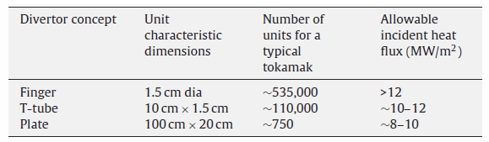
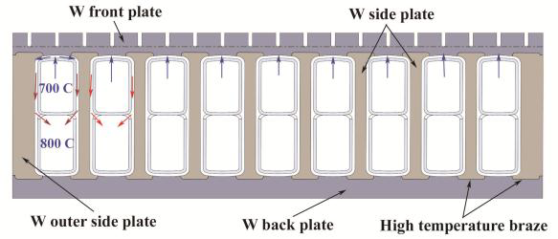
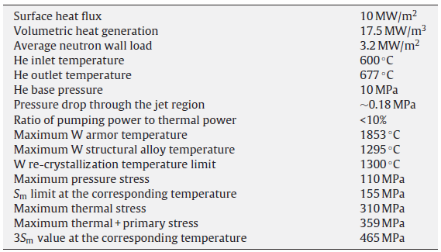
Configurations and Typical Requirements
Comparison of different divertor concepts for a tokamak with an assumed divertor area of 150m²:
Design parameters and thermomechanical results for the plate-type divertor:
Divertor type selection depends on the peak heat flux and heat flux profile.
The plate-type divertor concept has been selected for the ARIES-ACT1 with peak-time average heat flux of 10.6 MW/m².
Thermal cycling imposed on the divertors will be of two types:
High frequency (~3Hz)
Arising from ELMS
The resultant delta T is not defined.
Low frequency (10 -100 cycles total over lifetime)
Arising from warm shutdowns and subsequent reheating
The minimum W temperature will be controlled by external heating
Minimum temperature will be maintained above the DBTT
http://dx.doi.org/10.1016/j.fusengdes.2010.08.015

Slide 8
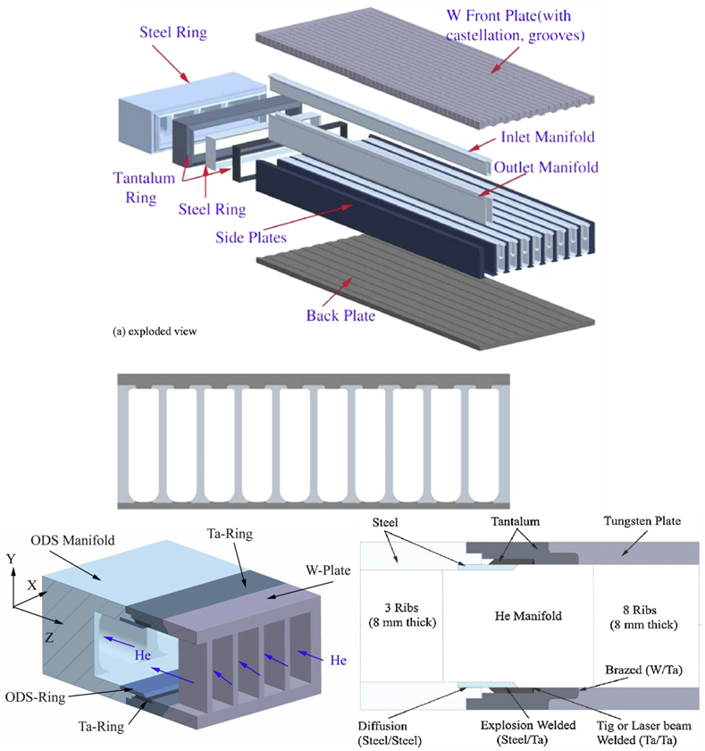
Plate Divertor Concept
Baseline Materials
Divertor assembly brazed with TBD alloy(s)
CP-W plasma-facing armor
TBD W alloy for other linear divertor core details
TBD ODS steel alloy manifolds (flow separators)
Transition section between core/header
Ta-2.5W tantalum alloy
Header
Machined from TBD steel alloy
Joined to He inlet/outlet ducts by TBD braze alloy(s) or welding
A Proposed Fabrication Sequence
Machine 2 cm by 5 cm channels by EDM or ECM into a solid W plate.
Braze front plate, back plate and side-walls (each < 10mm) together with a high temperature braze alloy
Fabricate a W-ODS transition joint as follows:
explosion weld thin ODS ring to thin Ta ring,
seal weld thin ODS ring to ODS manifold,
diffusion weld thin ODS ring to the ODS manifold,
braze thick Ta ring to the W-alloy plate,
TIG or laser weld thin Ta ring to larger Ta part
8
Notes:
Descriptions of baseline materials have been taken from available recent ARIES and ARIES-ACT1 published descriptions. “TBD” indicates that the specific alloy has not been indicated in the publications. Although most published renderings of the divertor show it as a flat plate, it is actually required to be curved, with a single radius, as shown in the preceding slides. The divertor is a heat exchanger with plasma-facing armor covering the finger and serving as the top plate of linear heat exchange core sections. A header supplies “cool” helium gas to the divertor, and directs heated helium gas away from the divertor. A transition section appended to the divertor serves to accommodate different thermal expansion rates of the header and divertor materials.
The plasma-facing armor baseline alloy is pure tungsten. The thimble portion of the fingers will be made of VM tungsten alloy, as is the plan for ITER. Sleeves and other small parts mating with the thimbles, to form the fingers, will be made from a tungsten alloy, as will the remaining bar and plate detail parts for the divertor. ODS steel alloy will be used to make the manifolds (flow separators).
To accommodate thermal expansion differences between the tungsten divertor and the ODS steel header, a tantalum alloy transition section is planned between core/header. The baseline alloy appears to be Ta-2.5W. The header design and material is undefined but it is likely to be made from ODS steel.

Slide 9
Design Concept Review – Geometry and Materials
Geometry
“Flat plate” divertor is actually curved (R ≈ 50-100 cm)
Curvature of brazed divertor core introduces many unaddressed challenges
Optimum braze joint thickness is ~0.02-0.03 mm.
Producibility & reliability decrease with increased braze joint thickness.
Proper fit-up of curved mating detail parts demands rigorous fabrication controls.
ODS steel manifolds must be inserted into curved core flow channels so as to create small precise flow passages.
W-Based Plasma Facing Materials
Tungsten alloys are attractive candidates for fusion divertor applications because of their
very high melting point
good thermal conductivity
low sputtering yield
low activation characteristics
good thermal creep strength
These desirable properties are offset by poor ductility and fracture toughness below ~0.3T_{M}
Even at temperatures above the ductile-to-brittle transition temperature (DBTT), the fracture toughness of relatively pure W is low. This makes it difficult to fabricate W alloys into useful product forms at ambient temperatures
Its recrystallization temperature and DBTT bound the range of useful operation temperature.
Notes:
A simplified “Flat plate” divertor is widely depicted, but its actual geometry is curved. A constant radius of curvature, approximately 50-100 cm is depicted in published sketches. The “fingers” used in the highest heat flux regions (near the He inlet/outlet); are expected to cover approximately 1/3 of the active divertor heat exchange area. The remaining 2/3 of the heat transfer surface will be a simple bar-plate-type heat exchanger core construction. Curvature of the brazed divertor core introduces many unaddressed challenges. Optimum braze joint thickness is ~0.02-0.03 mm. Producibility & reliability decrease with increased braze joint thickness.
Proper fit-up of curved mating detail parts demands rigorous fabrication controls, including:
Raw material specification, inspection and possibly formability verification testing
Elevated temperature forming process/spring-back
Machining
Residual stress relief process, avoiding recrystallization and increased DBTT
Cleaning processes
Dimensional inspections at critical manufacturing stages
It will be extremely challenging to manufacture ODS steel manifolds precisely enough that they can be inserted into curved core flow channels to create controlled small flow passages.
Gap tolerance is undefined.
Proper fit in curved flow channels demands very tight manifold dimensional tolerances.
Roll forming of straight lengths appears quite feasible, but adding curvature to match the
divertor channel radius may buckle the parts and retard flow locally in the gaps.
Roll forming of curved parts requires precise dies and process parameters/controls
Response of a curved divertor to location- and time-varying heat flux and cycling in operation may cause high stresses in the braze joints, which will likely be the weakest element of the divertor.
Designs of inlet/outlet header and interface with manifolds are not defined
Tungsten and its alloys are the best (and essentially the only suitable) materials for plasma-facing components, which are the armor plates, in the case of the divertor. The performance advantages of tungsten come at the price of great difficulties in processing these hard and brittle alloys.

Slide 10
Design Concept Review – Materials I
The selection of W alloys so far (mainly CP-W) has been based on existing experience and commercial availability (low risk).
Chances of survival of components without cracking as a result of thermal cycles (low frequency – arising warm shutdowns and subsequent reheating, and more importantly transient ones arising from ELMs) are low. Thermal stresses on currently envisioned tungsten components and required dissimilar metal joints will likely exceed their capabilities. Laboratory experience with prototype W parts has underlined this threat.
Relatively high risks of brittle fracture exist (during operation and fabrication) from very small defects at relatively low stress levels, especially at room and moderately elevated temperatures.
Notes:
The reliability of available W alloys for other parts in the divertor is questionable. On one hand, Siegfried Malang believes that the rise of the minimum W temperature to > 800 C by a higher He temperature is sufficient for thimbles made of VM-tungsten (which are likely to have a very fine wrought structure due to their deep-drawing manufacturing process) if fabrication (deep drawing and brazing) is at temperatures and time periods sufficiently low to avoid relevant recrystallization. On the other hand, Tillack, et. al., in Fusion Engineering and Design 86 (2011), pp. 71-98, stated that, “Development of more tungsten alloys or dispersion-strengthened composites is necessary before tungsten can function reliably in a high temperature divertor heatsink.”…. and …… “we need more ductile materials (particularly for tungsten alloys) with high fracture toughness than are now available.” Whether more-ductile tungsten alloys will be needed depends upon final requirements and as-fabricated properties of each element of the divertor. As design and operating requirements mature, and defect detection limits become available, perhaps some minimum values of ductility and fracture toughness at various temperatures may be defined.
The time-dependency of recrystallization temperature, and the effect of deformation during forming (which will have to be done at some elevated temperature) and subsequent stress-relief heat treatments are not well defined. Prior deformation will reduce the temperature for the start of recrystallization (and loss of ductility) as much as a few hundred degrees. Even partial recrystallization will reduce ductility markedly. It is not clear how the upper use limit for W has been established and whether it takes prior deformation levels into account.
Radiation effects are not well defined. Major radiation damage mechanisms will be (1) displacement of the atoms from their lattice sites as a result of collisions with highly energetic fusion neutrons, and (2) gas production in the metallic lattice resulting from diverse neutron induced nuclear reactions. These reactions will limit the lifetime of the first structural wall of the fusion reaction chamber.
Variability of properties (strength, elongation, transition temperature, recrystallization temperature, etc.) does not appear to have been defined sufficiently to establish statistical design allowables.

Slide 11
Design Concept Review – Materials II
These issues have stimulated consideration of various higher performance W alloys (still relatively low risk and commercially available to some extent):
Tungsten-rhenium alloys
Great choice, but Re leads to a lower thermal conductivity, relatively high activation by neutron irradiation, and cost escalation.
Dispersion strengthened tungsten with lanthanum-oxide (e.g. WL10 composed of W-1%La₂O₃)
Various improvements, but still has a rather limited temperature window
Vacuum-Metallized (VM) tungsten, doped with ppm amounts of Al and potassium silicate
Superior properties, but can be fabricated only as thin wires and sheets. Also suffers delamination when loaded in specific directions
A clear need exists for development of higher performance W alloys to address currently identified environmental structural durability shortcomings and fabrication challenges
Notes:
It is questionable whether efforts to develop more ductile alloys of tungsten would succeed without R&D breakthroughs. Rhenium additions have proven useful, but tungsten-rhenium alloys were ruled out to avoid the activation and burn-up issue of rhenium, and the reduction of thermal conductivity by rhenium.
A W-lanthanum oxide alloy has advantages over pure W because in promises slightly higher ductility and recrystallization temperature. However, this is marginal. Only a few levels of alloying additions have been evaluated (e.g. 25% Re, 1% La2O3, 1.1% TiC) for ARIES. None appear to be acceptable.

Slide 12
Design Concept Review – Fabrication/Processing I
Baseline fabrication approaches
Divertor assembly furnace brazed in vacuum with TBD braze alloy(s)
Thimbles deep drawn from sheet
Armor and other linear divertor core details machined from plate or bar
Transition section formed and/or machined from sheet or plate or bar and brazed to manifolds/core/header with TBD braze alloy(s)
Manifolds roll-formed from sheet to match divertor radius of curvature
Headers formed and/or machined from sheet or plate or bar
Assembly process for joining the core to the headers is not defined
Some proposed processes (machining and cutting) are fairly well developed ; others (forming and joining) will require process development
General materials processing challenges include:
Forming and machining parts to attain proper braze joint gaps
Forming manifolds to
Attain proper flow channel gaps
Permit insertion into brazed tungsten channels
Dimensional control of brazed subassemblies/assemblies
Joining manifolds to header (preferably without brazing)
Nondestructive evaluation of brazed joints
Notes:
Baseline fabrication approaches have been gleaned from available recent ARIES and ARIES-ACT1 published descriptions. “TBD” indicates that the specific alloy has not been indicated in the publications.
The thimbles of the fingers will be deep drawn from sheet. Reportedly, deep drawing of VM tungsten has been demonstrated to be a feasible production process. Sleeves and other small parts mating with the thimbles, to form the fingers, as well as bars and plates for the remaining 2/3 of the divertor core, will be formed and/or machined from wrought alloy, most likely in the form of plate or bar/rod. The divertor has a simple bar-plate-type heat exchanger core construction. The fingers, armor, plates and bars will be brazed in a vacuum furnace to form a divertor assembly.
The elements of the transition section will be formed, welded, and/or machined from sheet, bar or plate, and brazed to the divertor using TBD braze alloy(s), probably after the divertor is brazed.
The manifolds will be roll formed into complex and precise shapes so that, after the 9 manifolds are inserted into divertor core channels, they will create thin flow passages between the hot tungsten surfaces and the manifold, for the helium to pass and gather heat. A secondary forming operation may be needed to form projections to set the flow gaps. How the manifolds will be joined to the header is not defined. If adequate sealing cannot be obtained by press fitting, perhaps a low temperature braze alloy(s) will be used to seal the joint.
Headers will be formed, welded, and/or machined from sheet, bar or plate. A brazing operation may be used to join detail parts if a one-piece header cannot be made economically. The assembly process for joining the headers to the core is not defined.
Summarizing the most likely materials processing challenges that will be faced in developing manufacturing methods for the divertor parts, subassemblies and assemblies. Although some key features remain to be defined, it seems obvious that successful performance of the divertor will depend upon precisely controlled dimensions for the manifolds, channels, fingers and especially the gaps that separate these elements to form the He flow paths. Dimensional precision and control is essential to successful assembly of brazed and mechanically mating parts, and will determine the strength and crack propagation resistance of the braze joints, which profoundly influence the durability and reliability of the divertors. If manifolds can be joined to the mating slots in the inlet/outlet header and sealed adequately without the need for brazing these joints, there will be benefit for cost and reduced risks of distorting or damaging the divertor during manufacture. Nondestructive evaluation of braze joints is an essential tool for assuring adequate braze joint integrity and strength.

Slide 13
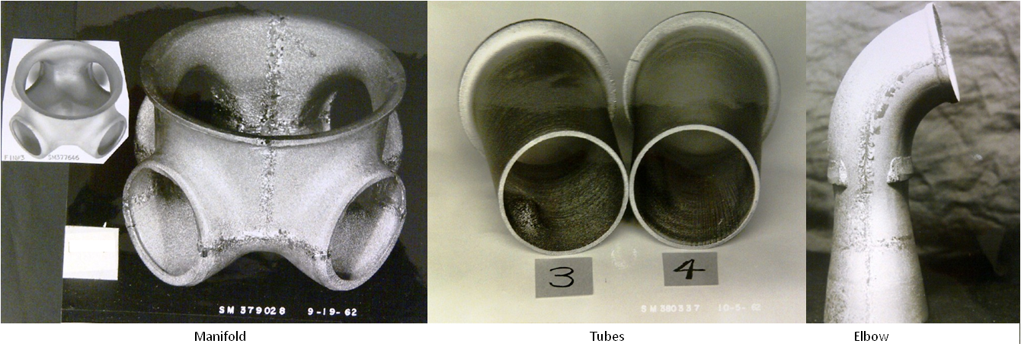
Design Concept Review – Fabrication/Processing II
Machining and Cutting
Satisfactory techniques have been developed and successfully employed for cutting, machining, blanking and shearing tungsten alloys.
Heating will probably be needed to minimize cracking.
Some parts may be machined with standard machine tools as part of the normal flow in a production shop with controlled processes.
Machining and other cutting processes applied to tantalum alloys and ODS steel are not expected to pose any serious problems.
Forming
Aerospace parts have been hot-formed and welded from tungsten sheet.
Deep drawing of the tungsten thimbles has reportedly been done successfully.
Forming process development will be required for ARIES parts.
Notes:
Satisfactory techniques have been developed and successfully employed for cutting, machining, blanking and shearing a variety of tungsten components. Heating will probably be needed or useful in some cases to minimize cracking. Some parts may be machined with standard machine tools as part of the normal flow in a production shop. Process parameters to minimize cracking and chipping must be determined for each part, include clamping tools/methods, coolant, as well as the usual machining feed/speed/tool selections.
Machining and other cutting processes applied to tantalum alloys and ODS steel are not expected to pose any serious problems, with two exceptions: 1) surface embrittlement of Ta alloys by N and O at high temperatures must be avoided, or contaminated surfaces must be removed, and 2) fine dispersions of oxides in ODS steel may be coarsened by high temperatures, reducing properties. Metalworking temperatures must be controlled accordingly.
Aerospace parts have been hot-formed and welded from tungsten sheet (~0.1” thick) at Boeing. The photos show recrystallized large grains in GTA welds that were revealed by etching. Flanges have been formed from tungsten sheet by spinning and drawing.
Deep drawing of the tungsten thimbles has reportedly been done successfully in Europe.
Forming process development will be required for ARIES parts. It will be necessary to determine optimum parameters and means of controlling them to produce parts within tolerances specified and reasonable tool life. Parameters include die materials, heating method, forming temperatures, shielding gas, part transfer timing, lubricant/coating, interstage die-polishing and stress-relief temperature/time, forming speed and equipment.

Slide 14
Design Concept Review – Fabrication/Processing III
Joining
Welding of tungsten is feasible if parts are heated above the DBTT, but the recrystallized structure of the welds and adjacent HAZs are extremely brittle.
Welding of ODS steel is also feasible, but creep strength & ductility will be reduced due to oxide particle agglomeration.
Explosive welding is feasible, but currently proposed geometry of ARIES parts do not lend themselves to this process.
At coupon level, brazing W to itself and other refractory metal alloys such as Ta-W, as well as braze joints with ODS steel is very feasible. A long list of commercially available and special purpose brazing filler alloys exists that covers a wide range of application temperatures, allowing the selection of an alloy that will provide the right combination of properties in service. The main challenge for filler alloys will be to meet the low-activation requirements.
At component level, brazing requirements as currently envisioned in ARIES will be very difficult to realistically achieve. Maintaining a uniform and thin braze joint thickness will require very precise fit-up of curved mating detail parts, demanding rigorous fabrication controls. Producibility and reliability decrease with joint thickness variations. Meeting sealing requirements, if any, will also be a very big challenge.
Notes:
The brazing process likely to be used for the divertor is demanding but achievable with state of the art facilities. Boeing has plenty of experience with brazing CP-W to WHA for large and complex curvature components associated with hypersonic applications.
Requirements include:
a high-vacuum brazing furnace with adequate chamber volume and gettering method, with excellent temperature uniformity and thermal-cycle controls during the brazing process
melt and flow adequately to fill joints at the selected brazing temperature
not erode the base materials to a detrimental extent
for tungsten, melt sufficiently below the recrystallization temperature and below the temperature at which the DBTT would be significantly raised
for ODS steel, melt sufficiently below the temperature at which agglomeration of ODS particles would be detrimental
be vacuum stable at brazing temperatures, if vacuum brazing is selected
have sufficient strength and fracture toughness for the service environment after brazing (and post-braze annealing, if required)
be available in foil or paste form suitable for the TBD brazing process
be compatible with the radiation environment
be economically viable

Slide 15
Suitable NDE Methods and Capabilities
NDE Methods
Probably Unsuitable for ARIES Divertors:
Infrared Thermography
Computed Tomography
Laser Shearography
X-ray, Gamma ray, Neutron radiography and Backscatter X-ray
Magnetic particle inspection
Suitable for ARIES Divertors:
Ultrasonic, Through Transmission, Pulse/Echo or Phased Array
Liquid penetrant inspection, also called dye penetrant inspection or penetrant testing
Eddy-current testing
NDE Method Capabilities
NDE methods are assigned probability of detection (POD) values based upon demonstrated capabilities on known fatigue crack samples
POD values are based upon the utilization of commonly used industry NDE standards and specifications
NASA-STD-5009 (formerly MSFC-STD-1249) defines minimum detectable values for NDE methods on metallic components
Additional documents are available to assist with integrating the NDE and fracture control requirements
A POD study or demonstration may be required to validate NDE capability for some applications
Notes:
This is a “general list” and description of currently available NDE methods out in industry, with those suitable for this particular application identified. The current configuration, processes and access suggest that Ultrasonic , Liquid Penetrant and Eddy Current methods are the current prime NDE candidates. The other methods are less likely to be useful.
Probably Unsuitable for ARIES Divertors:
Infrared Thermography
Infrared (IR) waves detect changes in heat transfer capability of the object.
Material is likely too thick for this technique
Computed Tomography (CT)
A technique for producing 2-D and 3-D cross-sectional images of an object from flat X-ray images.
The density and Z (Atomic #) of tungsten and positioning of the detectors or X-ray source preclude using CT for this application. It may be possible to CT some of the samples for information
Laser Shearography
Applies a stress to a part and detects surface strain displacement.
It is unlikely that the material could be stressed to create a measureable surface strain for this method
X-ray, Gamma ray, Neutron radiography and Backscatter X-ray
Detects volumetric features by passing through matter, are scattered and absorbed and the degree of penetration depends on the kind of matter and the energy of the rays.
The density and Z of tungsten , sensitivity, configuration and required equipment makes these techniques difficult and probably not feasible
Magnetic particle inspection (MPI)
A non-destructive evaluation (NDE) process for detecting surface and slightly subsurface discontinuities in ferroelectric materials.
The magnetic properties of tungsten or a tungsten alloy likely will not lend itself to this inspection
Suitable for ARIES Divertors:
Ultrasonic, Through Transmission, Pulse/Echo or Phased Array
Water or gel coupled high frequency ultrasound detects changes in the acoustic impedance at interfaces.
There is a history of conducting inspection on tungsten using ultrasonic methods and it may be suitable for wrought material and braze inspections
Liquid penetrant inspection, also called dye penetrant inspection (DPI) or penetrant testing (PT)
Widely applied, low-cost inspection method used to locate surface-breaking defects in all non-porous materials.
Penetrant would likely be a good candidate for surface inspections after machining operations
Eddy-current testing
Uses electromagnetic induction to detect flaws in conductive materials
There is a history of conducting eddy current inspection and tungsten alloys appear to have sufficient conductivity
The capabilities of an NDE method is assigned a statistical capability based upon the ability to detect flaws of a given size. There are existing standards within industry that provide these sizes that are subsequently used in a fracture control approach. This application would likely require additional demonstrations to validate these numbers because of the non-routine inspections required.

Slide 16
Considerations for the ARIES Divertor NDE
The primary divertor material is currently specified to be either tungsten or a tungsten alloy
NDE will likely be required as follows:
Wrought material stage to check for inherent flaws prior to machining operations
After each critical process (cutting, forming, machining, brazing) to check for surface and subsurface defects
NDE candidate methods must be defined based upon material properties, critical initial flaw sizes (CIF), NDE method detection capability and hardware accessibility
Detectable CIF sizes may determine the suitability of various NDE techniques
Assumption is that there will be no internal access to inlet or outlet manifolds
Notes:
NDE should be performed at various stages of manufacture to verify 1) that the wrought material does not contain any flaws; 2) that the cutting, forming or machining process has not induced flaws; 3) that the brazing has sufficiently flowed and hasn’t left unacceptable voids or defects at the braze joint; and 4) that high stress thermal regions at the tip of the grooves/slots are free of defects. These inspection should be coordinated with the critical initial flaw sizes identified during the fracture analysis that are detectable by the selected NDE method(s).

Slide 17
Preliminary Requirements and Candidate NDE Methods
Wrought Materials (before machining)
Ultrasonic inspection
Post Cutting, Forming and Machining
Liquid penetrant or eddy current
Post Brazing
Ultrasonic inspection using a combination or longitudinal, shear, or phased array techniques
In Service High Stress Slot Regions
Eddy current or TBD method(s)
Notes:
This chart identifies likely inspection stages and locations during the fabrication process along with the preliminary NDE methods identified.

Slide 18
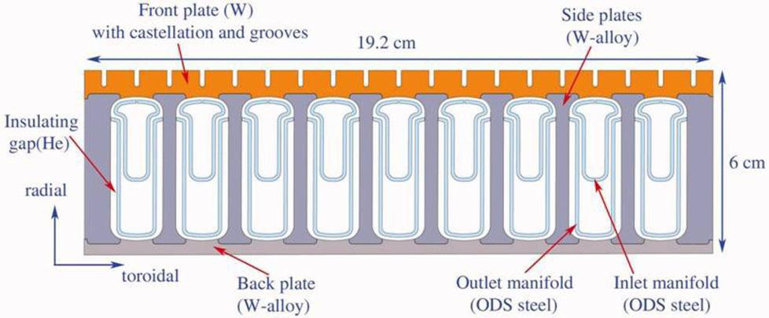
Divertor Features Requiring NDE
Braze Inspection between:
1) Front Plate Armor & Side Plates
2) Back Plate and Side Plates
Potential Cracking at Tips of the Grooves
Notes:
This shows the areas requiring NDE after fabrication, specifically front and back plate braze joints along with the tips of the grooves in the front plate.

Slide 19
Braze Joint Ultrasonic Inspection
Ultrasonic inspection technique to be developed
Transducer to be located on front plate (armor) and back plate surfaces & sound pulsed to braze joint
Combination of longitudinal wave and shear wave modes will likely be required to cover off-angle joint configuration
Phased array ultrasonic technique to be evaluated as a potential option
Reference standards will be required for feasibility tests & calibration
Critical initial flaw (CIF) size is TBD
Ultrasonic transducers pulse sound to the braze joint
Notes:
This slide shows a schematic of ultrasonic transducers located on the surface plates and how they would introduce sound waves to areas of interest in the braze joint. The single transducers shown in this sketch may be supplemented with phased array ultrasonic techniques to provide a more thorough and detailed inspection.

Slide 20
Slot Tip Crack Inspection via Eddy Current Technique
Tungsten has a published electrical conductivity of ~31% IACS
Small eddy current probe with a coil at the tip is positioned in slot
Cracks at the tip of the slot disturb the eddy current field and are recorded
Probes will travel the length of the slot using manual or automated/robotic fixtures
Inspection within high radiation fields may require hardened equipment
Reference standards with calibration notches required to validate feasibility and for system calibration
Critical initial flaw (CIF) size is TBD
Eddy Current Probes in Slot
Notes:
It appears that the conductivity of tungsten will permit the use of eddy current inspection techniques. A specialized eddy current probe with a coil at the tip is placed into the slots and used to examine the bottom of the crack for potential defects after fabrication. Depending on the configuration it may be possible to use a similar approach to perform this inspection using robotic equipment as an in-service inspection.

Slide 21
NDE Technique Development
Mechanical test samples will be required for development of design data and fabrication processes:
Provide statistically valid design data (strength, modulus, ductility, fracture toughness, crack growth, creep, thermal expansion, radiation damage limits, etc.) at relevant elevated temperatures
Develop fabrication processes (forming, cutting, brazing, heat treatment, etc.)
The same samples may be evaluated before and after testing to aid in the development of NDE techniques:
Develop/calibrate NDE methods
Validate the capability of the selected NDE methods
Aid in estimating probability of detection
Notes:
As part of the development process, mechanical testing will be required to anchor the M&P data. A portion of these samples will be inspected using NDE during the development process to assist with both process and NDE technique development and eventually to validate the capability of the NDE method(s).

Slide 22
Advanced NDE Technologies: Automated Evaluation
Potential automation features can be developed and integrated into inspection systems to improve throughput, isolate radioactive items from human contact, and reduce time spent attending to the process by:
Developing a motorized robotic crawler system
Integrating with developed positioning system to provide inspection location guidance
Providing situational awareness and positioning capability via on-board cameras
Utilizing automatic NDE sensor positioning and data collection to reduce inspection costs
Incorporating automated systems capability that scans and records data
Drawing on industrial experience developed within Boeing
Notes:
This chart discusses the potential to utilize automated and remote inspection systems such as crawlers and positioning apparatus to conduct NDE scans.

Slide 23
Advanced NDE Technologies: In Situ Evaluation
Develop and implement NDE sensor technology for in-situ detection and monitoring of difficult to access parts/components
Assess conditions in operational environment critical to monitoring infrastructure that provides more rapid data collection
Reduce maintenance cycle time and disassembly required for access to perform inspections on critical components
Provide a developmental framework, associated developmental tools and applicable techniques for predictive analytic models
Notes:
In-situ inspection capability provides the opportunity to monitor given areas remotely. These may be high-stress, critical areas or areas that are difficult to access for inspections. A system and the associated sensors/equipment would have to be developed to implement this capability.

Slide 24
Advanced NDE Technologies: Data Fusion
NDE Data Fusion is used to compare and verify indications acquired by one inspection method to data from another inspection method using the same reference coordinates for a more thorough evaluation of the information. It is a PC-based tool that uses AVS/Express visualization software to convert NDE measurements and part geometry data to display NDE data on CAD models.
Advantages Include:
Enables easy reference and comparison to the manufacturing baseline NDE data collected
Provides a tool that can be used as an off-line tool for data analysis (not for real-time in situ inspection analysis)
Provides assurance that parts are covered 100% by noting missing data (puzzle pieces)
Organizes data files into groups of parts to directly compare flown hardware over the entire part and not in portions
Tracks changes between maintenances monitoring against baseline NDE data
Incorporates a visualization capability to provide a better level of understanding of feature size/location for non-experts and management
Identifies trends indicating change in part material property in relation to location
Integrates finite element analysis and mechanical properties data (can be added to expand system capabilities)
Notes:
NDE data fusion is a technique that integrates the data from multiple NDE methods into a common data base on CAD models. This concept takes the available NDE data and integrates it into a common database which can then be used in conjunction with design and material properties to assess specific components or regions of a system. In summary, it integrates the NDE data with design requirements and provides cradle-to-grave assessment and monitoring of a component.

Slide 25
General Recommendations – I
While finalizing all current design concept details (geometry and materials) will remain a work in progress, it is very important to finalize a reasonable window that restricts changes to key material thermomechanical processing and fabrication parameters.
It is well known that small changes in such parameters can significantly affect short and long term properties of low damage tolerance materials such as those currently envisioned (base and joint materials), especially in the extreme environments associated with fusion energy reactors. For example, changes in the level of cold work can significantly alter recrystallization temperatures.
Necessary (statistically sound) structural design allowable and critical forming/joining parameter development efforts should be commenced once this window is established, otherwise high risks may be introduced late in the project.

Slide 26
General Recommendations – II
Special and nonstandard thermomechanical tests may need to be designed to carefully simulate environmental exposure effects where necessary. Due to complexities of such environmental fusion reactor simulations, focus should be on understanding requirements first and then testing accordingly to establish threshold properties, below which structural integrity is guaranteed. This is especially applicable to creep, fatigue, fracture toughness, and crack growth data.
Structural lifetime analyses need to focus further on the various time dependant degradation phenomena anticipated at plasma facing surfaces and transition joints.
Based on the selected design configurations, a preliminary list should be prepared to estimate the size of defects that have fairly high probabilities of detection in the proposed construction materials/joints, for selected state of the art NDT methods. This information would be used for design and reliability estimates, as well as to guide NDE development.

Slide 27
General Recommendations – III
Explore the relative producibility and cost of complex parts if made by the following alternative, nontraditional methods, as applicable to the shapes needed. Such a program could provide an entirely new design option for future reactor designers.
Bulk additive manufacturing approaches
Powder metallurgy near-net shape manufacturing
Surface build up via deposition (e.g. CVD, PVD, Cold Spray, etc)
General Fabrication
Fabrication of individual divertor parts are critical tasks that need to meet the requirements for high functionality, high reliability, and reasonable costs.
To control quality and properties, detailed processing specifications need to be created for shaping and joining processes, and specified on design drawings.
Standard repair procedures need to be developed and documented for frequent anticipated repairs.

Slide 28
General Recommendations – IV
Fabrication Automation
A plan should be developed to determine which operations will require or will benefit from automation.
Given enough funding and equipment, any degree of automation can be used, provided the manufacturing processes are fully developed, including tolerance limits for key dimensions and processing parameters.
Automation will be required for fabrication operations involving materials and assemblies that have become radioactive hazards.
Prime candidates for automation:
Armor machining
Thimble forming
Assembly of divertor cores and armor for brazing
Additive manufacturing
Cleaning processes
Dimensional inspection
Nondestructive inspection

Slide 29
General Recommendations – V
Forming:
Define candidate materials, processes and design configurations (including dimensions and tolerances) for forming (1) W divertor core faceplate (armor), backplate, exterior and interior bar walls, and (2) ODS steel manifolds
Determine material and process specification requirements for raw material formability and verify supplier acceptance of prospective requirements.
Verify supplier capability to produce the required formed parts.
Brazing:
Define candidate component and braze alloy materials, processes and design configurations for brazing the following:
Tungsten divertor core (including armor and thimbles)
Design to shield armor/core brazed joints from extreme heating due to direct/indirect plasma attack
Ta alloy transition section to divertor core and ODS steel inlet/outlet header
Inlet/outlet header to manifolds
Determine material and process specification requirements for brazed assemblies and verify supplier acceptance of prospective requirements.
Verify supplier capability to produce the required brazed parts.
Prepare prototype brazed assemblies from selected materials and processes; compare predicted vs. actual dimensions and assess braze quality.

Slide 30
General Recommendations – VI
NDE:
Define which parts and assemblies need NDE evaluation
Develop a Destructive Inspection/Test Plan
Develop an NDE Plan that is integrated with the Fracture Control Plan
Identify and Validate NDE Methods
Dynamic subcomponent testing
Develop NDE reference standards
Prepare NDE specifications and technique sheets
Demonstrate on system unit simulated samples and mechanical property test samples
Establish an NDE database
Down-select validated methods
Implement and train personnel (production phase)

Slide 31
Outline of Boeing Concept Proposal - I
Critical Issues:
A review of the environmental durability requirements and structural integrity – lifetime assessments (analytic and experimental) made so far, indicate the clear need for tougher W alloys with improved ductility, lower DBTT, higher creep strength, higher recrystallization temperatures, superior corrosion, and neutron radiation damage resistance.
Fabricating divertor core detail parts that have the required tolerances on a production basis may be very challenging and uneconomical. Brazing may be very difficult to accomplish due to the curved divertor shape and dimensional tolerances required to achieve optimum braze joint gaps and fill them with minimal voids.
Objective:
Address the two critical material and fabrication shortcomings to increase reliability and enable improved reactor performance by providing higher safety margins and design flexibility.
While developing a new material system may appear as a daunting task, it is important to note that key characterization efforts still outstanding for the current concept candidates, including addressing microstructural heterogeneities at joints and long term exposure effects will probably require the same level of resources and effort.

Slide 32
Outline of Boeing Concept Proposal - II
Concept Proposal:
Produce divertors in the current curved plate configuration in the form of a functionally graded composite structure, using a combination of additive manufacturing and severe plastic deformation fabrication approaches with very few or no braze joints. Such manufacturing approaches are currently under development/investigation at Boeing for other alloys systems.
Use second-phase (HfC) particle-strengthened dilute W-Re alloys, such as W-3.6Re-0.26HfC (developed decades ago) that have been synthesized using novel ball milling and consolidation approaches currently under development/investigation at Boeing for other alloys systems. The resultant ultrafinegrained structure with a high/uniform density of nanoscale second-phase particles will simultaneously provide ultra high temperature strength and neutron radiation damage resistance.
Advantages:
A moderate addition of Re can appreciably improve the low-temperature ductility and high-temperature strength of W. Additionally the presence of uniformly distributed fine particles of hafnium carbide (HfC) can dramatically increase the high-temperature strength of Re alloys. Recrystallization temperatures are also much higher than those of CP-W.
The use of additive manufacturing approaches to fabricate integral inlet/outlet channels into one core piece will potentially eliminate joints in the core, reduce part count, and eliminate dissimilar junctions. The process will also allow incorporation of compositional variations and blended/graded transitions.
Complex curvatures may be introduced as needed to optimize design

Slide 33
Summary Conclusion
The ARIES ACT Divertor design is not sufficiently detailed to allow the determination of failure thresholds for insertion into the Reliability Model.
The ARIES ACT Divertor design is sufficiently detailed to allow identification of the critical areas in which research efforts should be concentrated for the goal of achieving high divertor reliability, and for allowing suggestions as to how that research could be most effectively conducted.

Slide 34


