Slide 1
Vacuum Vessel
Recent Progress

Slide 2
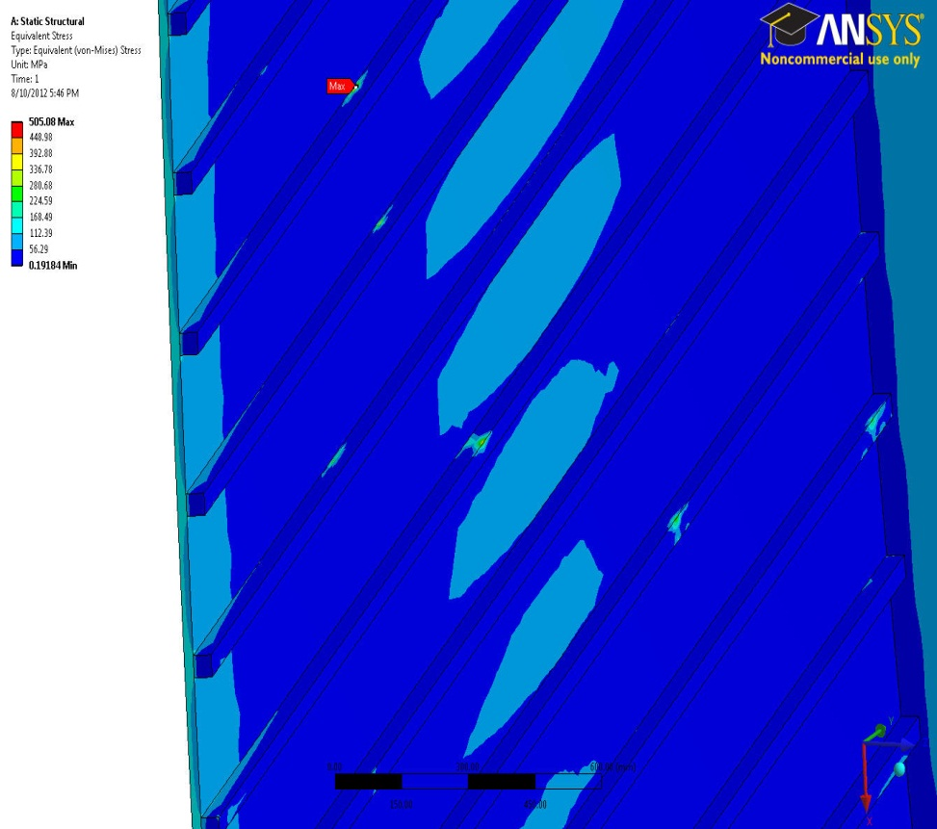
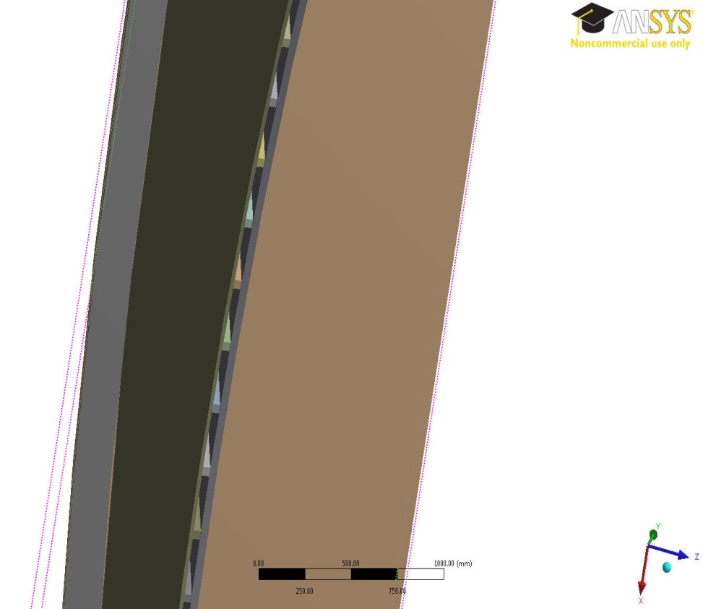
Horizontal or Vertical Rib?
Over-Stressed Spots
We get over-stressed spots on the horizontal ribs (Very high stress spots)
Switching from the horizontal to vertical ribs over the port walls.

Slide 3
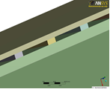
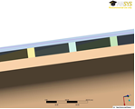
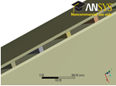
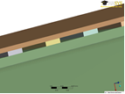
Vertical Ribbed Structure
Variety of vertical Ribbed Structures has been designed and analyzed
(different Sheet thicknesses, Rib thicknesses, gap between sheets, distance between sheets)

Slide 4
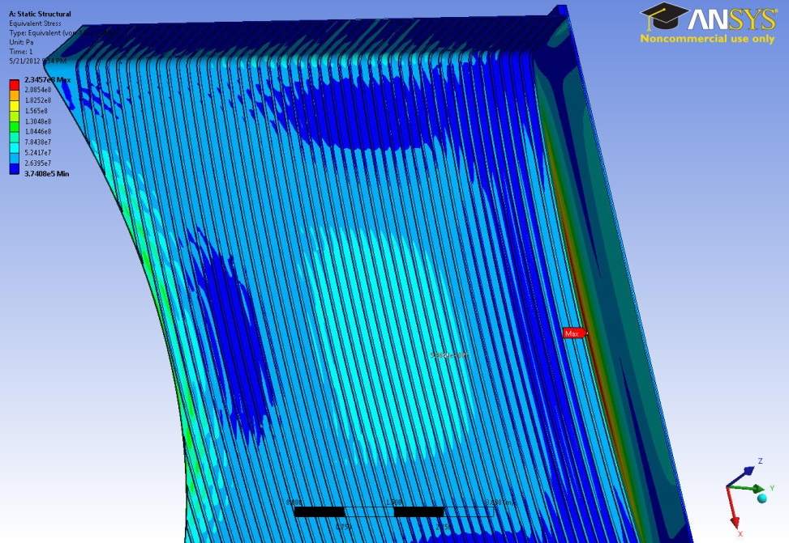
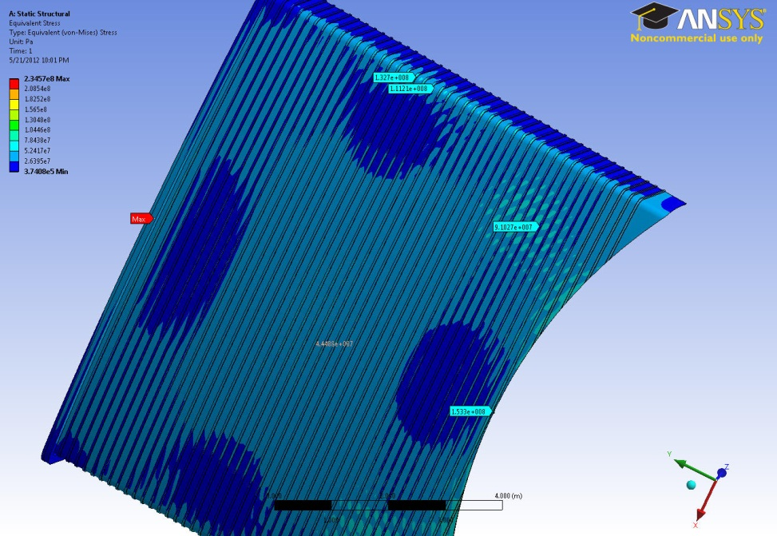
Vertical Ribs
Ribs Attached to the Outer Sheet
Ribs Attached to the Inner Sheet
All areas are less than the yield stress

Slide 5
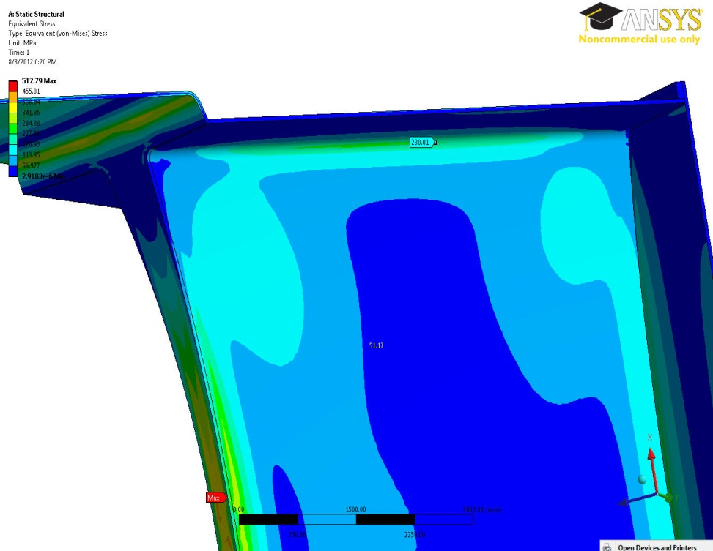
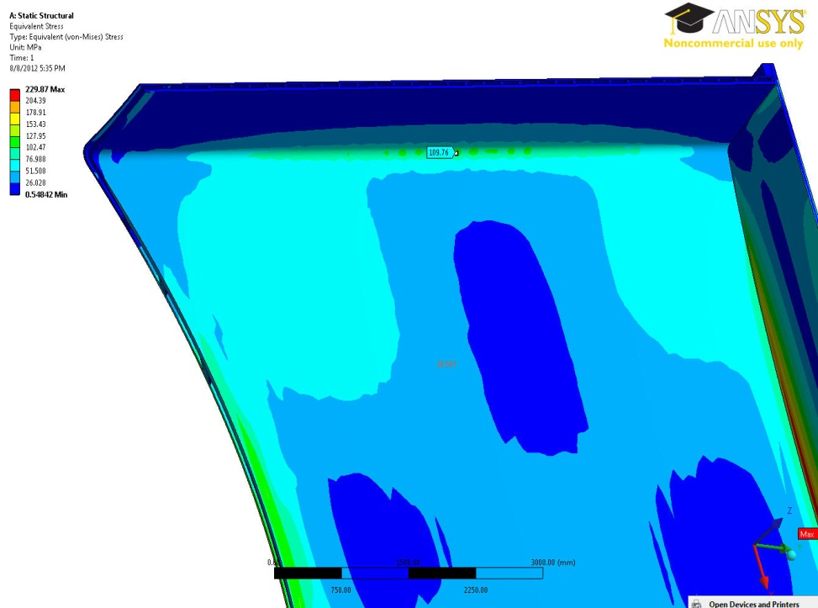
Comparison (Vertical Ribbed/ Solid Single wall)
Very thin solid single wall VV
(5-cm)
Vertical Ribbed Structure VV
( Double Wall)
230 MPa
110 MPa
In the vertical ribbed structure, the stress amount around the port top and bottom corners gets 52% lower than its counterpart area on the very thin solid single wall VV (5-cm)

Slide 6
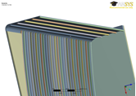
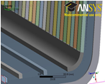
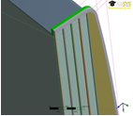
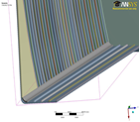
Mixed Ribbed Structure (Vertical/Horizontal)
Horizontal ribs on the top and bottom port wings are required to lead the He coolant throughout the port
Variety of mixed ribbed structure has been designed and analyzed
The door ribbed structure has been designed too

Slide 7
Final Design Parameters (Mixed Ribbed Structure)
Design Parameter | Size
Distance between vertical ribs | 18-19cm
Distance between horizontal ribs | 25cm
Rib thickness | 4cm x 4cm
Gap between inner and outer sheets | 4cm
Outer wall (Sheet) thickness | 2cm
Inner wall (Sheet) thickness | 4cm

Slide 8
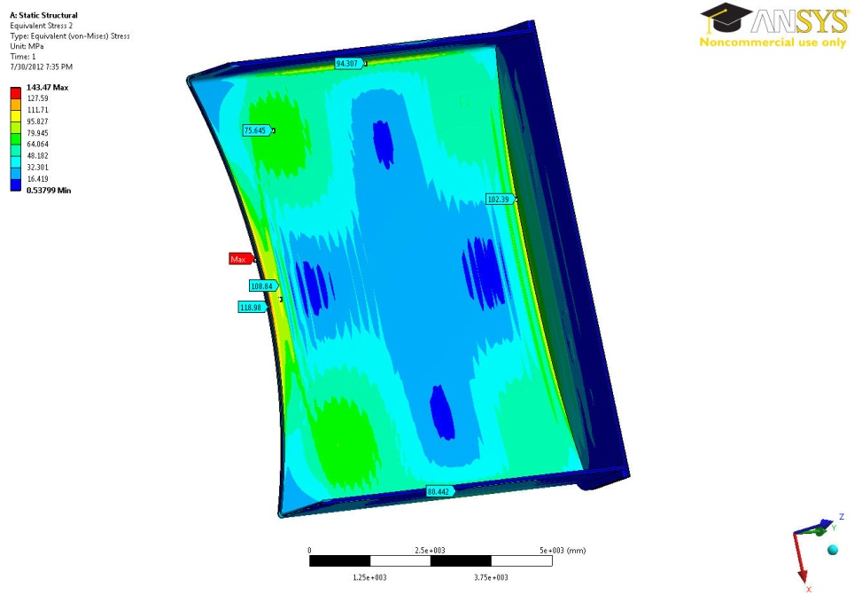
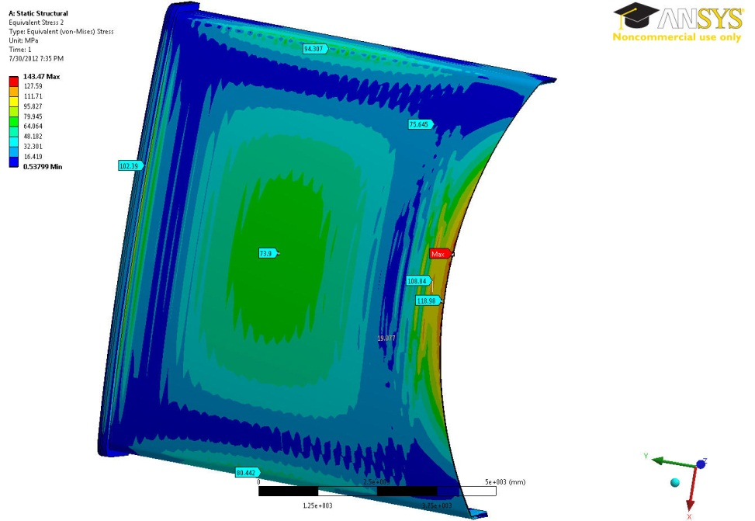
Safe Outer/Inner Sheets
74Mpa
108Mpa
94Mpa
102Mpa
73Mpa

Slide 9
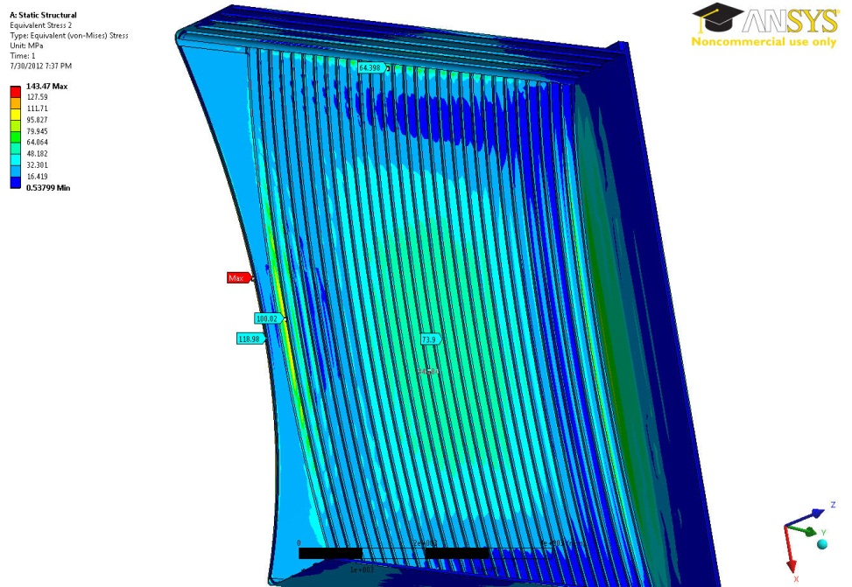
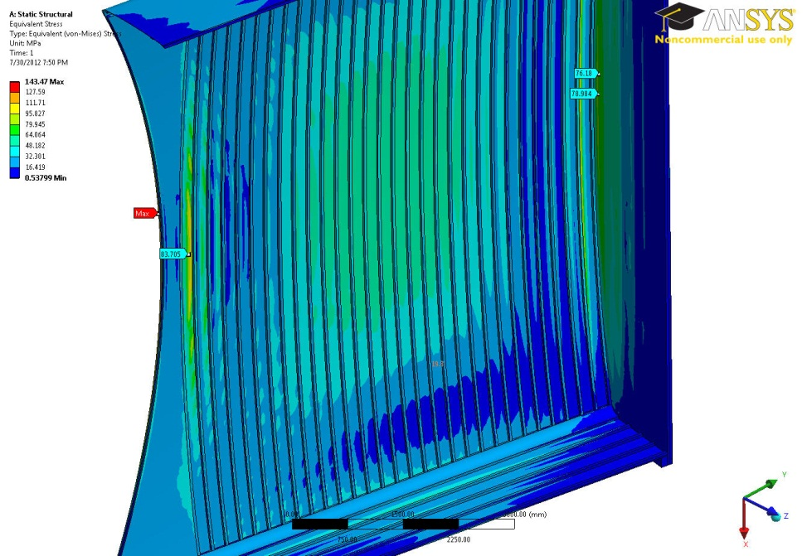
Safe Vertical/Horizontal Rib Structure
64Mpa
100Mpa
76Mpa

Slide 10
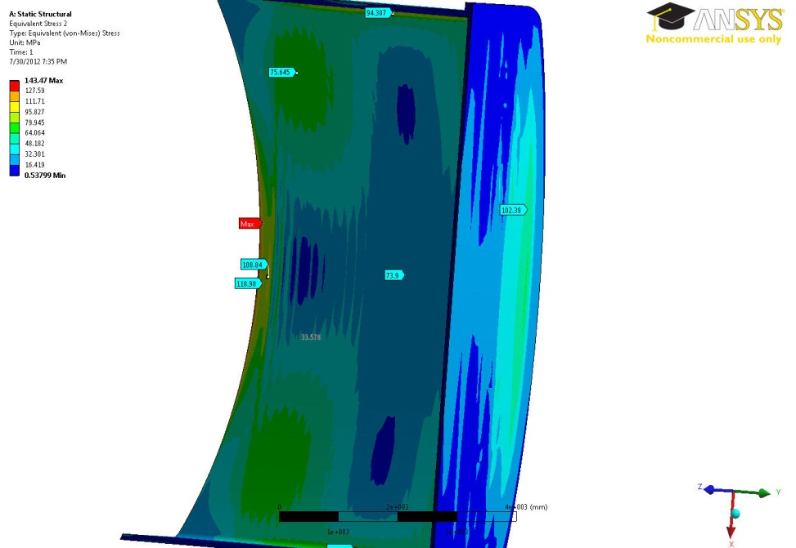
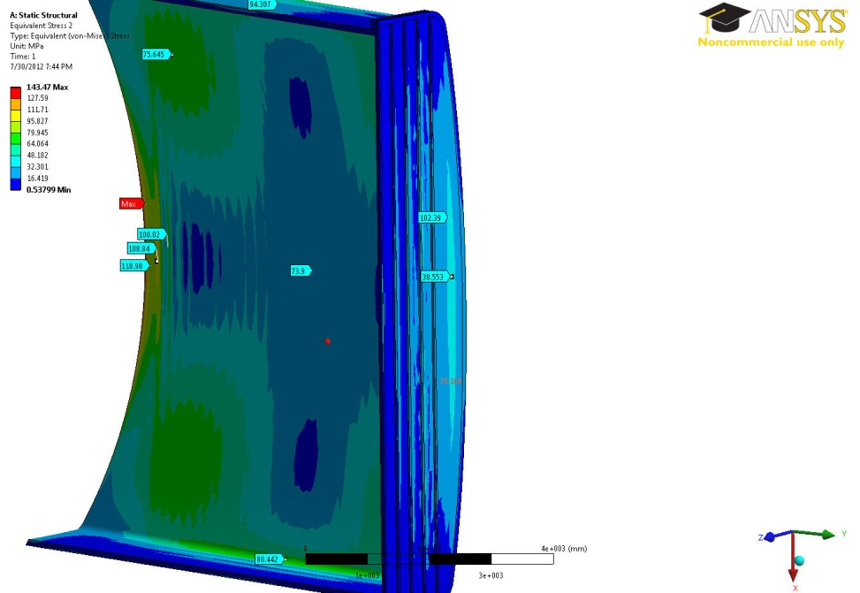
Safe Rib Structured Door
102Mpa

Slide 11
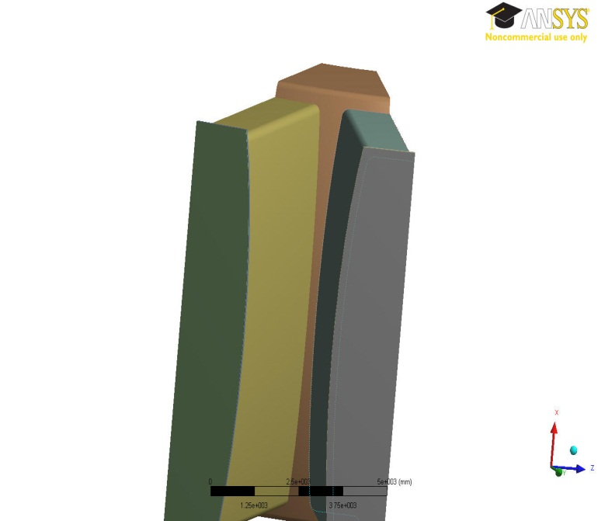
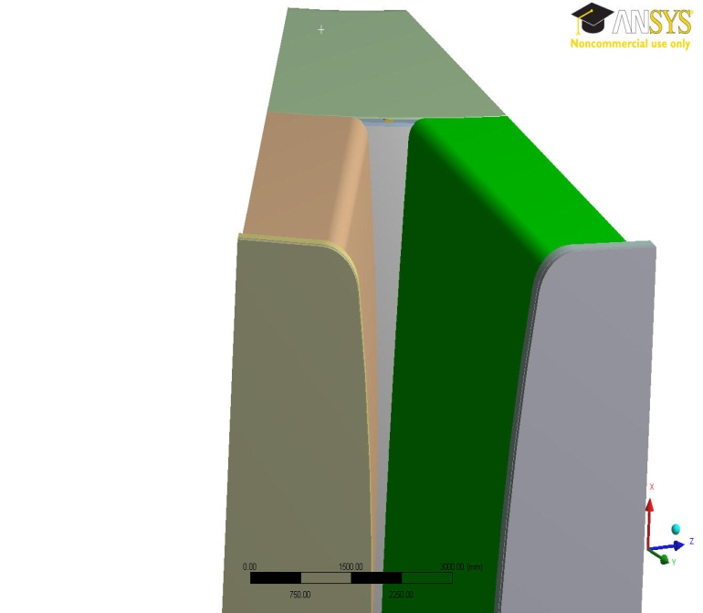
Currently in Progress
Previous Model (with Lip)
New Model (without Lip)
The model geometry is changed a little (No lip on the top and bottom)
The ribbed configuration for the ports and doors should be checked and validated again for the new model
Finding the rib configuration for the main body (Inboard)

Slide 12
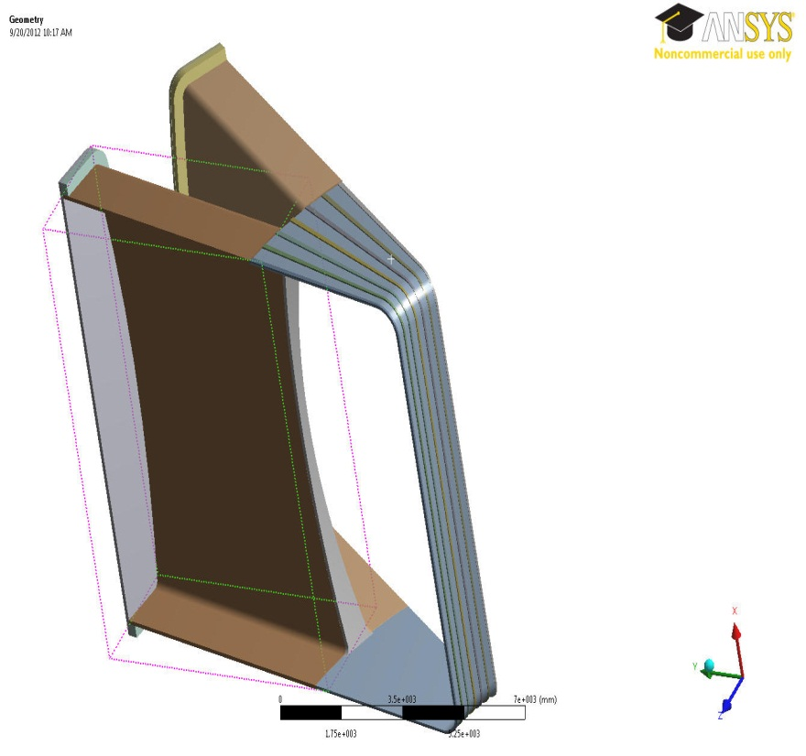
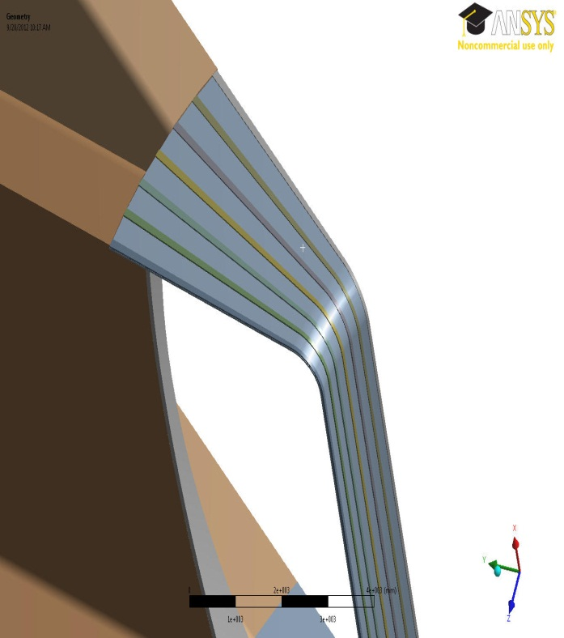
Currently in Progress (Ribbed Structure Body)
The ribbed structure for the main body is under design and analysis (Inboard Ribbed Structure)
The criteria for the inboard ribbed structure is to tolerate the loads and being matched with the port ribbed structure in order to feed and lead the He coolant through out the whole vacuum vessel

