Slide 1
FESAC Charge on MFE Priorities
For the Next Decade
Dale Meade
ARIES Quarterly Meeting
September 26, 2012
Bethesda, MD

Slide 2
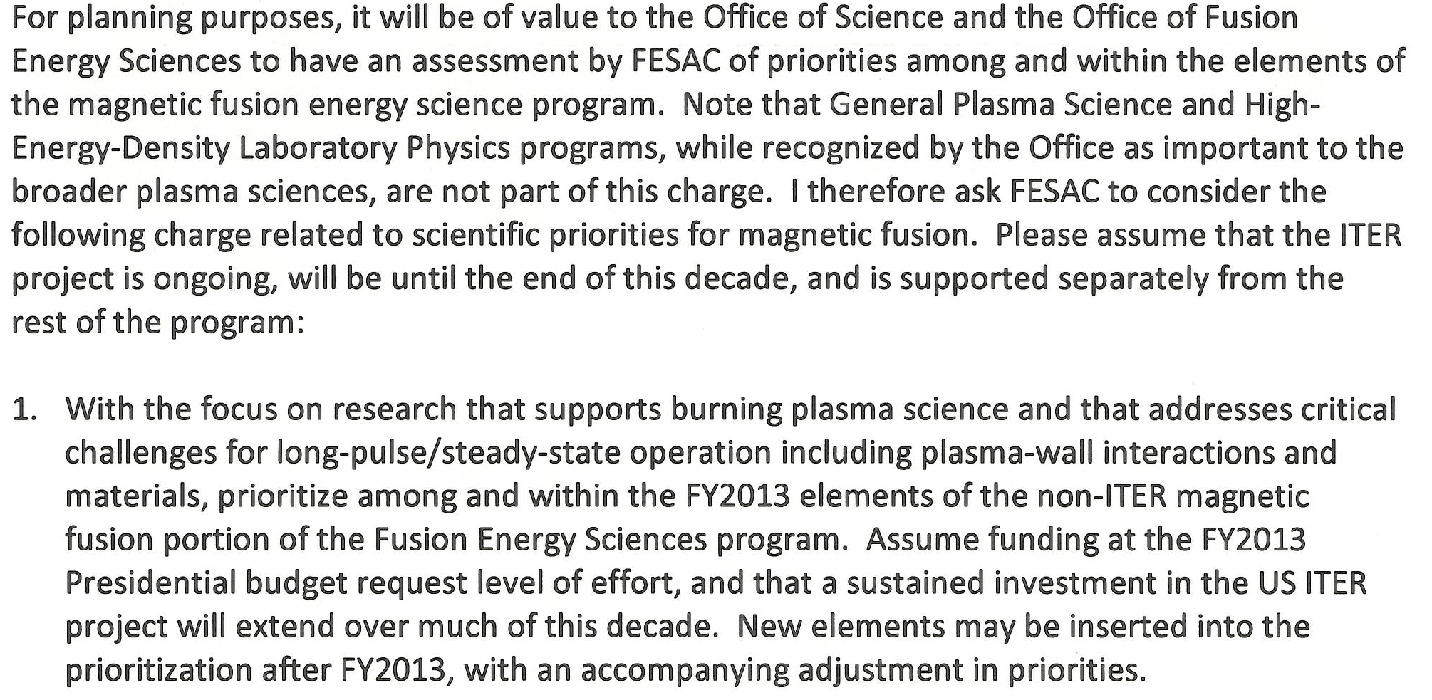
Charge to Subcommittee of FESAC (1)
April 13, 2012

Slide 3
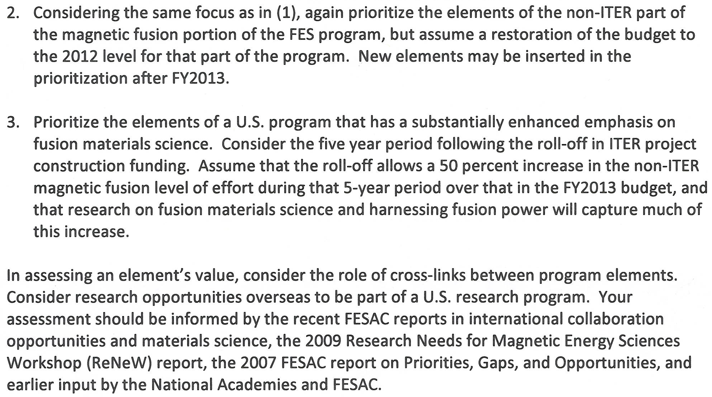
Charge to Subcommittee of FESAC (2)
April 13, 2012

Slide 4
Members of Subcommittee of FESAC
Bob Rosner, Univ Chicago Chair
Riccardo Betti, Univ of Rochester
Mike Brown, Swarthmore
Vincent Chan, GA
Bruce Cohen, LLNL
Steve Cowley, Culham, UK
Ron Davidson, PPPL
Jim Drake, U MD
Nat Fisch, PPPL
Chuck Greenfield, GA
Sibylle Günter, IPP Garching
Ian Hutchinson, MIT
Mitsuru Kikuchi, Japan Atomic Energy
Mark Koepke, Univ West Virginia
Jiangang Li, ASIPP, China
Bill Madia, Stanford, Madia Assoc
Rajesh Maingi, ORNL
Mike Mauel, Columbia Univ
Ron Parker, MIT
Don Rej, LANL
Peter Stangeby, Univ Toronto, Canada
Carl Sovinec, U Wis
Steve Zinkle, ORNL
Martin Greenwald, FESAC chair, Ex-officio
Rough schedule – subcommittee to prepare report for FESAC review ~ Nov, 2012

Slide 5
Members of FESAC
Martin Greenwald, MIT, Chair Riccardo Betti, Univ Rochester, Vice Chair
Rich Callis, GA Bruce Cohen, LLNL
Ray Fonck,, Univ Wis Amanda Hubbard, MIT
Hantao Ji , PPPL Chris Keane, LLNL
Ramon Leeper, Sandia Kathryn McCarthy, INEL
Dale Meade, FIRE Ellen Meeks,
Farrokh Najmabadi, UCSD Bob Rosner, Univ Chicago
Edward Thomas, Auburn Nermin Uckan, ORNL
Steve Zinkle , ORNL Cary Forest, Univ Wis, Ex-officio
Lee Cadwallader, INEL, ANS Ex-officio John Steadman, IEEE, Ex-officio

Slide 6
Status
• Subcommittee held two meetings (July 19 & 31) to receive public input - ~ 10 oral talks, ~ 80 white papers received and two webinars hosted by US BPO – posted on FIRE Program News (July 5 to Aug 13 )
• Subcommittee is using ReNeW Thrusts and Tasks as building Blocks
• Have setup criteria and have prioritized tasks
• Will need to estimate the costs of various tasks
• Then assemble into scenarios for three charges
• Completion ~ November/December
• Impact of ARIES Studies on Fusion Program Planning
- ARIES self-consistent integrated design studies identify high leverage R&D
- FESAC 2007 Report - Priorities, Gaps and Opportunities: Towards A Long-Range Strategic Plan For Magnetic Fusion Energy
- Fusion Nuclear Science Program Assessment (FNSPA)
- FESAC 2012 Materials/Collaboration Reports
• Deliverables of FY 2010 ARIES Proposal well aligned with near term needs for fusion planning tasks -

