Slide 1

TAE-EP Interaction in ARIES ACT-I
K. Ghantous, N.N Gorelenkov
PPPL
ARIES Project Meeting, , 26 Sept. 2012

Slide 2
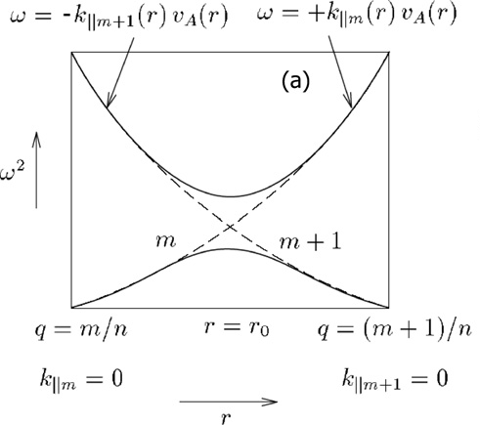

Alpha particles transport
Since v_{α0} ≥ v_{A}
Its possible that a particles resonantly interact with Alfvenic modes.
This can drive modes unstable. However, MHD modes are heavily dampened by phase mixing due to the continuum.
BUT TAE modes can exist! They are isolated eigenmodes and are susceptible to being driven unstable.
Due to toroidicity, modes couple and a gap is created in MHD continuum at
And this is where the TAE mode resides at
ω_{TAE}≈v_{A}/2qR
1

Slide 3

TAE modes driven unstable by α particles
The distribution of EP is decreasing in r.
Known 1D bump on tail.
Positive slope in v results in growth of modes.
Inverse Landau damping.
2

Slide 4
TAE modes driven unstable by α particles
So distribution of EP as a function of Pφ
Known 1D bump on tail.
Positive slope in v results in growth of modes.
Inverse Landau damping.
3

Slide 5
TAE - α particle Interaction
Particles resonate with TAE modes at
where
α particles profiles are modified due to interaction with modes.
Modes drive by free energy of α particles depends on their profiles.
1.5D modeling:
And use linear theory to model drive and damping of TAE modes due to background plasmas and alphas
Transport of alphas due to TAE modes is modeled based on QL theory
4

Slide 6
QL model
Illustration of self consistent QL relaxation
where
instability
diffusion
Saturation at marginal stability
5

Slide 7

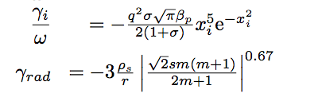
1.5D Reduced QL model
Linear theory for growth rate. Instead of integrating the expressions for γ
We use expressions that are approximations:
the mode number, plateau of maximum
Plasma parameters ( given by TRANSP)
Isotropy (isotropic for alphas)
Linear theory for damping rates. Main mechanisms in ARIES are:
Ion Landau damping
Radiative Damping
6

Slide 8
Integrating relaxed profiles.
Instead of solving the self-consistent QL equation. We assume the distribution function keeps diffusing until TAE modes are marginally stable everywhere.
i.e
7

Slide 9
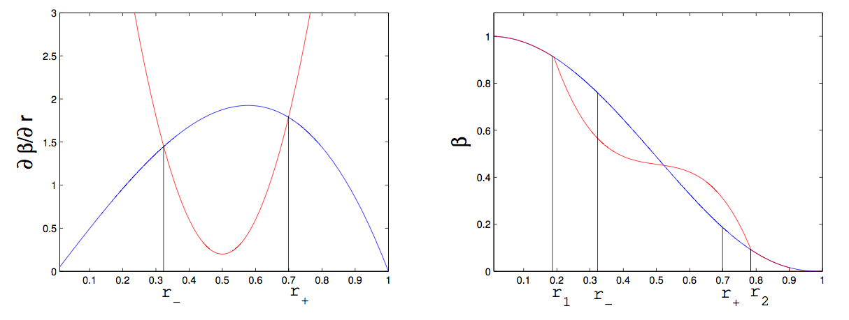
Integrating relaxed profiles.
Instead of solving the self-consistent QL equation. We assume the distribution function keeps diffusing until TAE modes are marginally stable everywhere.
i.e
8

Slide 10
Integrating relaxed profiles.
Instead of solving the self-consistent QL equation. We assume the distribution function keeps diffusing until TAE modes are marginally stable everywhere.
i.e
With the constraints:
Particle conservation
continuity
9

Slide 11
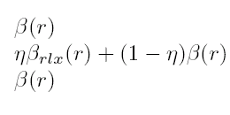

Accounting for velocity dimension
Only part of the phase space resonant with the mode.
Fraction of space calculated by
Kolesnichenko is
Kolesnichenko’s rough estimate for the percentage of particles that are resonant is η
10

Slide 12
NOVA and NOVA-K
To apply 1.5D on experimental results, NOVA and NOVA-K are used to give quantitative accuracy to the analytically computed profiles.
We find the two most localized modes from NOVA for a given n close to the expected values at the plateau.
We calculate the damping and maximum growth rate at the two locations, r1 and r2, to which the analytic rates are calibrated to by multiplying them by the following factor, g(r) .
11
1

Slide 13
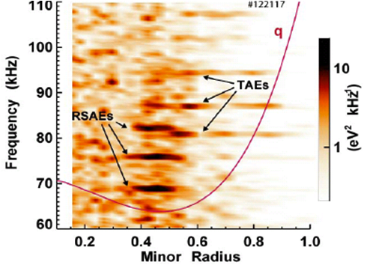
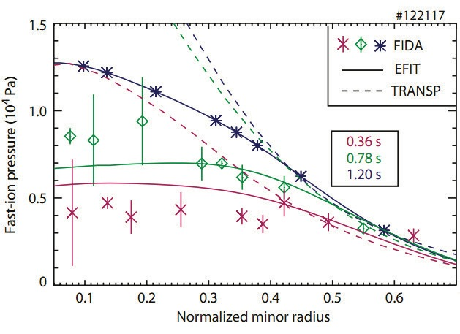
Validation with DIII-D runs
TAE observation using interferometers
FIDA measures of the distribution function
12

Slide 14
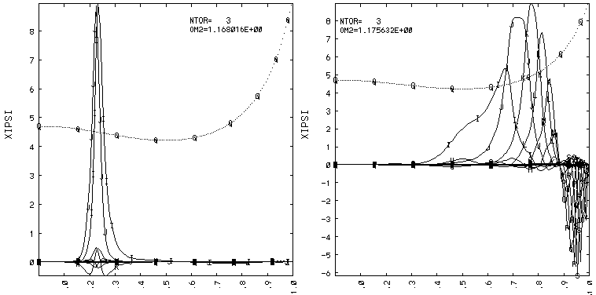

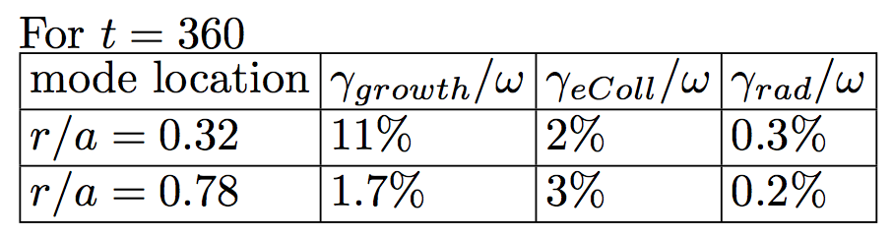
NOVA and NOVA-K results
13

Slide 15
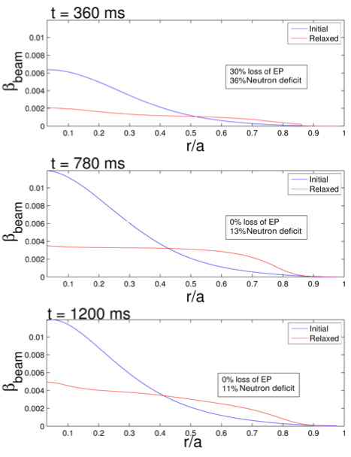
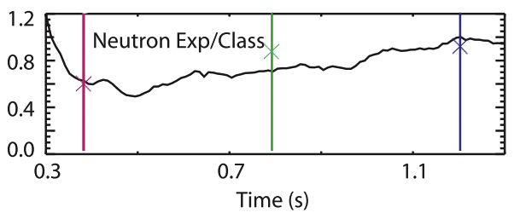
Applying 1.5D model on DIIID
14

Slide 16
ARIES ACT-1 parameters from TRANSP
We apply 1.5D on shot 10001A53 at t = 250, 400, 600, 800 and 1190 ms
The Tokamak parameters are
We use the quintessential case 10001A53 at t=600 ms to run NOVA
15

Slide 17
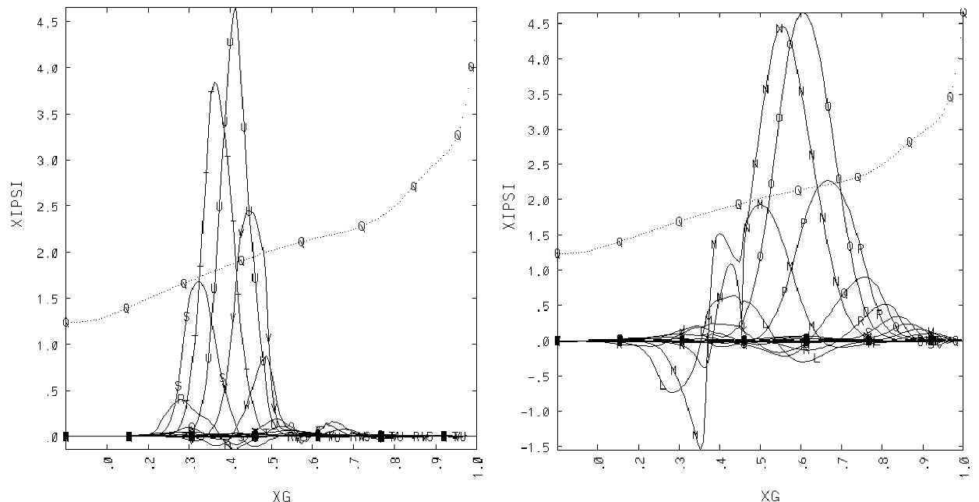
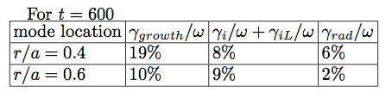
NOVA and NOVA-K ARIES ACT-1
16

Slide 18
1.5D Model results with NOVA normalization
at t=600
Loss 4%
17

Slide 19
18

Slide 20
19

Slide 21
20

Slide 22
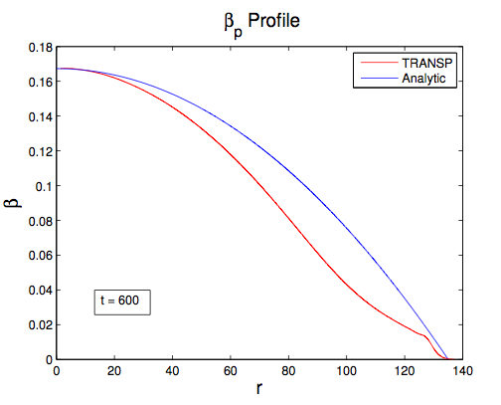
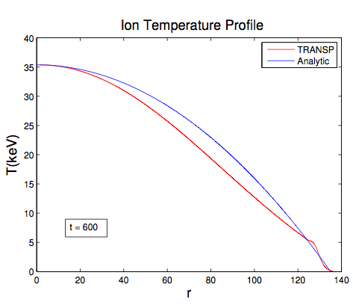


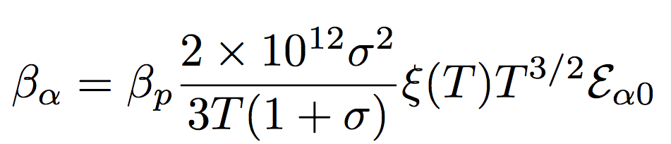
Analytic expressions
21

Slide 23
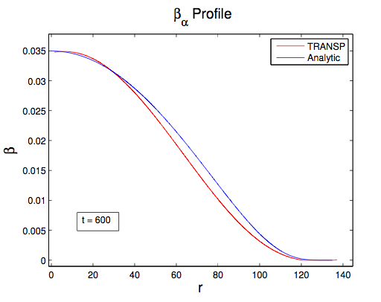
Analytic expressions
22

Slide 24
Parameter space loss diagram
Given, T_{i0} and β_{p0} we can estimate T_{i}(r), β_{p}(r), β_{α}(r) .
Given profiles, we can compute
γ_{α}, γ_{iL}, γ_{iT}, γ_{eColl}
This allows to make a parameter space analysis of TAE stability and α particle losses.
Caveat: Radiative damping’s analytic expression requires knowledge of the details of T_{e} profiles and the safety factor and shear profiles, making it hard to model without further assumptions.
23

Slide 25
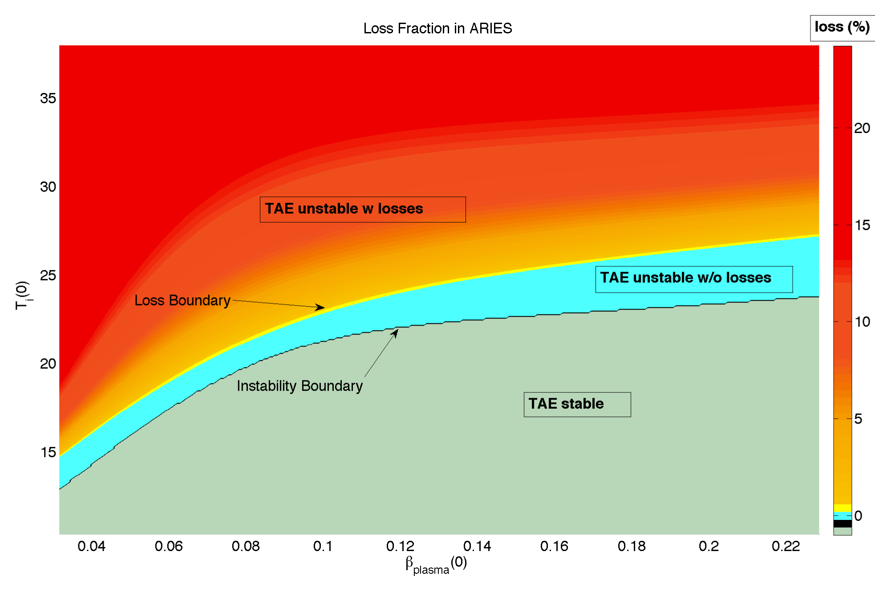
Parameter space diagram
24

Slide 26
Parameter space diagram INCONCLUSIVE
Parameter space diagram agrees with NOVA-K normalized 1.5D if radiative damping is not considered.
Accounting for radiative damping might shift the loss diagram significantly allowing for a large operational space without any significant α particle losses.
25

Slide 27
Conclusion
Using NOVA and 1.5D model, there can be up to 9% loss of α particles. (Since 1.5D is a conservative model, this is great news for ARIES ACT-1.)
More detailed study of the radiative damping is required to access whether the TAE modes in ARIES ACT-1 will result in losses or not.
As a preliminary study, α particles in ARIES ACT-1 are well confined upon interacting with TAE modes.
26

