Slide 1

Updated Thermal Performance of Finger-Type Divertors
M. Yoda, S. I. Abdel-Khalik, D. L. Sadowski,
B. H. Mills, and J. D. Rader
G. W. Woodruff School of Mechanical Engineering

Slide 2
Objectives / Motivation
Objectives
Evaluate thermal performance of gas-cooled divertor designs in support of the ARIES team
  Develop generalized charts for estimating maximum heat flux
  and required coolant pumping power
  Demonstrate how dynamically similar experiments with different coolants can be extrapolated to prototypical conditions with helium
Motivation
Provide design guidance and develop correlations that can be used in system codes
Determine how divertor thermal performance will be affected by changes in material and coolant temperature limits

Slide 3
Approach
Conduct experiments that span non-dimensional parameters at prototypical conditions
  Instrumented test sections that closely match divertor geometry
  Match nondimensional coolant flow rate (Reynolds number Re) and ratio of solid to coolant thermal conductivities k_{s} / k
  Matching k_{s} / k requires limited set of experiments with (room temperature) He
  Measure cooled surface temperatures and pressure drop ⇒ Nusselt number Nu, loss coefficient K_{L} as a function of Re and k_{s} / k
Develop power-law correlations for Nu, K_{L}
  Extrapolate to prototypical conditions to determine

Slide 4
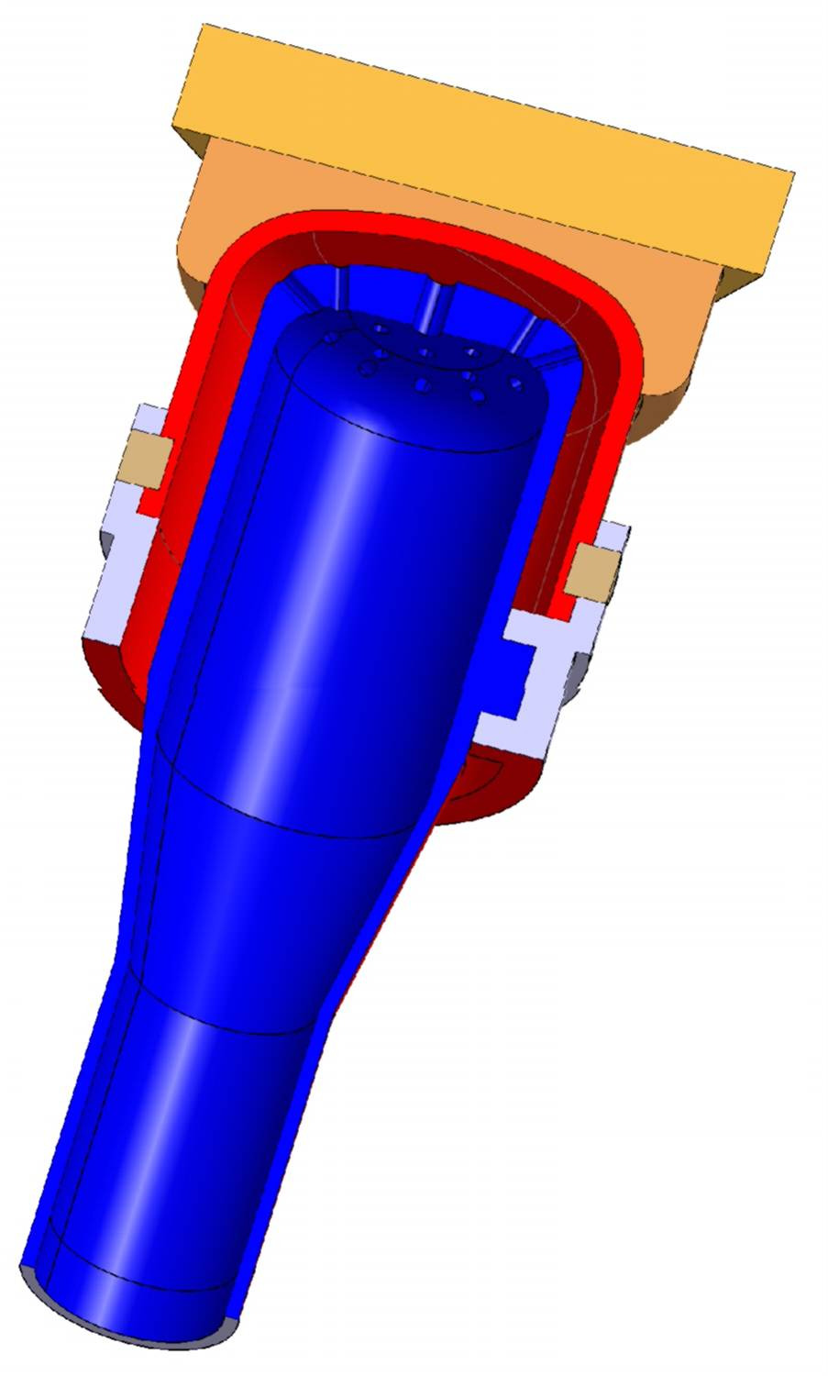
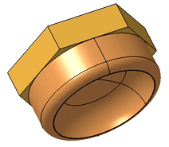
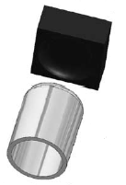
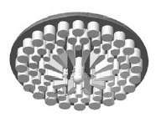
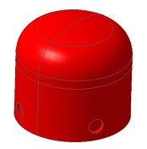
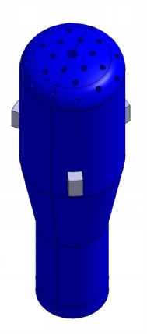
Finger-Type Divertors
Can accommodate heat fluxes exceeding 10 MW/m²
Cover small area: ~5×10⁵ modules for O(100 m²) divertor
HEMJ
HEMP
15.8
[Diegele et al. 2003; Norajitra et al. 2004; Ihli 2005]
W
W-alloy
14 mm
Notes:
4

Slide 5
GT Test Module
Coolants: air, helium (He), argon (Ar)
  Re range ≈ 8×10³ −1.5×10⁵, vs. Re_{p} = 7.5×10⁴
  He, Ar from gas cylinders: single-pass experiments
Brass test sections without and with pin fins
  k_{s} / k = 900, 5000, 7000 for He, air, Ar, vs. (k_{s} / k)_{p}
  ≈ 340 for W- 1% La₂O₃ at 1200 °C, He at 700 °C
  48 fins: 1 mm dia., 1.2 mm pitch, 2 mm long
  Heated by oxy-acetylene torch: q″≤ 2.0 MW/m²
  One round jet (2 mm exit dia) impinges on cooled surface
  Measure coolant mass flow rate , temperatures at inlet, exit (T_{i}, T_{e}); inlet pressure p_{i}, pressure drop Δp
  Thermocouples measure temperatures 1 mm from cooled surface
q″
1
TCs
2
1
5.8
10 mm
12 mm
5
Notes:
5

Slide 6
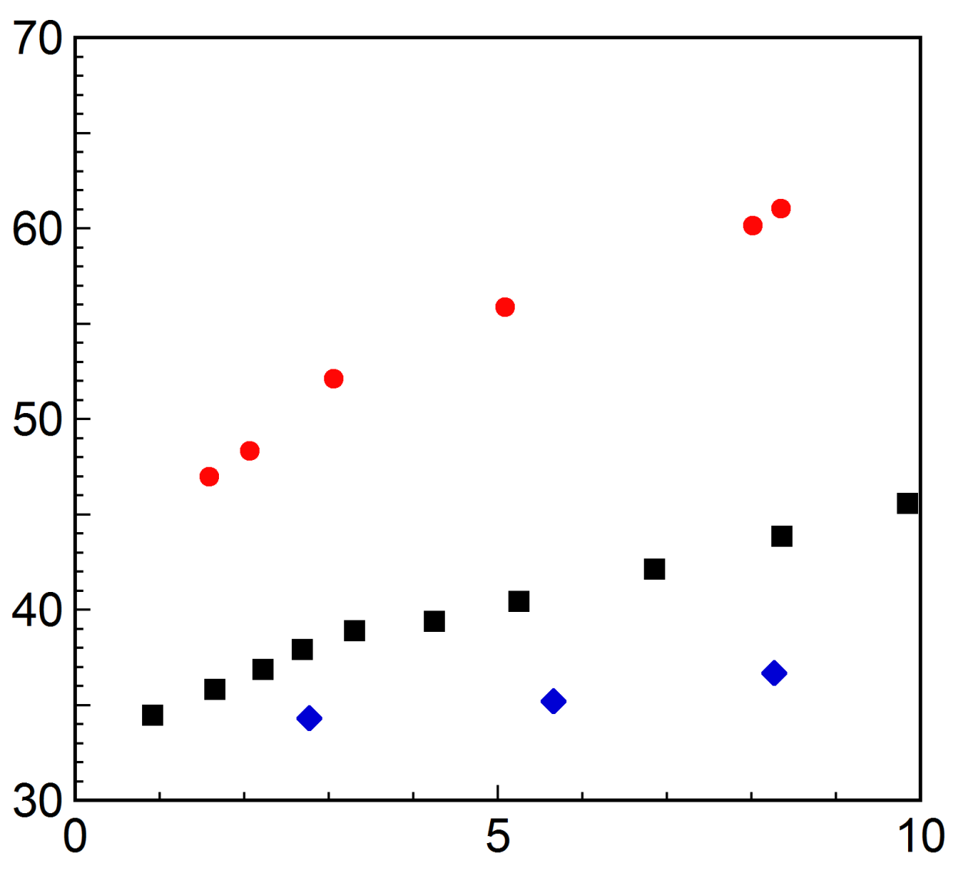
Conduction vs. Convection
Heat removed at cooled surface [%]
For test section without fins, numerical simulations ⇒ fraction of heat removed by coolant at cooled surface (via convection) varies with coolant
  Remainder of heat conducted through divertor walls
Air
Helium
Argon
Re [/10⁴]
Notes:
6

Slide 7
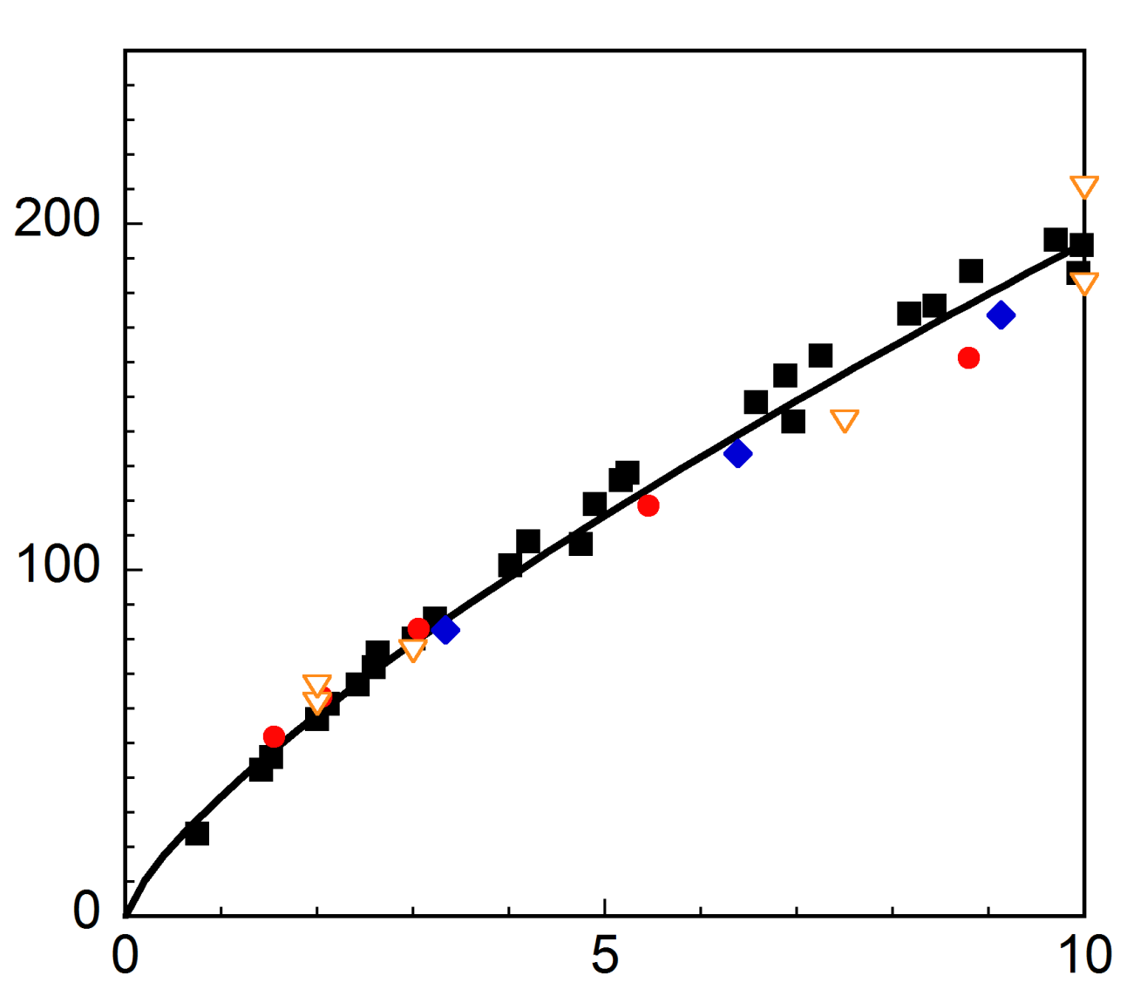
Heat Transfer: No Fins
Experiments: Air, He, Ar
Simulations: k_{s}/k = 340, 900, 7000
For test section without fins, Nu (Re, k_{s} / k) results for air, He and Ar described by a single power-law correlation (R² > 0.99)
  Experimental data validated by numerical simulations at different k_{s}/k
Nu (k_{s}/k)^{−0.124}
Re [/10⁴]
Notes:
7

Slide 8
Heat Transfer: Fins
Experiments: Air, He, Ar
For test section with fins, experimental results with air, He and Ar suggest that Nu essentially independent of k_{s} / k ⇒ most of the heat removed by convection
Results described by a single power-law correlation (R² > 0.99)
Nu
Re [/10⁴]
Notes:
8

Slide 9
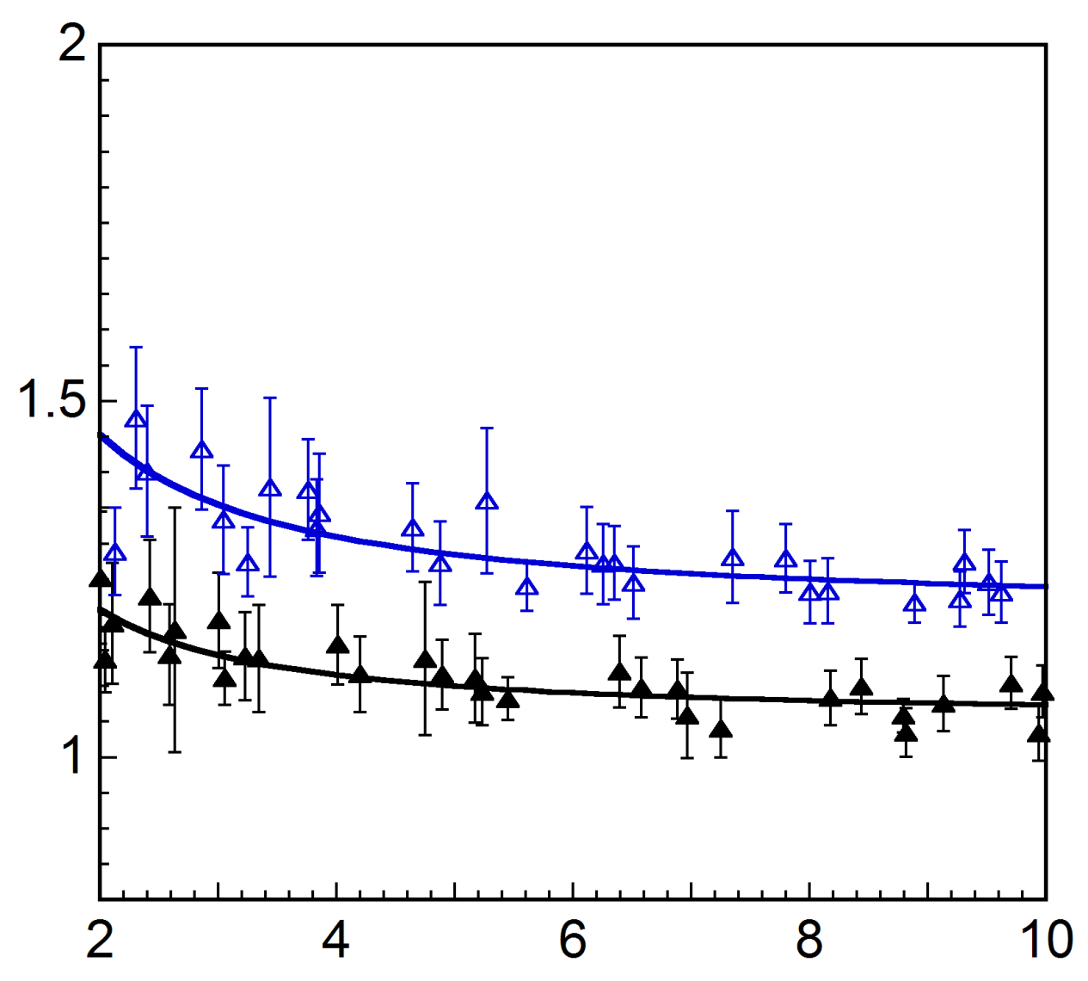
Pumping Power
❐ No fins
❒ Fins
Loss coefficient K_{L} for air, He, Ar (i.e., different k_{s} / k)
  Fins increase K_{L} (and ) by ~18% at Re_{P}
  Curve-fit data to power-law correlations
Loss Coefficient K_{L}
Re [/10⁴]
Notes:
9

Slide 10
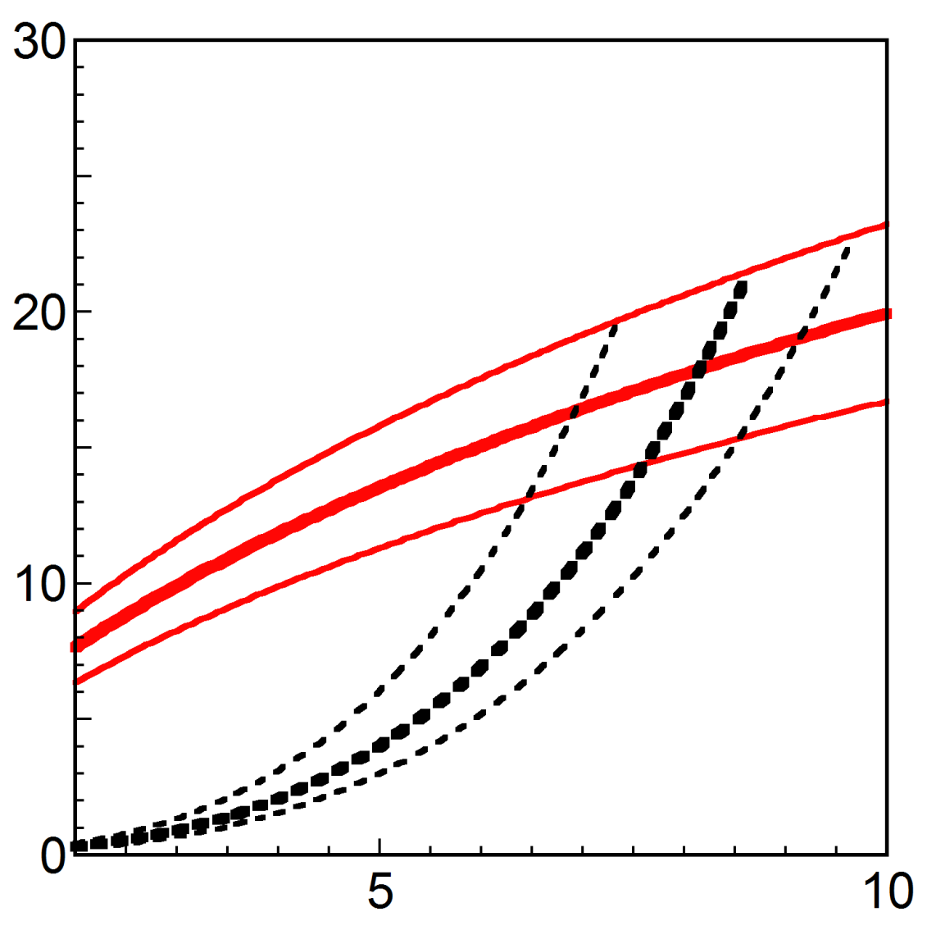
Max. Heat Flux: No Fins
Max. incident heat flux [MW/m²]
based on 1.13 cm² area
at pressure boundary vs. Re
  Ratio of to incident thermal power β
  Max. pressure boundary temp. T_{s}
  Helium inlet temp. T_{in} = 600°C
  = 17 MW/m² at prototypical conditions, vs. original value of 22 MW/m²
T_{s} = 1300°C
1200°C
1100°C
15%
β = 10%
20%
Re [/10⁴]
Notes:
10

Slide 11
Max. Heat Flux: Fins
Max. incident heat flux [MW/m²]
based on 1.13 cm² area
at pressure boundary vs. Re
  Helium inlet temp. T_{in} = 600°C
  ≈ 21 MW/m² at prototypical conditions ⇒ fins increase by ~23%, at the cost of 18% greater
T_{s} = 1300°C
1200°C
1100°C
β = 10%
15%
20%
Re [/10⁴]
Notes:
11

Slide 12
Conclusions
Performed experimental studies of finger type divertor without and with fins using air, helium and argon
Developed power-law correlations for Nu (Re, k_{s} / k) for divertor without fins, and for Nu (Re) for divertor with fins
  Extrapolations to prototypical conditions suggest maximum heat flux is about 17 MW/m² for max. temperature of 1200 °C at pressure boundary for divertor w/o fins (for 12 mm dia. tiles, or 1.13 cm² area): accounting for k_{s} / k reduces extrapolated values of
  Max. heat flux about 21 MW/m² for divertor with fins: 23% improvement
Developed power-law correlations for K_{L}(Re)
  Extrapolations suggest fins increase coolant pumping power by ~18% at prototypical conditions

Slide 13
Tasks through Dec. 13
Experimental studies of finger-type and HEMJ divertors without fins at prototypical value of k_{s} / k ≈ 340
  Single-pass experiments with He with tool steel test sections
  Increase incident heat flux to ~4-5 MW/m²
Numerical simulations of finger-type divertor with different pin-fin arrays
  Optimize diameter to length, diameter to pitch ratios
  Determine if most of heat removed by convection
Develop generalized correlations for Nusselt number and loss coefficients for finger-type and HEMJ divertors for use in system codes
Start numerical simulations of plate-type divertor at various k_{s} / k
Complete initial configuration of helium test loop
  10 g/s at 10 MPa

Slide 14
Tasks through June 13
Experimental studies of finger-type divertor with optimized pin-fin array at prototypical value of k_{s} / k ≈ 340
  Single-pass experiments with He near room temperature on test sections made of tool steel
  Develop new test section design suitable for high-pressure He loop
Numerical simulations of HEMJ with pin-fin arrays
  Experimental studies of plate-type divertor at k_{s} / k ≈ 1200
  Experiments with air: mass flow rates of He too small
Develop generalized correlations for Nusselt number and loss coefficients for plate-type, finned finger-type and finned HEMJ divertors for use in system codes

