Slide 1
The Planning of Reliability Centered Maintenance Programs for Nuclear Fusion Power Plant
I-Li Lu, Ph.D.
Applied Statistics,
Applied Mathematics
Platform Performance Technology

Slide 2
Presentation Outline
Objectives
Solutions based on the Integrated Decision Evaluation & Analysis System (IDEAS)
Optimization Concepts
Cyclical Random Plasma Leakage Models
Simulation
Conclusion

Slide 3
Objectives
Reliability, Availability, Maintainability, and Inspectability (RAMI):
DEMO must demonstrate a high enough availability for power producers to build a commercial fusion plant.
Power producers cannot expect an ultimate fusion power plant availability of 80% (or more) if DEMO cannot demonstrate a 50% or higher availability. Achieving this DEMO availability goal will require reliability in component design, design integration for RAMI , high maintainability, and systems to monitor and inspect components. We must develop and qualify methods and capabilities needed to achieve RAMI objectives.

Slide 4
An Integrated Decision Evaluation & Analysis System
Structural Data:
In-service failures
Event history
Semi-structural Data:
Maintenance Data
Un-structural Data:
Real-time Feed:
Sensor feed
MMSGs and FDEs
Reference Data:
Engineering input
Maintenance Guide
Bulletins
Parts Consumption Data
Parts Sales Data
Data Mining
Data Mapping
Text Mining
Integrated Statistical analysis
For Independent and Correlated
Systems and Components
Risk Management
Reliability
Maintainability
Availability
Survivability
Constrained Cost Minimization
Root Causes
Degradation Models
Adaptive methods (Correction
Factor, MCF-NHP, Flowgraph)
Bayesian Prior and Update
Diagnosis/Prognosis
Diagnostics/Prognostics
Optimization Opportunity
Monitoring & Alerting
Program Management
Health Management
Decision Support
System/Component Redesign
Optimal Troubleshooting Procedures
Mission Readiness
Input
Statistical Analysis
Output

Slide 5
Fusion R&D-Unique Tailoring
Inherent, but not obvious, in Reliability Centered Maintenance (RCM) and IDEAS is the process for handling large technological leaps
Large technology leaps were the hidden driver for RCM and IDEAS
IDEAS includes:
Standardized reliability analysis processes
Statistical treatment of recorded data
Analysis of model-generated data
Feedback of the above into testing
Items 2 – 4 address technology leaps
Fusion tailoring must include a large expansion of modeling, analysis of model results, and input of analysis results into experiment planning

Slide 6
Fusion RAMI Approach
Using standard methods, develop a Reliability Estimation Tool
Purposes of the Tool
Estimate reliability of the fusion power plant, plant systems, subsystems, and devices
Availability Estimates
Sensitivity Analyses
Maintenance Intervals
Maintenance Approach Analyses
Critical Item/Technology Identification
Experiment Planning Guidance
Facility Planning Guidance

Slide 7
Reliability Estimation Tool Structure
Overall tool structure designed and maintained by Boeing
Plant → System → Subsystem → Element breakdown defined by Boeing and power plant team
Data Mining of historical results by Boeing
Physical modeling of material/component behavior (for situations where historical data is unavailable or inadequate) by power plant team members or fusion community at large, as needed
Feedback of tool results to power plant team by Boeing
Experiment/Facility planning inputs by power plant team to fusion community

Slide 8
Integrated RAMI Programs for Nuclear Fusion Power Core
Divertors
Control
Systems
Monitoring & Alerting
CBM
PM
Support
Systems
Cooling
Systems
PM
PM
Structure
& Shield
PM & CBM
PM & CBM
Venting Systems

Slide 9
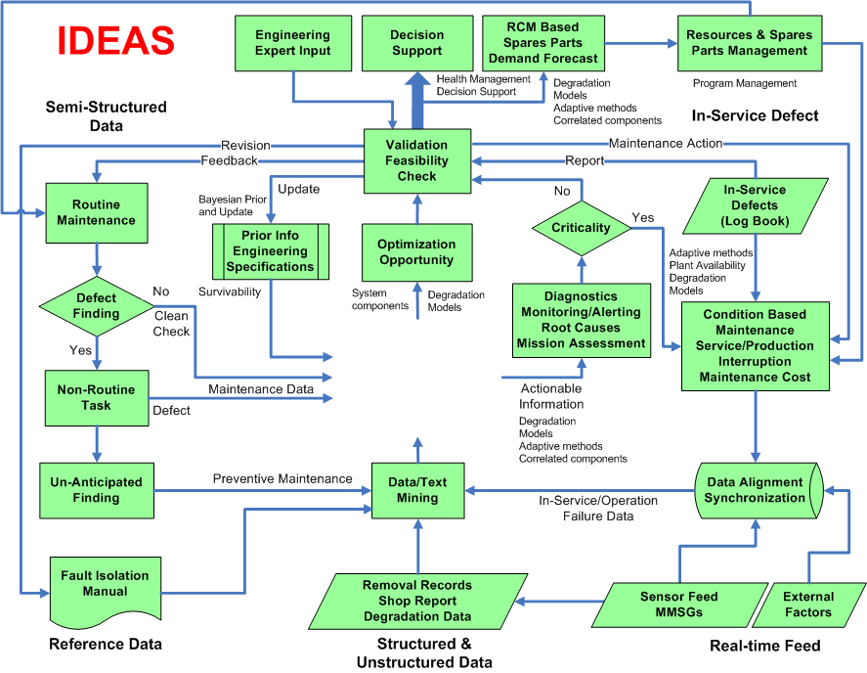
The IDEAS for Nuclear Fusion Power Plant

Slide 10
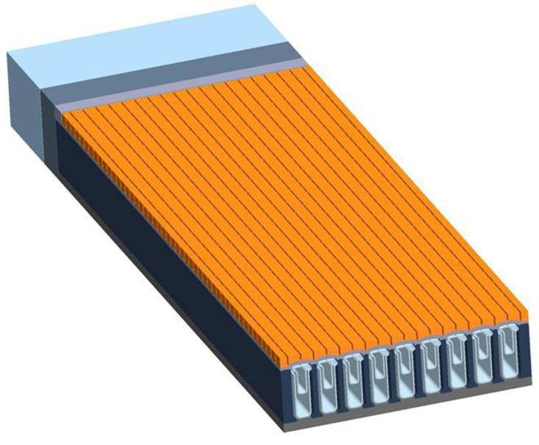
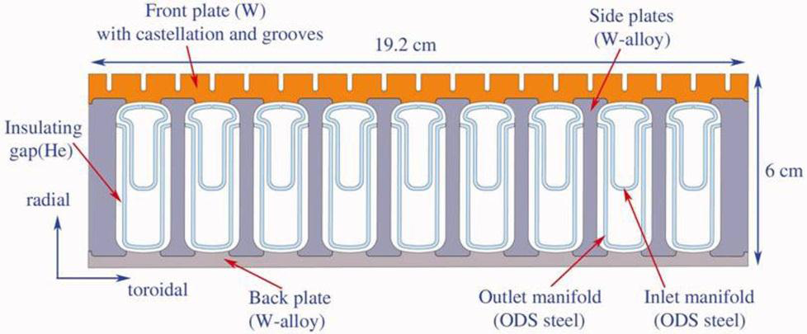
Flat Plate Divertor
Tungsten HCFP (Helium-cooled Flat Plate) divertor

Slide 11
Lower Bound : Edge-Localized Mode
2.50
Non-zero flux from -6.0 cm
to 30.5 cm: = 36.5 cm
4 x 37.5 cm = 150 cm
Call original length 37.5 cm
Expand all dimensions by 4
Plate is 150 cm long, from
-25 cm to 125 cm
Reduce all energies by 4 to keep total energy constant
1.25
-20
0
20
40
60
80
100
120

Slide 12
Upper Bound : Edge-Localized Mode
Non-zero flux from -6.0 cm
to 30.5 cm: = 36.5 cm
4 x 37.5 cm = 150 cm
Call original length 37.5 cm
Expand all dimensions by 4
Plate is 150 cm long, from
-25 cm to 125 cm
-20
0
20
40
60
80
100
120

Slide 13
Optimization Concepts – Flat Plate Divertor
Evident or Hidden Failures – that would lead to unacceptable operational penalties or cost.
Potential Failures – that do not have operational impact but would potentially cause failure if left un-attended.
Degradation
Accelerated Degradation
Opportunity for CBM
Extended life
On-set point.
(Opportunity for PM)
Significant damage (Evident)
Early Failure Induced by Premature PM
Results of Corrective or Preventive action
Minor Damage (Potential)
T_{MF}
T_{SF}
Operating Time
Too Early
(No Finding zone)
Effective Maint. Interval
(Latent Defect Zone)
Too Late
(Failure Zone)

Slide 14
A Random Degradation Model – Cumulative Damage Assessment for FPD
System
Survivability
Explore: Cyclical Random Plasma Leakage Models
Probability interval
subjective information, random shocks, environments, extreme temperature
Reliability
Link between field data and system survival
Covariates
Degradation
Stochastic
Process
usage rates
design changes
Hazard Rate
Stochastic Integration noise filter through random processes
System survivability
Interdependency of components - multivariate lifetime distributions
Interdependency of joint prior beliefs - multivariate prior distributions
Complete interdependency - both conditions above

Slide 15
Cyclical Random Plasma Leakage Models
Cyclical Random Plasma Leakage Models
Random Plasma Spills (Edge Localized Modes)
Two variables
Frequency of the spills (q) : average of 3 times per second (within 1 to 5 Hz) where q ~ N(m_{q} =3, s_{q} =1).
How much power (w) deposited on the divertor on location d at time t given a spill has occurred : where w ~ N( m_{w}, s_{w} | d ) and m_{w} and s_{w} will have values specified by the ELM power distribution table.
Let h_{t}(w|d) be the random process through time with imbedded random periodicity q and power deposited at time t on location d. We may use
as the simulation model to assess the cumulative damage on the outer divertor (degradation model)

Slide 16
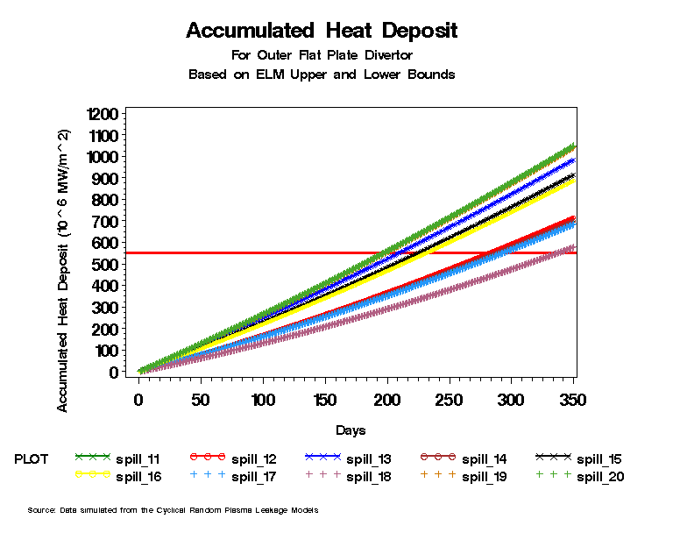
Degradation Model

Slide 17
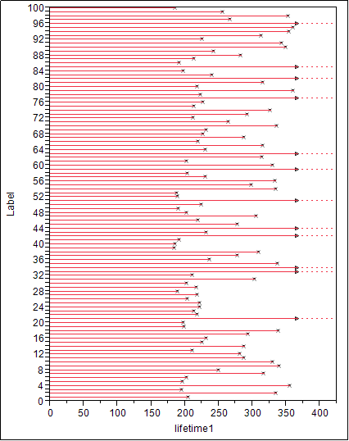
Lifetime Events Extracted from the Degradation Model

Slide 18
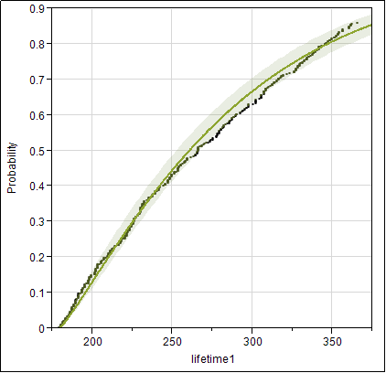
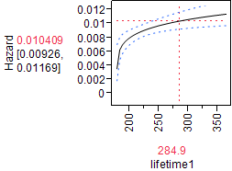
Reliability Model
TH Weibull

Slide 19
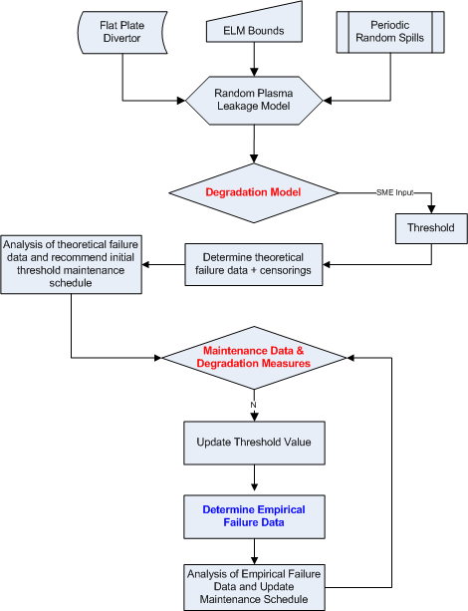
Reliability Centered Maintenance Process

Slide 20
Cyclical Random Plasma Leakage Models
Random Plasma Spills (Edge Localized Modes)
Create the Spill Model to describe the power deposit through time on the outer divertor. - Done
Construct the degradation model for the outer divertor using accumulated heat deposits - Done
Set initial thresholds (from SMEs or lab test results) to determine the theoretical failure data with censoring mechanism - Next
Analyze the theoretical failure data to recommend initial threshold maintenance schedule
Collect actual field maintenance data and associated degradation measures to update the degradation model and the threshold value.
Use the updated threshold value to determine the empirical failure data
Analyze the empirical failure data to recommend maintenance schedule for recurrent failure events

Slide 21
Threshold Plan
Return to plate-type divertor design and thermal stress analyses from ARIES
Make first estimate of “Failure Threshold” for divertor
Insert threshold in reliability model

Slide 22


