Slide 1
Update of Vacuum Vessel Analysis
Hamed Hosseini, Farrokh Najmabadi, Xueren Wang
ARIES Meeting
Washington, DC, May 30-June 1, 2012

Slide 2
Revisiting ARIES-AT vacuum vessel
AREIS-AT had a thick vacuum vessel (40 cm thick) with WC and water to help in shielding. (adoption of ITER vacuum vessel).
Expensive and massive vacuum vessel.
ITER Components are “hung” from the vacuum vessel. ARIES sectors are self supporting (different loads).
ARIES-AT vacuum vessel operated at 50ºC
material?
Tritium absorption?
Tritium transfer to water?
Vacuum vessel temperature exceeded 100ºC during an accident after a few hours (steam!)

Slide 3
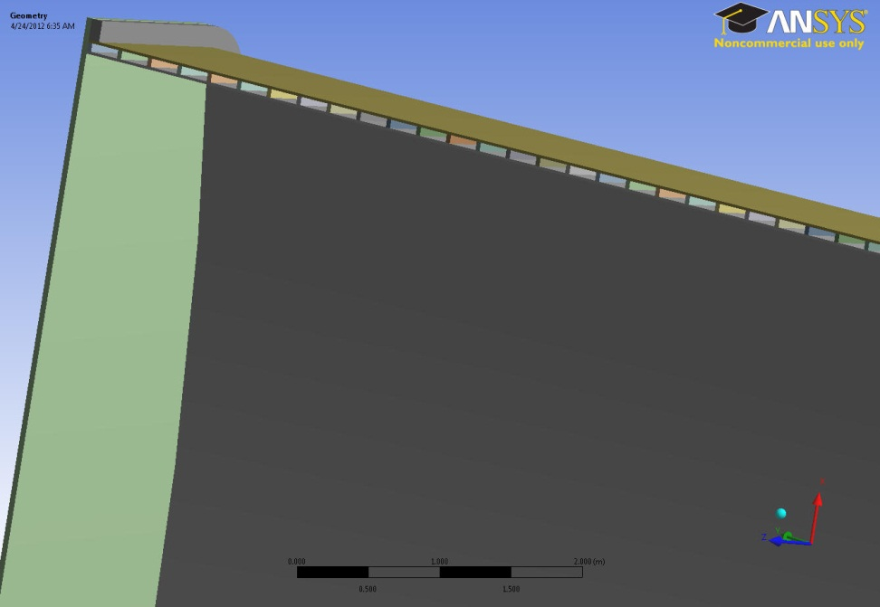
New Vacuum Vessel Design
Contains no water
Can run at high temperature: 300-500ºC. (Tritium permeation/inventory can set the temperature).
Cooled by He flowing between the ribs.
Tritium diffused through the inner wall is recovered from He coolant (Tritium diffusion to the cryostat and/or building should be much smaller.
Smaller (and cheaper?) vacuum vessel

Slide 4
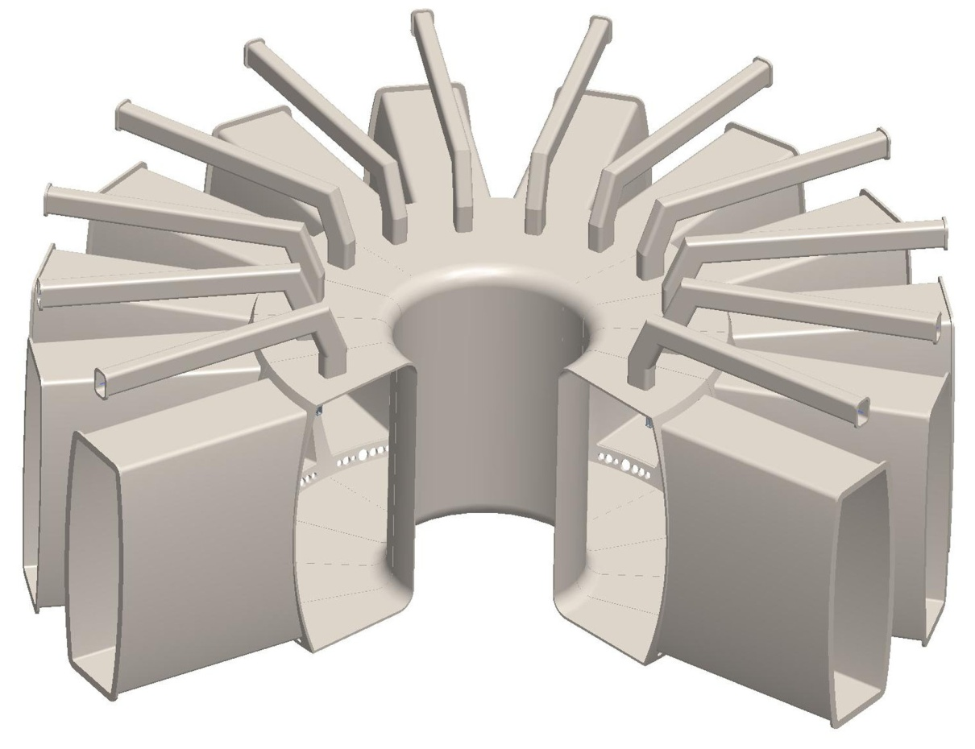
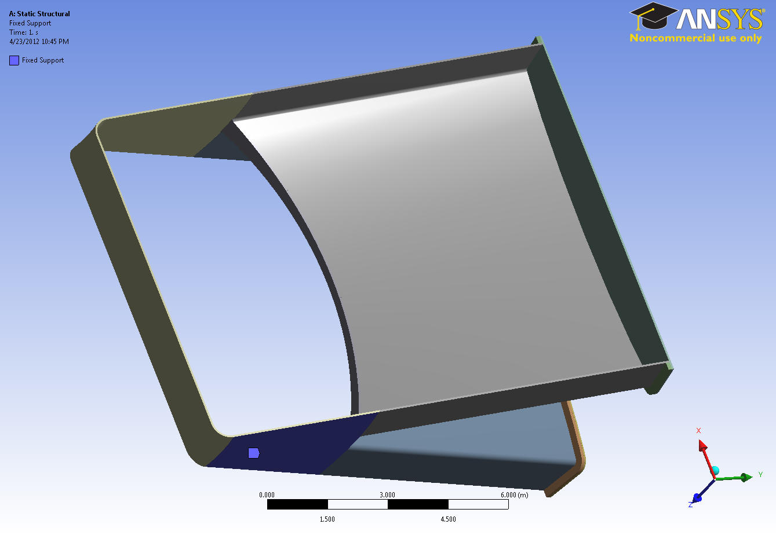
ANSYS Model of the vacuum vessel
Currently, we are only considering atmospheric and gravity loads.

Slide 5
Scoping Studies
Solid, constant thickness vessel for convergence studies and to find the areas of high stress.
A 10-cm steel vessel can support the loads. (discussed in the last project meeting).
Ribbed structure:
Focused on port walls to identify optimum ribbed structure (work is in progress).
Complete double-walled vacuum vessel will be analyzed once optimization of the ribbed structure is complete.

Slide 6
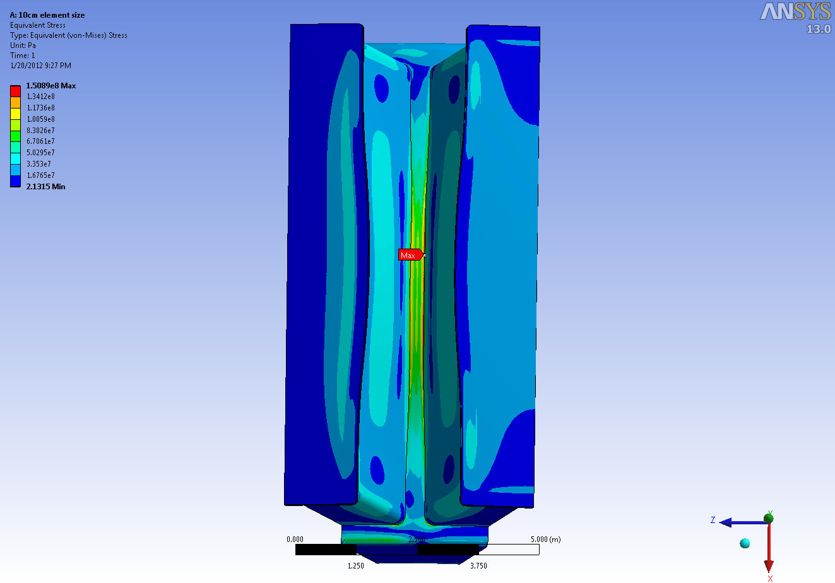
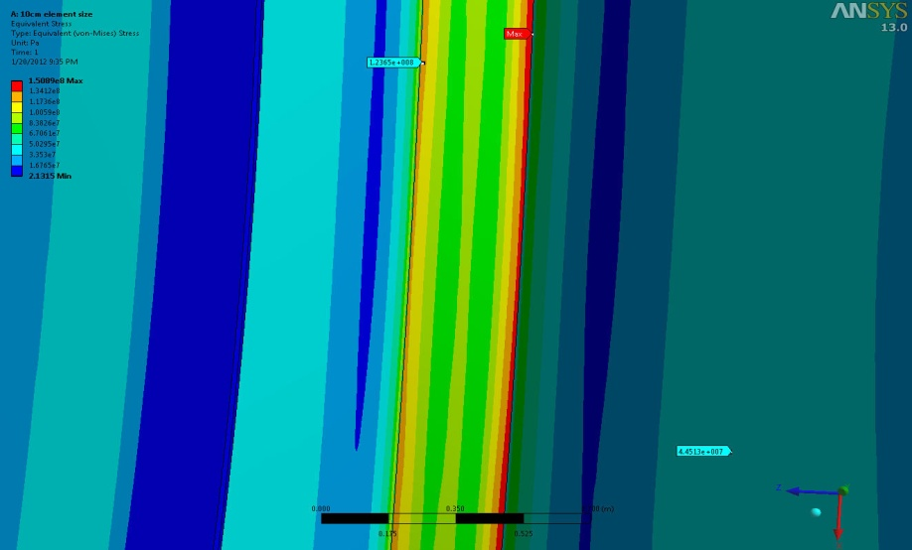
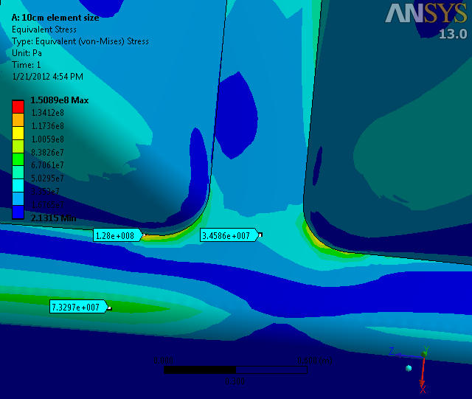
10cm Thick “Solid” Vacuum Vessel
123Mpa
46 Mpa
120Mpa
73 Mpa

Slide 7
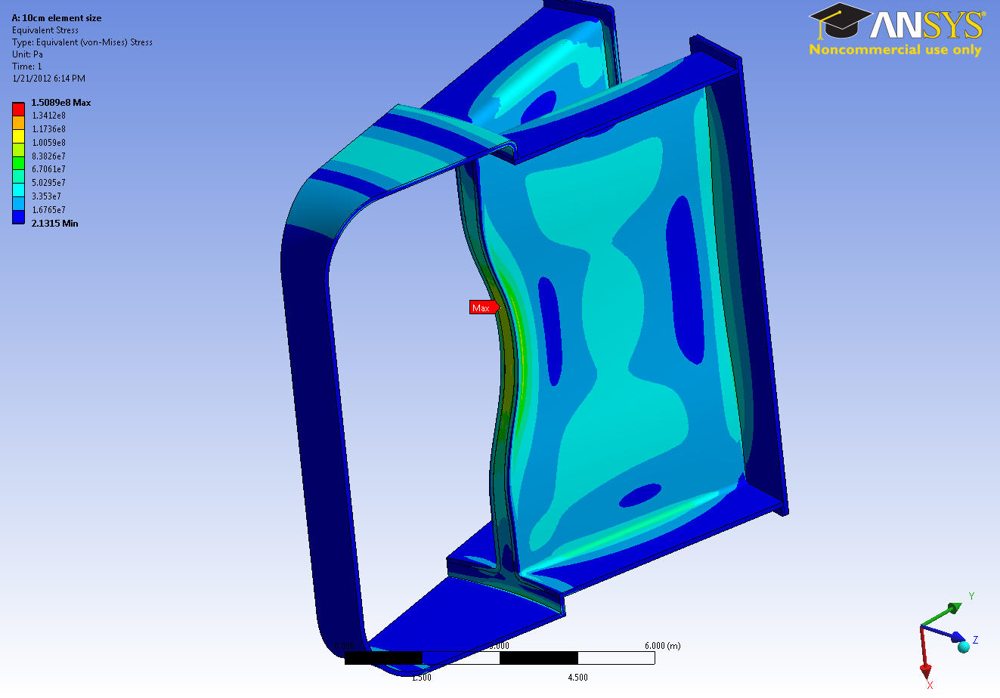
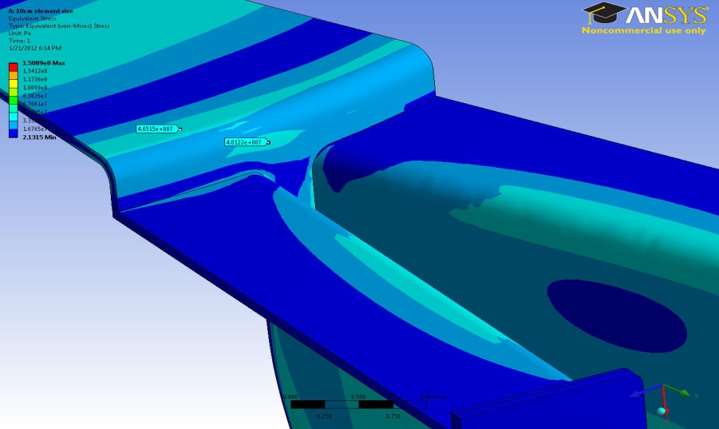
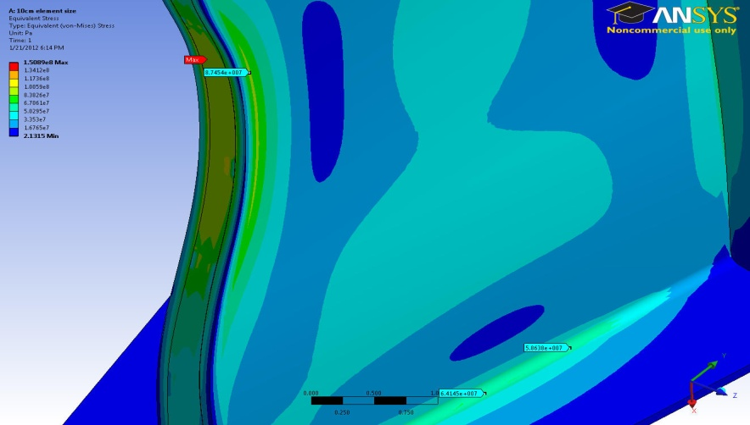
10cm Thick “Solid” Vacuum Vessel
45 Mpa
87 Mpa
64 Mpa

Slide 8
Scoping Studies
Solid, constant thickness vessel for convergence studies and to find the areas of high stress.
A 10-cm steel vessel can support the loads. (discussed in the last project meeting).
Ribbed structure:
Focused on port walls to identify optimum ribbed structure (work is in progress).
Complete double-walled vacuum vessel will be analyzed once optimization of the ribbed structure is complete.

Slide 9
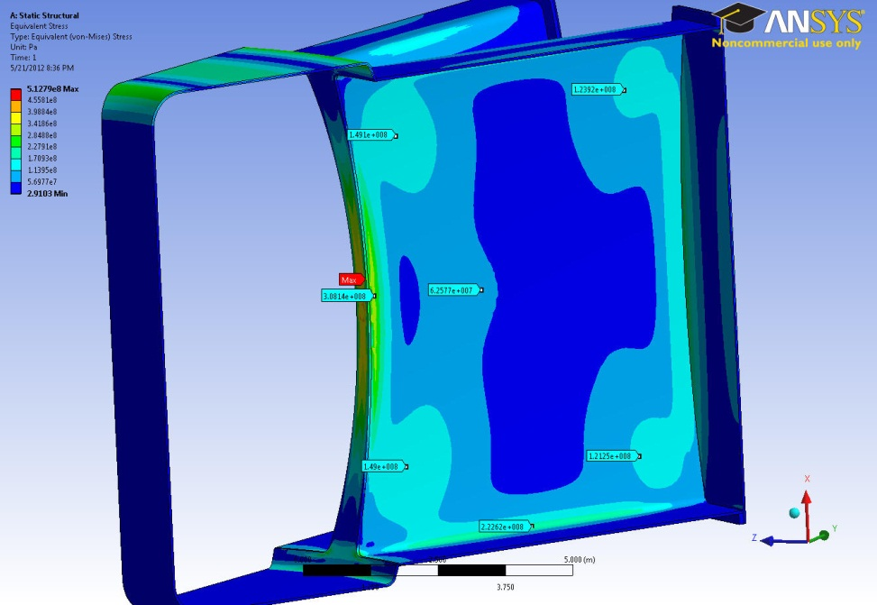
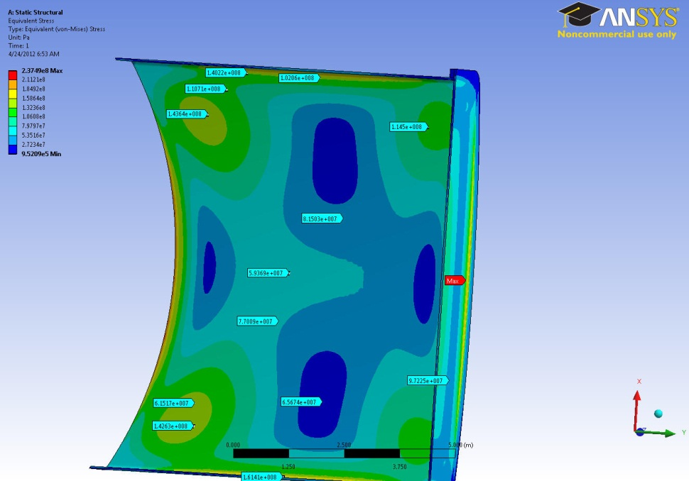
A simplified structure for optimizing ribbed structure:
5-cm thick Vacuum Vessel
Fixed BC - 5cm Thick Port
143 Mpa
116 Mpa
149 Mpa
123 Mpa
Fixed BC
149 Mpa
123 Mpa
143 Mpa
116 Mpa
Less than 5% difference between similar points

Slide 10
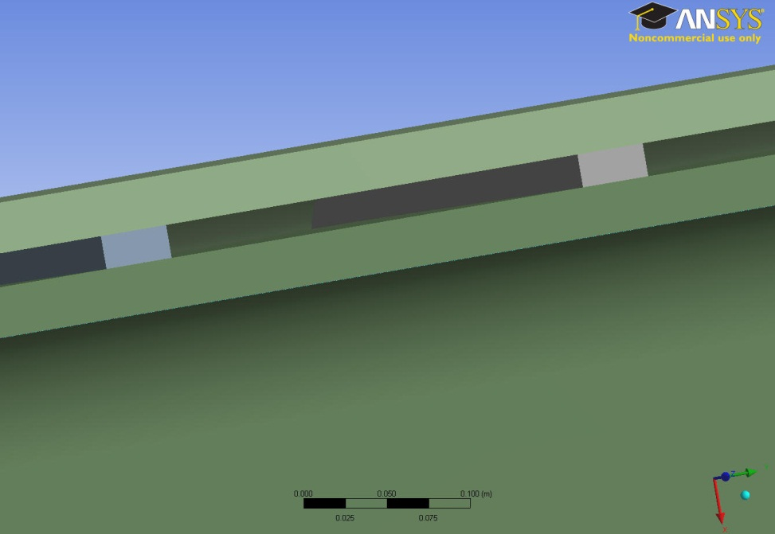
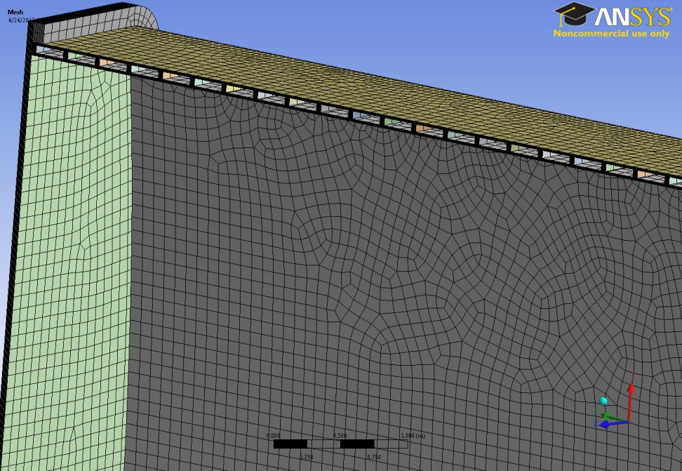
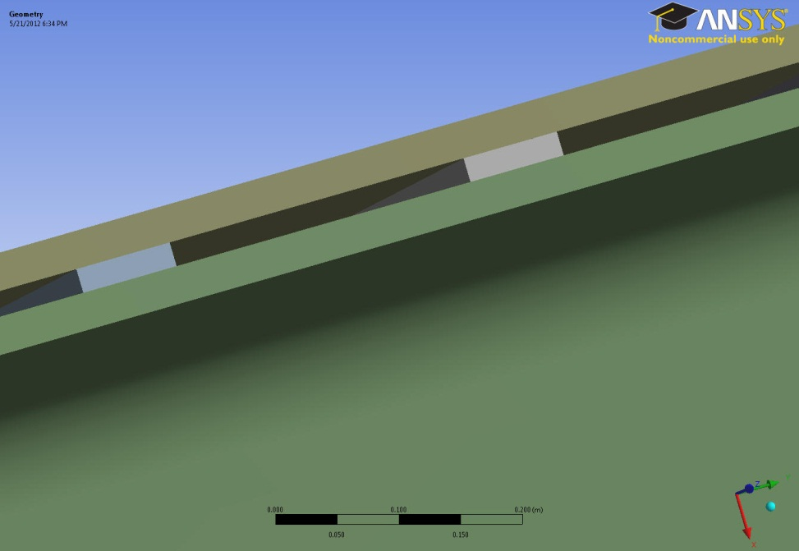
A variety of Rib size/spacing are considered.
2cm x 4cm Rib
3cm
2cm
4cm
8cm
3cm
2cm x 8cm Rib
2cm
3cm
8cm
3cm
3cm
3cm
8cm

Slide 11
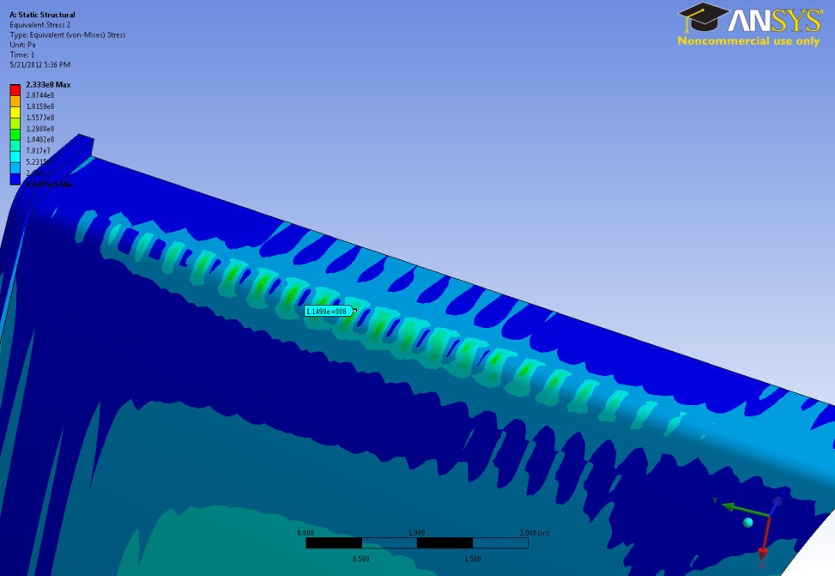
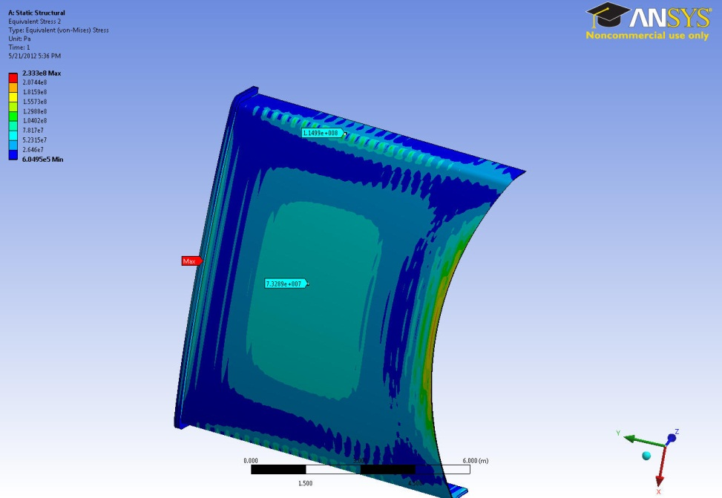
There is a substantial reduction in stress (outer plate)
74 Mpa
100 Mpa

Slide 12
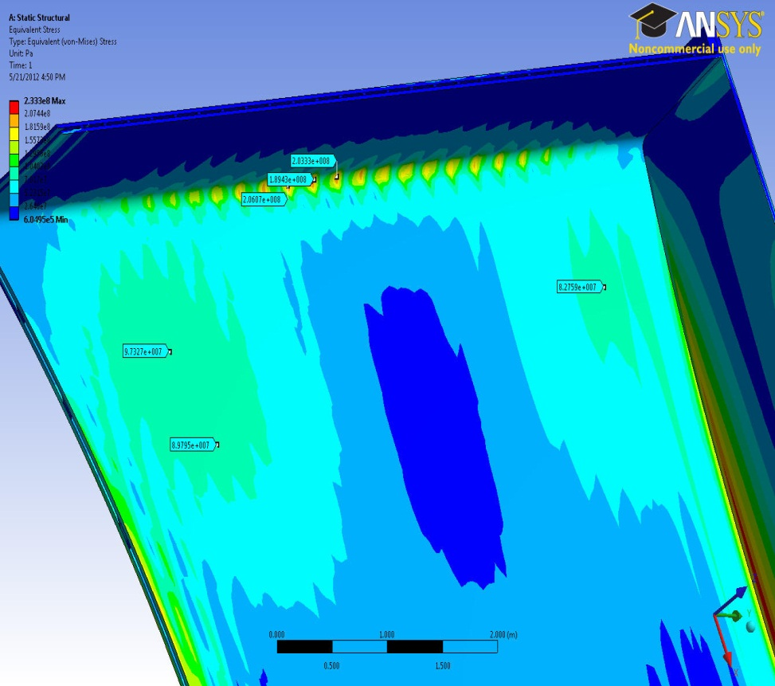
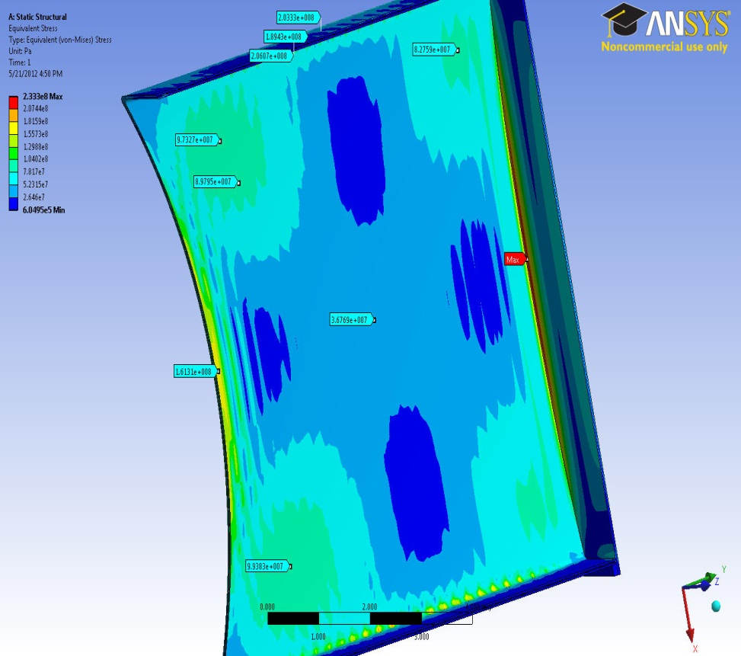
Stress is higher on the inner plate.
190 Mpa
200 Mpa
< 100 Mpa

Slide 13
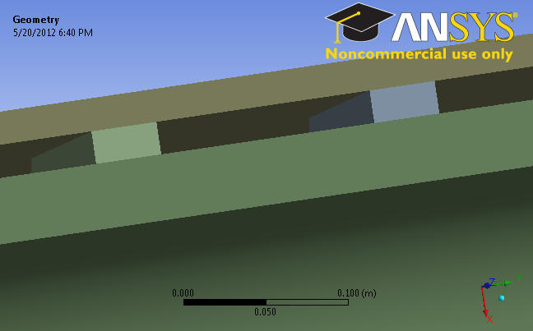
Increasing the thickness of inner plate and reducing distance between ribs helps reduce stresses
2cm
2cm
2cm
4cm
2cm
4cm
25 cm
13 cm
8cm
8cm
4cm
4cm

Slide 14
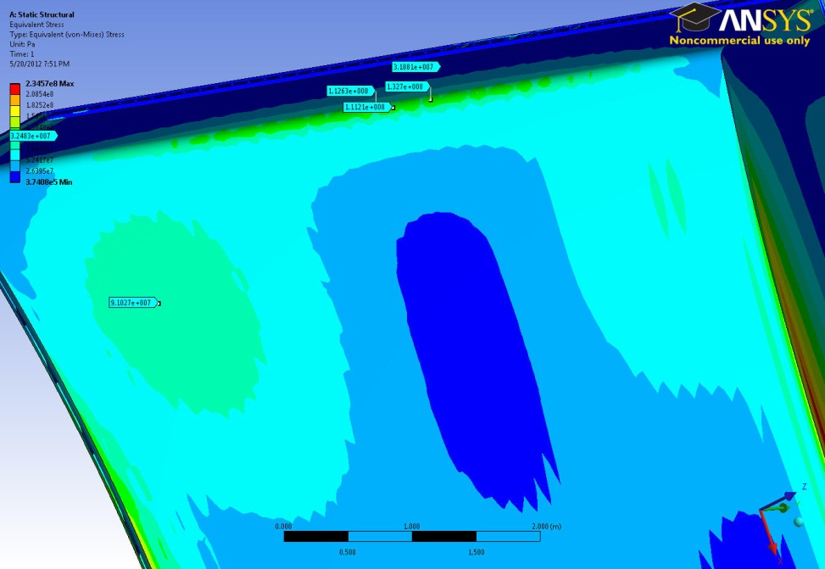
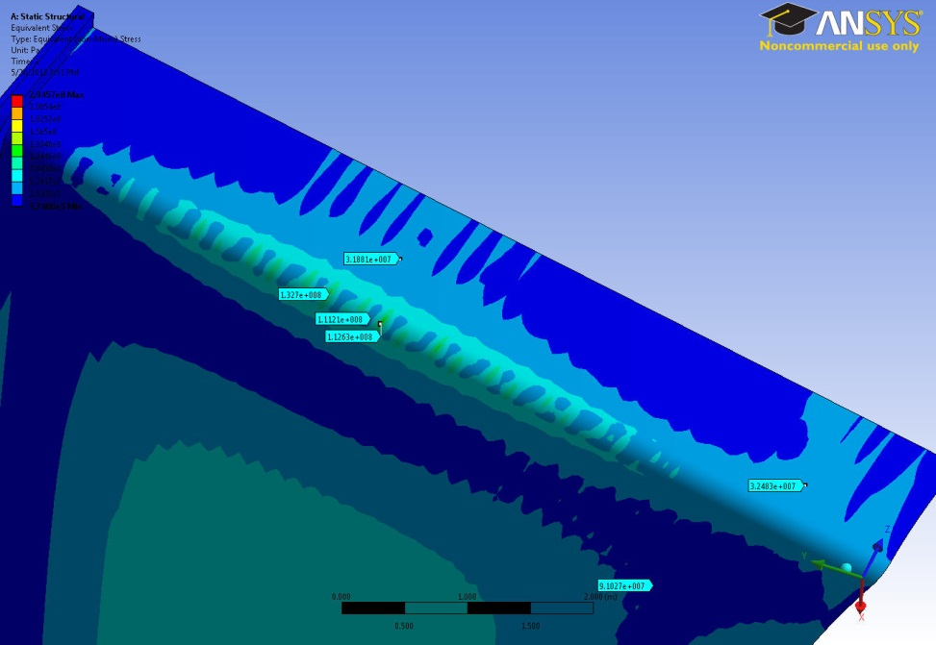
Stress Distribution (High Stress Areas)
Inner Sheet (4cm Thick)
Outer Sheet (2cm Thick)
112 Mpa
35% Stress Reduction
Not Over Stressed < 140 Mpa
130 Mpa
110 Mpa

Slide 15
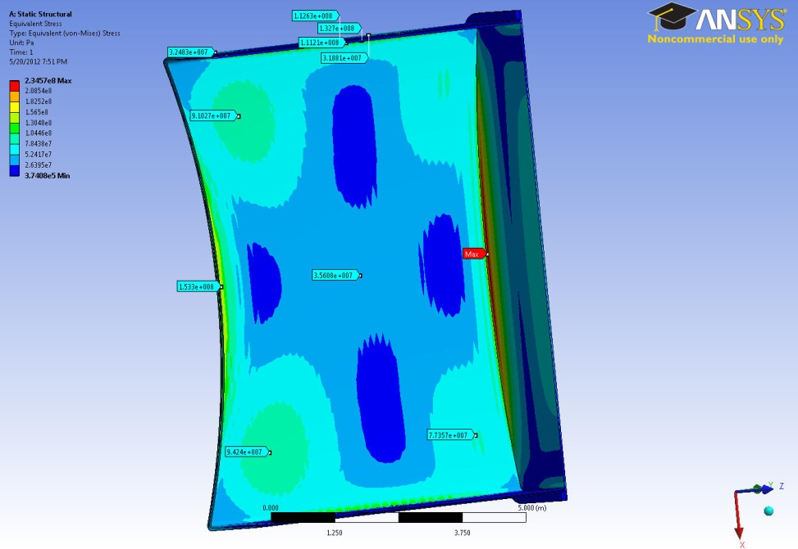
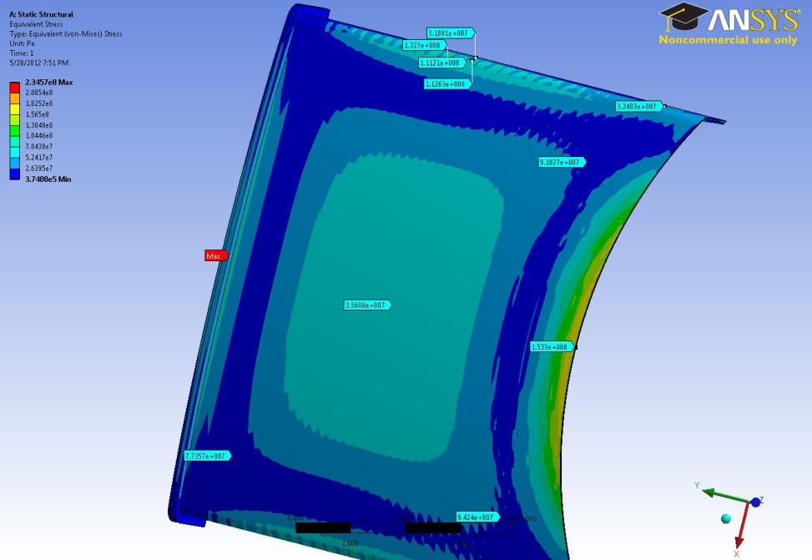
Stress Distribution
Inner Sheet (4cm Thick)
Outer Sheet (2cm Thick)
77 Mpa
91 Mpa
94 Mpa
74 Mpa
35 Mpa
78 Mpa

Slide 16
Comparison Table
Type of Vacuum Vessel | High Stress Region on the Port
5 cm Single Wall | 190 _ 230 Mpa
10 cm Single Wall | 80 _ 100 Mpa
8 cm Double Wall (Ribbed Structure) | 110 _ 130 Mpa
We are continuing to optimize ribbed structure (plate thickness, rib spacing, plates spacing, and rib direction).

