Slide 1
Coolant Connections to the DCLL Blanket
S. Malang, Dara Navaei, Xueren Wang
ARIES Project Meeting
UCSD
January 23-24, 2012

Slide 2
Scope of Presentation
Layout of coolant connections limited to the liquid metal supply to the IB blanket.
Basic geometry and power level taken from Laila’s presentation at the Project meeting in July 2011.
Main emphasis placed on LM flow path avoiding 3D MHD problems.
All LM coolant ducts inside the sector up to the IB blankets are concentric ducts embedded into the skeleton ring.

Slide 3
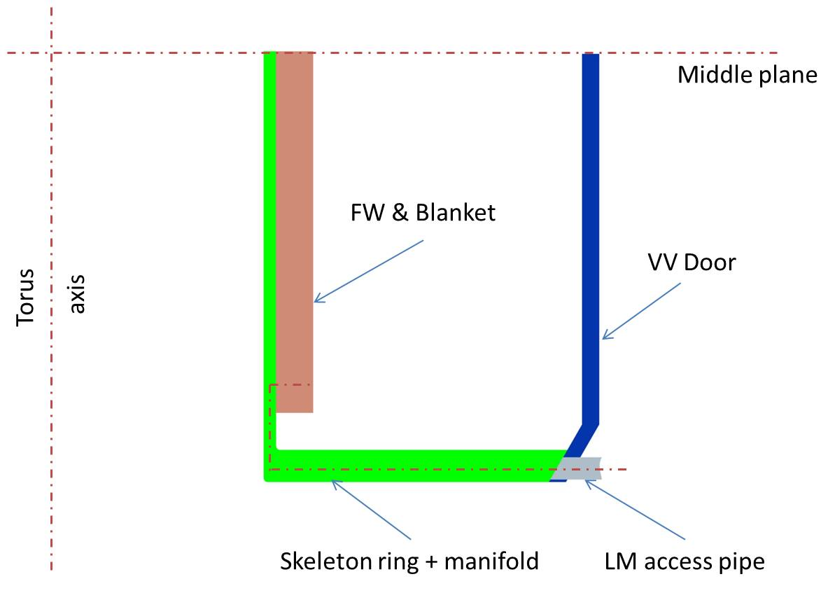
Liquid Metal Coolant Connections to IB Blanket

Slide 4
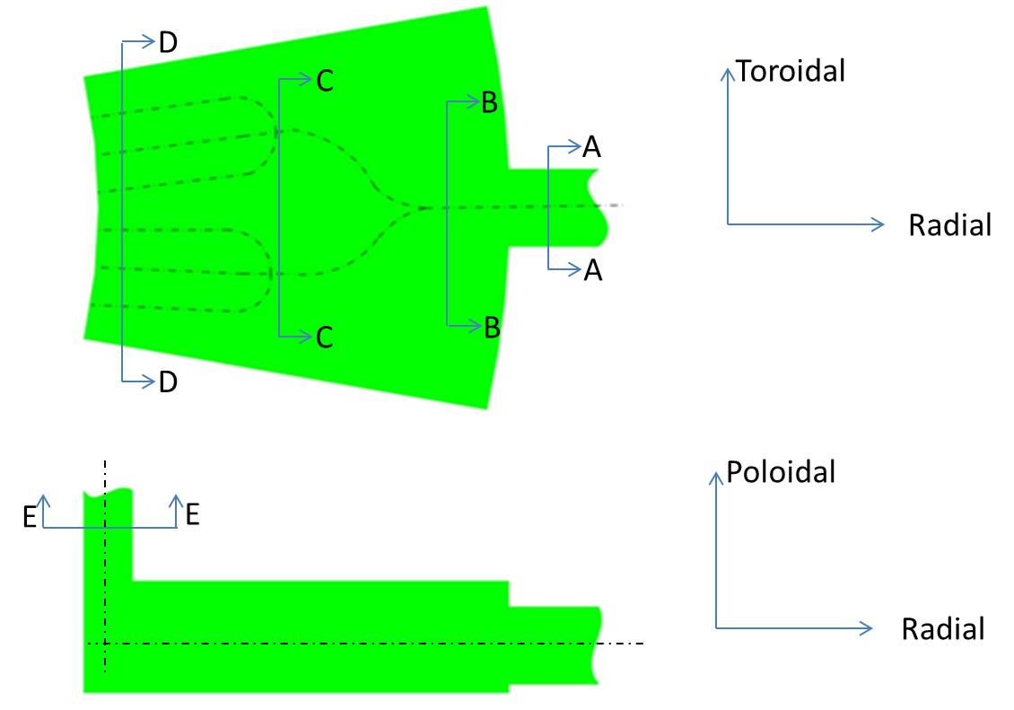
Principle Arrangement of Cooling Ducts in the Skeleton Ring

Slide 5


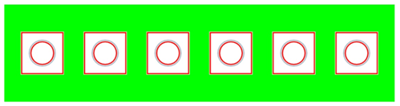

LM Coolant Ducts in the bottom part of Skeleton Ring
Cross Section C-C
Cross Section B-B
Cross Section A-A
Cross Section D-D

Slide 6


LM Coolant Ducts in the Vertical Part of the Skeleton Ring
Radial
Cross Section E-E
Enlarged
cross section
Toroidal

Slide 7
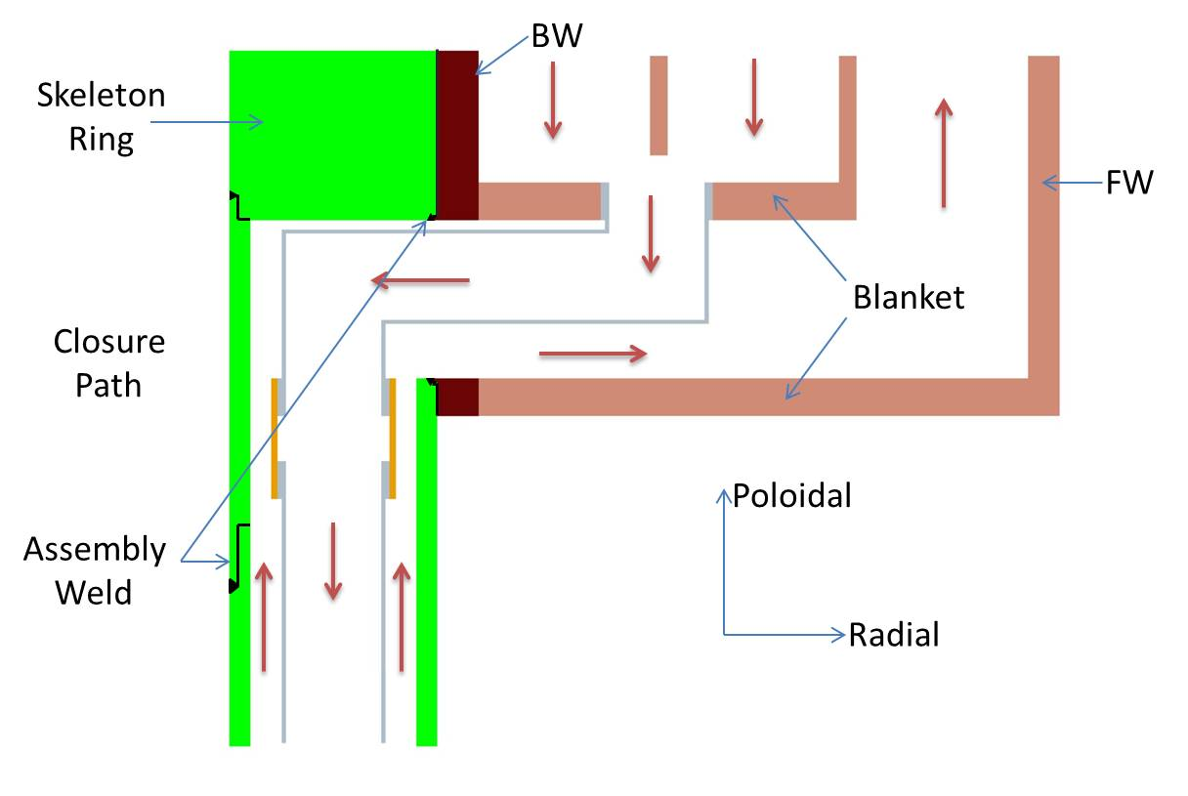
Transition from Skeleton Ring to Blanket

Slide 8
Basic Maintenance Concept for Blanket replacement (Described here for the IB blanket only)
Cut the coolant access pipes to a sector outside the inner door of the vacuum vessel. (For the IB blanket LM supply: 1 concentric tube)
Open the inner door.
Extract the entire sector in radial director, and transfer it to a hot cell.
Separate there the IB blanket from the skeleton ring by opening the closure plate, cutting the assembly weld between skeleton ring and blanket back wall, and by opening the mechanical connection between these two components.
Replace the old blanket by a new blanket.

