Slide 1
Preliminary Stress Analysis of Vacuum Vessel
By : Hamed Hosseini
Advisor: Prof. Najmabadi

Slide 2
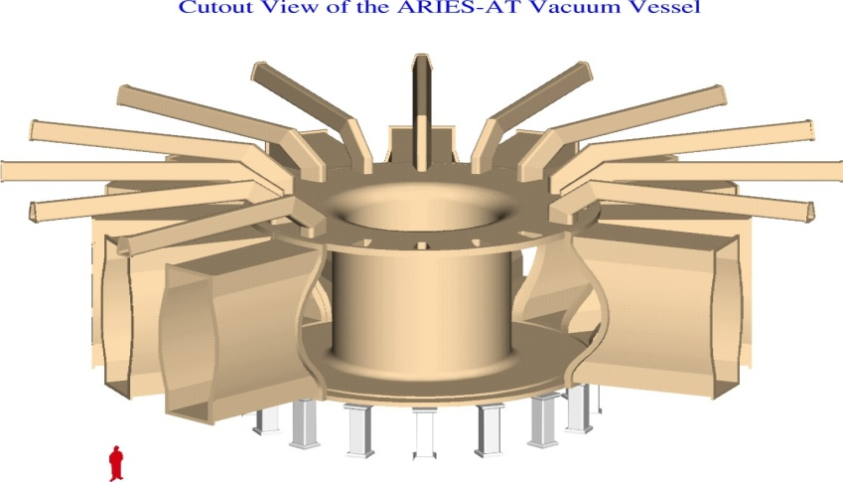
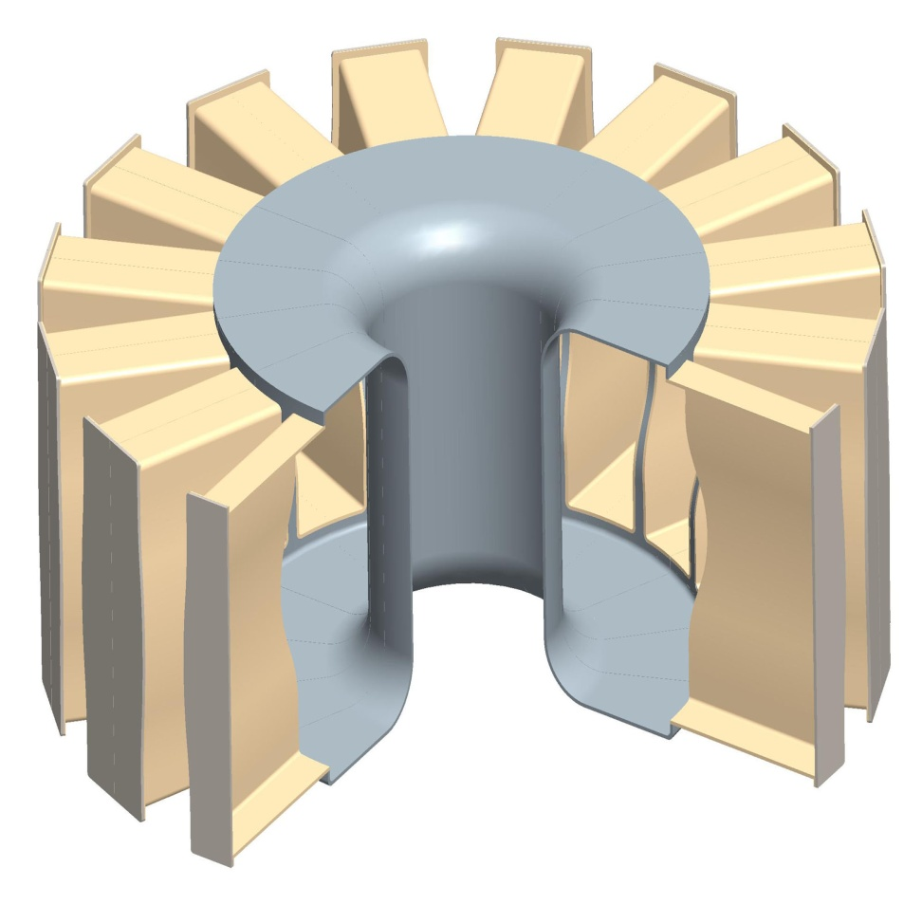
Introduction & Motivation
Vacuum Vessel
ARIES-AT
Vacuum Vessel provides high level vacuum environment to achieve fusion plasma.
The vessel is a structure with 16 core sectors and consists of vacuum body, ports, flanges and doors.
Ports allow maintenance access for replacement of sectors.
ARIES-AT was designed for sector maintenance with a double wall design.
Stress was not performed, and the geometry was not optimized.
Can the vacuum vessel accommodate a normal pressure (0.1 MPa)?
Vacuum Body
Doors
Ports

Slide 3
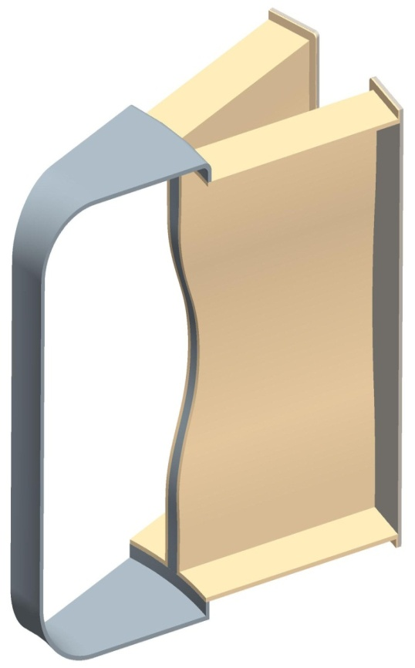
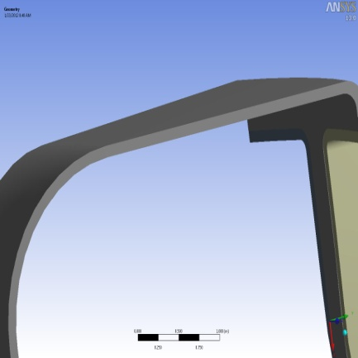
Introduction & Motivation
Vacuum Vessel
1/16 of Sectors (Symmetry )
Geometry of the vacuum vessel is taken from CAD, considering the very thin vacuum vessel (5 cm) and 10 cm thick.
Primary stress is performed by ANSYS Workbench to see if the thinner wall can accommodate the normal pressure loads and overpressure loads ( Motivation: How thin it can be based on the stress analysis).
How to mesh such a large scale model?
( Concerns : Memory, Meshing and solving time, mesh layers in thickness, convergence)
5(cm), 10(cm)
11 (m)
Uniform Thickness
10 (m)
Material : SST 316, Yield Stress: 140 MPa, and Working Temperature: 550 K

Slide 4
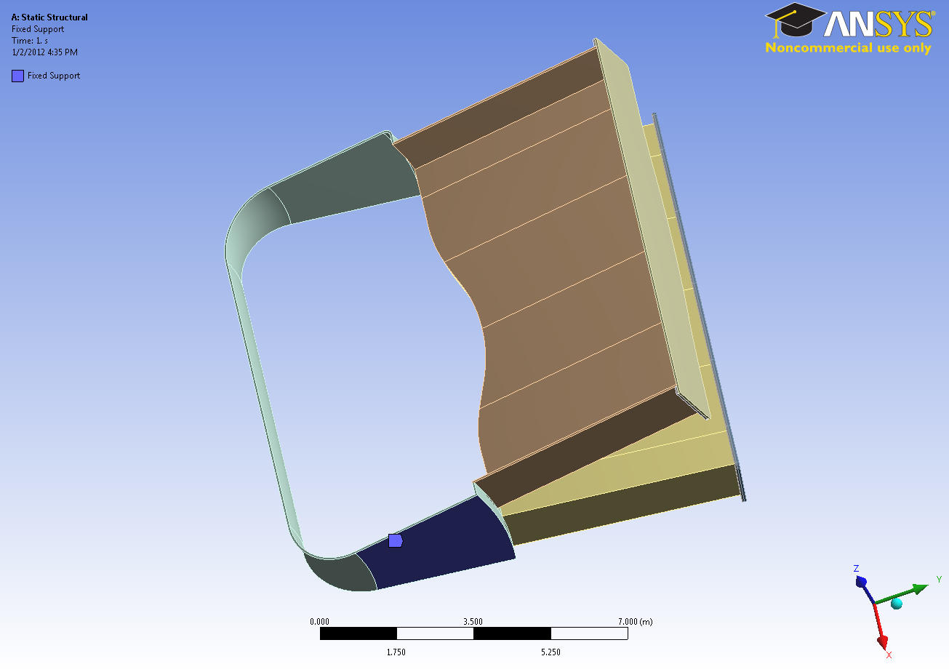
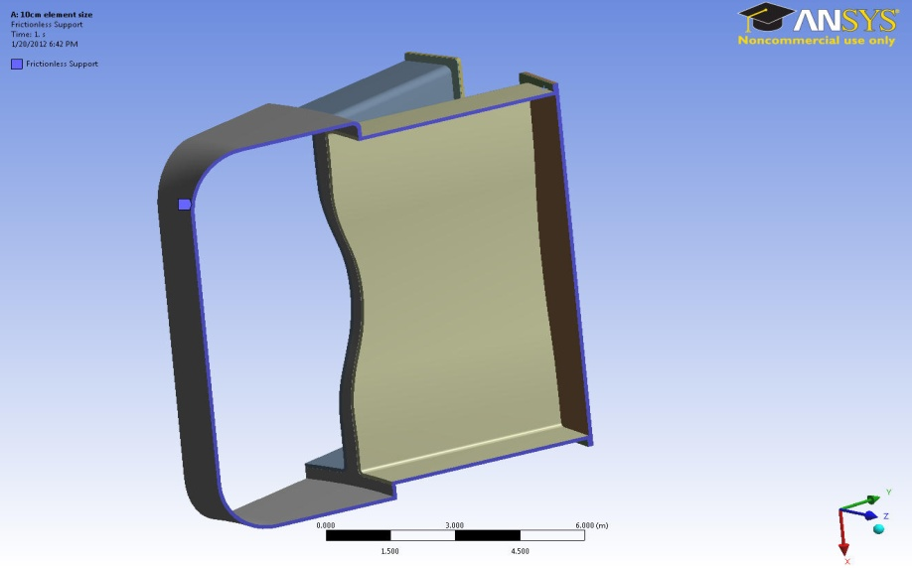
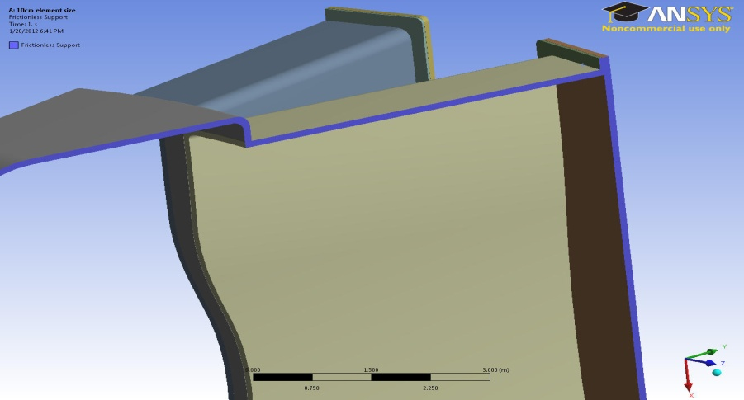
Boundary Condition
Fixed Bottom (Blue area is fixed)
Symmetry (Blue area)
Loads: Outside pressure: 1 (atm), Inside pressure: zero, and Gravity

Slide 5
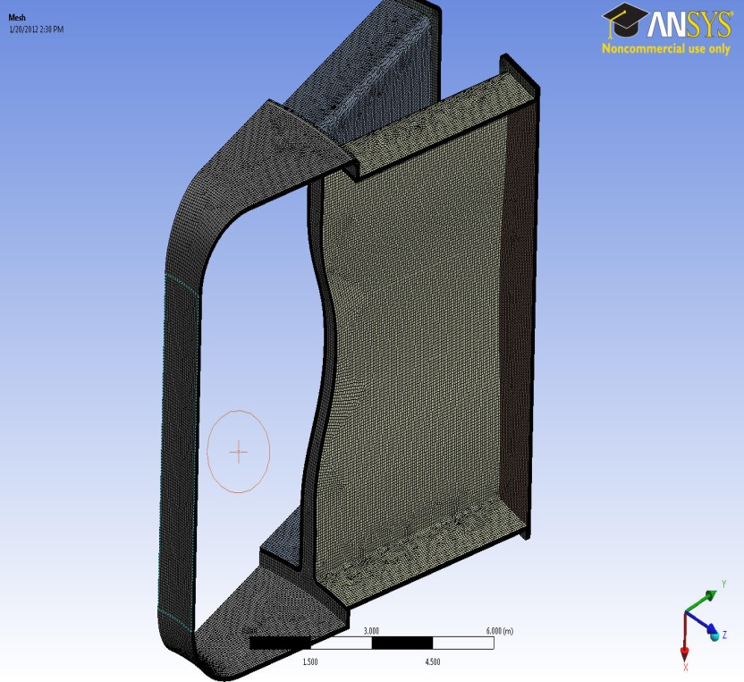
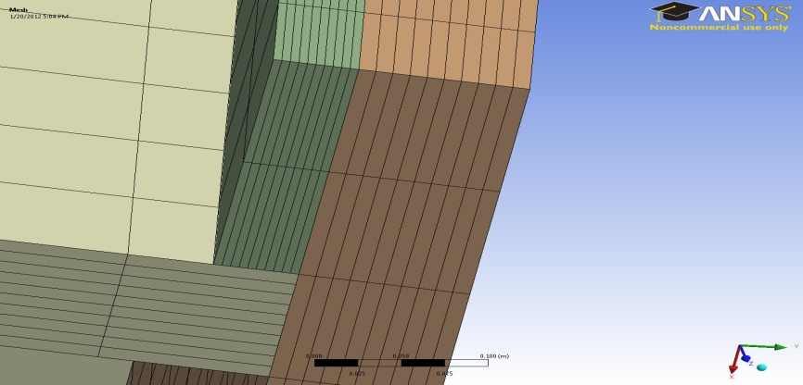
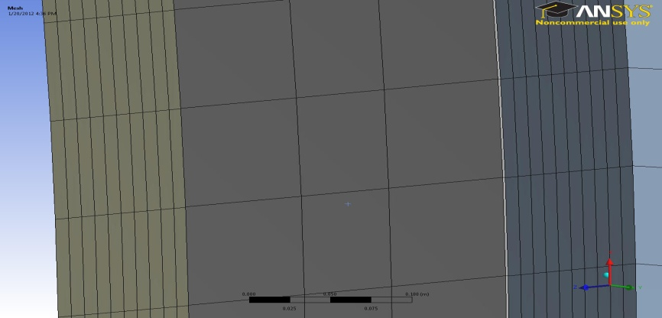
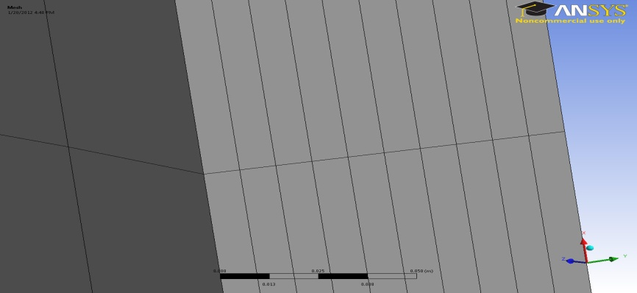
Meshing (Sweep Method)
Door
Flange
Port
Middle Wall
Ports
Inboard Structure
Creates Structured hexahedral Mesh.
Saves memory, meshing time and computing time
(structured Elements, less elements).
Control over mesh layers in the thickness.
Fast convergence.

Slide 6
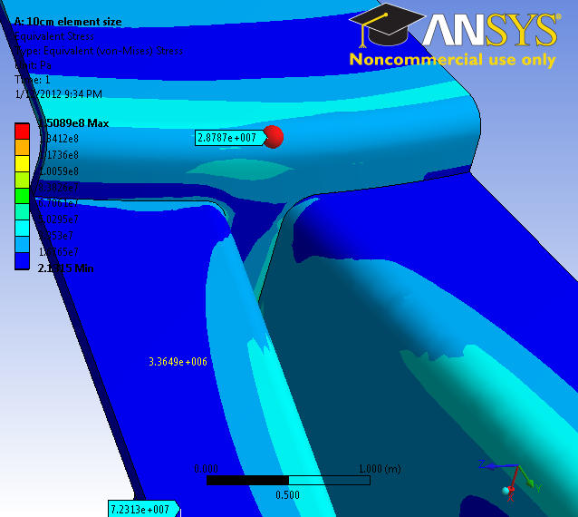
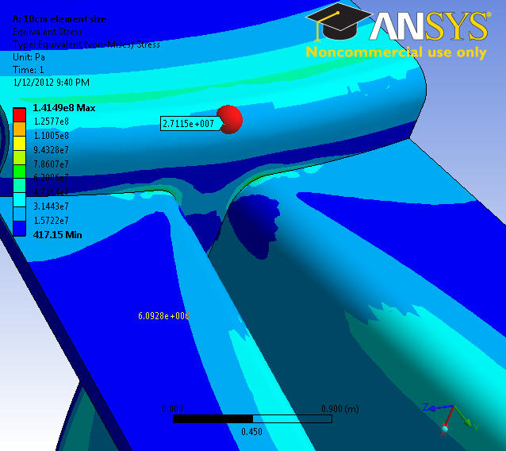
Convergence (Arbitrary Point)
6 (cm)x 6(cm)x 1(cm)
10 (cm)x 10(cm) x 1(cm)
5 %
Exact points on the body have 5% change in stress by changing the element size.

Slide 7
Convergence
Element Size | Number of Elements | Max. Pressure (Pa)
20 (cm)x 20 (cm) x 1(cm) | 58’500 | 1.27 e8
10 (cm)x 10(cm) x 1(cm) | 230’140 | 1.41 e8
6 (cm)x 6(cm)x 1(cm) | 578’260 | 1.50 e8
11 %
6.3 %
Convergence is checked by reducing the element size.

Slide 8
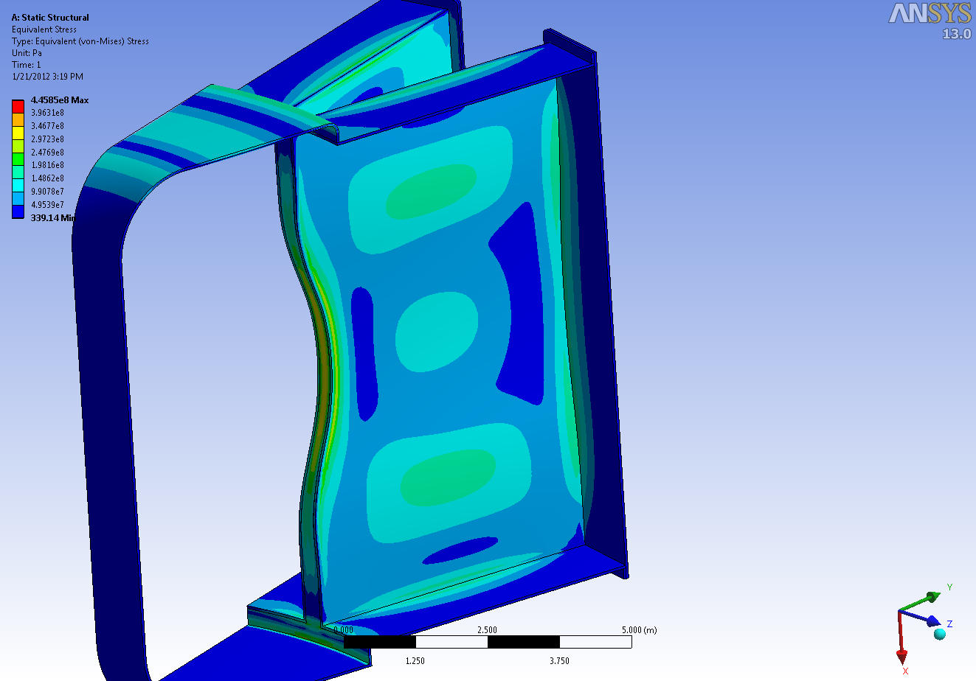
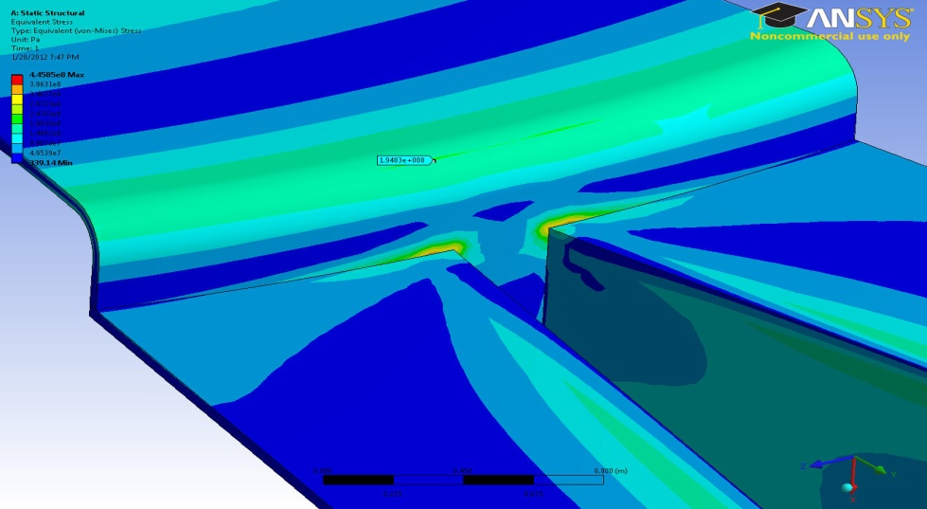
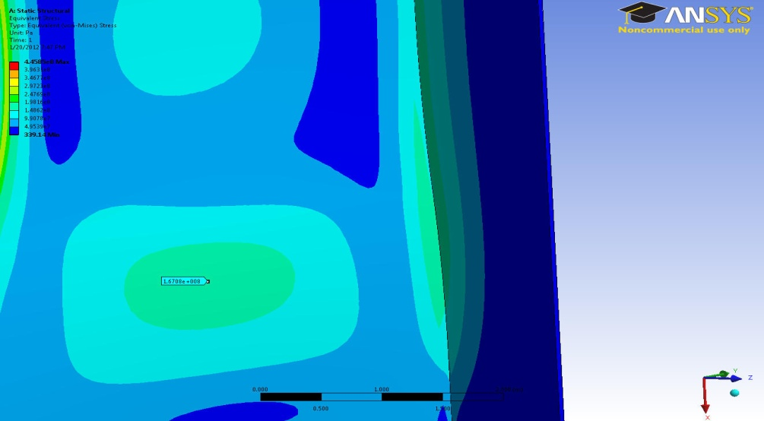
Results (5cm Thick Vacuum Vessel)
197 Mpa
174 Mpa
160 Mpa
120 Mpa
166 Mpa
130 Mpa
Top and some parts of the ports and doors are high stress (> 140 MPa)!
Material should be added to these regions to get the stress down.
Low stresses are on the Inboard (< 100 MPa)!

Slide 9
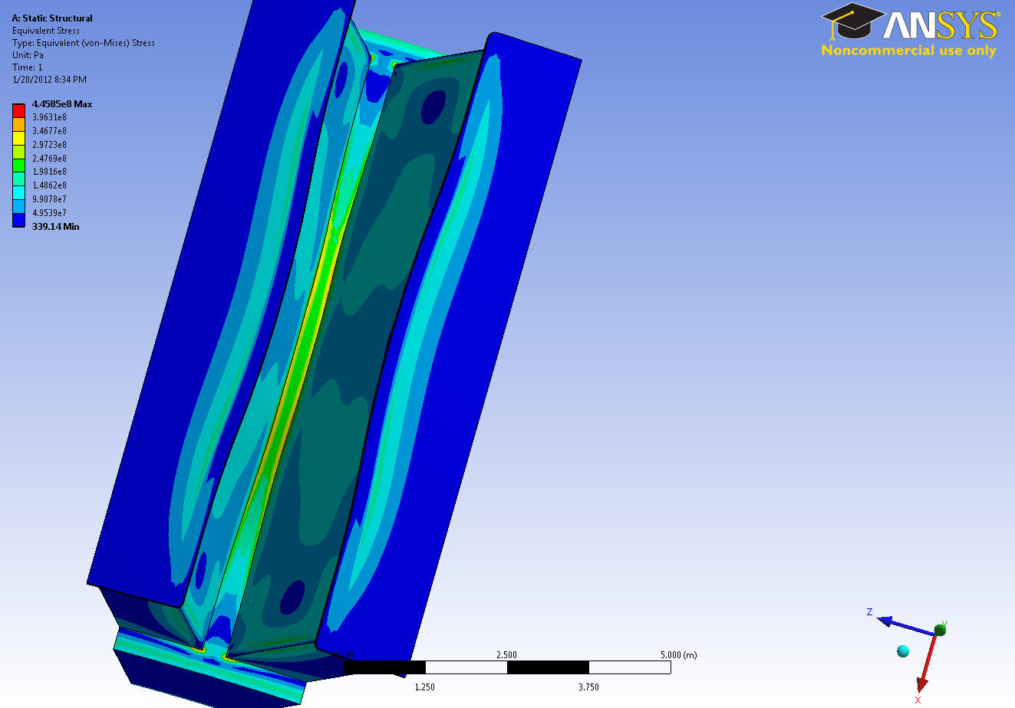
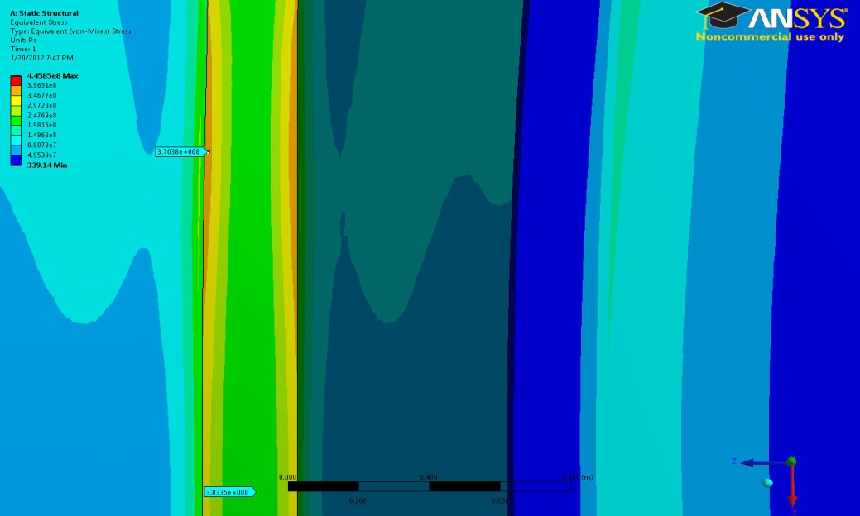
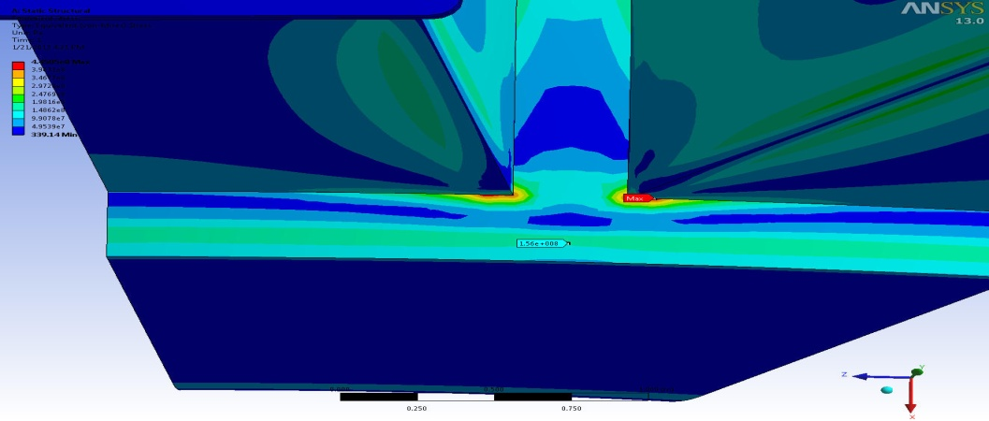
Results (5cm Thick Vacuum Vessel)
370 Mpa
120 Mpa
154 Mpa
156 Mpa
Maximum stress happens at the sharp corner (rounded corner? )
A large portion of the middle wall goes up to very high stresses ( Close to 400 Mpa).
The middle wall thickness should be changed to a bigger thickness.
How thick should be the middle wall ( approximately)?

Slide 10
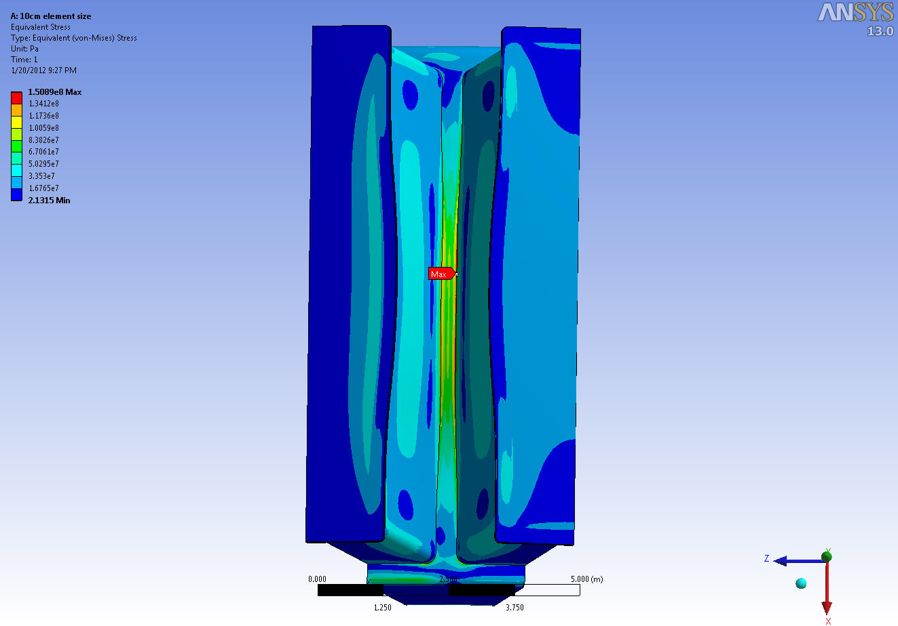
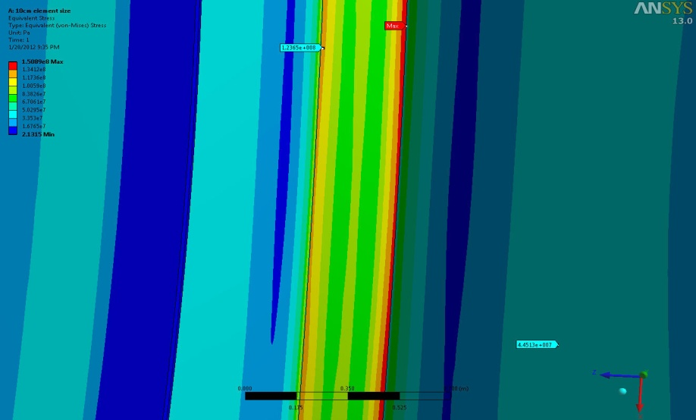
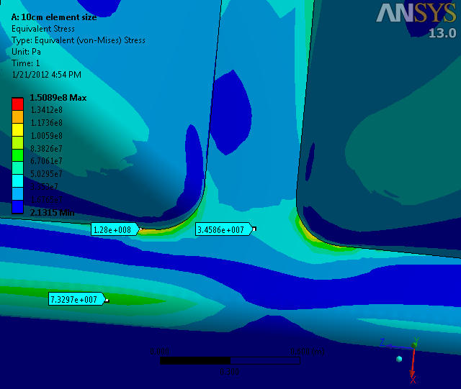
Results (10cm Thick Vacuum Vessel)
123Mpa
46 Mpa
120Mpa
73 Mpa
Stress in the middle wall gets very close to the yield point (140 Mpa).
The maximum stress (150 Mpa) jumps from the rounded corner to the middle wall (on the port- wall interface).
Inboard ports and doors are less than the yield stress.

Slide 11
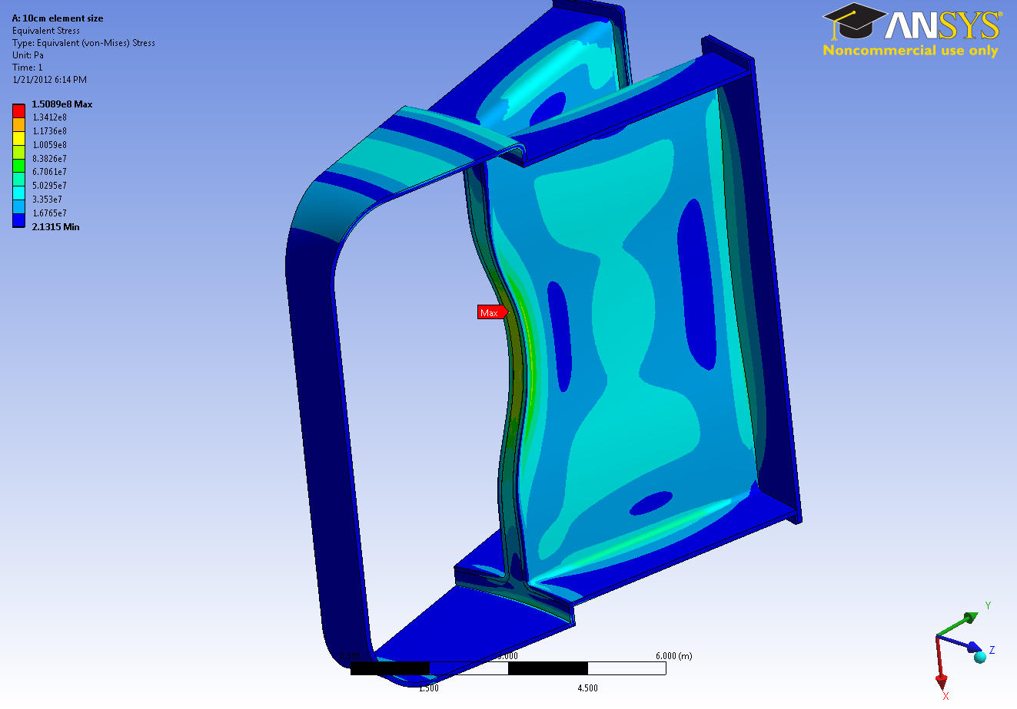
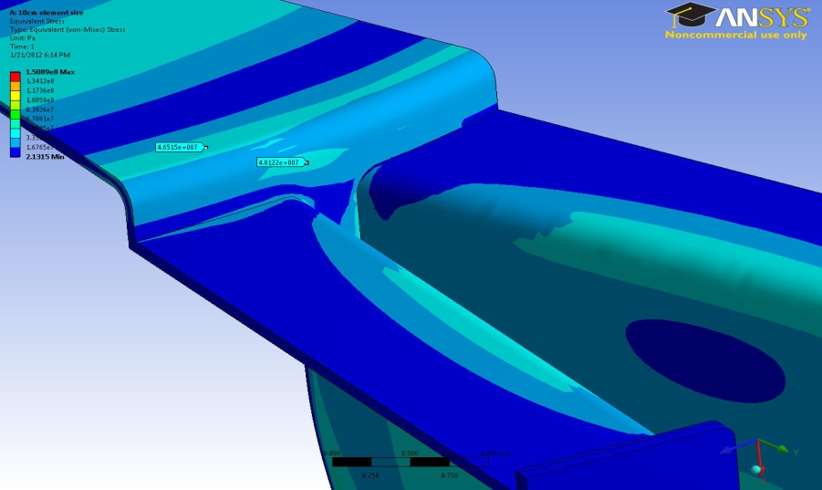
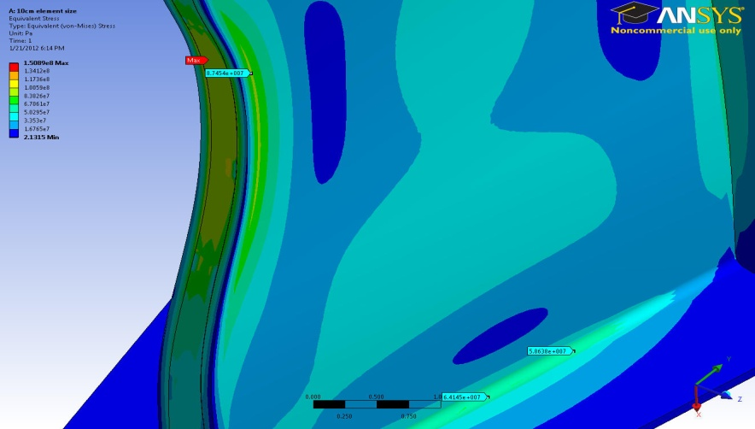
Results (10cm Thick Vacuum Vessel)
45 Mpa
87 Mpa
64 Mpa
Stress in other parts is less than the yield stress, even less than 100 Mpa.
No need to add material.

Slide 12
Summary
A preliminary structural analysis of the vacuum vessel was performed.
The locations of high stresses were identified (Some region of ports and doors, corners, top of the vessel, and the worst case is the middle wall).
According to the results, the middle wall thickness should be more than 10cm thick.
Stress on the Inboard structure was acceptable for ~5cm thickness. So, it is always safe to design the Inboard with 5cm thickness.

Slide 13
Future Analysis
Ribbed structure (new design)
Disruption electromagnetic loads

Slide 14
Thanks & Questions

