Slide 1
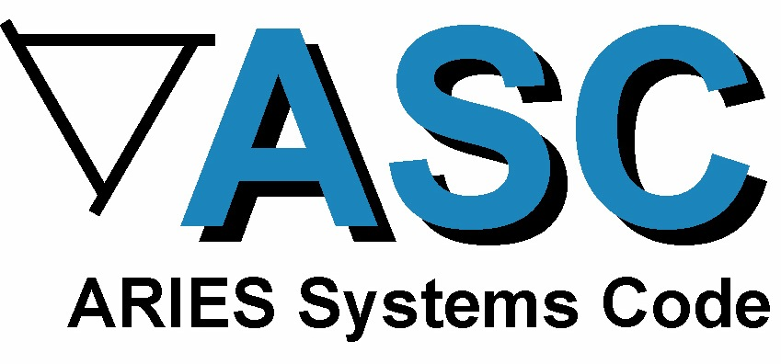

Updating the SCLL Design & ASC Documentation
Lane Carlson
ARIES Pathways Project Meeting
San Diego, CA Jan 23-24, 2012

Slide 2
ASC Progress
New!
Continual systems code updates to improve credibility and transparency.
Refining of SCLL design.
New comprehensive documentation.
New ASC Homepage for all ASC-related material.
Oct. 2011 action items for ASC:
Focus on updating and completing SCLL design
Delay issuing DCLL strawmen until a consensus on new thicker build is incorporated
Investigate additional 3D printing
Status
Ongoing
Forthcoming
Ongoing

Slide 3
ARIES Design Nomenclature
ARIES ACT-SA
-DC
SCLL, Advanced
DCLL, Conventional
Name | Blanket | Physics | Strawman Point
ACT-SA | SCLL (SiC self-cooled PbLi) | Advanced | Issued April 2011
ACT-SA (b) | SCLL | Advanced | Re-run June 2011
ACT-SA (c) | SCLL | Advanced | Re-ran Jan 2012
ACT-SC | SCLL | Conventional | Issued April 2011
ACT-DA | DCLL (dual-coolant PbLi) | Advanced | Forthcoming
ACT-DC | DCLL | Conventional | Forthcoming
All formally-issued strawmen available online: http://aries.ucsd.edu/carlson/aries/

Slide 4
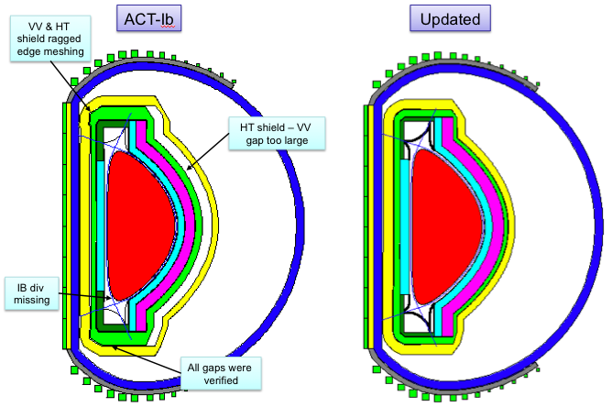
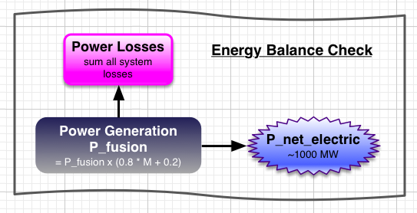
Substantiating SCLL Design
What is different from ACT - SA (b) such that we need the SA (c) update?
Radial build, plasma surface area corrected (July 2011 presentation)
Power balance corrected (Oct 2011 presentation)
New, easier-to-read printouts for strawman points

Slide 5
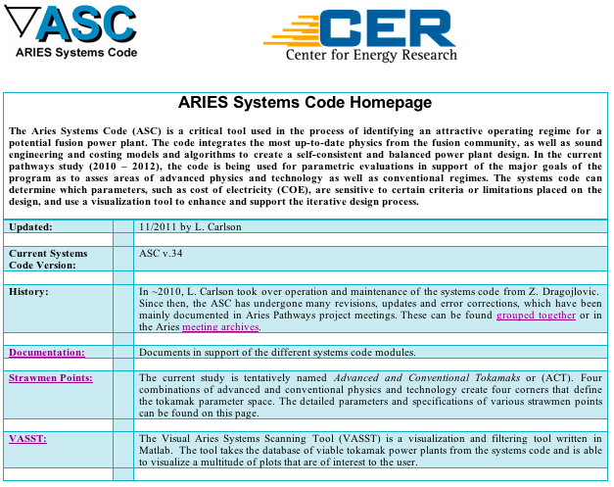
ASC Homepage
History
Documentation
Modifications
Equations
Code Modules
Input & outputs
Examples
Flow of calculations
Power flow diagram
Reference documents
Old documentation
Strawmen Points
VASST
http://aries.ucsd.edu/carlson/aries/

Slide 6
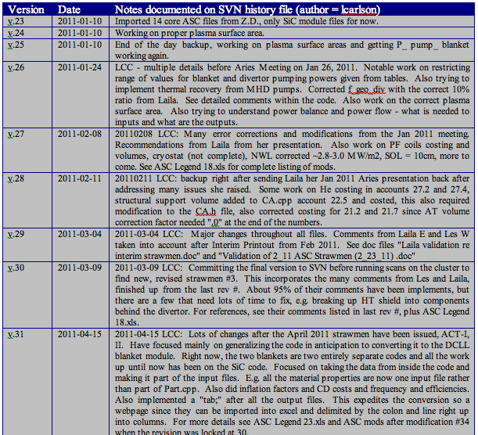
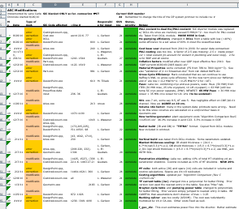
Documentation Page 1
Modifications:
Subversion SVN version control
SVN history log
Modifications sheet (ASC_mods.xlsx)

Slide 7
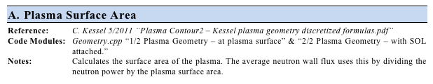
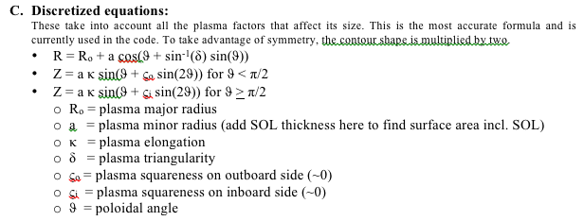
Documentation Page 2
Equations:
Volume calculations
Blanket, divertor pumping powers
First wall and divertor heat flux
Power summation
Gross cycle efficiency
Current drive
Part construction, references and constraints
Part or calculation
Ref. docs, where this resides in the code, notes
Equations, notes, assumptions
Defined variables and explanations

Slide 8
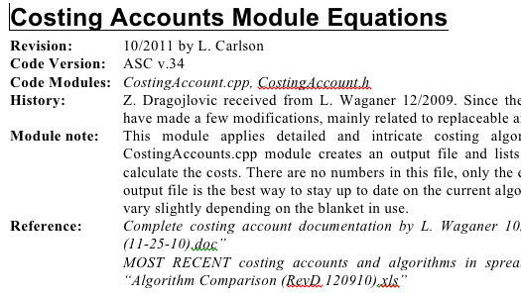
Documentation Page 3
Code Modules (C++):
Physics, Aries, Cost, Costing Accounts, Design Point, Geometry, Part.cpp
Code module
Date of documentation
ASC version (SVN #)
Module name
History of the module
Notes on module and its purpose
Reference docs (viewable on ASC Documentation page)

Slide 9
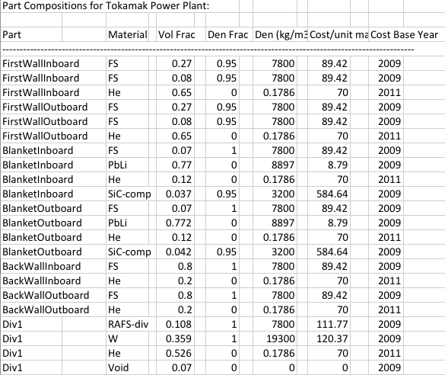
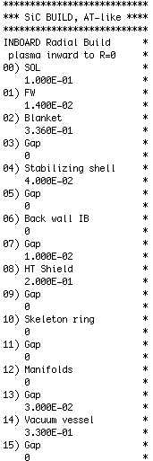
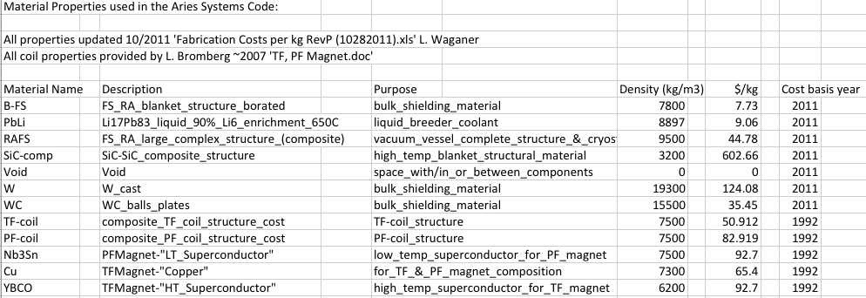
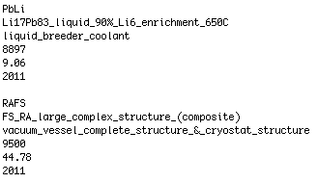
Documentation Page 4
Input files:
Raw data file from physics module
Setup files – choose divertor, blanket, scanning mode
Runaries script – designates points to scan
Radial build input file – IB, OB, vertical
Materials – name, purpose, density, cost, cost basis year
Inflation factors
Costing parameters
Magnets – TF and PF coil parameters
Power flow – neutron multiplication factors, efficiencies, power flow fractions

Slide 10
Documentation Page 5
Output files:
Raw data output file
Part files for CAD drawings
Costing accounts and algorithms
System engineering summary
Powers and heat fluxes summary
Inflation factors, material properties, part compositions printouts
Flow of calculations diagram – flow of the code structure
Power flow diagram – complete listing of all power fractions, power flow, generated, lost and recovered heat.
Reference documents – spreadsheets, papers, journal articles, etc. from contributing team members to reference equations, assumptions and hard numbers in the systems code.
Old reference documents – from Z. Dragojlovic for archival purposes.

Slide 11
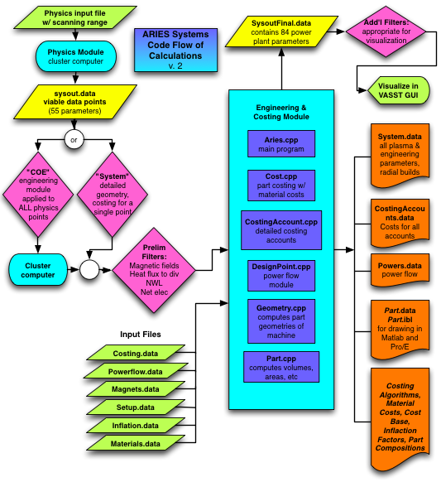
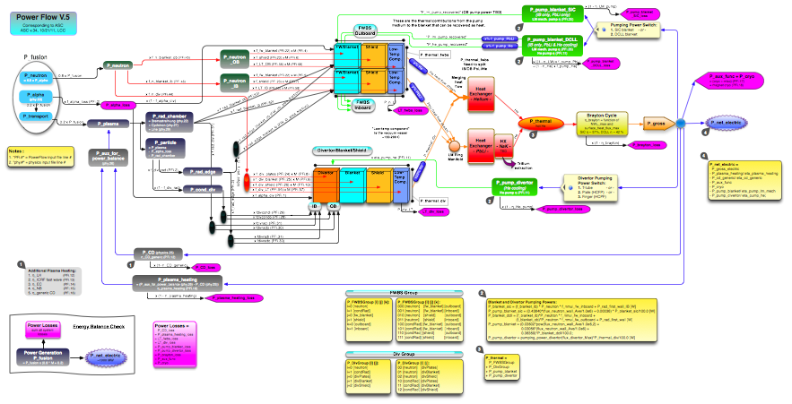
Documentation Page 6
Systems Code Flow of Calculations & Structure
Input files
Processing/computation
Databases
Output files
Filtering steps
Power Flow Diagram, as presented Oct. 2011

Slide 12
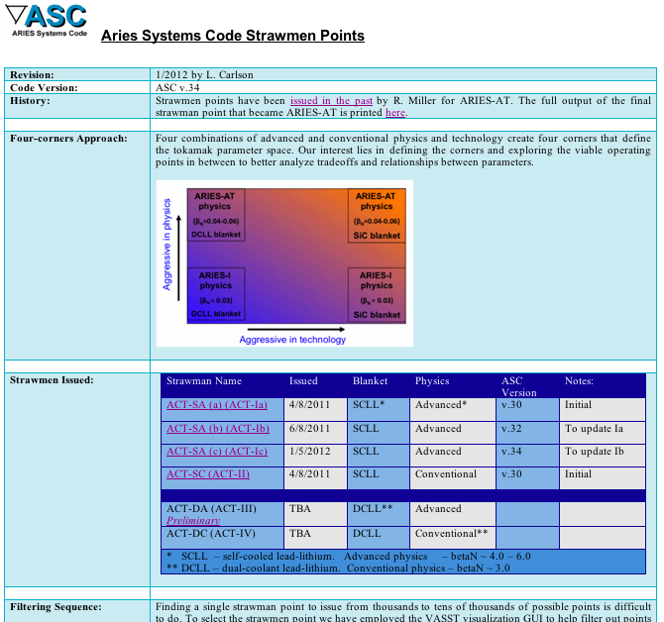
Strawmen Points Page
Version
History/overview
Four-corners approach
Strawmen issued
Name
Date
Blanket
Physics
ASC version
Notes
Filtering sequences

Slide 13
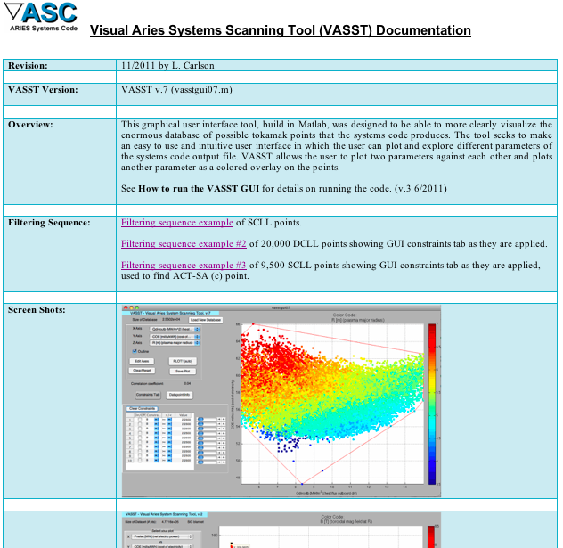
VASST Page
VASST Version
Overview
Filtering sequences
Samples
Screenshots

Slide 14
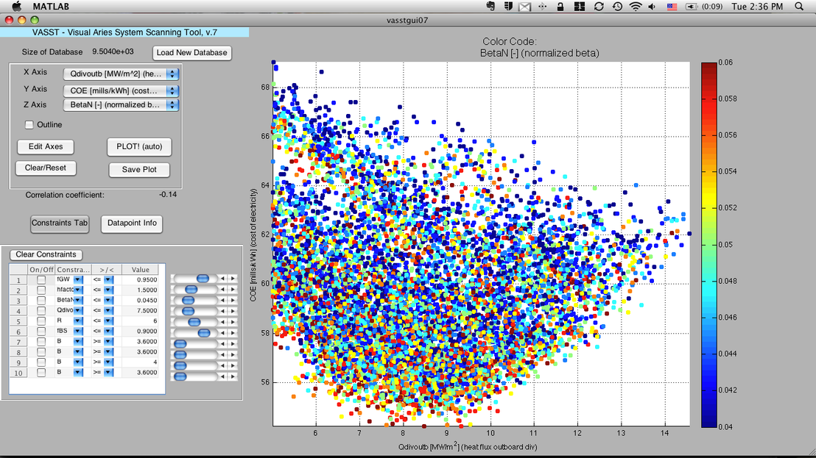
VASST Filtering Sequence
Used to help find ACT-SA strawman point

Slide 15
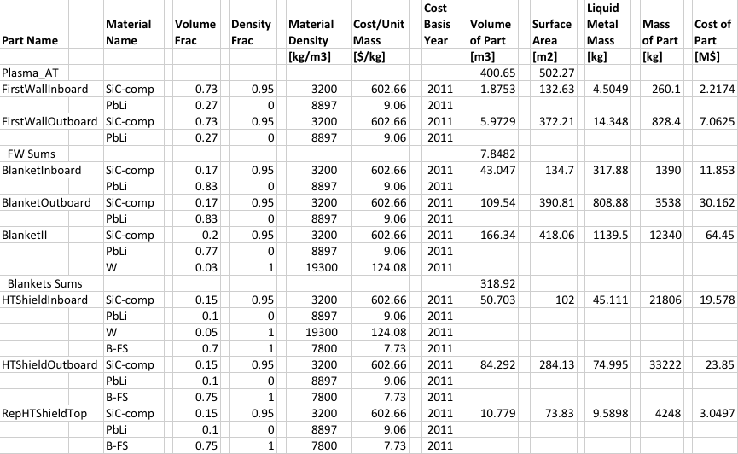
Easier-to-read part printouts combine all part parameters

Slide 16
Summary & Future Work
Modifications continue to enhance & clarify the ASC.
Comprehensive documentation posted on ASC Homepage:
http://aries.ucsd.edu/carlson/aries/
Ready to implement changes to SCLL design as they become available and ready to run further systems analysis.
Incorporate any new inputs and modifications into the code, e.g. new builds, compositions, physics parameters, etc.
Please call to attention any errors in documentation or updates to parameters/equations within the code.

Slide 17
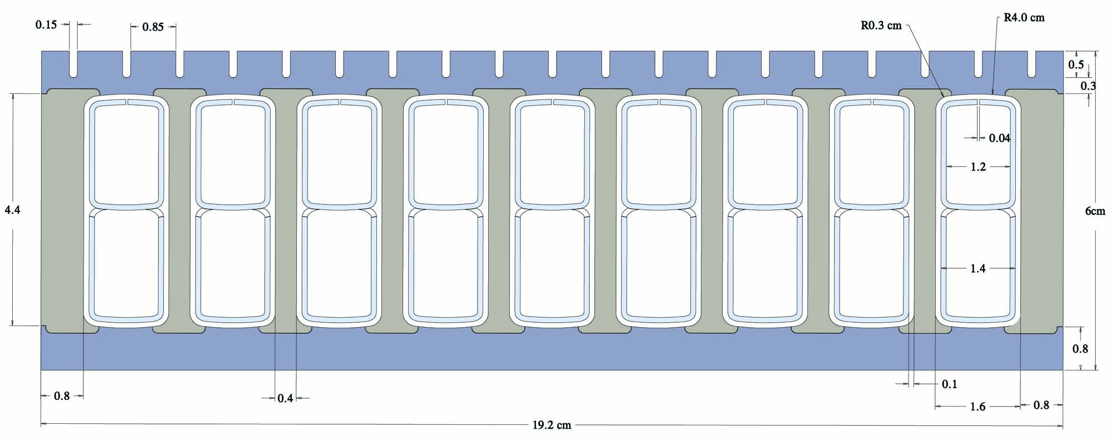
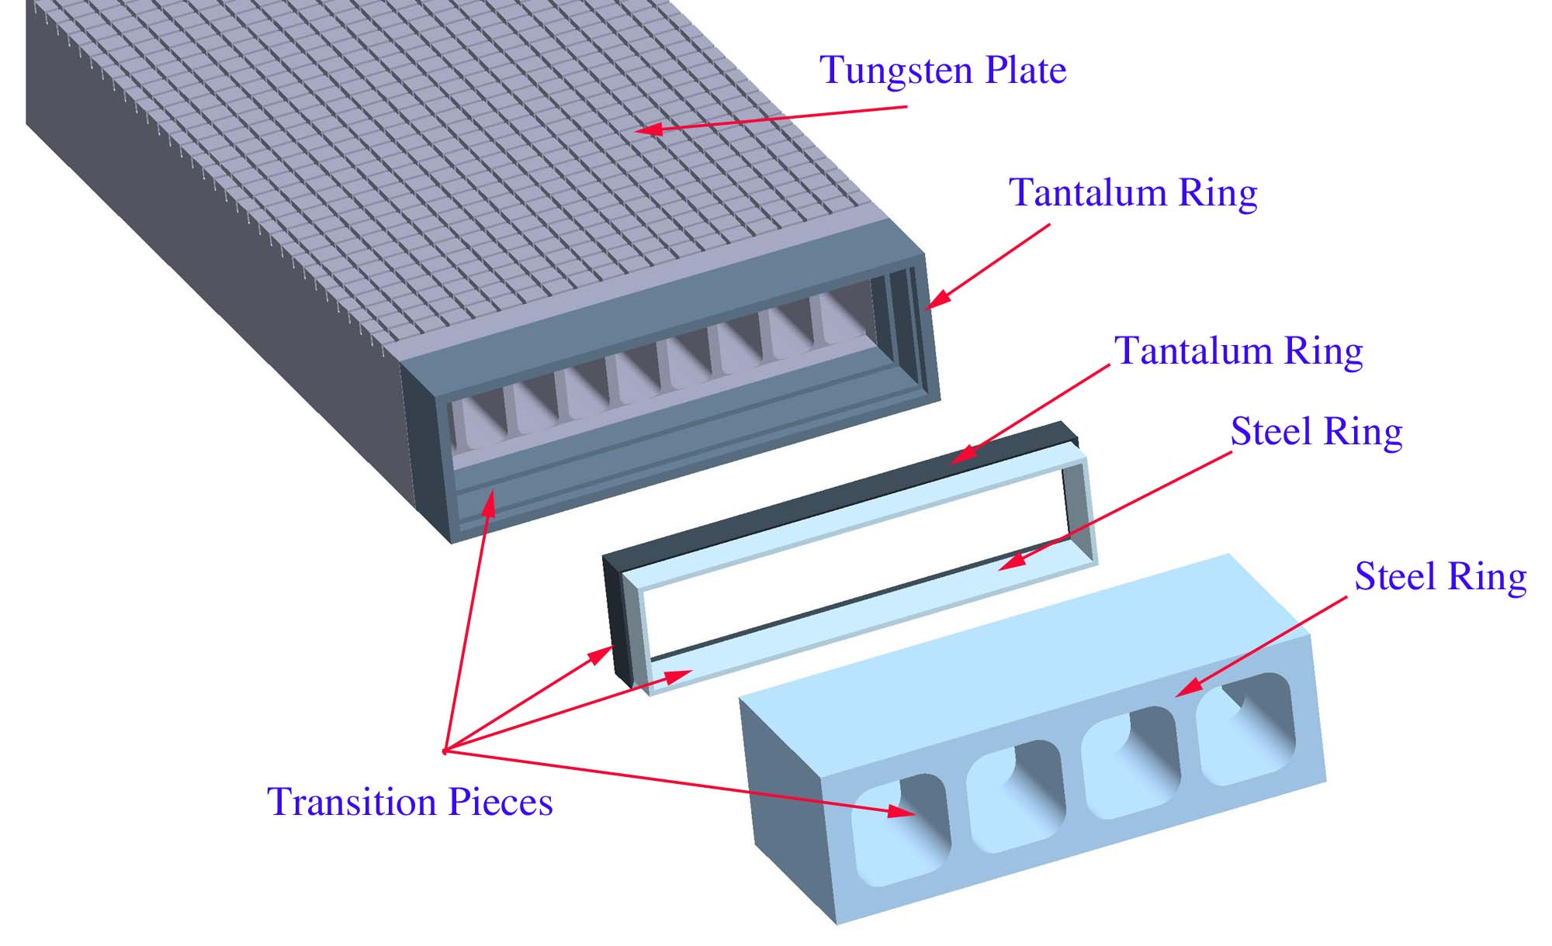
3D Divertor Printing

Slide 18
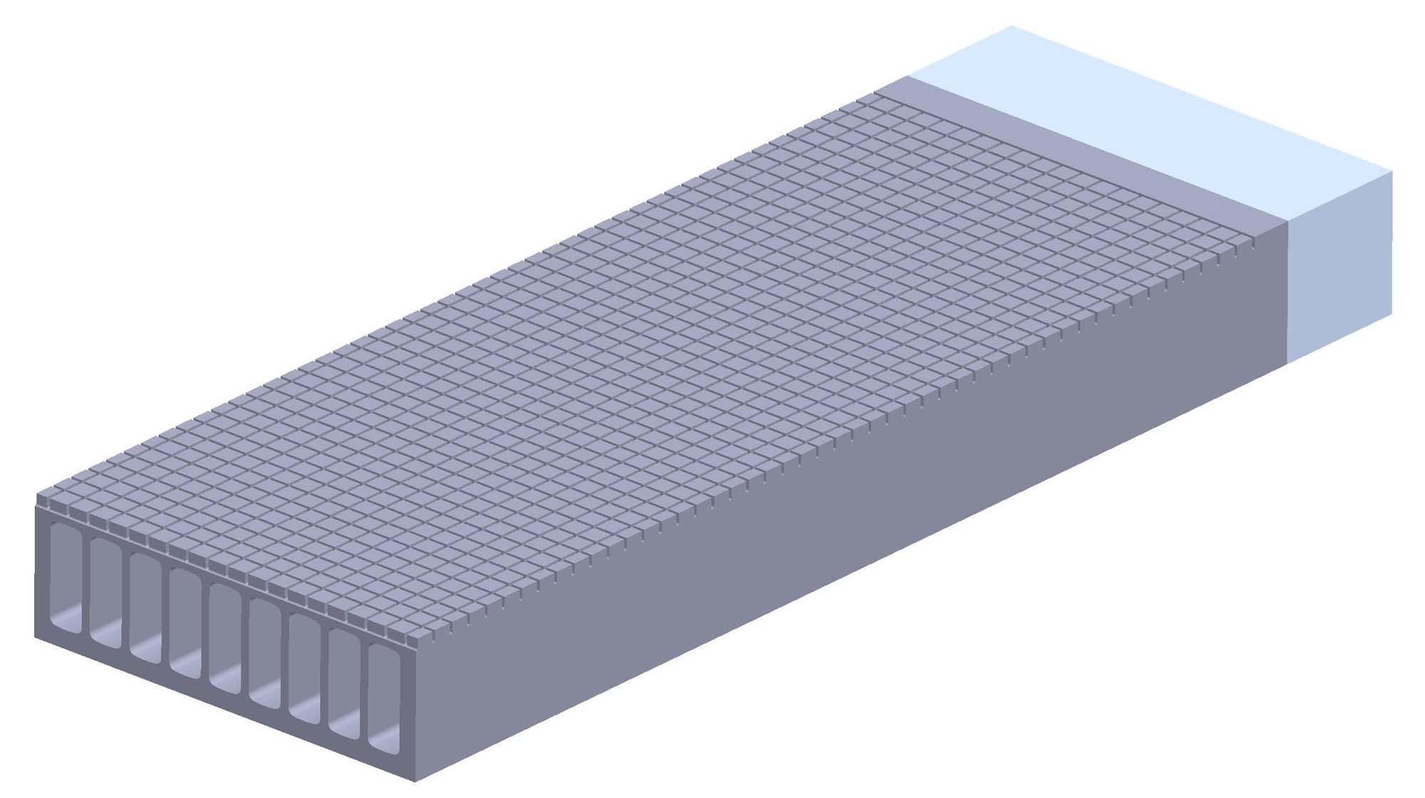
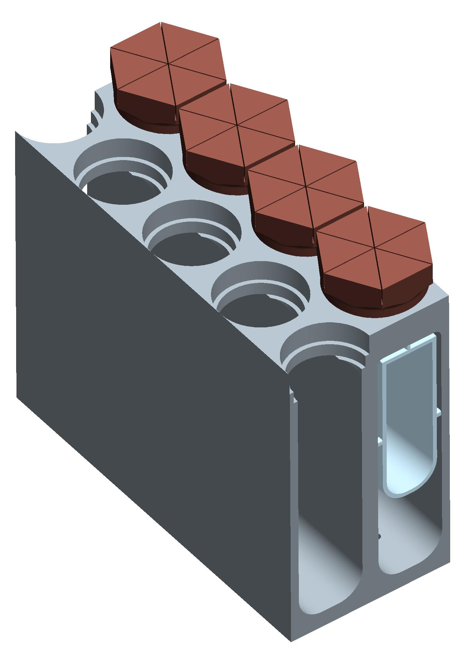
3D printing – what we’ve learned
Good exercise to evaluate clearances and assembly process.
Ambitious goal of printing ~1/2-m scale divertor module.
~30x longer printing time than initial part (~200 hours).
More material than anticipated ~150 in³ (3 cartridges).
Print ½ scale for time constraints.
~50 x 20 cm scale
~10 cm scale

