Slide 1
Progress on the Configuration Design of the Fusion Power Core for the ACT
(Draft)
X.R. Wang
M.S. Tillack
S. Malang
Sept. 29, 2011

Slide 2
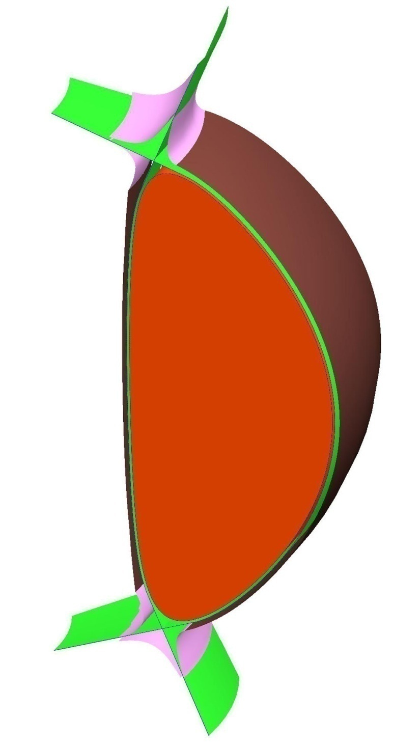
Dom plate
OB divertor plate
ARIES-ACT 1B(Aggressive Physics), Posted at ARIES Web: June 8, 2011
R=5.5 m
A=1.375 m
Elongation=2.2
IB divertor plate
Geometry Definitions (from Chuck):
Thickness of IB/OB SOL at mid-plane=10 cm
Curved FW
OB divertor location=R-a/2
IB divertor location=R-a
Plasma
IB FW
Results of CAD analysis:
Total plasma surface area=~475 m²
Total plasma volume=~417 m³
Total FW surface area=~452 m²
(A_{IB}=140 m²,A_{OB}=312 m²)
Total Divertor surface area=~143 m²
OB FW
OB FW
One sector (22.5 degree)

Slide 3
Design Options of the ACT-1b Fusion Power Core
 | Design Option #1 | Design Option #2
IB Blanket | Pb₈₃Li₁₇ cooled SiC/SiC structure | Pb₈₃Li₁₇ cooled SiC/SiC structure
IB Shield | Pb₈₃Li₁₇ cooled steel and SiC/SiC tube | Helium-cooled steel structure and ODS tube?
1st OB Blanket | Pb₈₃Li₁₇ cooled SiC/SiC structure | Pb₈₃Li₁₇ cooled SiC/SiC structure
2nd OB Blanket | Pb₈₃Li₁₇ cooled SiC/SiC structure | Pb₈₃Li₁₇ cooled SiC/SiC structure
OB Shield | Pb₈₃Li₁₇ cooled steel and SiC/SiC tube | Helium-cooled steel structure and ODS tube?
Upper/Lower Divertors | Helium-cooled W-based divertor | Helium-cooled W-based divertor

Slide 4
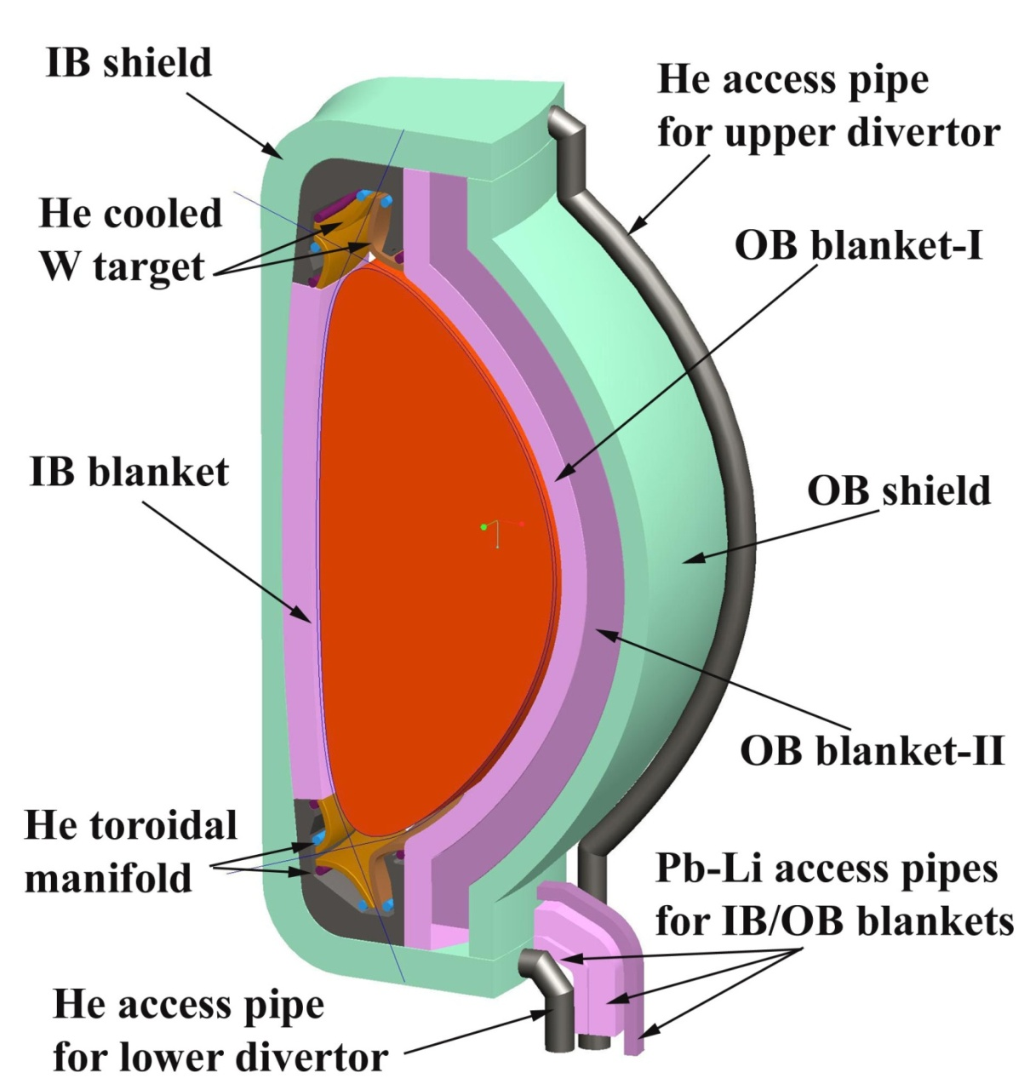
Power core configuration of the ACT 1B (Design option #1: Pb-Li cooled shield)
Thickness radius (ACT-1b straw-man)
Inboard:
TF coil annulus: 0.33 m
Vacuum vessel: 0.4 m
HT shield: 0.23 m
IB blanket: 0.34 m
Outboard:
1st Blanket: 0.29 m
2nd Blanket: 0.43 m
HT shield: 0.29 m
Vacuum vessel: 0.25 m
TF coil annulus: 0.33 m
Vertical build:
HT shield: 0.3 m
Replaceable HT shield: 0.29 m
Vacuum vessel: 0.4 m
All LM access pipes are designed as concentric tubes with the cold inlet flow (~650 °C) in the annulus, cooling in this way the inner tube (1100 °C) to the allowable temperature (~1000 °C) of the SiC/SiC.
He access pipes are also designed as concentric tubes (700/800 °C for outer/inner tubes)

Slide 5
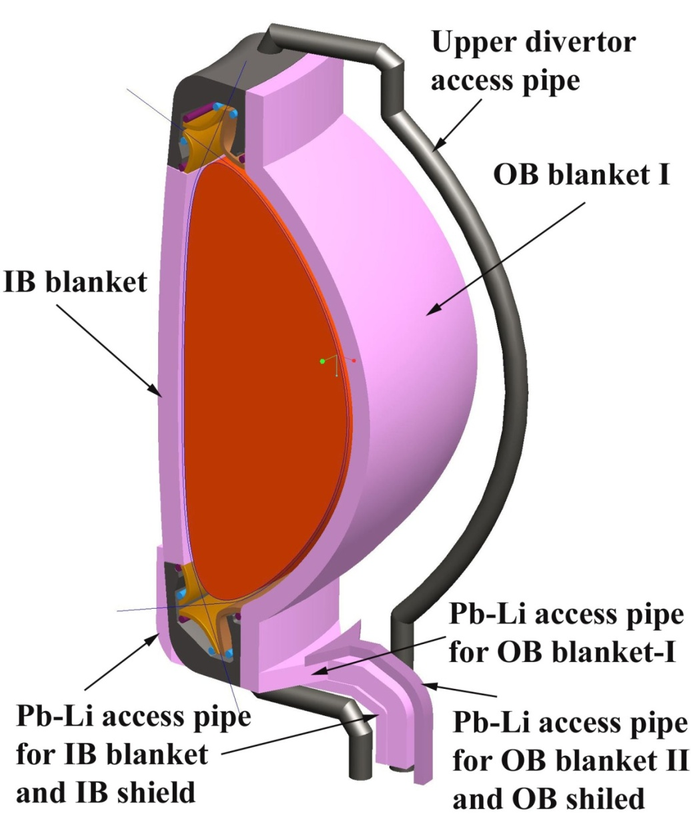
Design Option of the Coolant Routing
Circuit 1: series flow through the inboard shield and inboard blanket region
Circuit 2: flow though the first outboard blanket region
Circuit 3: series flow through the outboard shield and the second outboard blanket region
Circuit 4: Helium-cooled the upper divertor
Circuit 5: Helium-cooled the lower divertor

Slide 6
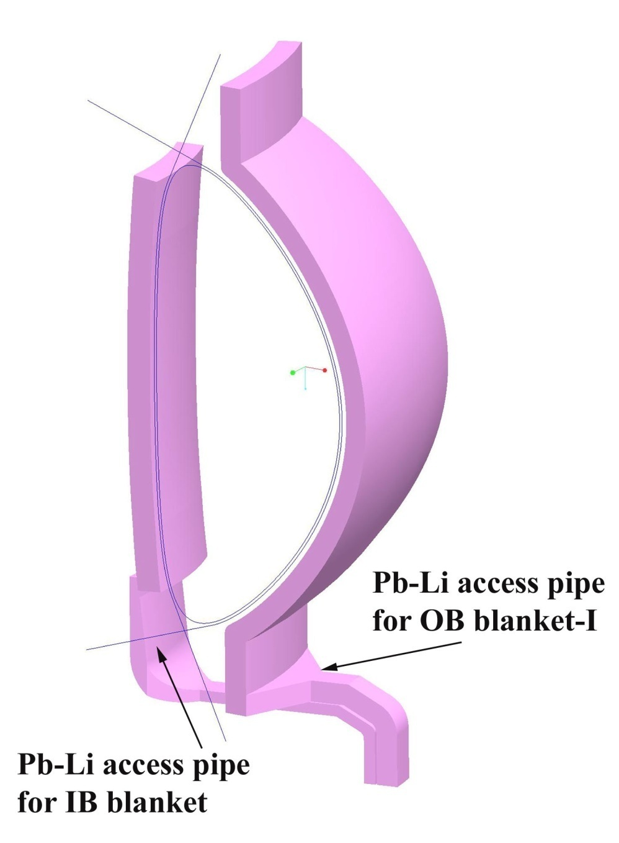
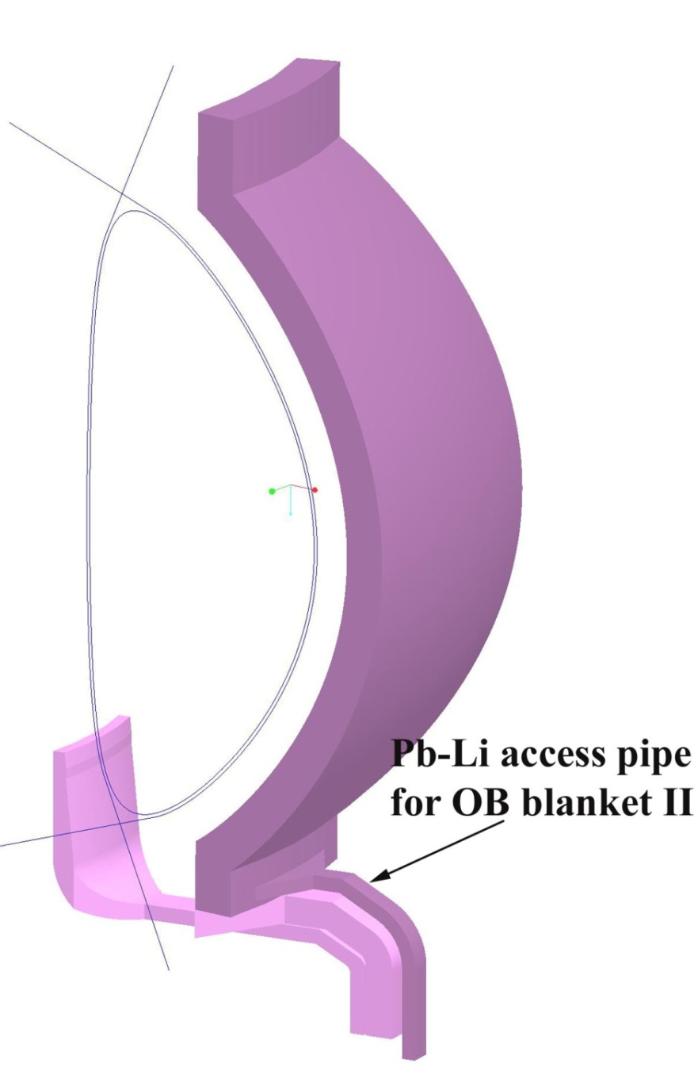
Design Option of the Access Pipes

Slide 7
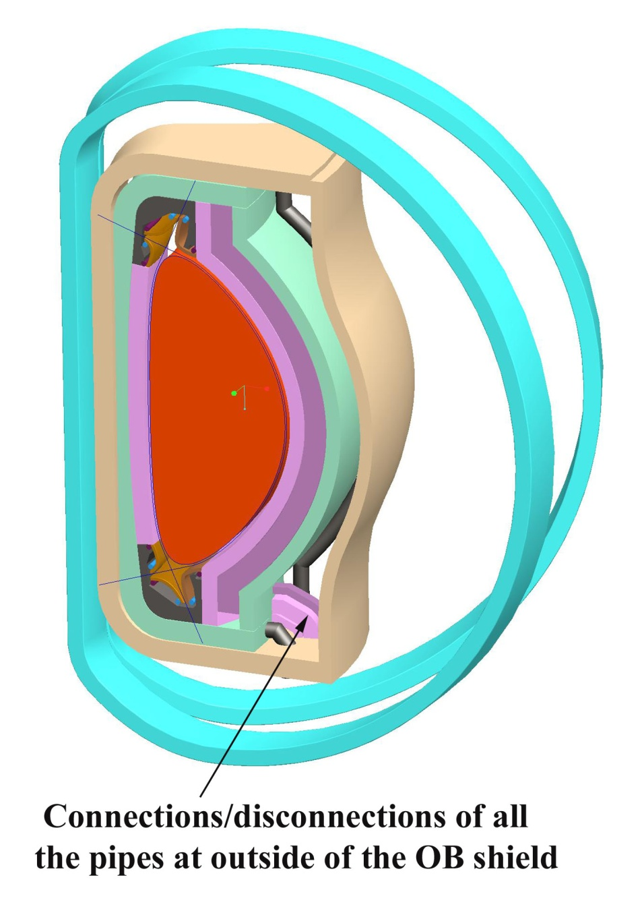
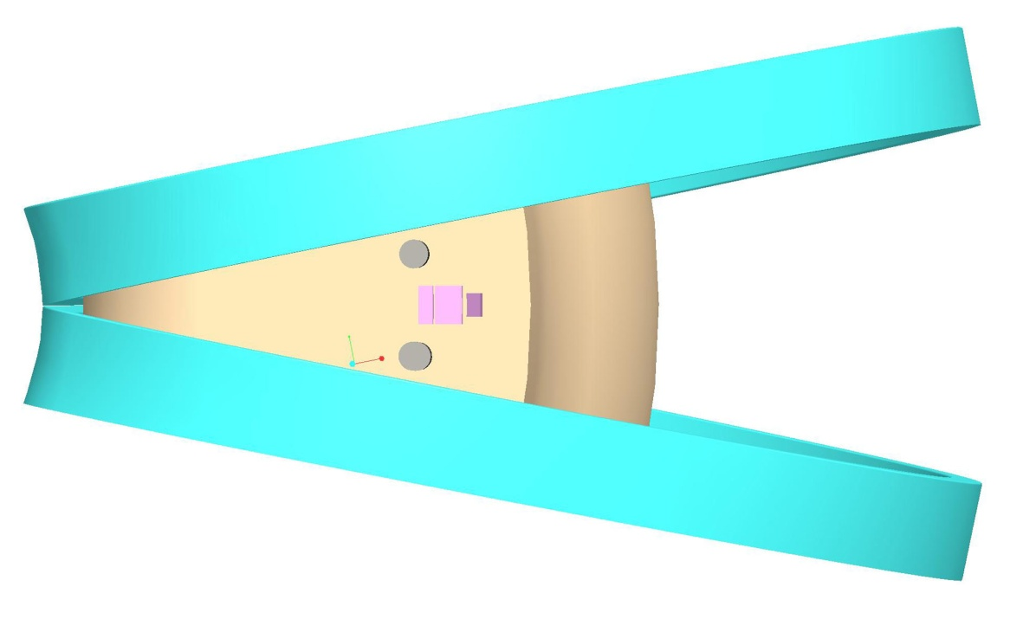
Pb-Li access
pipes
He access
pipes
Bottom view showing the space of all access pipes (5 circuits)
It is possible to make the Pb-Li access pipes bigger to reduce flow velocity.

Slide 8
Power Core Configuration of the ACT 1B (Design Option #2: Helium-cooled Shield)
In progress!

