Slide 1
Possibility of the He-Cooled SiC-Composite Divertor
X.R. Wang¹, S. Malang², M. S. Tillack¹
  ¹University of California, San Diego, CA
  ²Fusion Nuclear Technology Consulting, Germany
ARIES-Pathways Project Meeting
Gaithersburg, MD
July 27-28, 2011

Slide 2
Outline
Review of the ARIES SiC-composite divertor designs
  Helium-cooled small SiC-composite tube divertor for ARIES-I (1991)
  LiPb-cooled SiC-composite plate divertor for ARIES-AT (2000)
Update on the SiC composite properties and design window since ARIES-AT
Possibility of using SiC composite as divertor structural material with an impinging-jet-cooling scheme
  an ARIES-finger with modifications (semi-circular thimble)
  an original ARIES-finger (W thimble/channel replaced by SiC-composite)
  a larger SiC-composite tube with impinging cooling method
Summary

Slide 3
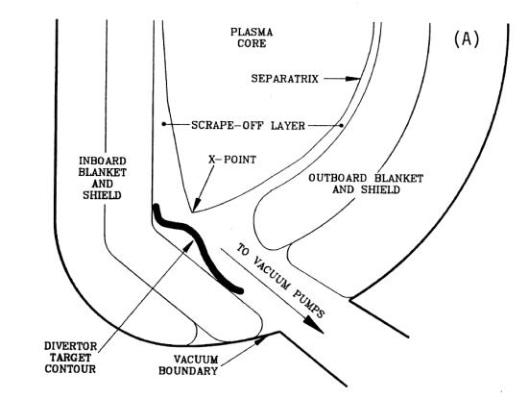
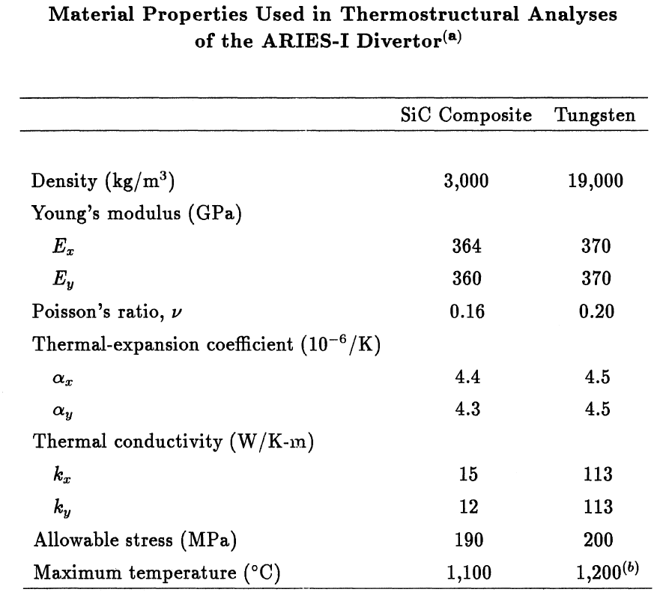
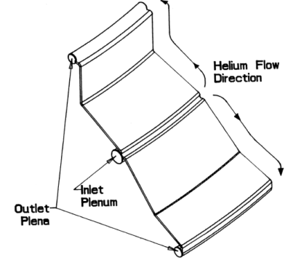
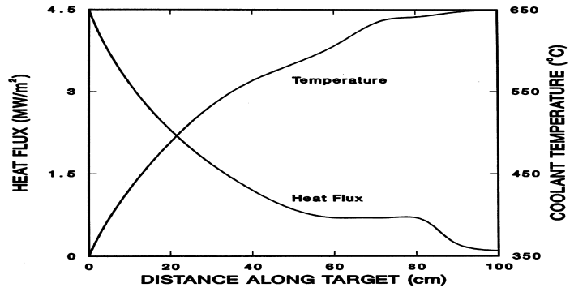
He-Cooled SiC/Sic Divertor of ARIES-I Was Designed to Remove a HF up to 4.5 MW/m²*
Attractiveness of SiC/SiC in fusion application:
  elevated temperature strength,
  chemical stability,
  low activation / low decay heat
  low thermal expansion
Issues
  swelling under irradiation,
  fabrication and joints,
  stress limit
Schematic of the ARIES-I layout
ARIES-Divertor target Configuration
*F. Najmabadi et al., “The ARIES-I Tokamak Reactor Study”, Final Report, 1991.

Slide 4
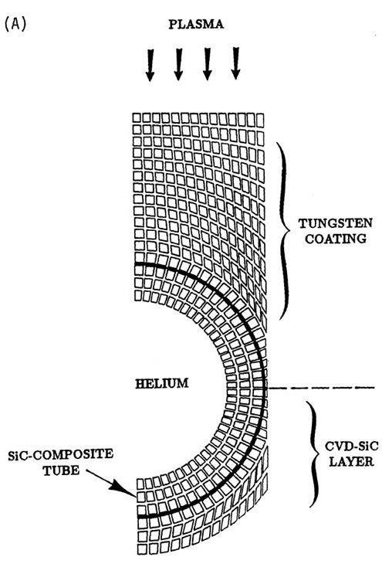
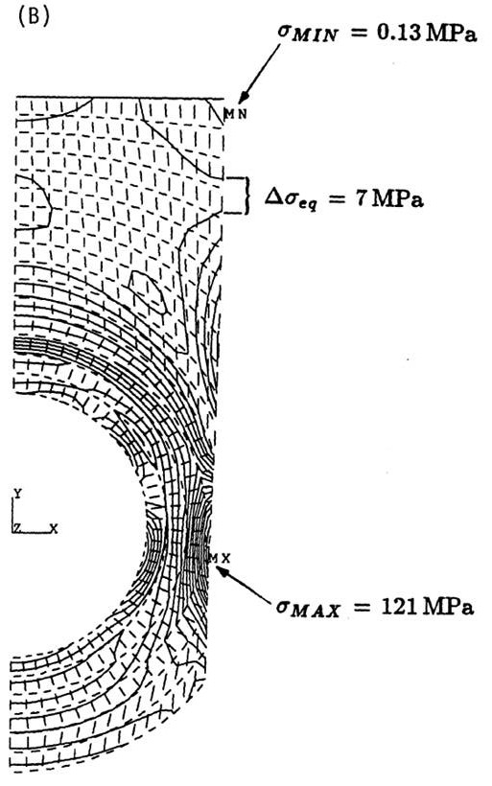
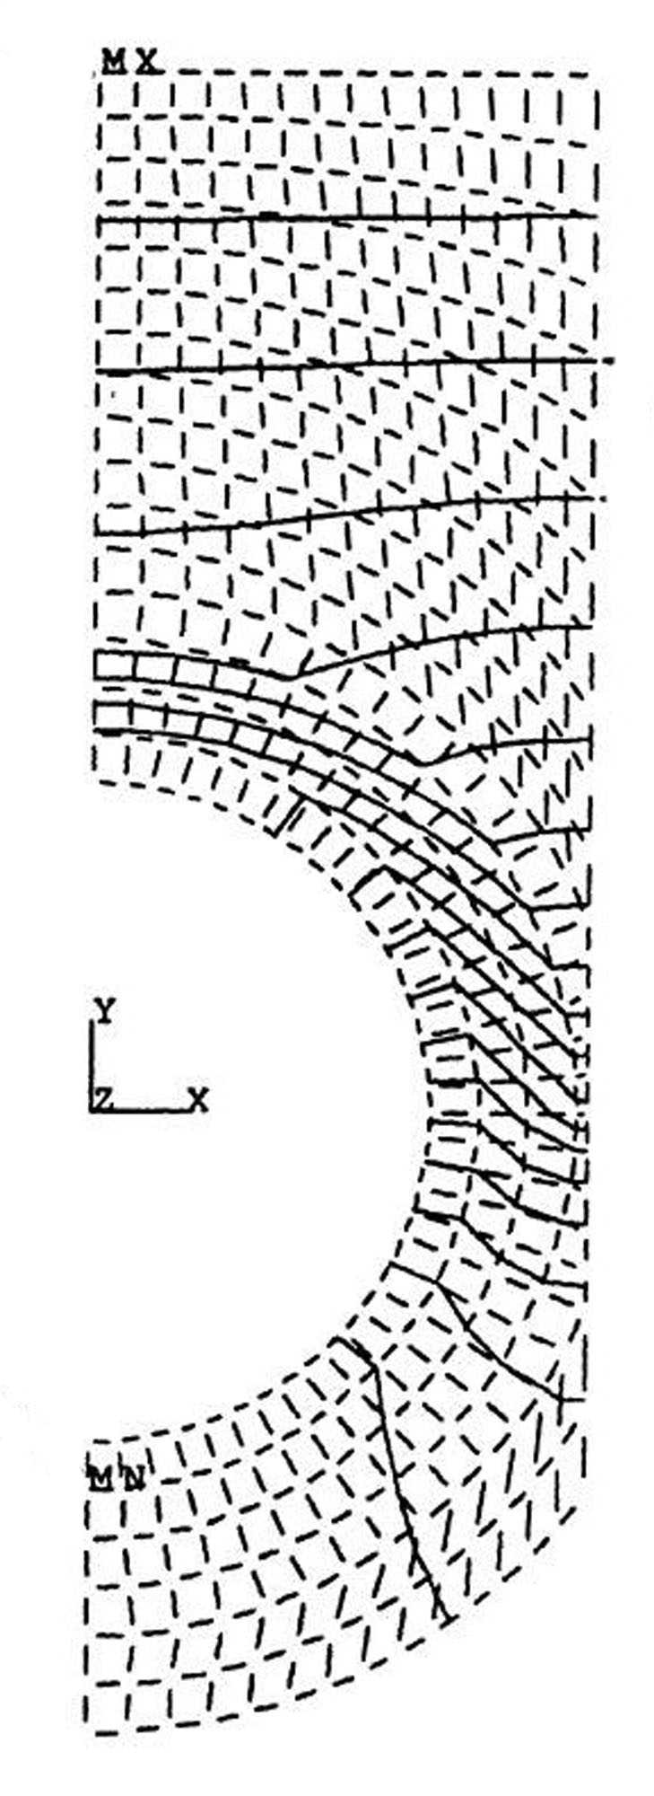
Pumping Power Was Larger than 10% in order to Meet Temperature and Stress Limits
2 mm W Coating
T_{max}=776 ᵒC
T_{interface}=700 ᵒC
Tube d=2.5 mm
Thickness t=0.5 mm
T_{min}=399 ᵒC
T_{inlet} =350 ᵒC, T_{exit} =650 ᵒC
P=10 MPa, v=150 m/s
q”_{peak}=4.5 MW/m^{2,} q_{v}=23 MW/m³
HTC=12.9 kW/m²-K
P_{p}/P_{th} =12%
σ_{p}=86 MPa
CVD: chemical vapor deposition
CVI: chemical vapor infiltration
Ts<1000 ᵒC
σ_{p+th} < 190 MPa

Slide 5
Stress Limit of the SiC/SiC Used in ARIES-I &AT Is Very Conservative Assumption
Properties were Used in ARIES-AT*
Stress limits for using in FEM analysis:
Conventional stress limits (3 S_{m}) can not be directly applied to ceramics.
The SiC/SiC stress limits should take into account for the non-linear elastic behavior associated with matrix micro-cracking and matrix-fiber debonding.
Based on the summary of the ARIES Town Meeting, it was recommended to limit the total combined stress to ~190 MPa. It might be too conservative.
Density | 3.2 g/cm³
Young’s modulus | 200-300 GPa
Poisson’s Ratio | 0.16~0.18
Thermal expansion coefficient | 4.0x10⁻⁶ /K
Thermal conductivity, in-plane | 20 W/K-m
Thermal conductivity, through thickness | 20 W/K-m
Minimum operating Temp (based on degradation of k under irradiation) | 600 ᵒC
Maximum operating Temp (based on void swelling) | 1000 ᵒC
Maximum allowable combined stresses | 190 MPa
*Summary, SiC/SiC Town Meeting , ORNL, January 18-19, 2000.
http://aries.ucsd.edu/Lib/PROPS/sic.html
*A.R. Raffray et al., Fusion Engineering and Design 80 (2006)
Notes:
The table shows the properties were used in the ARIES-AT thermo-mechanical analysis.

Slide 6
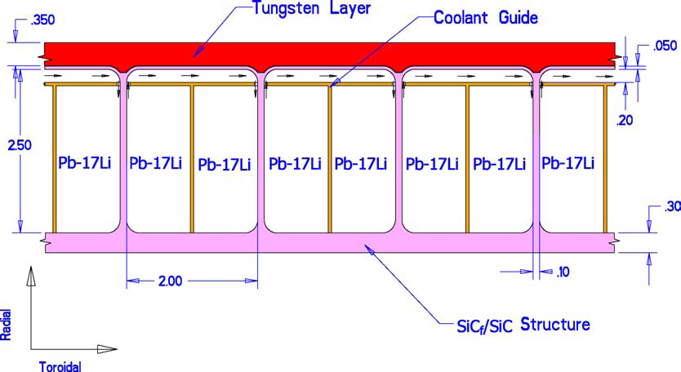
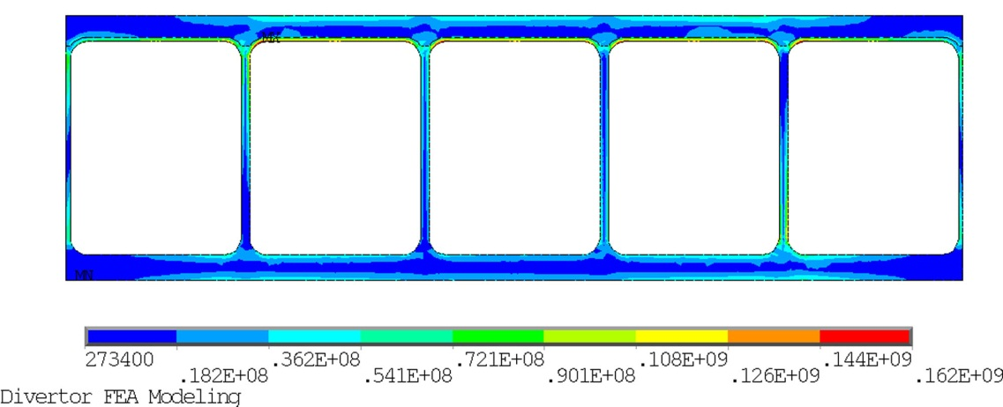
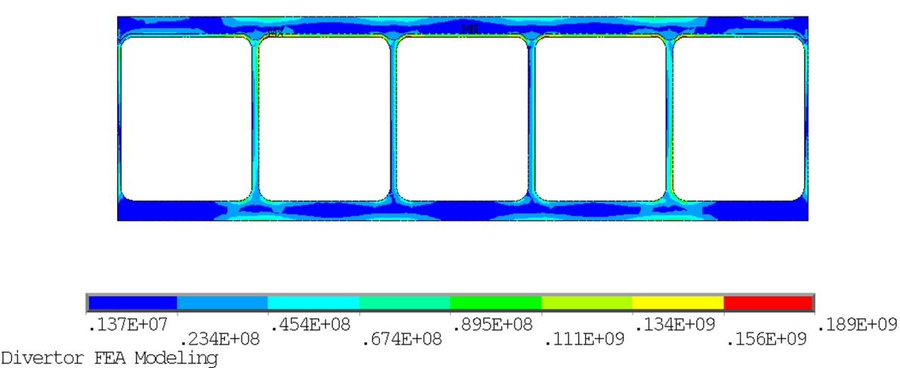



ARIES-AT LiPb-Cooled SiC-Composite Divertor Could Accommodate a HF up to 5 MW/m²
$σth$=45 MPa at W
$σth$=162 MPa at SiC
T-shaped flow separator
Thickness of SiC front plate=0.5 mm
Thickness of W armor=3.5 mm
Cross-section of cooling channel=25x20 mm
Operating pressure=1.8 MPa
Peak heat flux=5 MW/m²
Average heat flux=1.75 MW/m²
Inlet /outlet temperature=654/764 ᵒC
Max. W temperature=~1150 ᵒC
Max. SiC temperature=~950 ᵒC
Pressure drop=~0.7 MPa
Thermal stress at SiC=~162 MPa
Primary stress at SiC=~25 MPa
Combined stresses= 189 MPa
Distribution of thermal stress
$σp+th$=189 MPa at SiC
Distribution of combined stresses
*A.R. Raffray et al., Fusion Engineering and Design 80 (2006)

Slide 7
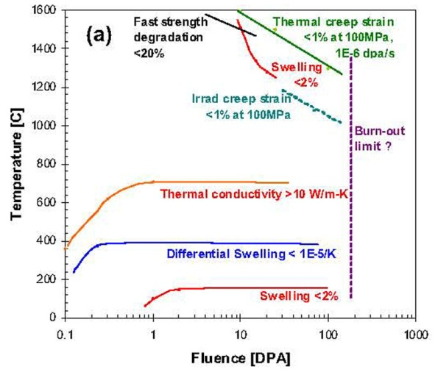
Update on Operating Temperature Window for SiC Composites Since ARIES-AT*
Operating temperature of he-cooled SiC-composites mainly limited by:
  High temperature swelling <2%,
  Irradiation or thermal creep strain <1% at a uniaxial stress of 100 MPa,
  Thermal conductivity through-thickness > 10 W/m-K
Yutai Katoh and Lance Snead recommended:
  Lower operating temperature > 700 ᵒC (ARIES-AT, ~600 ᵒC)
  Upper operating temperature <~1200 ᵒC
  (ARIES-AT, 1000 ᵒC)
-Preliminary design windows for 3D balanced orthogonal CVI SiC/SiC for thermal structural application
-Dotted lines indicate lack of confidence and/or experimental substantiation.
There is no update on the stress limit in literatures. The same allowable stress (190 MPa) as the ARIES-I and ARIES-AT will be assumed in FEM analysis.
*Yutai Katoh and Lance Snead, Fusion Science and Technology, 56 (2009).

Slide 8
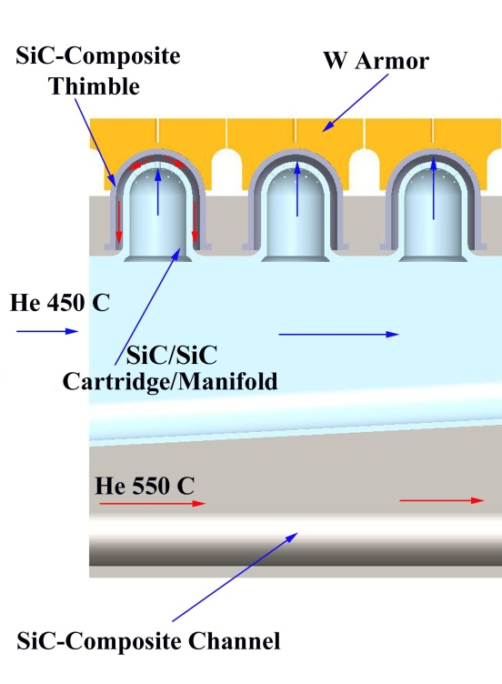
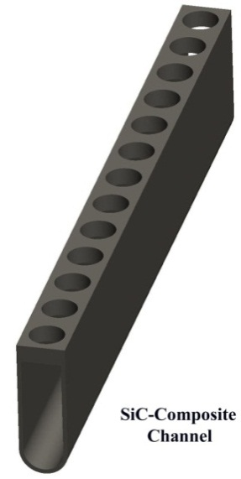
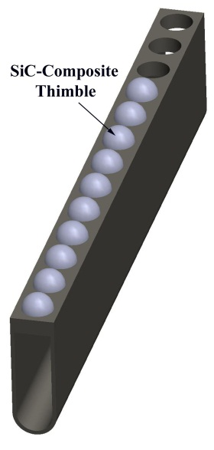
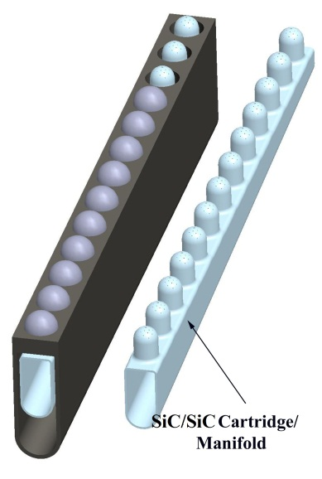
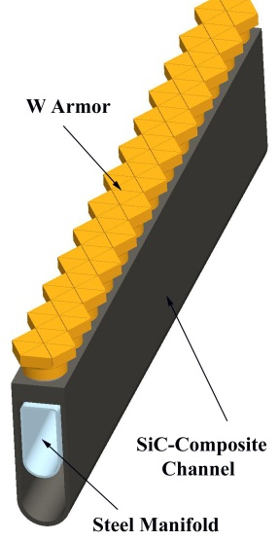
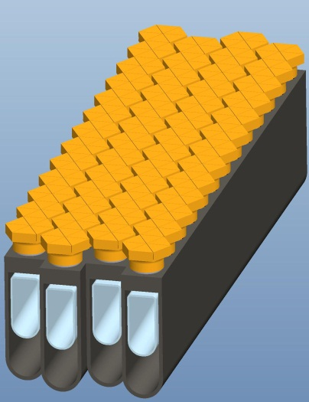
A SiC-Composite Finger Is Designed to Accommodate A HF up to ~5 MW/m²
SiC-composite tube
Width of Armor=26 mm
Diameter of thimble=20 mm
Thickness of thimble=1 mm
Height of the plate=70 mm
Step 1
Step 2
Step 3
Fabrication
Methods:
Joints techniques: *H. Kishimoto, A. Kohyama, J. of Nuclear Materials
**B. Riccardi et al, Int. J. Materials and Product Technology
W/SiC composite joints using hot-pressing technique*
Holding temperature of 1500 to 1800 ᵒC
Joint shear strength as high as ~90 MPa
SiC/SiC composite joints using brazing technique**
Si-16Ti (melting temperature ~1330 ᵒC)
Si-18Cr (melting temperature ~1305 ᵒC)
or using silicone resin to joint them together at 1200 ᵒC.
Step 4
Step 5

Slide 9
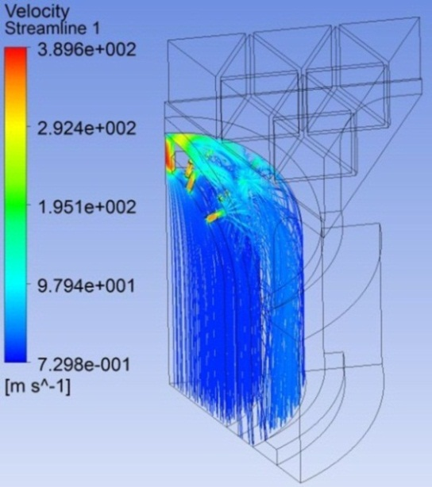
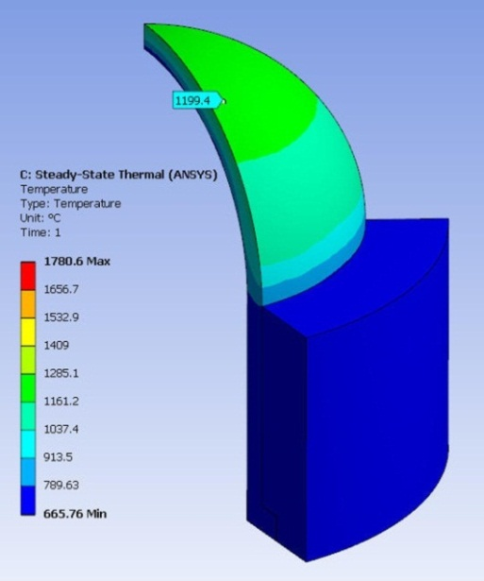
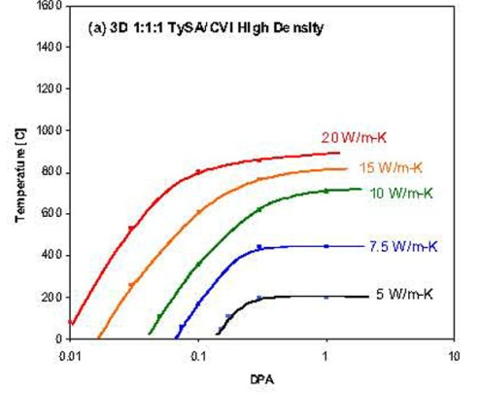
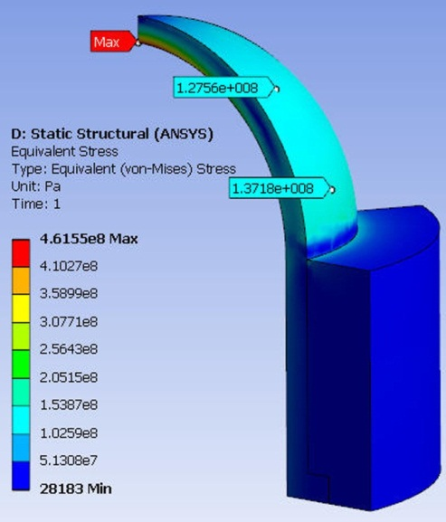
Pumping Power and Stress Limits Are not Satisfied for a HF of 5 MW/m²
Temperature-dependent properties of the W are used in the analysis
Thermal conductivity of the SiC/SiC is dependent on both irradiation temperature and fluence. In analysis, the K(T) is shown in the figure.*
*Yutai Katoh and Lance Snead, Fusion Sci. and Tech., 56 (2009).
Velocity
Temperature
Operating temperature for SiC/SiC: 700 < T_{SiC} < 1200 ᵒC
Loads and cooling conditions
  q”=5 MW/m² (uniform), q_{v}’’’=17.5 MW/m³
  P=10 MPa, T_{in}/T_{exit}=600/700 ᵒC (450/550 ᵒC for T_{allow}= 1000 ᵒC)
CFX and FEM results(Not Optimized)
  V_{jet}=~390 m/s, HTC(Local)=9.78x10⁴ W/m²-K
  P_{p}=~15% P_{removed} (P_{p}~12.5% for T_{allow}= 1000 ᵒC)
  Max. T_{sic}=1199 ᵒC(< T_{allow}= 1200 ᵒC) (T_{SiC}=999 ᵒC for T_{allow}= 1000 ᵒC)
  Max. σ_{p+th}=~462 MPa (> σ_{allow}=~190 MPa) (σ_{p+th}=~475 MPa for T_{allow}= 1000 ᵒC)
Stress
Pumping power and stress limits are not satisfied.
Stress

Slide 10
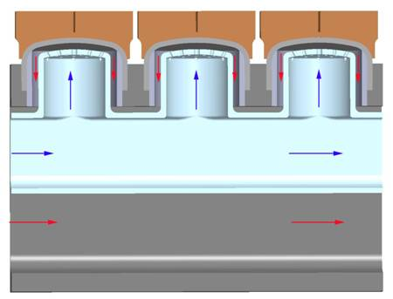
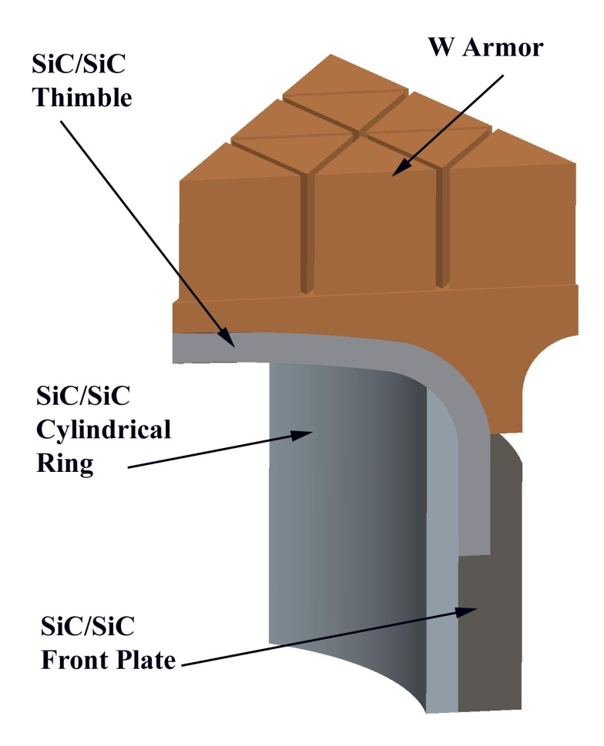
Original ARIES-Finger Configuration Is Applied in the SiC/SiC Divertor
SiC-Composite Finger
Using the original ARIES finger configuration
  VM-W thimble, cylindrical ring and W channel replaced by SiC/SiC
  ODS steel cartridge replaced by SiC/SiC cartridge
  1 mm thick SiC-composite thimble
  1 mm thick SiC-composite cylindrical ring
  2 mm thick SiC-composite front plate
  5 mm W armor
W armor and SiC composite jointed together by hot-pressing method
SiC-composite thimble, cylindrical ring and front plate jointed together by brazing method

Slide 11
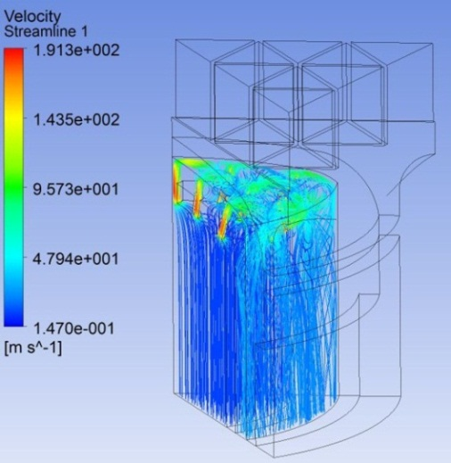
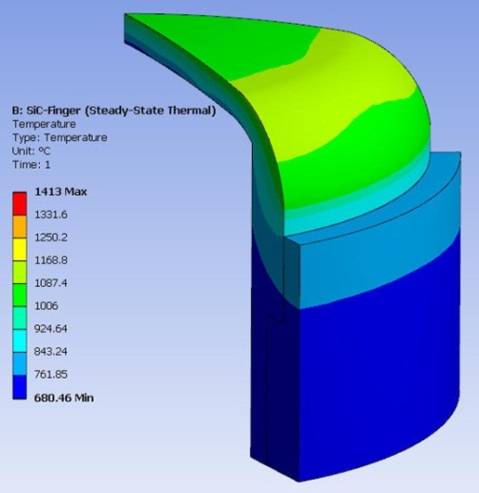
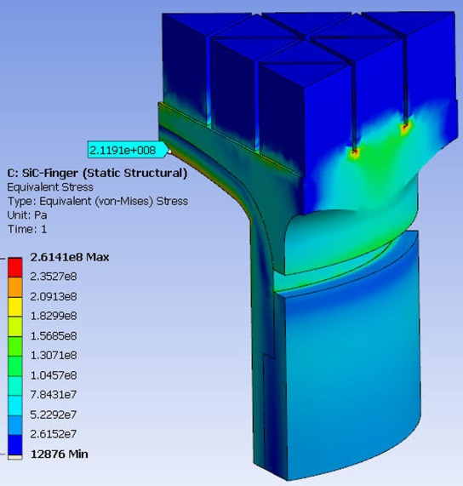
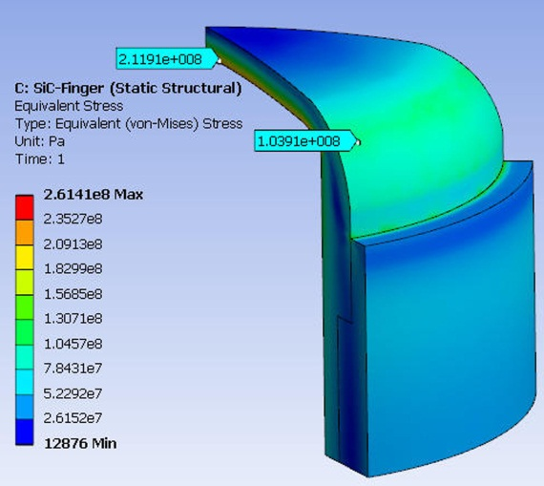
Temperature and Pumping Power Limits Are Satisfied
Velocity
Temperature
Stress
Operating temperature for SiC/SiC: 700 < T_{SiC} < 1200 ᵒC
Loads and cooling conditions
  q”=5 MW/m²(uniform), q_{v}’’’=17.5 MW/m³
  P=10 MPa, T_{in}/T_{exit}=600/700 ᵒC (450/550 ᵒC for T_{allow}=1000 ᵒC)
CFX and FEM results
  V_{jet}=~191 m/s, HTC(Local)=6.52x10⁴ W/m²-K
  P_{pumping}=~6.5% of the P_{removed thermal} (<10%) (P_{p}~5.7% for T_{allow}=1000 ᵒC)
  Max. T_{sic}=1120 ᵒC(< T_{allow}=~1200 ᵒC) (T_{SiC}=980 ᵒC for T_{allow}= 1000 ᵒC)
  Max. σ_{p+th}=~212 MPa (> σ_{allow}=~190 MPa) (σ_{p+th}=~223 MPa for T_{allow}= 1000 ᵒC)
  Max. shear stress at the W/SiC interface σ_{shear} =~58 MPa
  The SiC thimble (1 mm thick) could be thinned to ~0.5-08 mm to meet the stress limit. However, there are too many brazing joints required.

Slide 12
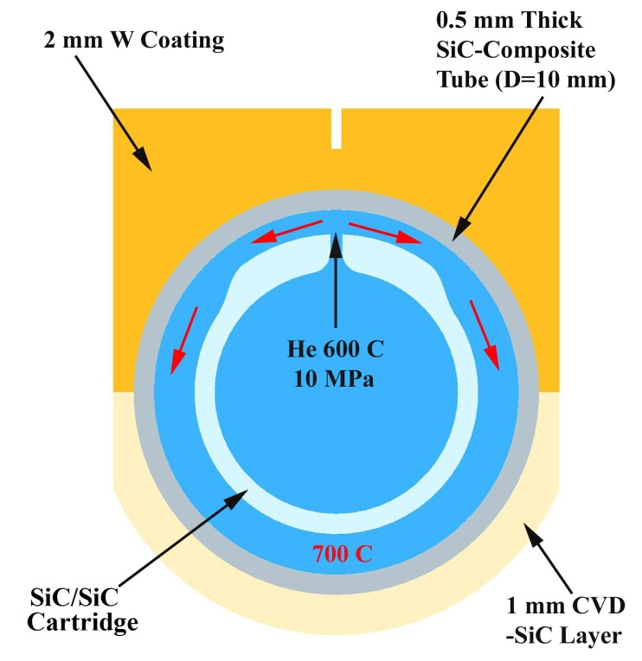
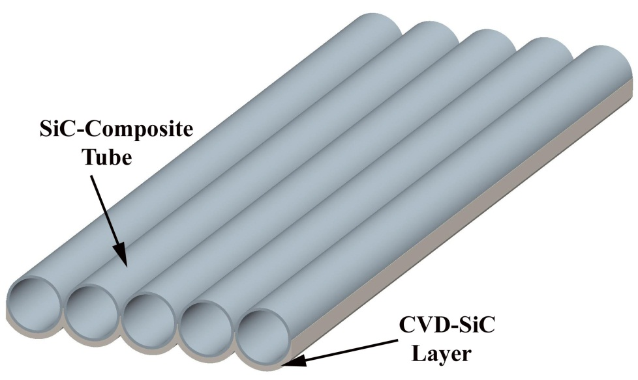
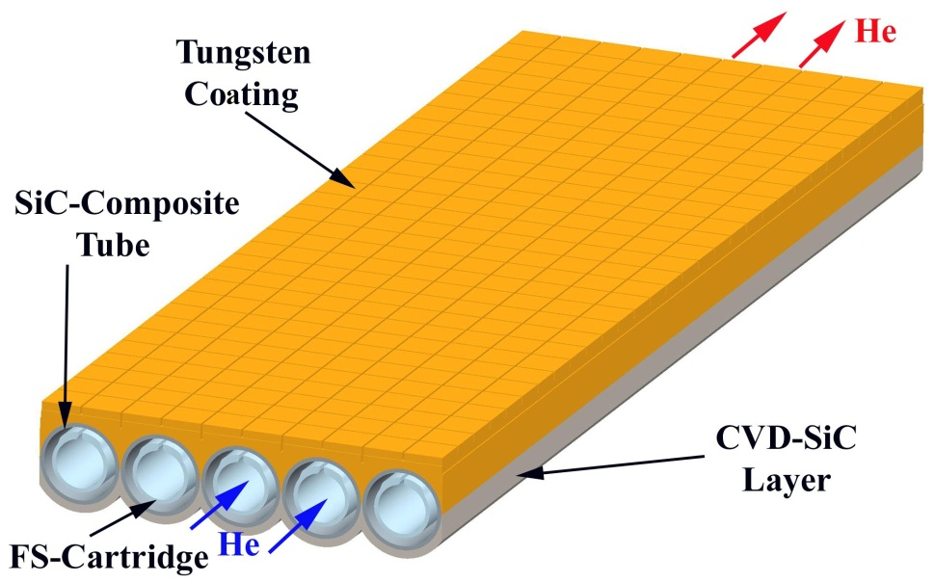
SiC/SiC Tube Target-Plate Cooled by Jet-Impinging Scheme Is Proposed
Rad.
Pol.
Tor.
Cross-section of SiC/SiC tube with impinging cooling scheme
10 mm diameter tube ( ~4 times larger than ARIES-I tube)
½ mm thick tube
1 mm SVD-SiC layer
SiC/SiC cartridge or ODS-steel cartridge
Impinging-jet cooling scheme
Notes:
W coating and CVD-SiC layer would play a structural role after bonded together.

Slide 13
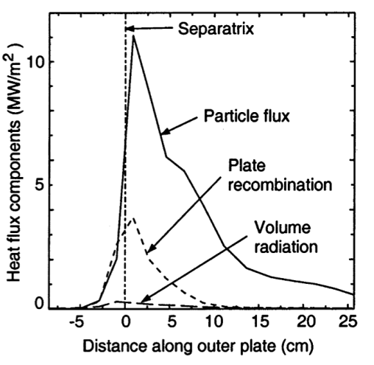
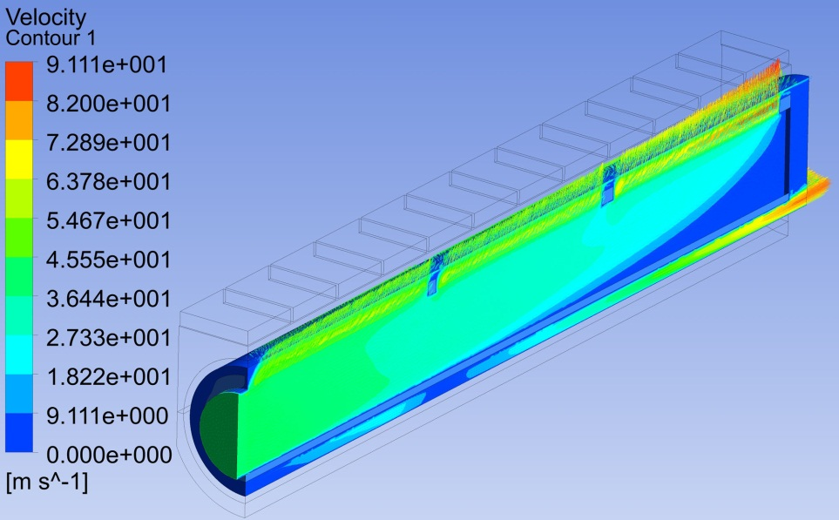
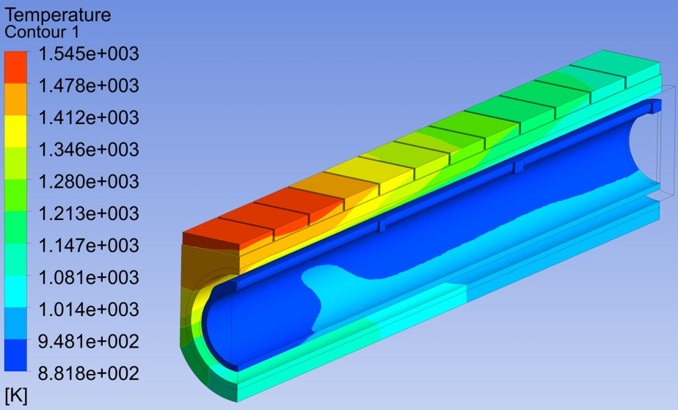
CFX Results Indicate The Temperature and Pumping Power Limits Are Satisfied
ARIES-AT like heat-flux profile with a max. value of ~5 MW/m² and an average of ~ 1.75 MW/m² is assumed in the analysis
q_{v}= ~17.5 MW/m³
T_{inlet}/T_{outlet}= 600/700 ᵒC based on SiC-composite operating temperature of 700 <T_{SiC}< 1200 ᵒC
CFX results (some optimizations):
  V_{jet}=~91 m/s, T_{max. SiC}=~1180 ᵒC, T_{min. SiC}=~710 ᵒC, Tmax. W= 1272 ᵒC
  HCT_{local}=~2.623x10⁴ W/m²-K
  P_{pumping}/P_{removed} _{thermal}=~3.5%
Velocity distribution
There is a large room for the pumping power to push to a higher heat flux. The cartridge can be tapered along the poloidal direction to reduce the jet velocity and rise temperature at lower heat flux region.
Temperature distribution

Slide 14
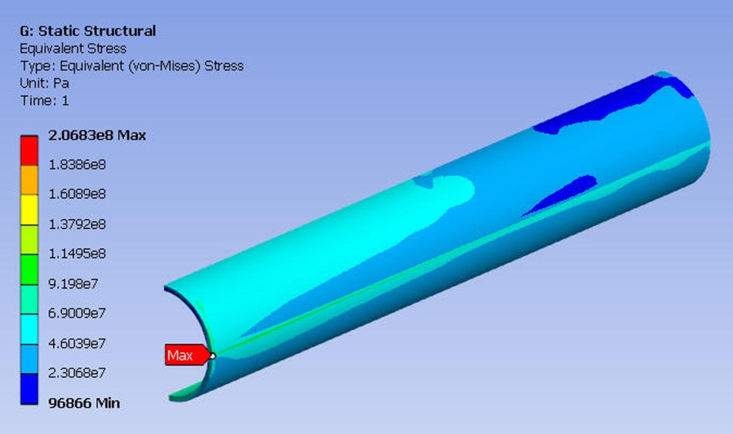
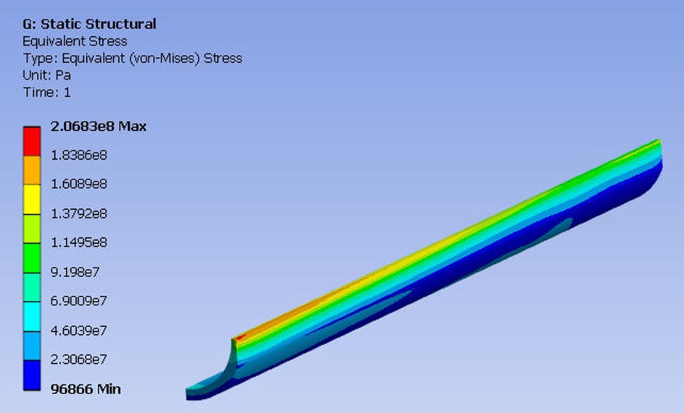
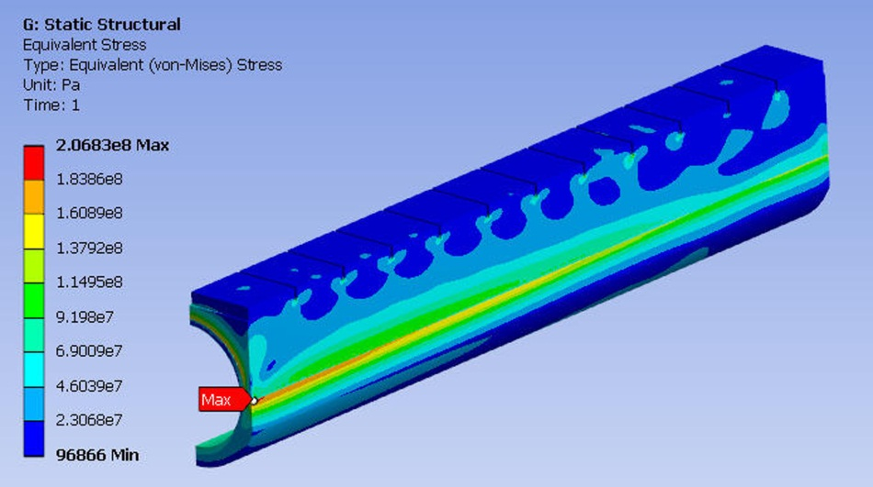
Stress Limit Is also Satisfied Although It is very Conservative
207 MPa
140 MPa
SiC composite tube
CVD-SiC layer
Max. combined primary and secondary in SiC-composite tube is ~140 MPa (< σ_{allow} =~190 MPa).
Max. Combined primary and secondary stress in CVD-SiC layer (not a major structure) is ~207 MPa at low heat flux region where the temperature is the lower (~710 ᵒC).
Max. shear stress at interface is ~73 MPa
Further optimization of the cartridge to rise temperature at the lower heat flux region can reduce thermal stress.
SiC composite tube with W coating

Slide 15
Summary and Conclusions
Three configurations of he-cooled SiC-composite divertor concepts have been investigated, including
  a modified finger
  an original ARIES-finger
  a tubular plate with impinging-jet cooling scheme
CFX and FEM results indicate that both configuration 2 and 3 can possibly accommodate a non-uniform heat flux with a maximum value up to 5 MW/m² while satisfying the temperature, pumping power and stress limits.
The tubular plate design (Configuration 3) has a better thermal performance, and it is easier to be fabricated, much less brazing required, and potentially have higher reliability.

