Slide 1
Update on Fracture Analyses
Jake Blanchard
July 2011

Slide 2
Outline
2-D Analysis of Flat Plate Divertor
  High stress areas
  Crack locations
  Thermal stress included
  Consider full power and cool-down
Future Work
Conclusions

Slide 3
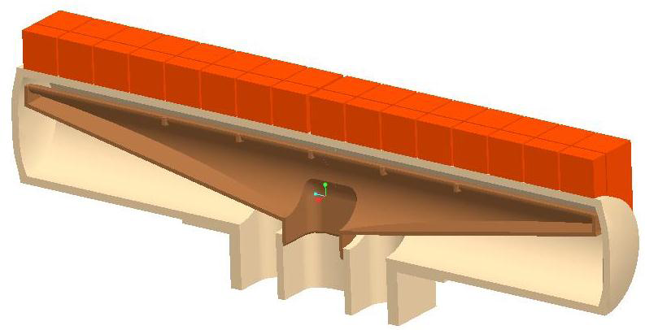
Last Time We Analyzed This Design
Tungsten
OD = 15 mm
Coolant pressure ~ 10 Mpa
Coolant inlet temperature ~ 600 ºC
t = 1 mm

Slide 4
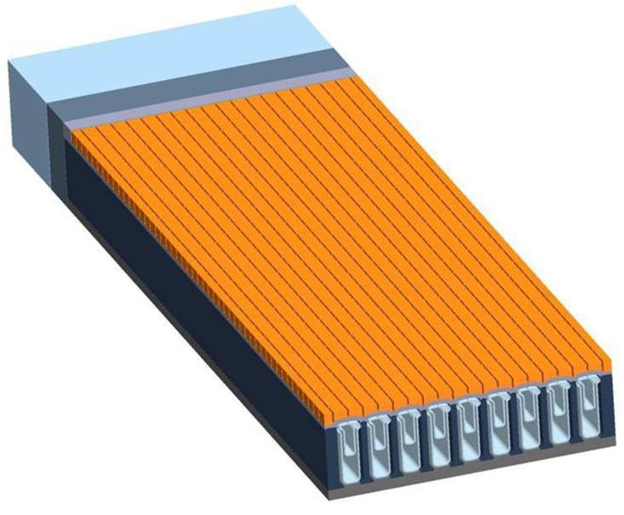
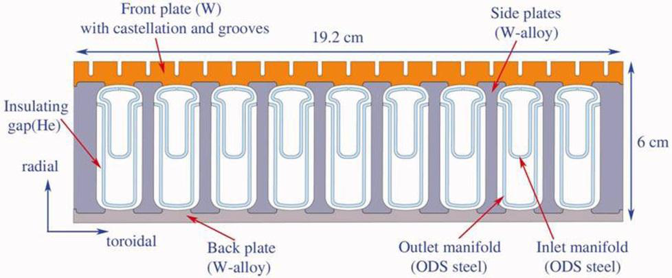
Here We Switch to Plate-Type Divertor
Tungsten HCFP(Helium-cooled Flat Plate) divertor

Slide 5
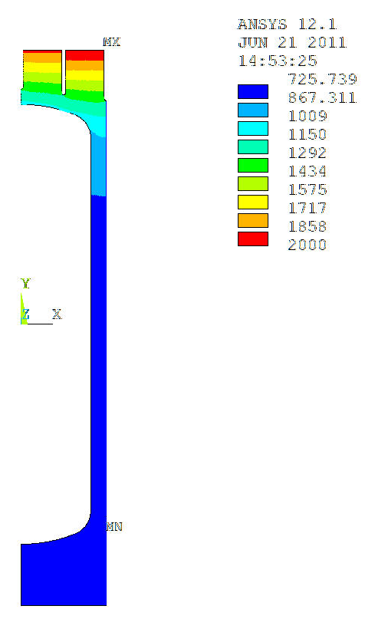
Temperature Distributions Simulated Using ARIES Design Loads with Simplified Convection Cooling
2-D Planar models are used in these preliminary studies (simulating long cracks)
Convection coefficients adjusted to correlate with ARIES CFD results
Studies show fracture results insensitive to small changes in temperature
^{Convection}
q”=11 MW/m²
q’’’=17.5 MW/m³
P=10 MPa
T_{coolant}=600 ᵒC
Max. T_{armor}= 2000 ᵒC
Max. T_{structure}=1310 ᵒC
Min. T_{structure}=725 ᵒC
ºC

Slide 6
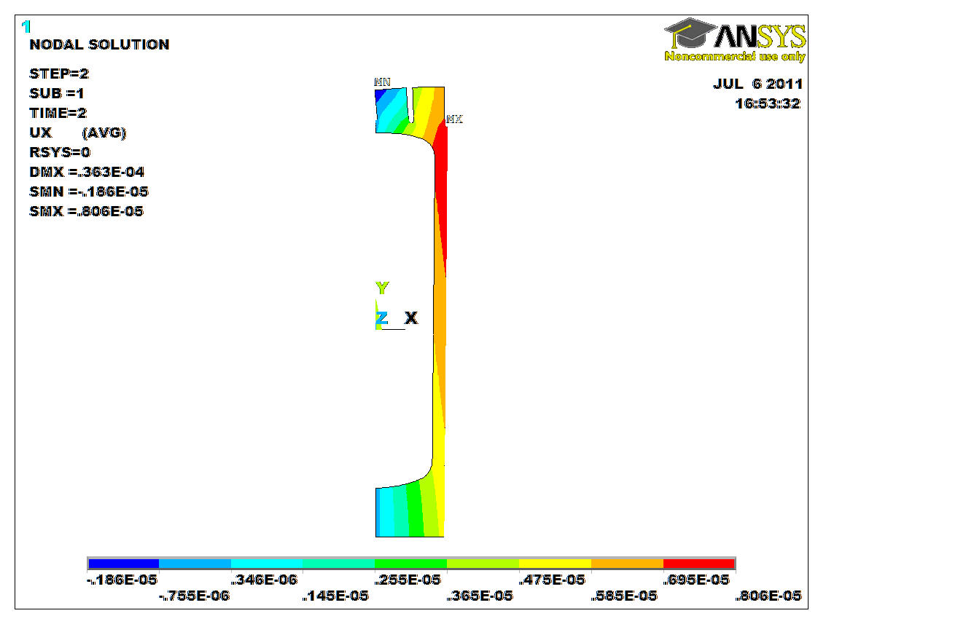
Structural Boundary Conditions Adjusted to Not Over-Constrain Model
Planar rotations in x-direction simulate panel bow
Results calculated with both plane stress / plane strain assumptions in z-direction
Surface must remain planar but my rotate
symmetry

Slide 7
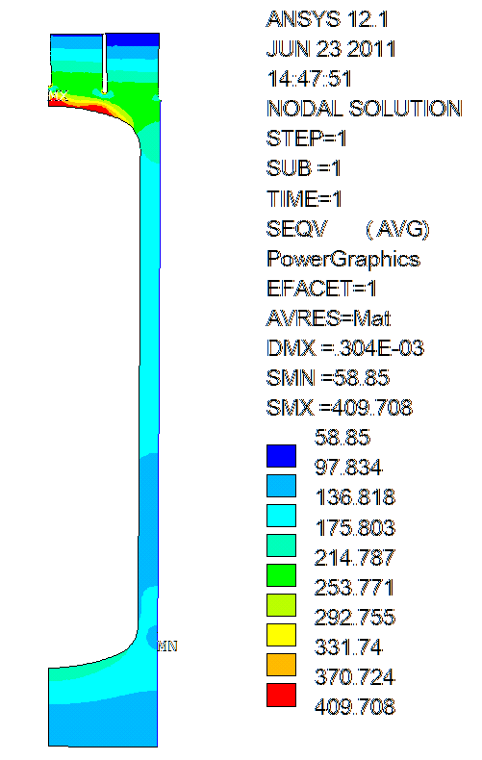
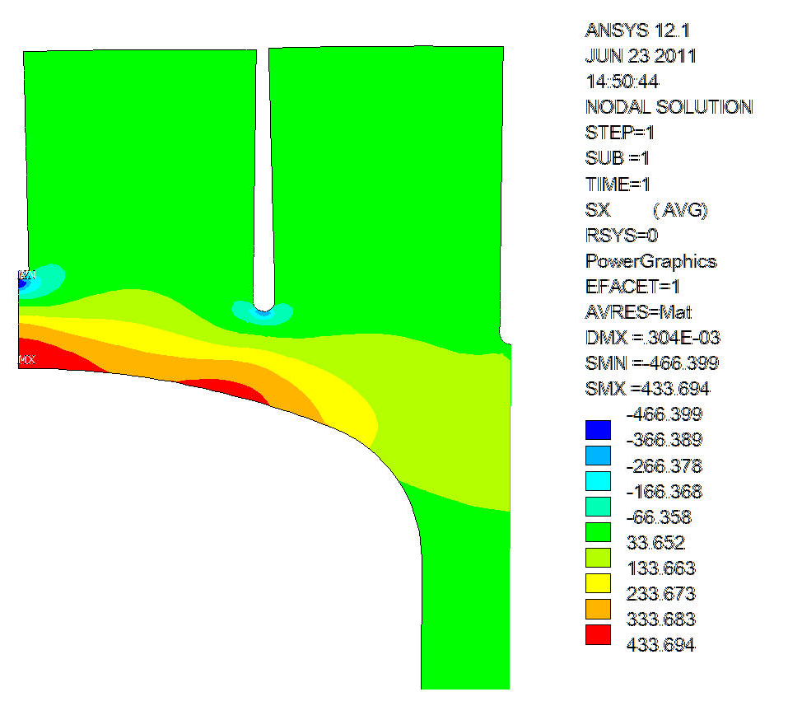
Analysis of Uncracked Structure Identified Two Areas of High Stress
Crack Stress Intensities investigated for regions of max tensile and compressive stresses
Region of max compressive stress has tensile stress at cool down due to plasticity
Equivalent Stress (MPa)
X-Direction Stress (MPa)
Max. Compressive Stress
Max. Tensile Stress

Slide 8
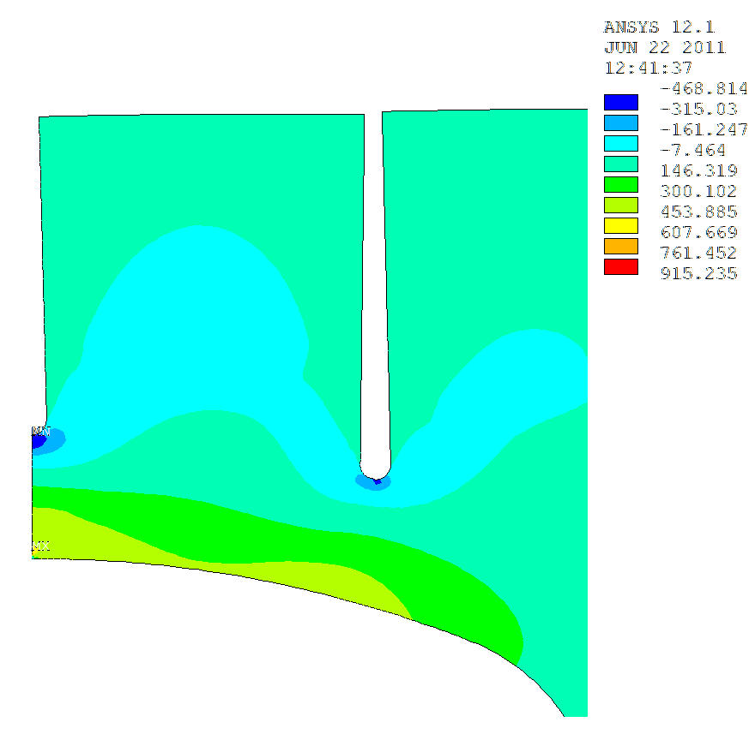
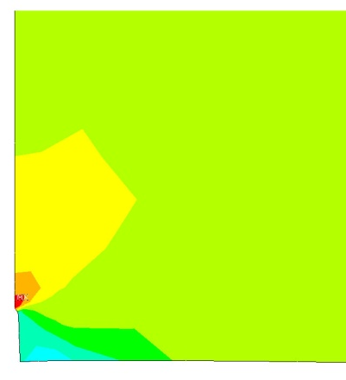
Crack on Internal Surface of Outer Wall
Max stress intensity occurs when hot
Plane stress / plane strain assumptions give similar results
Crack face

Slide 9
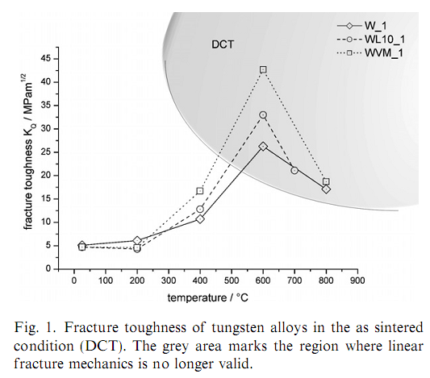
Fracture Toughness of Tungsten
This is just a representative data set

Slide 10
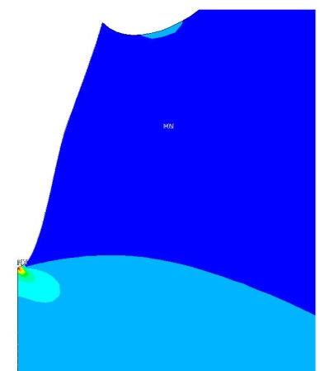
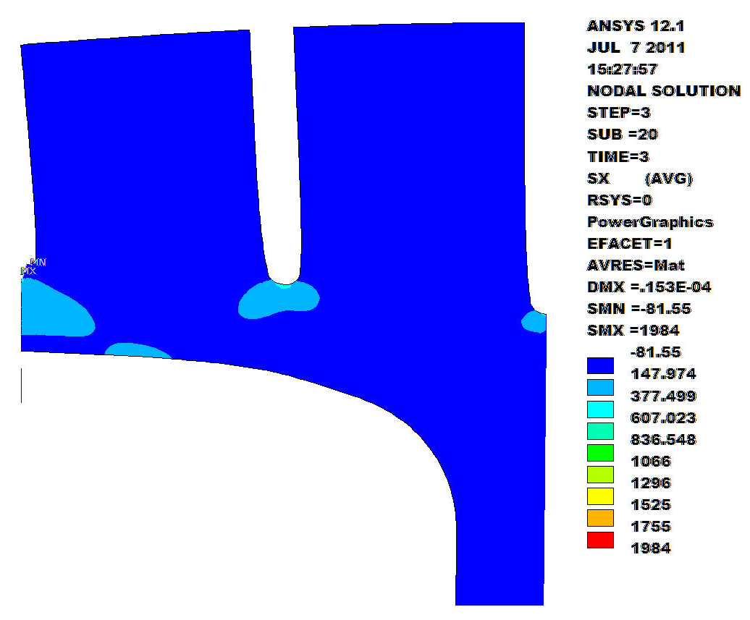
Crack on External Surface of Outer Wall
Max stress intensity occurs after cool-down
Plane stress / plane strain assumptions give radically results – full 3-D model required, but results should be closer to plane strain

Slide 11
Future Work
3-D fracture models
Cracks in “Tiles” and elsewhere
Try to clarify appropriate toughness data for failure analysis

Slide 12
Conclusions
For this design, stress intensity is highest on inner surface at full power
Stress intensity is also quite high at outer surface on shutdown
It appears that permissible crack depths will be less than 50 microns
3-D analysis, toughness review, and review of NDE capabilities are needed to make concrete design recommendations

