Slide 1
Design Improvements of the W-Based Divertor Concepts
X.R. Wang¹, S. Malang², M. S. Tillack^{1,} J. Burke
¹University of California, San Diego, CA
²Fusion Nuclear Technology Consulting, Germany
ARIES-Pathways Project Meeting
Bethesda, MD
April 4-5, 2011
Notes:
In this presentation, I am going to report recent design improvements and updates on design and analysis on divertor

Slide 2
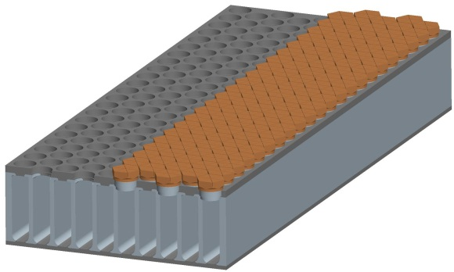
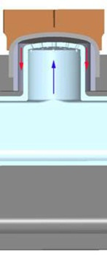
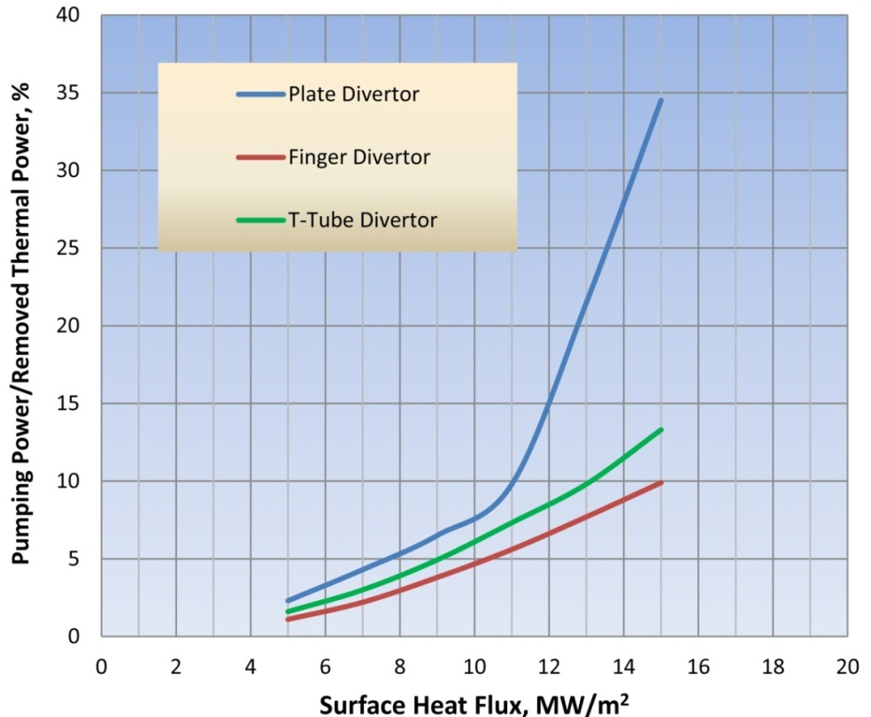
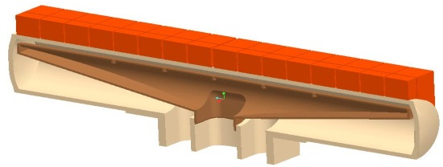
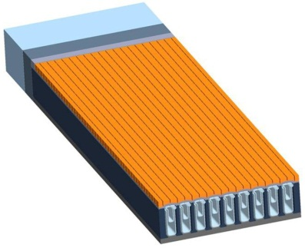
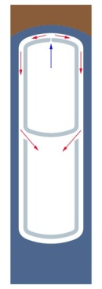
Status of the He-cooled W Divertor Concepts
1. HCPF(He-cooled Combined Plate and Finger)
Design limits :
Minimum temperature of the W structure 700 ᵒC
(embrittlement)
Maximum temperature of the W structure 1300 ᵒC (recrystallization)
Pumping power 10% of thermal power removed.
2. HCTT(He-Cooled T-Tube)
3. HCFP(Helium-cooled Flat Plate) divertor

Slide 3
Modifications
Since fracture toughness of the W alloy is reduced by low temperature irradiation, the lower temperature limit (~700 ᵒC) must probably be raised to ~ 800 ᵒC to avoid the embrittlemeent of the W structure.
To achieve this, the He coolant exit temperature has to be raised to a range of 750~800 ᵒC (previous cooling conditions: T_{exit}=650~700 ᵒC, T_{Inlet}=600 ᵒC).
Advanced ODS steel (such as 12CrYWTi) would be one option for the manifold. Creep tests of the 12CrYWTi at 800 ᵒC and 138 MPa showed the specimen is in the steady-state stage at ~5000 h and ruptured at ~14500 h.*
Such a higher He exit temperature require a reduction in the maximum heat flux in order to keep the maximum temperature of the W structure under the upper operating limit of 1300 ᵒC.
We should make new optimizations to the divertor concepts with a goal to find the maximum allowable heat flux with obeying the 1300 ᵒC limit for the W structure and 10% limits for pumping power.
HCPF(Finger)
HCFP(Plate)
HCTT(T-Tube)
*R.L. Klueh et al./J. of Nuclear Materials 307-311 (2002) 455-465.

Slide 4
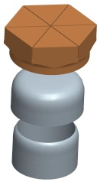

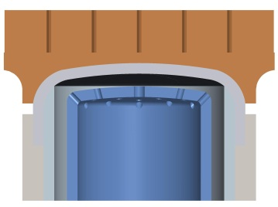
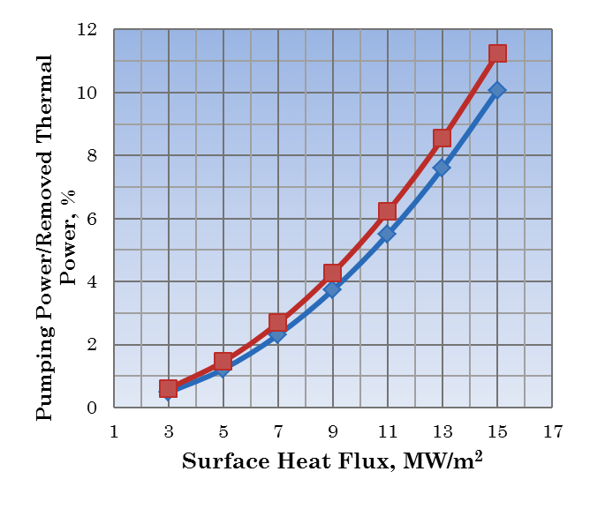
Reevaluation of the HCPF Concept
P_{pumping power}/P_{removed power} <10%
A: 800 <T_{s}<1300 ᵒC, T_{exit}=800 ᵒC, T_{in}=700 ᵒC
B: 700 <T_{s}<1300 ᵒC, T_{exit}=700 ᵒC, T_{in}=600 ᵒC
A
B
The allowable heat flux calculated by CFX
Case A, ~14 MW/m²
Case B, ~15 MW/m²
Material applications:
Armor: pure W
Cup-shaped thimbles: VM-W
doped with ppm of Al₂(SiO₃)₃ or K₂SiO₃
Front, side and back plates: WL10
(W-1%La₂O₃)
Fabrication:
Armor: powder HIPing(hot isostatic pressing)
Thimbles: Drawn and rolled from sheet (up to 1 mm)
All the plates: HIP
Armor
Thimble
Ring
HCPF
Finger

Slide 5
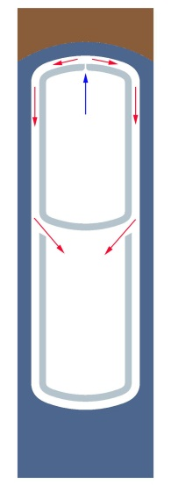
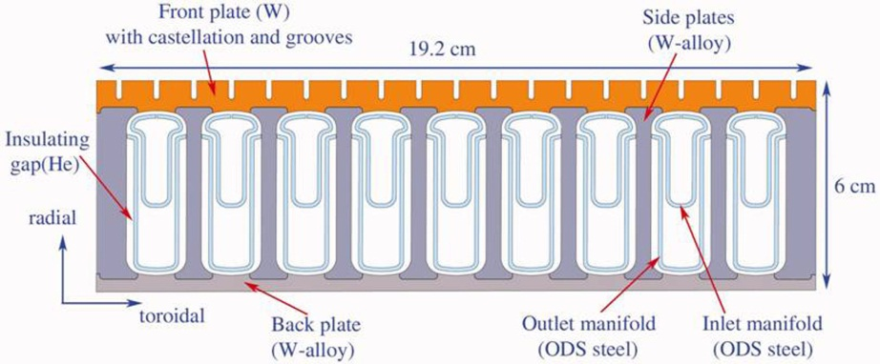
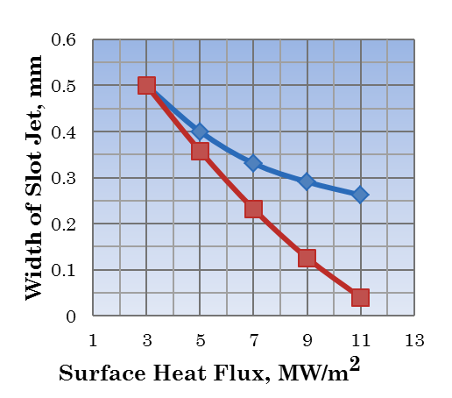
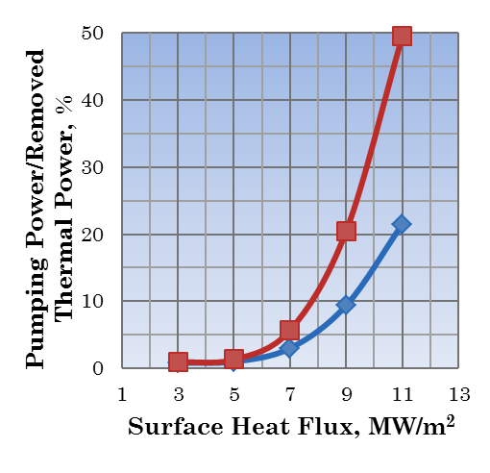
Reevaluation of the HCFP Divertor
P_{pumping power} /P_{removed power} <10%
A: 800 <T_{s}< 1300 ᵒC, T_{exit}=800 ᵒC, T_{in}=700 ᵒC
B: 800 <T_{s}< 1200 ᵒC, T_{exit}=800 ᵒC, T_{in}=700 ᵒC
C: 700 <Ts< 1300 ᵒC, T_{exit}=677 ᵒC, T_{in}=600 ᵒC
B
The allowable heat flux calculated by CFX
Case A, ~9 MW/m²
Case B, ~7.8 MW/m²
Case C, ~11 MW/m²
A
Material applications:
Armor: pure W
Front, side and back plates
(thickness> 2mm)
Pure W or WL10 (W-1%La₂O₃)
Fabrication:
All plates: HIP
A
B

Slide 6
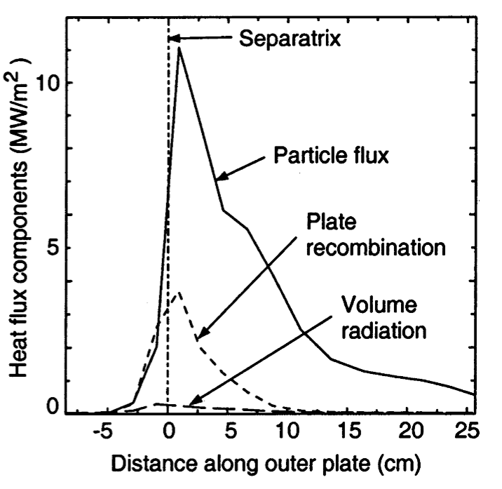
How Can A Non-uniform Heat Flux Profile be Handled in Divertor Design
In previous studies, all evaluations until now were concerned with the layout of the finger and plate concepts for the maximum allowable heat flux.
However, there is a rather steep profile in the plate direction with a ratio between the maximum (11 MW/m²) and average heat flux (3.5 MW/m²) of 2~3.
How can the localized HHF be accommodated for in our divertor design?
Example of the ARIES-AT or RS Design
*T.D. Rognlien, presented at the ARIES Town Meeting

Slide 7
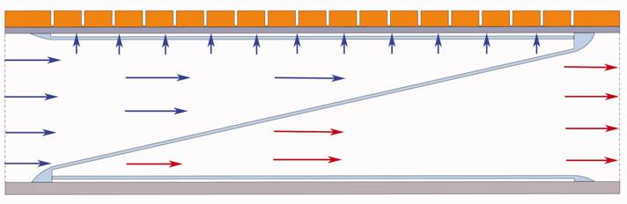
Adjustment of the Cooling to a Power Profile in Plate Direction
With the finger, plate and T-Tube design, the coolant flows in poloidal direction in parallel channel. The heat flux, cooling condition, and the temperatures are equal in these parallel channels.
The helium enters at one side of the plate and leaves at the other side, and the heat flux into the plate is low at the channel inlet, rises to a maximum value, and goes down again in the direction to the exit.
Inside the channel there is an inlet manifold with decreasing cross-section, and an outlet manifold with increasing cross-section. With this arrangement, the He velocity in the inlet and outlet manifold remains constant over entire length of the plate.
The design method for adjusting the cooling to a power profile in the plate direction is to maintain the He velocity through the nozzles (jets) as well as the coolant temperature rise (T_{exit}-T_{inlet}) as constant over the entire length of the plate. In this way, the pressure drop (∆P) will remains constant.

Slide 8
Design Method of Accommodating to a Power Profile in Plate Direction
To maintain the jet velocity v_{jet}, coolant temperate rise ∆T and the ∆P as the constant:
We have to adjust the local coolant mass flow rate to the local divertor heat flux, and this requires the ratio of the mass flow rate to surface heat flux should be constant. This means we have to adjust the flow cross-sections to the local divertor heat flux.
The ratio of the local cross-section area of the nozzle to the cross-section area of the nozzles at the location of the maximum heat flux has to the same ratio of the local heat flux to the maximum heat flux:
S_{nozzle at local} / S_{nozzle at max} = q”_{local} / q”_{max} (S_{nozzle}: CS area of the nozzles)
The slot should not become too small for practical reason, the continuous slot should be replaced by an interrupted slot with ratio
L_{slot at local} / L_{slot at max} = q” _{local} / q”_{max} (L_{slot}: length of the slot)
Examples:
Plate design with jet cooling through a slot
Heat flux (MW/m²) 10 5 2
Slot length (mm per 5 mm unit) 5 2.5 1

Slide 9
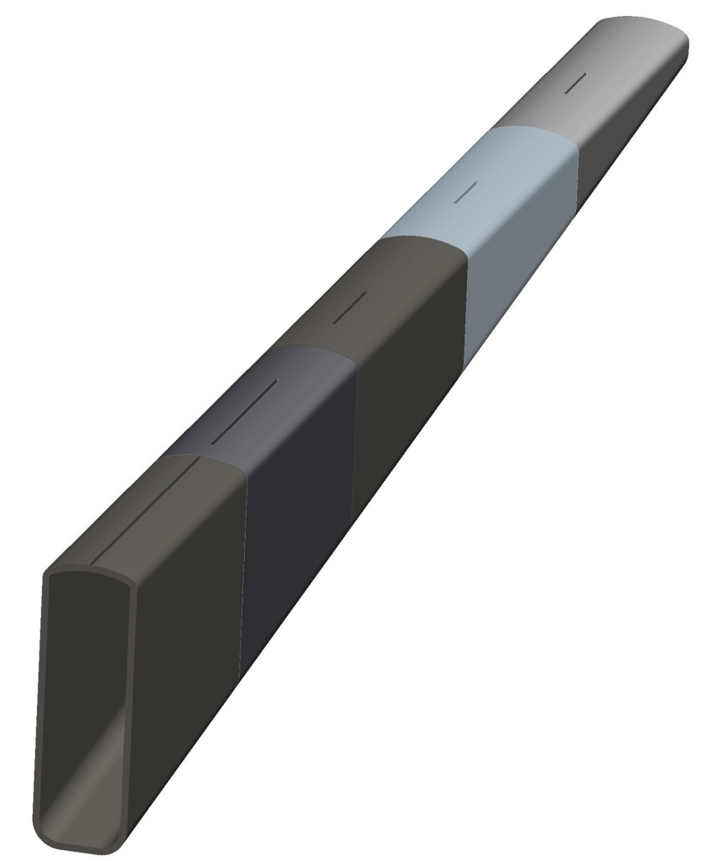
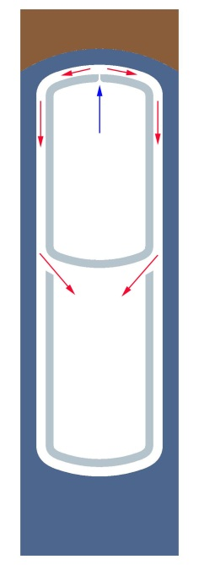
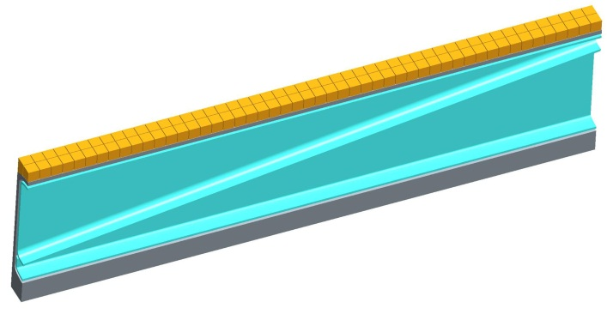
Example of the HCFP Divertor to Accommodate a HF Like ARIES-AT
HHF region
q’’ _{max}=11 MW/m²
~4 MW/m²
~6 MW/m²
700 ᵒC
A_{jet}=0.5 x 18 mm²
per 50 mm
800 ᵒC
HCFP: poloidal length ~30 cm
High heat flux region ~5 cm in the poloidal direction
V_{jet}, ∆T and ∆P remain constant
A_{jet}=0.5 x 27 mm²
per 50 mm
A_{jet}=0.5 x 50 mm² per 50 mm

Slide 10
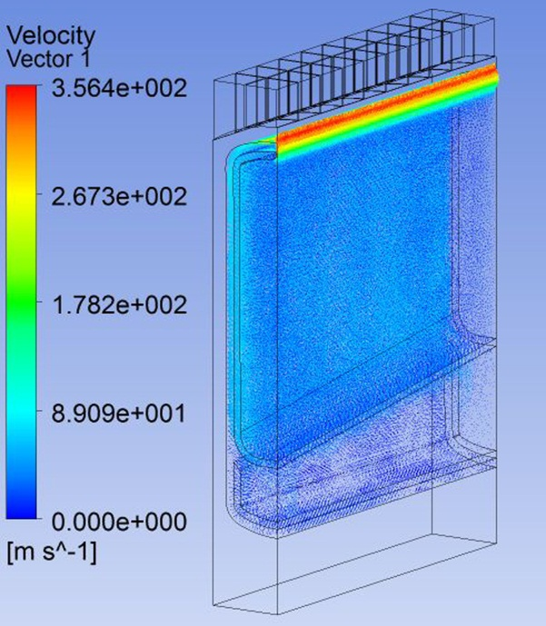
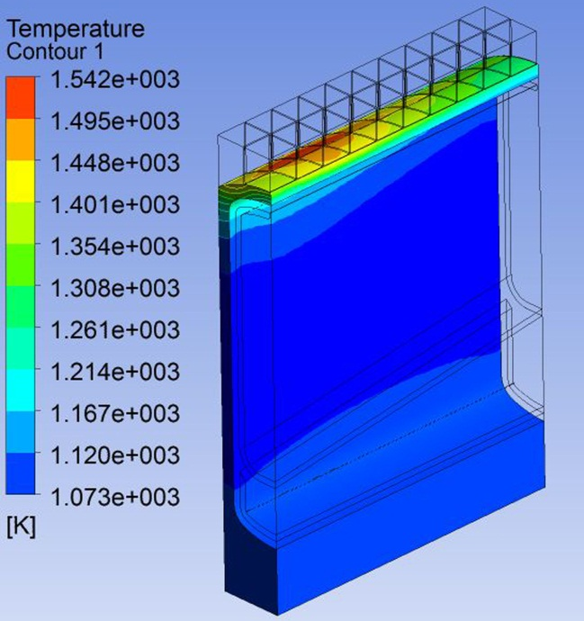
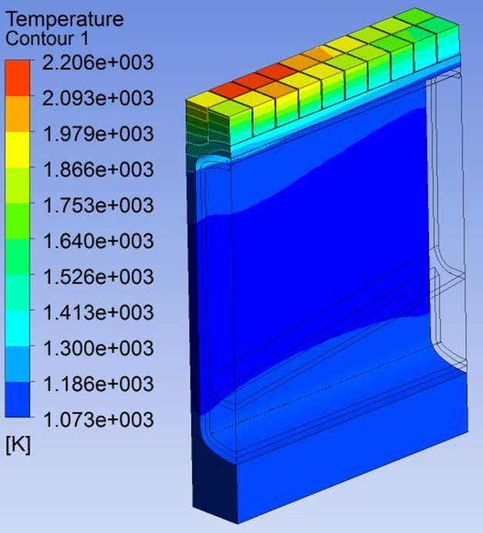
CFD Results Indicated the Plate can Handle the ARIES-AT Like Power Profile
Only high heat flux region(L=50 mm) with the maximum heat flux of 11 MW/m² is simulated by CFD code in order to reduce the elements and nodes.
Total number of the nodes is ~4.1 million for the high heat flux region.
CFD results are based on T_{exit}/T_{inlet}=800/700 ᵒC and W structure operating temperature of 800 <T_{s} <1300 ᵒC
V_{jet}=356 m/s, T_{s,max} =1296 ᵒC, T_{s,min} =800 ᵒC, T_{armor,max} =1933 ᵒC
P_{pumping} /P_{removed thermal}=9.6%

Slide 11
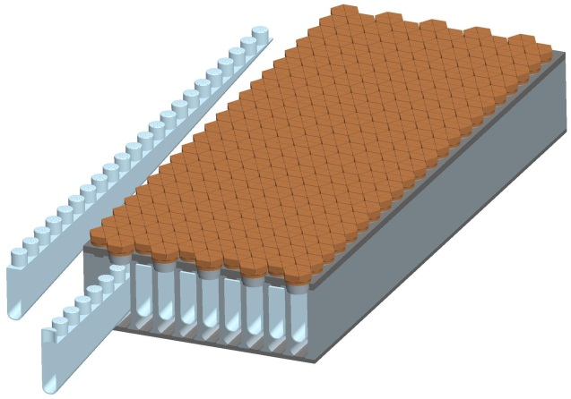

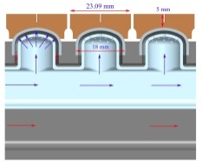

Example of the HCPF to Accommodate a Power Profile Like ARIES-AT
800 ᵒC
700 ᵒC
HCPF: poloidal length ~30 cm
~2 to 3 fingers in the high heat flux region,
Maintaining the V_{jet}, ∆T and ∆P as constant over whole poloidal length
Keeping the nozzle diameter constant and decrease the number of nozzles in the same ratio as the local heat flux
Accommodating much higher localized heat flux (about 6% only for q’’=11MW/m²)
No analysis been done.
800< Ts <1300 ᵒC
700< Ts <1300 ᵒC
Uniform heat flux

Slide 12
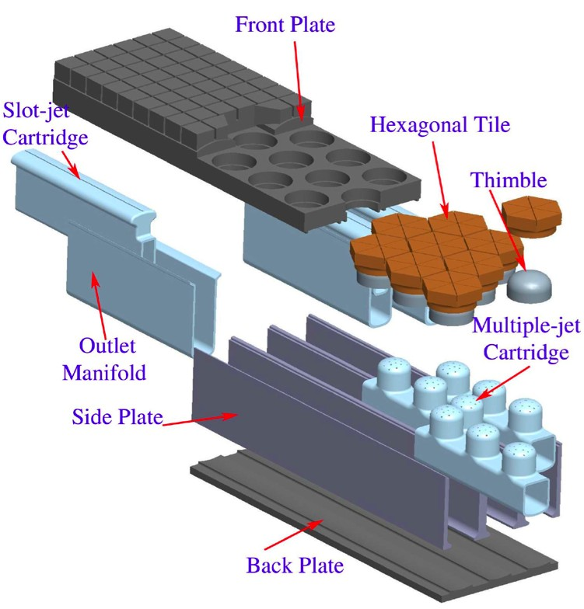
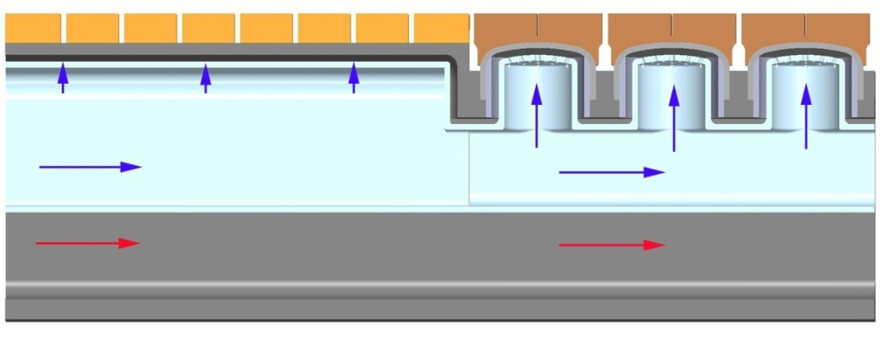
Fingers can be combined with slot jets for localized HHF handling capability and minimum units
Cartridges with both slots and fingers can be combined
Limit fingers to zones with the highest heat flux
q’’< 7 MW/m²
q’’> 7 MW/m²
Notes:
Two heat flux zone divertor

Slide 13
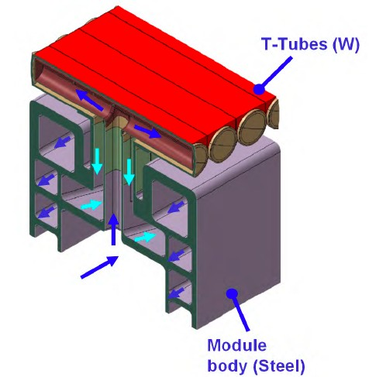
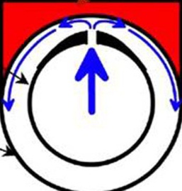
Example of the HCTT to Accommodate a Power Profile Like ARIES-AT (Jeremy)
HHF region
rad.
pol.
tor.
V_{jet}, ∆T and ∆P remain constant

Slide 14
Summary and Conclusions
Divertor concepts including the finger, T-Tube and plate-type, have been re-evaluated and optimized based on raising the minimum W temperature from 700 ᵒC to 800 ᵒC in order to avoid enbrittlement under neutron irradiation.
Allowable heat flux based on the operating temperature limits of 800 ᵒC < Ts <1300 ᵒC
HCPF(Finger), q’’_{allow}=14 MW/m²
HCTT(T-tube), q’’_{allow} =???(waiting for results from Jeremy)
HCFP(Plate), q’’_{allow}=9 MW/m²
Stresses for the adjustment of the W minimum temperature from 700 to 800 ᵒC have not been checked, yet. However, thermal stress should be reduced because of the raising the W minimum temperature.(∆T=400 ᵒC comparing to ∆T=500 ᵒC).
Previous studies indicate in all concepts, stress relaxation by plastic deformations reduce the stresses to a degree that the sum of primary and secondary stresses remain below the 3 S_{m} limit of the ASME code.
Initial results indicate that the plate-type divertor can accommodate a localized HHF like the ARIES-AT with maximum heat flux of 11 MW/m² while meeting the design limits of the W-structure temperature and pumping power.
Expecting (without CFD analysis) the finger can handle much higher localized HHF than the plate.

