Slide 1
Elasto-Plastic-Creep Modeling for the First Wall with W Armor
X.R. Wang¹, S. Malang², M. S. Tillack¹
¹University of California, San Diego, CA
²Fusion Nuclear Technology Consulting, Germany
ARIES-Pathways Project Meeting
Bethesda, Washington DC
April 4-5, 2011

Slide 2
Outline
A simple thermal creep model for comparing the ANSYS results to experimental creep data
Structural criteria in time-dependent elasto-plastic-creep analysis
Creep rupture data and Norton Law parameter for Euorfer 97 steel
Elastic-plastic-creep modeling of the first wall with W armor

Slide 3
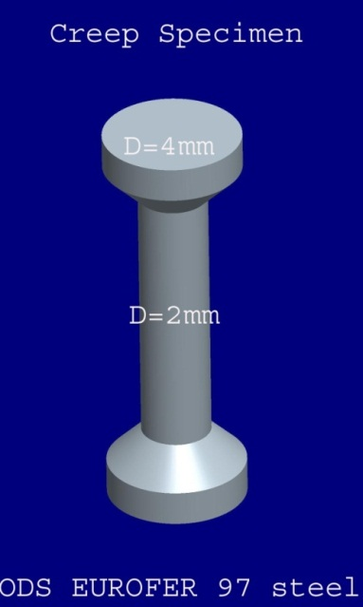
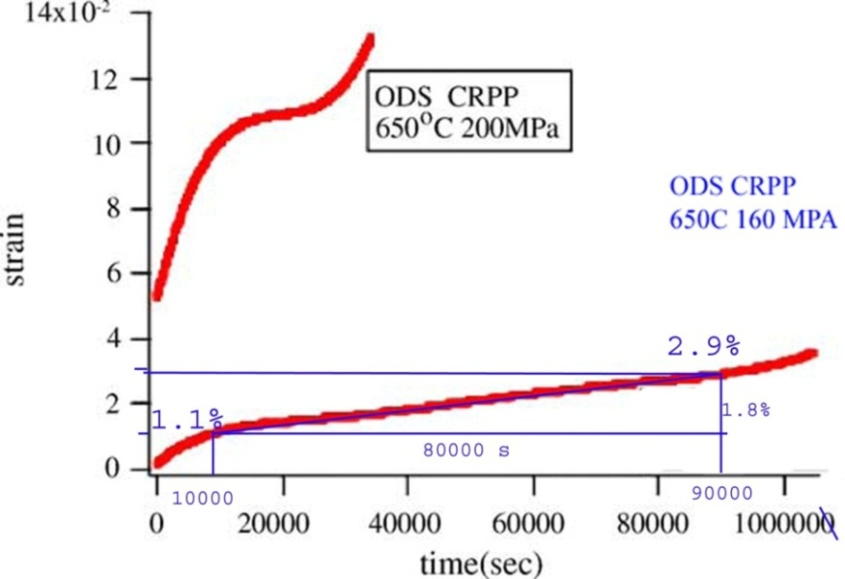
Thermal Creep Test for ODS EUORFER 97 Steel*
Applied constant stress:160-200MPa
Applied temperature: 650 °C
Corresponding creep strain rate associated with the steady stage: ~2.25E-7 1/s at applied stress of 160 MPa
Creep strain in primary stage: 1.1%
Creep strain in secondary stage: 1.8%
Norton Creep Law :
dε_{cr}/dt=C1σ^{C2}e^{-C3/T}
C1,C2, C3 are temperature-dependent creep constants, σ is applied stress, T is temperature
C3=0
Creep exponent C2: 4.9-5.5
Assuming C2=5.1, the creep constant C1=3.245E-49
*G. Yu at al, Fusion Engineering and Design, 75-79, 1071(2002)

Slide 4
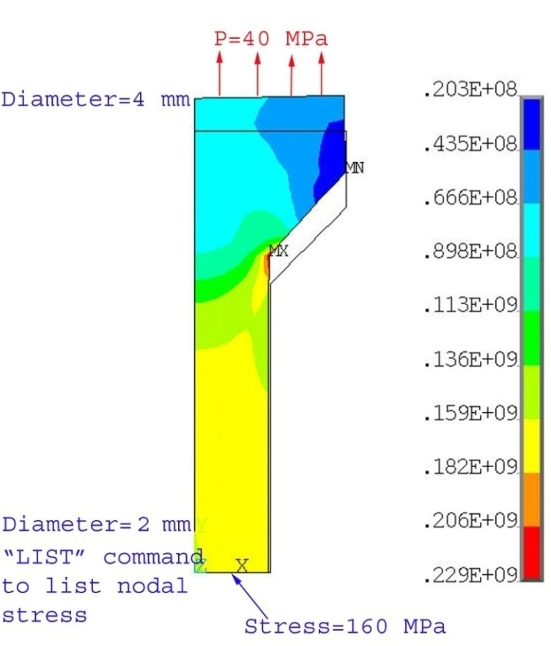
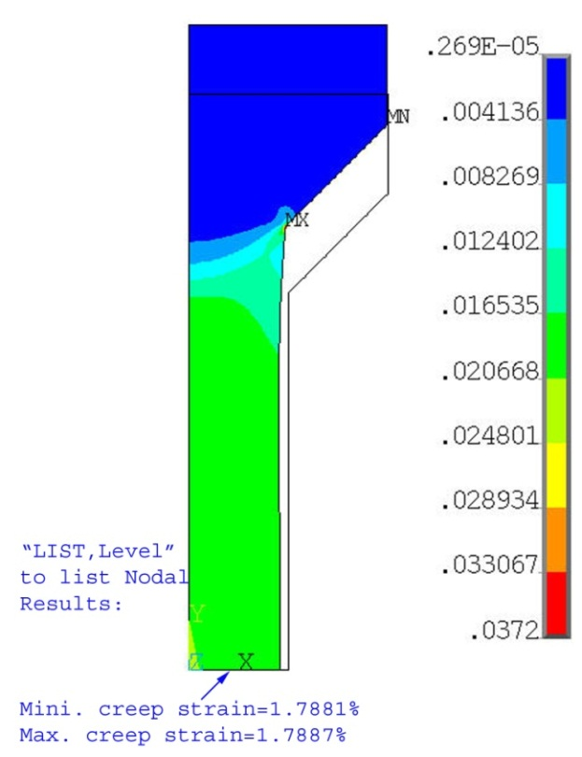
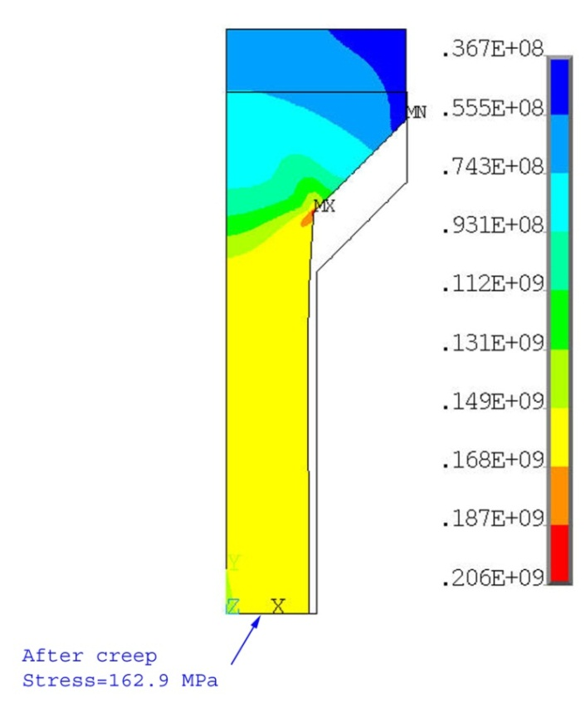
Comparison of ANSYS Creep results To Creep Tested Data
Stress Model (1/4 Specimen)
Stress after 80000 s
Creep strain after 80000 s
Axisymme-tric
element
behavior
Symmetry
BC
ANSYS modeling, ε_{cr}=~1.788%
Hand calculation, ε_{cr}=~1.8%
Exp. Data (Creep-time curve), ε_{cr}=~1.8%
Deformed shape was exaggerated by a factor of 10

Slide 5
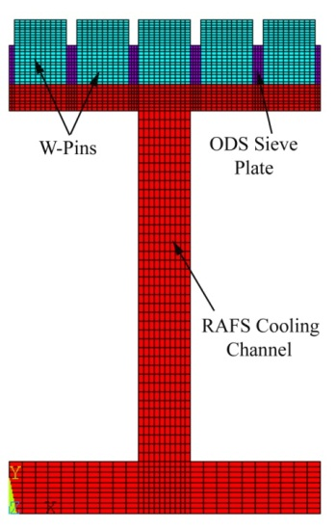
Thermal Creep Modeling of the FW Armor
Temperature of the W-pins is ~ 680 ºC, therefore, thermal creep is not important as a deformation mechanism. W thermal creep begins to become significant around 1500 ºC and above.
As there is not enough creep coefficients for ODS steel (12YWT), and the thermal creep of the ODS steel is not included. (Yu’s creep data only at T=650 ᵒC and σ=160 MPa)
Only F82H material will be considered in the creep model, and the creep data of Eourfer 97 steel will be used in analysis.
Norton model is used in ANSYS, and primary stage is not
included.
Irradiation induced creep is not considered at present
because of difficulty to find the irradiation induced creep data
(Arnold Lumsdaine is helping us to collect the creep data.)
*R.L. Klueh et al./J. of Nuclear Materials 307-311 (2002) 455-465.

Slide 6
Structural Criteria in Time-Dependent Elasto-Plastic-Creep Analysis
Structural strain limits: At elevated temperatures where creep occurs, it is generally impossible to avoid strain accumulation. However, it is necessary to limit strain accumulation to avoid excessive structural distortion and fracture.
The calculated maximum accumulated positive principal inelastic (plastic plus creep) strain at the end of life must meet the three limits:
Membrane (strain averaged through the thickness) ≤ 1%
Local (maximum strain anywhere) ≤ 5%
Membrane + bending ≤ 2%
The criteria were used in the design of metallic HTR-components with high application temperature of 750 ᵒC ~1000 ᵒC (INCONEL 617)
Need experts’ opinion on this structural criteria
Need to study ITER SDC-IC (Structural Design Criteria In-vessel Components) and make a comparison
*Alfred Snow, “US Elevated Temperature Structural Design Standards: Current Status and Future Direction,” Westinghouse Electric Corporation, 1976.
Notes:
In pure elastic analysis, we usually use 3 Sm limits of ASME code for avoid ratcheting. Sm is allowable stress. If the claculated primary stress intensity is less than the Sm, then the structure is in elastic region. If the sum of primary plus secondary stresses remains below 3 Sm limit, the design is fine.

Slide 7
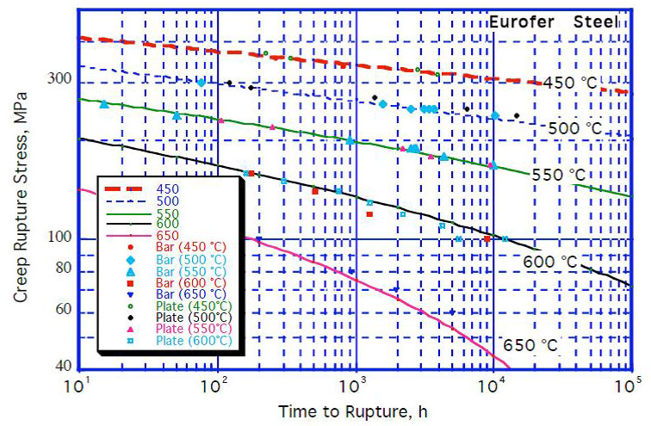
Creep Rupture Curves of Eurofer Steel(FZK, CIEMAT data)*
Creep Rupture Stress, Sr
FW | 450 ᵒC | 500 ᵒC | 550 ᵒC
S_{r}, MPa at 1000 h | 328 | 254 | 185
S_{r}, MPa at 10000 h | 295 | 221 | 152
*F. Tavassoli, DEMO Interim Structural Design Criteria, Appendix: A Material Design Limit Data, CEA/DEN/SAC/DMN, Dec. 2002.
*M. Rieth, et. al, “EOUOFER 97 Tensile, Charpy, Creep and Structural Tests” FZKA 6911, Oct. 2003.

Slide 8
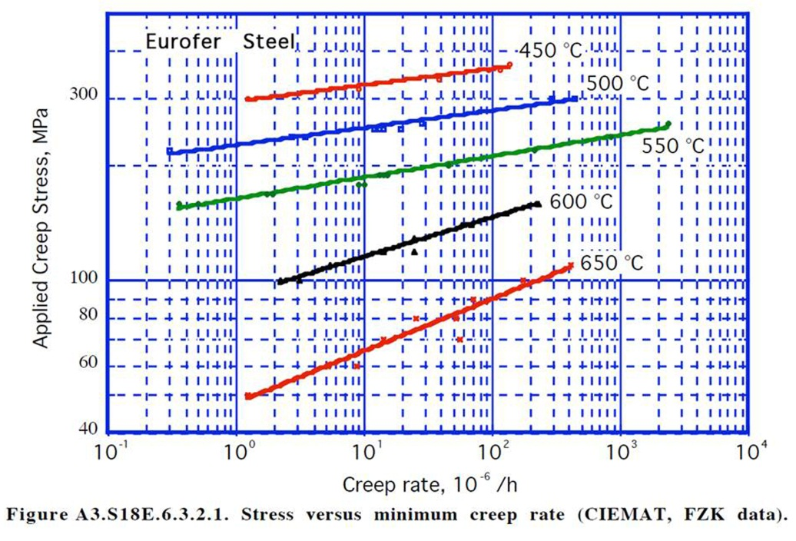
Creep Coefficients of EUOFER Steel(FZK, CIEMAT data)*
Only the secondary stage is considered.
The creep is ignored at temperature less than 425 ᵒC.
Norton creep equation is expressed by:
dε_{cr} /dt=C1σ^{C2}e^{-C3/T}
(creep rate in 10⁻⁶/h, σ in MPa in fig.)
Allowable creep rate (1/h) corresponding to 1% creep limit (Structural Criteria #1)
Norton law parameters for Eurofer Steel
Only C1, C2 and C3 are inputted into ANSYS.
T | C1 | C2 | C3 | Stress, MPa | Creep rate,1/h
450 ºC | 8.352E-57 | 22.718 | 0.0 | 300 | 1.574E-6
500 ºC | 1.376E-50 | 21.19 | 0.0 | 220 | 5.950E-7
550 ºC | 4.566E-40 | 17.769 | 0.0 | 160 | 6.676E-7
600 ºC | 2.490E-19 | 9.5095 | 0.0 | 100 | 2.601E-6
650 ºC | 6.217E-12 | 6.7473 | 0.0 | 50 | 1.807E-6

Slide 9
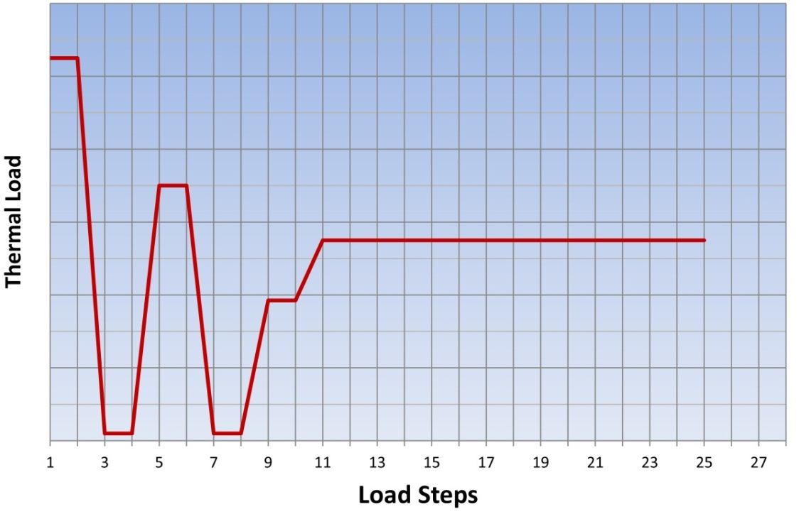
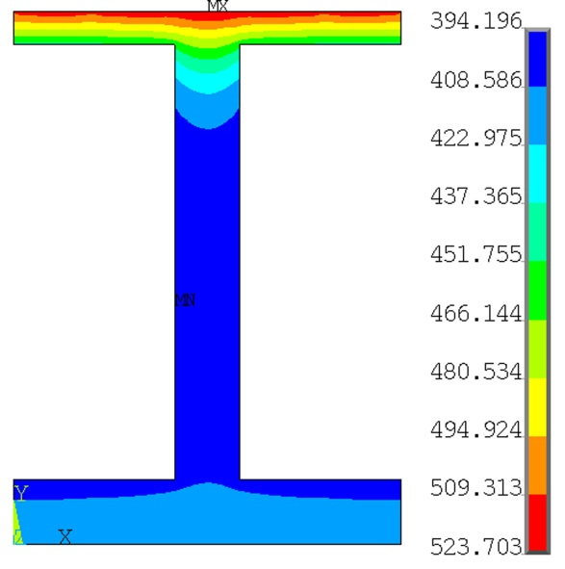
Thermal Loads for the Elasto-Plastic-Thermal Creep Model
Nonlinear structural behaviors of the FW are simulated by a combined elastic, plastic and creep models.
Processes of the fabrication, heat treatment, reactor start-up and normal operation are included in plastic model.
There are no stress, no plastic strain and creep strain during the FW brazing process.
The FW is in the plastic range during braze cool-down.
At this moment, the creep strains are ignored during the heat treatment because of such a short time.
1050ᵒC
Elasto-Plastic
Elasto-Plastic
and Creep
700ᵒC
q=1MW/m²
385ᵒC
P=10 MPa
20ᵒC
Temperature
contour during
operation

Slide 10
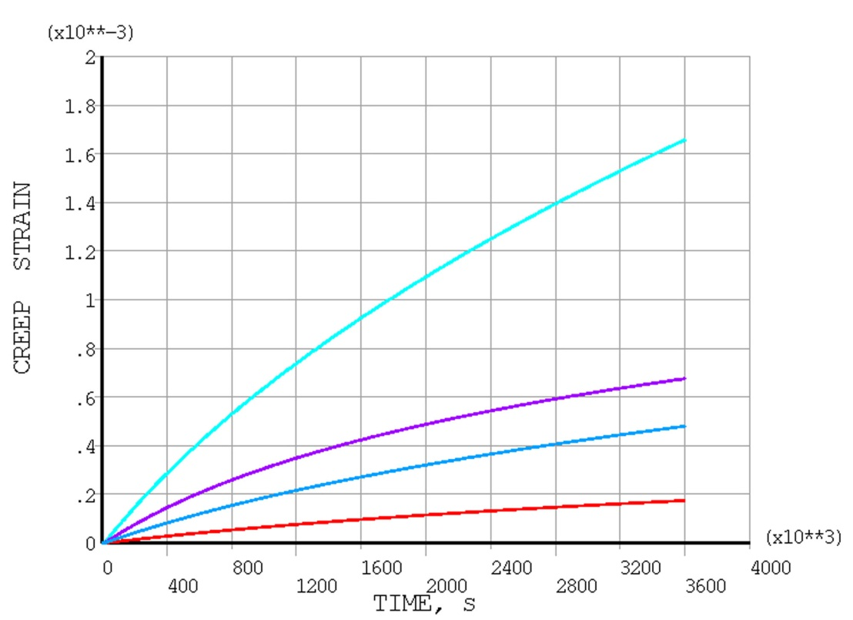
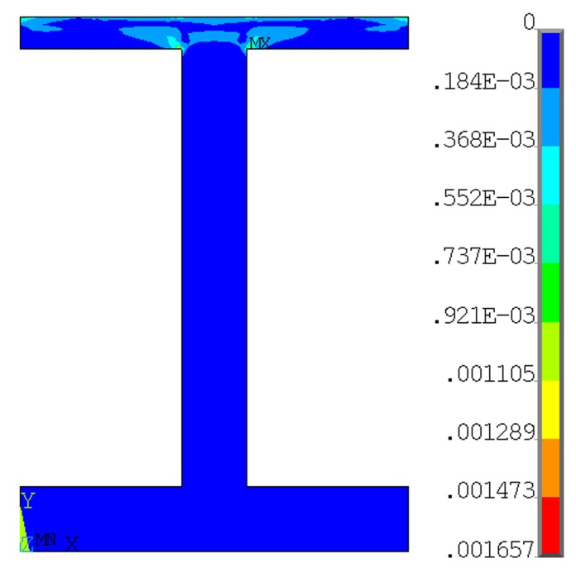
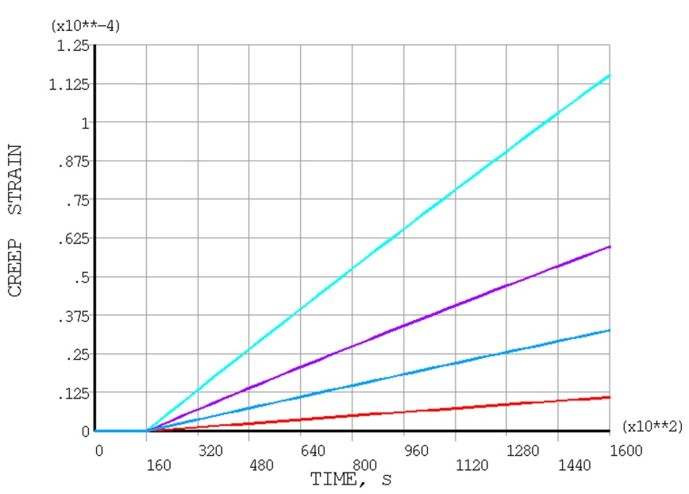
Local Creep Strain of the F82H
Node B
525 ᵒC
Node A
Node A
450 ᵒC
Node C
500 ᵒC
Node D
500 ᵒC
Node B
Node C
Creep strain at node A
Node D
Fabrication
Node A
The maximum local creep strain of the F82H plate at 1000 hours is ~ 0.17% at the Node A where the local stress occurs caused by sharp corner at the temperature of 450 ᵒC.
Ɛ_{cr}=~0.07% at the Node B with maximum temperature of 525 ᵒC.
Ɛ_{cr}=~0.05% at the Node C with temperature of 500 ᵒC
Node B
Node C
Node D

Slide 11
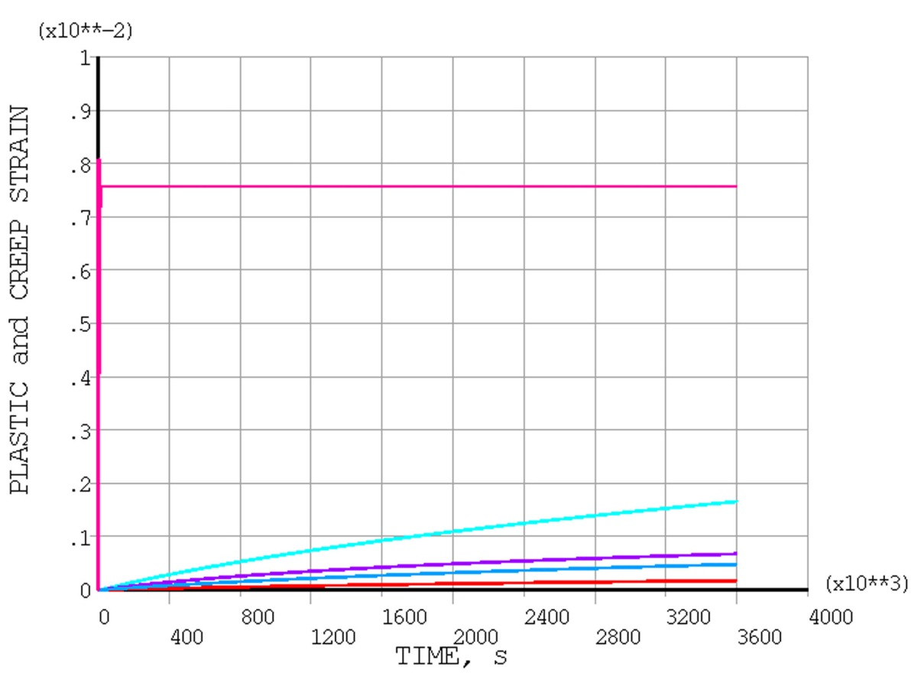
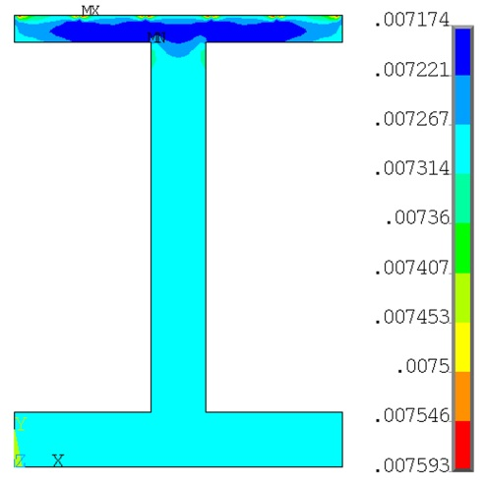
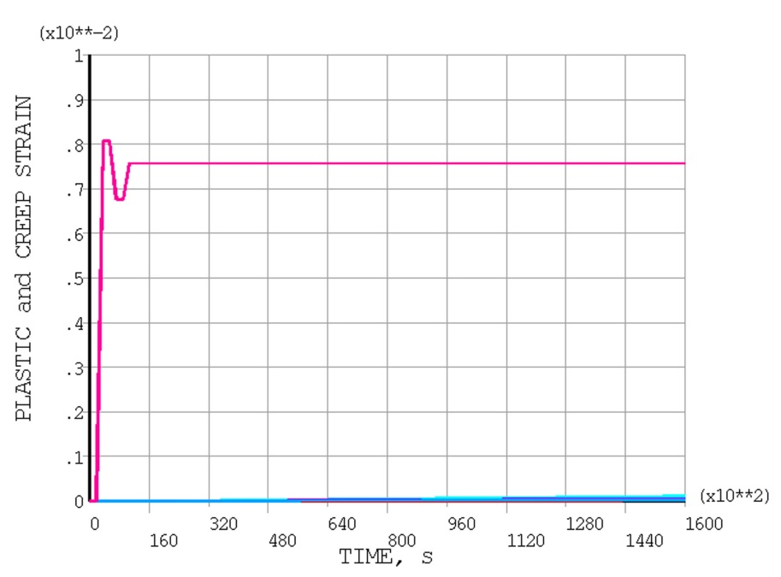
Plastic Strains After 1000 Hours
Node B
525 ᵒC
Local plastic strain
Plastic
strain
Node A
450 ᵒC
Ɛ _{plasticity}=~0.76% after 1,000 hours
Creep strain at node A
Node B
C
D
The total local strain (plastic + creep) at node A is ~0.9%, and ~0.8% at the node B after 1000 hours.
The plastic strain mainly occurs in the processes of the FW fabrication, and there is no additional plastic strain during normal operation.
Thermal creep can help relax the total stresses of the F82H plate during the operation, but can not recover the deformation which occurs during the FW fabrication.

Slide 12
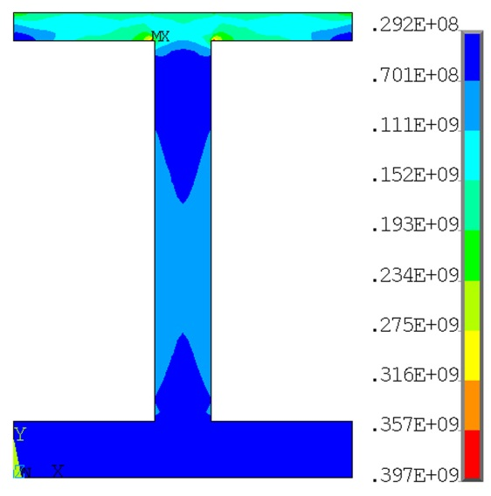
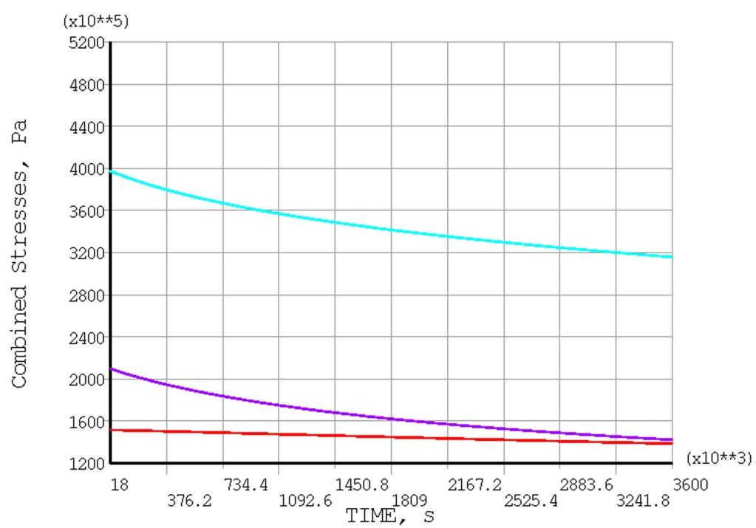
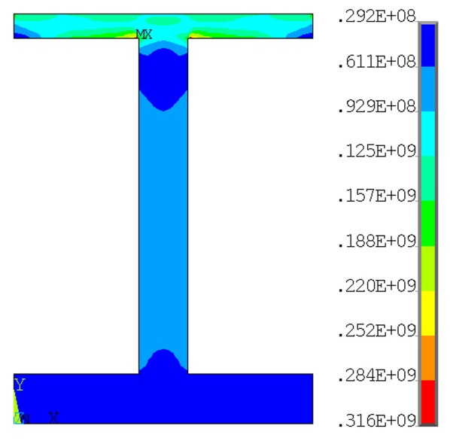
Stress Relaxation by Creep Deformation
Node B
525 ᵒC
Node A
450 ᵒC
Node C
500 ᵒC
Node A
Node B
Node C
σ_{primary+thermal}=397 MPa
at t=5 hours (fabrication
and reactor start-up)
Total stress is reduced by stress relaxation caused by creep strain.
Local σ_{primary+thermal}=~316 MPa with stress relaxation of creep at t=1000 hours

Slide 13

Summary
Full time-dependent elasto-plastic-creep analysis is performed in a operating time of ~1000 hours for the FW, and a long operating time such as 10,000 h or even longer may need to be analyzed.
Calculated local creep strain ~0.17% and the plastic strain is ~0.72% at the Node A after 1000 hours. The local plastic plus creep strain is ~0.9%.
Expected local creep strain is roughly ~1.57% after 10,000 h and the total strain is ~2.4% (< 5% local strain limit), however it needs confirmation by analysis (assuming the initial creep rate of 1.57 E-6 1/h)
Further assessments of the structural strains are needed to compare other two strain limits, also including to study ITER SDC-IC
Possible design methods to reduce the local total stresses and local creep strain of the F82H
Round the sharp corner where it causes local primary stress
Node A

