Slide 1

Neutron Wall Loading Update
L. El-Guebaly, A. Jaber,
A. Robinson, D. Henderson
Fusion Technology Institute
University of Wisconsin-Madison
http://fti.neep.wisc.edu/UWNeutronicsCenterOfExcellence
Contributor:
X. Wang (UCSD)
ARIES Project Meeting
Bethesda, MD
April 4 - 5, 2011

Slide 2
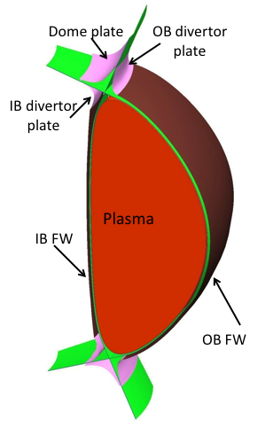
ARIES-ACT New FW/Div Configuration
January 2011 Strawman
Key parameters:
R = 5.5 m
a = 1.375 m
SOL = 10 cm
Elongation = 2.2
Fusion power = 1907.4 MW
Ave. NWL = 2.8 MW/m²
@ 10 cm from plasma surface
Surface areas:
Plasma = 475 m²
FW area:
IB FW = 139 m²
OB FW = 313 m²
IB & OB FW= 452 m²
Upper & lower divertors:
IB plate = 22.5 x 2 m²
Dome = 28 x 2 m²
OB plate = 21 x 2 m²
Div total = 143 m²
FW + Div Surface area = 595 m²
Area of wall @10 cm from plasma = 547 m²
Main features:
Curved IB FW (allowing 11 cm extra space at top/bottom)
Per Kessel,
OB div plate @ R-a/2
IB div plate @ R-a

Slide 3
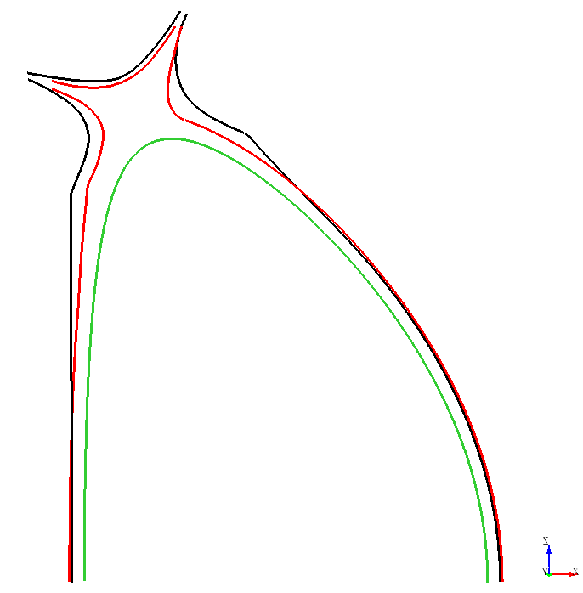
New vs. Old FW/Div Configuration
Old
Smaller entrance to divertor region.
More conforming FW to:
Capture neutrons before reaching divertor
Allow 11 cm more space at IB top/bottom for DCLL He/LiPb manifolds
Reducc nuclear heating at IB magnet.
New
Plasma

Slide 4
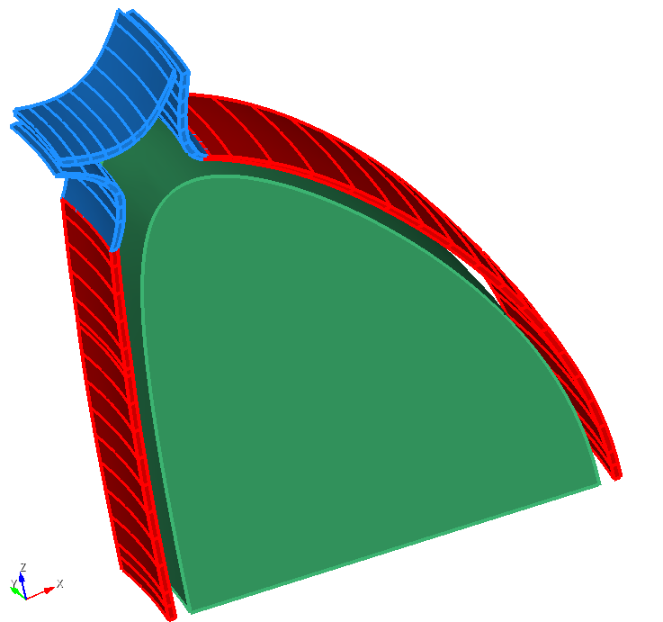
3-D NWL Model
Includes:
Plasma boundary
IB & OB FW
IB & OB div plates and dome.
FW and divertor segmented vertically and radially to improve accuracy.
10 million particle history.
Statistical error < 1%.
MCNP 3-D Model

Slide 5
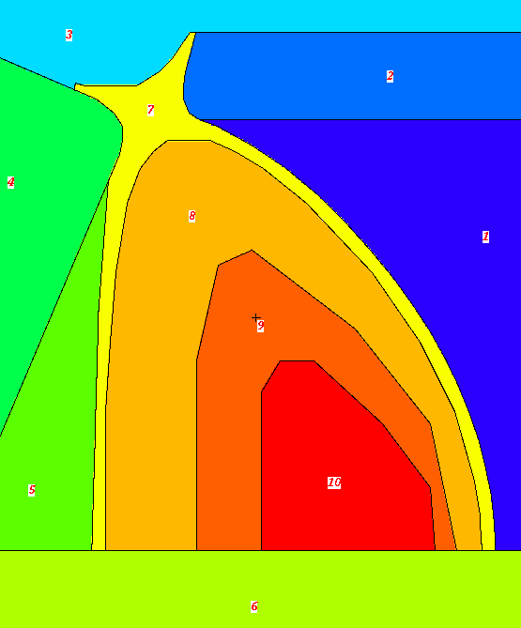
Neutron Source Sampling
Options:
Uniform within plasma boundary.
Unrealistic, but used to check geometry (1/2011 ARIES presentation by El-Guebaly).
Three-nested source regions with variable intensity peaking at magnetic axis:
Good approximation.
Intensities borrowed from ARIES-RS: 63%, 32%, 5%.
3. Actual distribution:
Source density distributed on R-Z grid not available yet.
Results identical to 3-nested source, except for 10% higher peak at IB midplane (refer to 5/2008 NWL presentation by Wilson).
5%
32%
63%
MCNP 2-D Plot
(3-nested Source Regions)

Slide 6
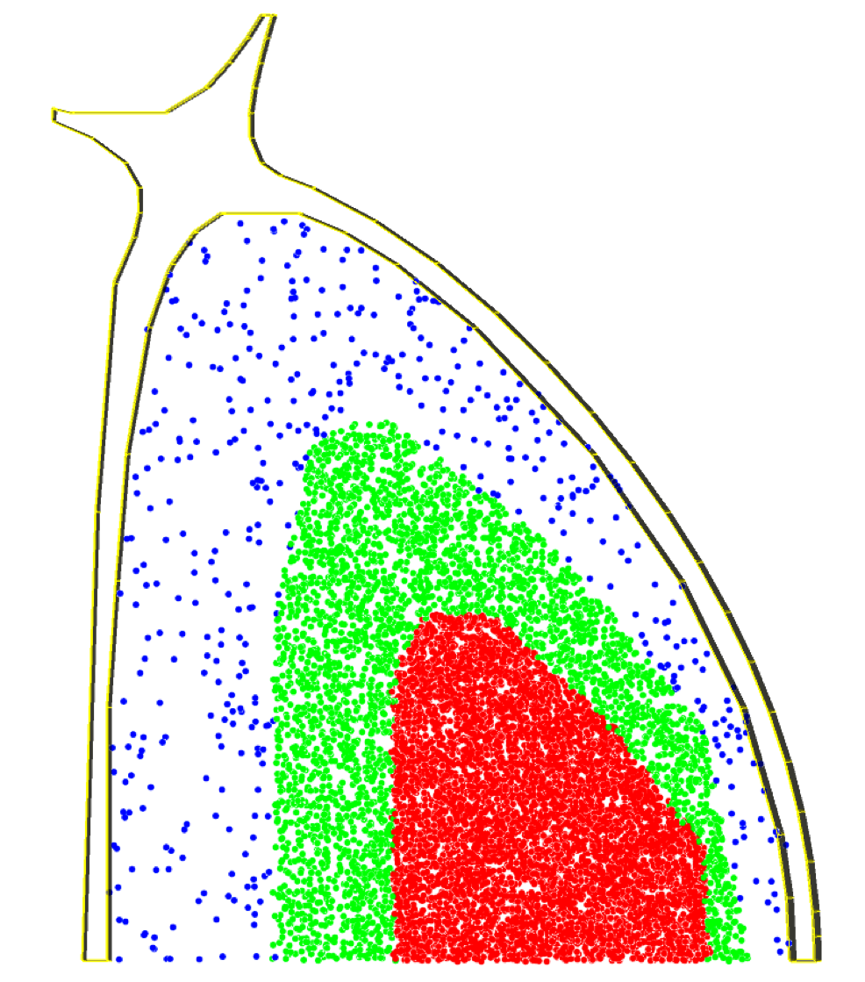
Three-nested Source Regions Within Plasma
Neutron Source Intensity:
63%, 32%, 5%
(Example: 10,000 particles random sampling)

Slide 7
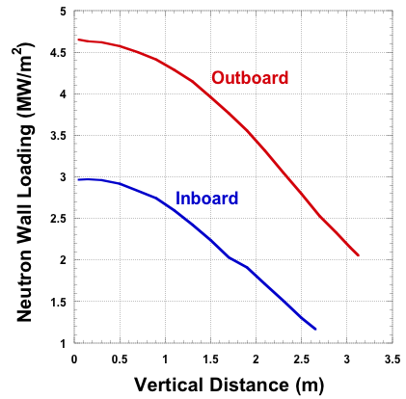
IB and OB Results
Machine Ave NWL (P_{f} x 0.8/area):
@ 10 cm from plasma surface 2.8
Peak OB NWL @ OB midplane 4.7
Ave OB NWL 3.6
Peak IB NWL @ IB midplane 3 x 1.1* = 3.3
Ave IB NWL 2.3
______________
* Correction factor for actual source distribution (refer to 5/2008 NWL presentation by Wilson).

Slide 8
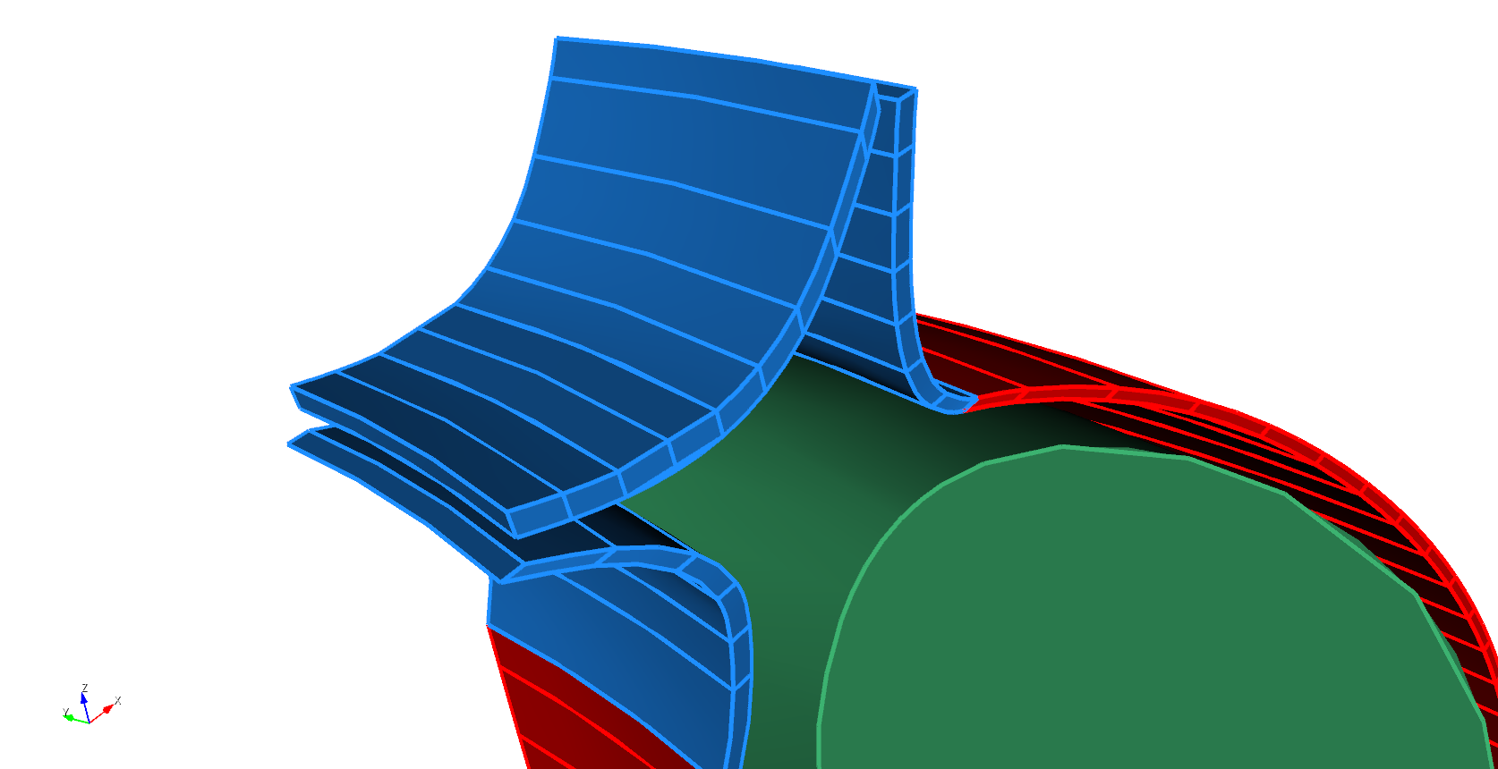
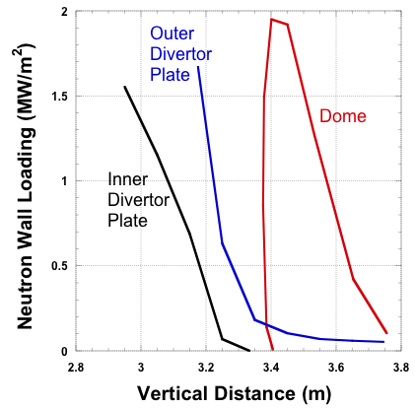
Divertor Results
Peak Div
NWL
Machine Ave NWL (P_{f} x 0.8/area):
@ 10 cm from plasma surface 2.8
Peak Div NWL 2
Ave Div NWL 0.7

Slide 9
Summary of NWL Results
Machine Ave NWL (P_{f} x 0.8/area):
@ 10 cm from plasma surface 2.8
Peak IB NWL 3.3
Ave IB NWL 2.3
Peak OB NWL 4.7
Ave OB NWL 3.6
Peak div NWL 2
Ave div NWL 0.7
Peak to average NWL = 1.68

Slide 10
Conclusions
Peak NWLs will be used to redefine radial builds for ARIES-ACT:
3.3 MW/m² for IB
4.7 MW/m² for OB
2 MW/m² for divertor.
For ASC, peak to average NWL = 1.68 (not 1.5).

