Slide 1

Comments on ARIES-ACT Strawman
L. El-Guebaly
Fusion Technology Institute
University of Wisconsin-Madison
http://fti.neep.wisc.edu/UWNeutronicsCenterOfExcellence
Contributors:
L. Carlson (UCSD), L. Waganer (Boeing), S. Malang (UCSD)
C. Kessel (PPPL), J. Minervini (MIT), K. Schultz (GA),
L. Cadwallader, B. Merrill (INL),
W. Sowder (Quality Management Services, Inc.),
DOE
ARIES Project Meeting
Bethesda, MD
April 4 - 5, 2011

Slide 2
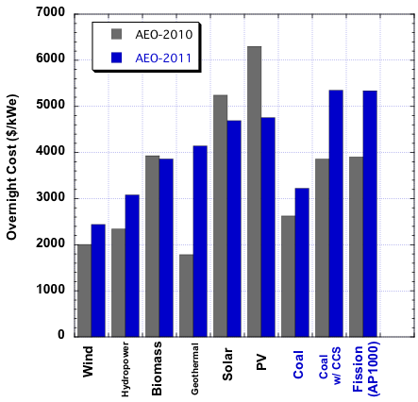
11/2010 DOE Annual Energy Outlook for 2011
http//:www.eia.gov/oiaf/beck_plantcosts/pdf/updatedplantcosts.pdf
Report provides critical input into development of energy projections and analyses.
It outlines current (2010) and projected (2011) Overnight Cost for fission, coal, natural gas, and renewables
For nuclear and coal, projected cost increased by 37% due to:
Higher global commodity prices
Rising costs of capital intensive technology
Scarcity of construction firms experienced in complex engineering projects.
Do these attributes
apply to fusion?

Slide 3
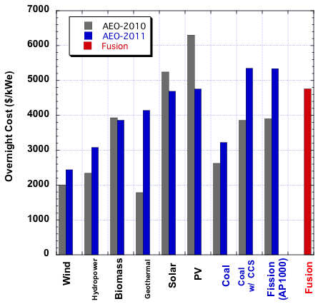
ARIES-ACT vs. Other Sources of Energy
Fusion cheaper than fission ?!
ARIES-ACT
2/2011 Strawman
COE = 66 mills/kWh
Renewables

Slide 4
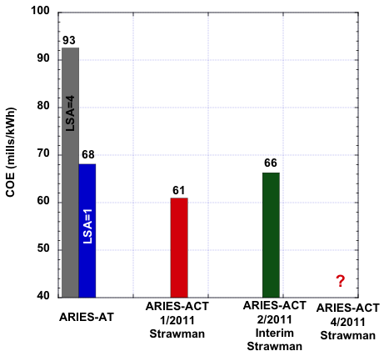
Cost of Electricity (in 2009 $)
FCR = 0.09652
FCR = 0.05828
FCR is Fixed Charge Rate.

Slide 5
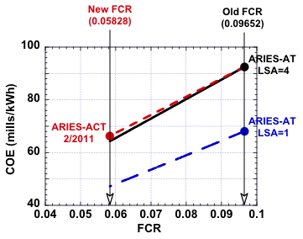
Impact of FCR on COE
For same FCR of 0.05828, 2/2011 ARIES-ACT:
Is more expensive than ARIES-AT with LSA=1
Has comparable COE to ARIES-AT with LSA=4.

Slide 6
“Place Holders” for ARIES-ACT Strawman (to be updated as design evolves)
Radial build:
ARIES-AT SiC/LiPb FW and blanket design
No thermal shield for TF magnets
18 MWy/m2 EOL fluence for replaceable components
40 FPY lifetime of permanent components.
Neutron power distribution: 65% to OB, 25% to IB, 10% to divertor
20/80 power split for He loop of divertor and LiPb loop of FW/blanket/shield
65 MW P_{aux} (need nuclear heat load to LHe thermal shield and TF magnets)
2 mills/kWh for D&D cost (need new algorithm for Class A and Class C LLW)
Cost of startup, stability control, and plasma fueling systems
Economic life = 40 y; Design lifetime = 47 y; Consider 50 or 60 y life?
Peak / average NWL = 1.5
Material unit costs:
LiPb with 90% enriched Li and < 50 wppm Bi impurity.
Multiplier for nuclear-grade materials (currently 1, meaning industrial/commercial materials)
Multiplier for safety-related components (currently 1, meaning no safety-related components).

Slide 7
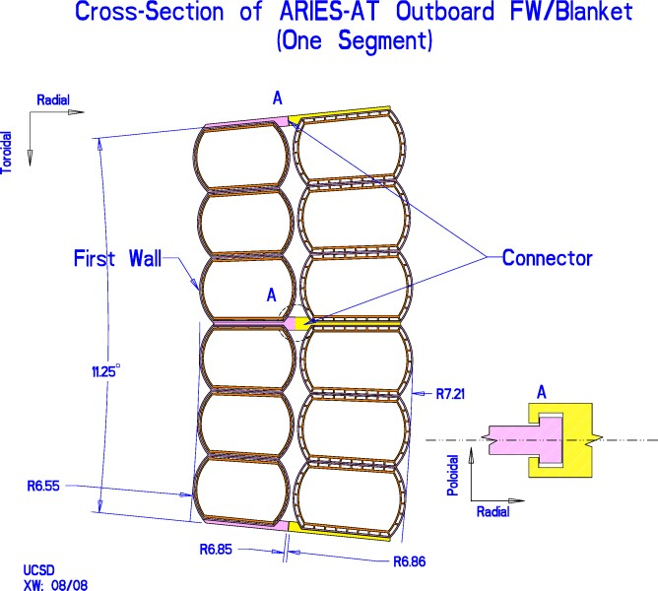
SiC/LiPb FW and Blanket Design
Any changes to ARIES-AT FW/blanket design?
Can FW handle:
Peak NWL of 4.7 MW/m² ?
Disruption
High heat flux during transients?
Structure: SiC/SiC Composites
Coolant / Breeder: LiPb

Slide 8
LHe Thermal Shield for ARIES-ACT
Magnet designers recommend thermal shield between VV (operating @ 200ºC) and TF magnets (operating @ 4 K).
Per Kessel:
4 K magnet cannot face 200ºC components
4 K cryogenic LHe cryoplant is never capable of handling such high heat loads
It takes so much energy (300 W/W) and coolant capacity to reject high heat at 4 K
Rejecting heat at 70-100 K is cheaper and takes less energy (10 W/W).
ITER LHe thermal shield (ITER Newsline – 2/7/2011 - #163):
2 cm thick stainless steel panels coated with low-emissivity silver
LHe cooling pipes welded to panels
Operates within 80-100 K during plasma operation
Korea completed full-scale mock-up of 10° inboard section and tested main procedures of fabrication including cutting, bending, forming, buffing, welding, and machining
Korea plans to make another mock-up for outboard 10° section, which will be assembled with inboard section.
Will include ITER’s 2 cm thick LHe thermal shield in ARIES-ACT radial build.

Slide 9
LiPb Cost
Per Waganer, 90% enriched LiPb could cost ~$9/kg based on:
Current cost of 99.97% pure Pb with 300 wppm Bi ($3/kg)
Predicted cost for 90% enriched Li of $1000/kg
LiPb material cost = Pb unit cost x LiPb mass x Pd-wt%
+ Li unit cost x LiPb mass x Li-wt%.
Q: Besides Pb and Li material costs, what are associated costs for:
Mixing tons of Li an Pb to make `6300 tons of Li_{15.7}Pb_{84.3} eutectic?
Control Bi impurity below 50 wppm?
Purification system to remove byproducts?
Waganer’s suggestions:
MHTT Account should reflect additional cost for:
Mixing Li and Pb to make Li_{15.7}Pb_{84.3} eutectic
Online purification system to remove:
Pb byproducts (Bi, Po, Hg radioisotopes)
Corrosion products (Fe, Ni, Cr radioisotopes)
Fuel Handling and Storage Account should include cost of:
T separation
Replenishment of Li.
Incremental cost increase to MHTT Account? (currently ~$200M – low compared to > $450M in ARIES-ST and CS)
Need industrial quote for tons of 30-90% enriched Li and LiPb.

Slide 10
Li and Pb Mixing Process Should Avoid High Melting Phases
Concerns:
- Non-uniform mix
- Formation of hard melting phases (with T_{m} > 235ºC)
~ 6270 ton Pb
(11.3 g/cm³)
~ 40 ton Li
(0.53 g/cm³)
ARIES-ACT Volumes
(2/2011)
235ºC - melting point of Li_{15.7}Pb_{84.7} eutectic
(formerly known as Li₁₇Pb₈₃)

Slide 11
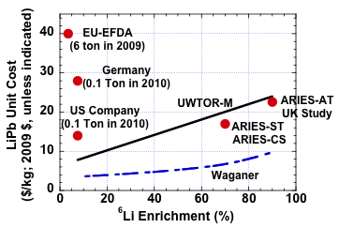
LiPb Unit Cost
LiPb
Original
1982 UWTOR-M Cost Estimate
Based on COLEX Enrichment Process (by ORNL)
American and German companies sell LiPb at much higher prices
than predicted by UWTOR-M and Waganer

Slide 12
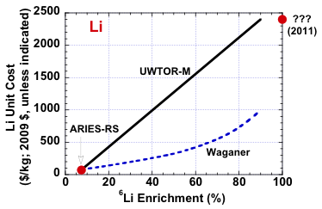
Cost of Li Enrichment
Original
1982 UWTOR-M Cost Estimate
Based on COLEX Enrichment Process (by ORNL)
Shape of curve? Straight as in UWTOR-M?
Convex as proposed by Waganer? Or Concave?

Slide 13
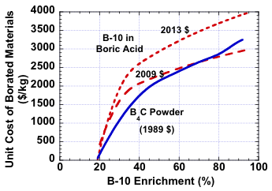
Boron Enrichment Provides Guidance
Ceradyne, Inc. (formerly Eagle Picher): US company for B enrichment
Concave enrichment curve (not straight nor convex) .
Large cost for any enrichment.
Pricing based on volumes > 1 Ton. Much larger quantity has slightly lower unit cost (< 10%).
30% price increase over 4 years (not just proportional to inflation rate).

Slide 14
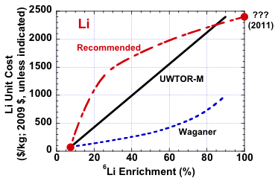
Recommended Li Enrichment Cost
Boron
Lithium
Concave (not convex) enrichment curve for Li.
LiPb unit cost will be estimated accordingly.

Slide 15
Nuclear-Grade Components (12/2009 ARIES Presentation by El-Guebaly)
Besides technical side for any material (functions, complex/simple shape, etc.), administrative side (inspections, qualified suppliers, material certifications, etc.) cost more in nuclear industry because of added quality assurance, documentation, and controlled manufacturing processes that are different from commercial industry type of activities.
Nuclear standards costs 2-10 times commercial standards due to QA, lots of inspections, records, and field work:
Complete traceability of items from raw material to finished product (paper work can cost more than item!):
Material constituents must meet ASME specs and impurity level, with documentation
Designers should follow Section III rigorous design rules, use FEA, and analyze it exhaustively, with documentation
Plans drawn for fabricators, with documentation
Fabricator has “hold points” to allow inspection, with documentation
Welding must be performed by Certified Nuclear Welders, inspected, radiographed, and documented
After assembly, the vessel is pressure tested to ~125% pressure, test is witnessed by Certified Inspector, and documented
If all documentations, inspection, and pressure test results are satisfactory, component receives N-stamp status and is documented.
Documentation is kept on file for the life of the vessel
Extensive quality assurance standards (big cost item)
Stringent testing requirements.
Suggest applying nuclear-grade to structural elements (not fillers):
SiC/SiC composites of FW, blanket, shield, and divertor
W alloys of FW and divertor
FS structure of FW, blanket, shield, and divertor
Pipes carrying radioactive He and LiPb coolants.

Slide 16
Safety-Related Components (12/2009 ARIES Presentation by El-Guebaly)
Besides basic function, these N-stamp components implement safety function, such as:
Confine radioactivity
Limit public/workers exposure to radiation.
ARIES safety-related components:
Vacuum vessel, maintenance ports, penetrations for plasma heating/control, and pumping ports (1st confinement barrier for radioactivity and ultimate heat sink for removing decay heat)
Pipes penetrating VV, unless isolation valves separate VV from externals
LiPb system (pipes penetrate VV and contains highly radioactive LiPb)
Cleanup/isolation/monitoring systems:
Isolation valves for He
Rupture disks (to guarantee pressure remains below limit)
Monitors for loss of coolants
Monitors for Po-210 detection
Monitors in detritiation system building (e.g., T monitors that send signal to building HVAC system to isolate building if T air concentration becomes too high and T cleanup system shifts into high efficiency mode to remove T)
Confinement building (2nd confinement barrier for radioactivity).
NOT Safety-related systems:
All in-vessel components: FW, blanket, divertor, shield, manifolds (not required for confinement of radioactivity; not needed to ensure public or plant safety)
Helium system (providing that isolation valves placed on helium lines at VV and He contains small amounts of T).
Open safety-related question: Could failure of FW/blanket/shield endanger the VV (safety-related component) that in turn endangers workers/public?

Slide 17
Economic Impact
Recommendations:
Nuclear-grade materials:
Increase unit cost of structural elements by factor of 1.5 (10th-of-a-kind):
SiC/SiC composites of FW, blanket, and shield, and divertor
W alloys of FW and divertor
FS structure of FW, blanket, shield, and divertor
Pipes carrying radioactive He and LiPb coolants (in MHTT Account).
Safety-related components:
Increase unit cost of structural elements by factor of 2 (10th-of-a-kind):
Vacuum vessel
Maintenance port enclosures
Pumping port enclosures
Penetration enclosures (for plasma heating/control).

