Slide 1
Fracture of Divertor Structures
Jake Blanchard
ARIES Meeting
April 2011

Slide 2
Outline
Primer on Fracture Mechanics
Preliminary Results for Divertor Structures
Future Plans

Slide 3
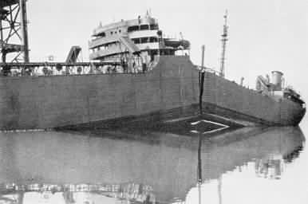
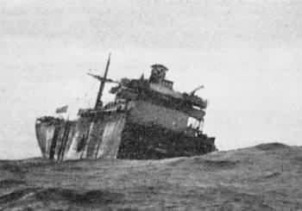
Design of Engineering Structures
In early 20th century, design of metal structures was strictly stress based
Onset of high performance ships (Liberty ships, WWII) changed things

Slide 4
What happened?
high strength
stress
fracture
Low strength
Temperature

Slide 5
Fracture Mechanics
Size and Orientation of Cracks
Stress Fields
Material Properties

Slide 6

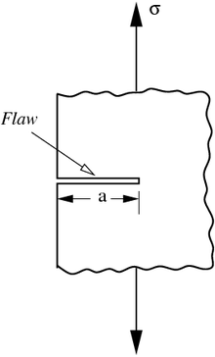
Crack Tip Stress Fields (Elastic)
Consider a sharp crack in an elastic material
r
K is stress intensity factor
Function of geometry and loading
Fracture occurs when K reaches critical value (K_{IC} – fracture toughness)
θ

Slide 7
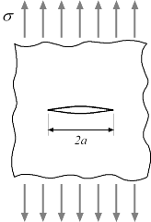
An Example
Consider an infinite plate with a through crack
Glass: K_{IC}=1 MPa-m^{0.5}
Al: K_{IC}=20 MPa-m^{0.5}
For a=100 microns, fracture stresses are 56 MPa for glass and 1,100 MPa for Al

Slide 8
Fracture Toughness (room temp)
Material | Toughness (MPa – m^0.5)
7075 Aluminum | 24
4340 Steel | 50
Silicon Carbide | 4
Polystyrene | 1
Tungsten (polycrystalline) | 5
Beryllium | 10
These values depend strongly on processing.

Slide 9
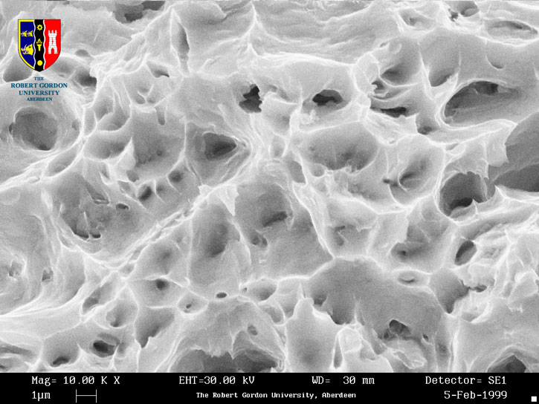
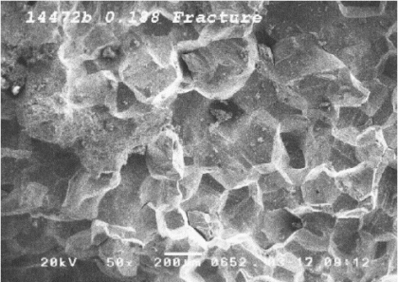
Ductile vs. Brittle

Slide 10
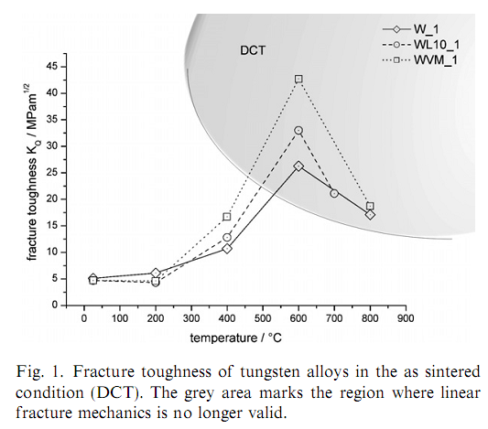
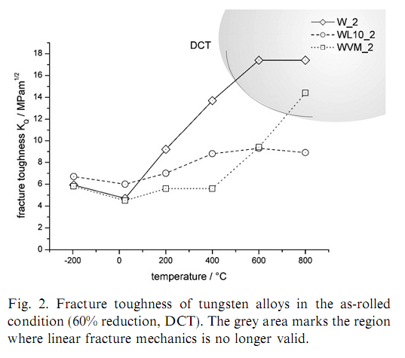
Temperature Dependence

Slide 11
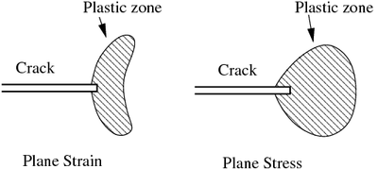
Stress Fields in Ductile Materials
Ductile materials will develop plastic deformation at crack tips
This toughens material and resists catastrophic crack growth
Previous analysis is not valid
Analysis uses integral around crack tip, rather than stress intensity factor

Slide 12
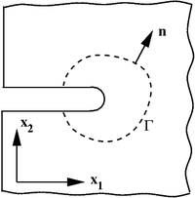
Failure Criterion for Ductile Materials
Base failure prediction on work required to create fresh fracture surface
Write as line integral
W=strain energy density
T=tractions
U=displacement

Slide 13
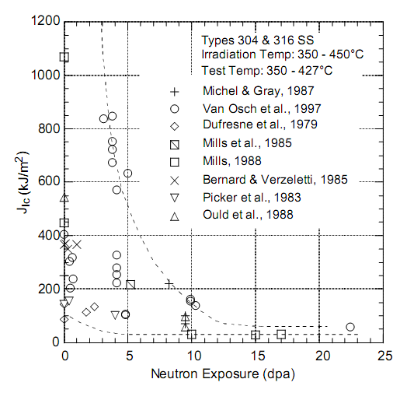
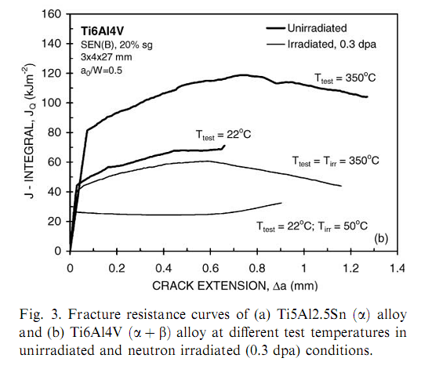
Irradiated Materials

Slide 14
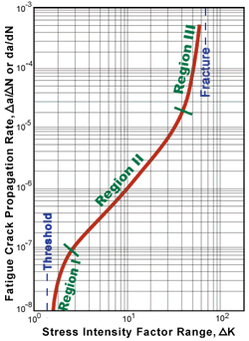
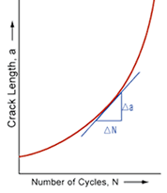
Fatigue Crack Growth
Previous analyses refer to catastrophic, unstable crack growth
Repeated application of loads can lead to incremental crack growth

Slide 15
Characterizing Cracks
Key Question: What is initial crack size?
We need non-destructive examination (NDE)
Options:
Dye penetrant
Ultrasound
X-rays
Eddy currents
Thermography
Etc.
Costs and capabilities vary

Slide 16
ITER Structural Design Criteria
Primary Loads
Primary + Secondary Loads
Elasto-Plastic Analysis

Slide 17
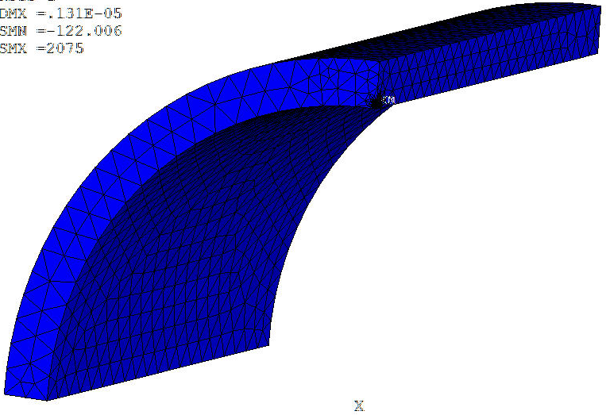
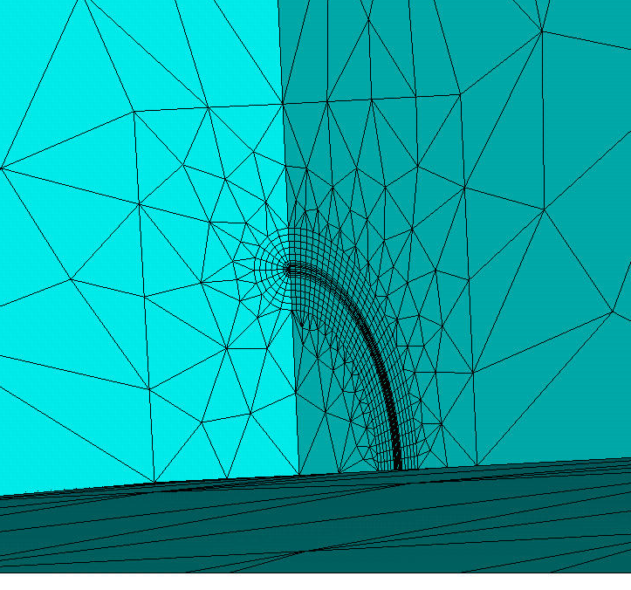
ANSYS Finite Element Model of Circumferential Crack
Stress intensities along crack face using the ANSYS CINT command
Elastic-Plastic material properties for Tungsten used
Currently only pressure loads are considered, but thermal stresses to be included
Crack face

Slide 18
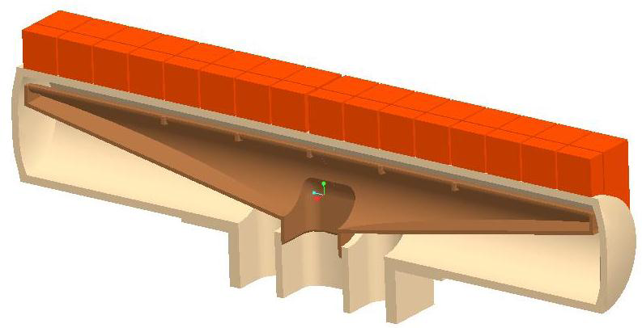
Initial Fracture Studies Based on T-Tube Geometry and Pressure Loads
Tungsten
OD = 15 mm
Coolant pressure ~ 10 Mpa
Coolant inlet temperature ~ 600 ºC
t = 1 mm

Slide 19
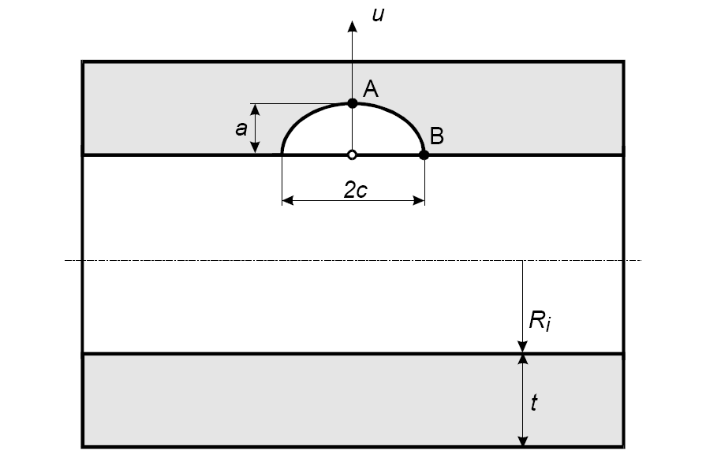
Initial Studies Compute Stress Intensities for Axial Cracks in Pressurized Cylinder
Case 1: Circular crack; c/a=1
Case 2: Elliptical crack; c/a=2
Use elastic-plastic properties
for tungsten.
Calculate J₁ and then report
equivalent K_{I}.

Slide 20

Variation of Stress Intensity with Location along Crack Tip (a = 0.1 mm)
Case 1: Circular crack; c/a=1
Case 2: Elliptical crack; c/a=2
a = 0.1mm
φ

Slide 21
Maximum Stress Intensity as a Function of Crack Depth

Slide 22
Conclusions
We’ve got to include fracture in our design analysis, particularly when using materials with limited ductility
So far, there are no major red flags
We will include thermal stresses in the future

