Slide 1
Studying Thermal Creep on a Sample using ANSYS
Dara Navaei, Siegfried Malang, Xueren Wang
ARIES Project Meeting
Jan. 26th ,2011 UCSD

Slide 2
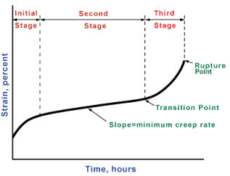
Definition of Creep
Creep is a rate dependent material nonlinearity in which the material continues to deform under a constant load (ANSYS). Creep is highly time dependent and it displays its effects over a long time. Creep has 3 stages:
Source:http://www.ndted.org/EducationResources/CommunityCollege/Materials/Mechanical/Creep.htm

Slide 3
Stages of Creep
Creep has three stages:
First Stage: It is considered by the work-hardening behavior of the material. It makes the material more difficult to deform under strain.
Second Stage: Creep in this stage is steady state. In this stage, there is a balance work-hardening and thermal-softening which causes a constant and steady creep. (minimum creep rate)
Third Stage: In this stage, creep accelerates due to the accumulating damage which will cause rupture at the end of the stage.

Slide 4
Creep analysis in ANSYS
ANSYS is able to analyze first and second stages of creep.
ANSYS uses Implicit and Explicit methods for creep.
Implicit is fast and accurate and works with temperature dependent creep constant.
In Divertor analysis, all the material properties are temperature dependent.
Explicit method is used for the analyses if it would not allow use to temp. dependent materials. It does not perform elastic-plastic analysis.

Slide 5
Implicit Creep Analysis in ANSYS
ANSYS is able to do elastic-plastic and creep analysis at the same time.
ANSYS has 13 prepared creep models and one user defined model.
Eight creep models for primary stage:
Strain Hardening:
Time Hardening:
Modified Strain Hardening:

Slide 6
Implicit Creep Analysis in ANSYS
Three creep models for secondary stage:
Generalized Garofalo:
Norton:
Two primary +secondary models:
Time Hardening:
Generalized Time Hardening for primary stage.
Constants need to be specified in ANSYS for each model.

Slide 7
The Significance of Creep Analysis
In the second stage, the slope is ascending so it may lead to the third stage and cause failure and rupture.
Creep is highly time dependent, thus it can show its effects in a longer time.
All our present analyses on the divertor are rate-independent.
Creep is temperature dependent and it has more effects in higher temperatures.

Slide 8
The Significance of Creep Analysis
The divertor operates in a range of high temperature (600-700 C). Therefore…
Creep has to be included in the divertor analyses.
Creep causes relaxation of secondary stress which decreases the total stress of the divertor.

Slide 9

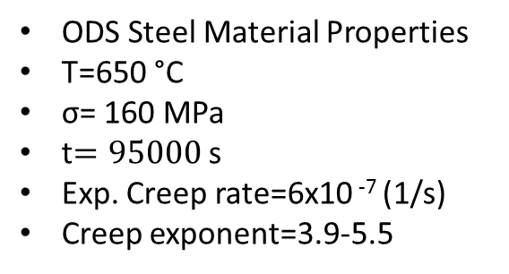
The Configuration of the Sample (one quarter of creep specimen)
L=15mm
L=3.8mm
r=4mm
r=1mm
Symmetry B.C.
P=42 MPa
ODS Steel Material Properties
T=650 °C
σ= 160 MPa
t$=95000$ s
Exp. Creep rate=6x10 ⁻⁷ (1/s)
Creep exponent=3.9-5.5
C1=2.50E-46
C2=4.8
C3=0
The Creep data was taken from “Thermal creep behavior of the EUROFER 97 RAFM steel and two European ODS EUROFER 97 steels”

Slide 10
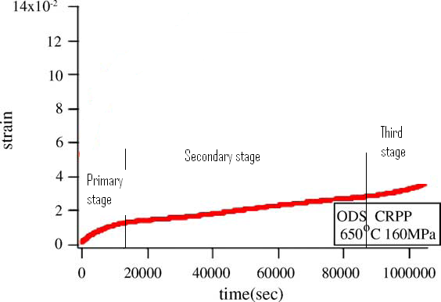
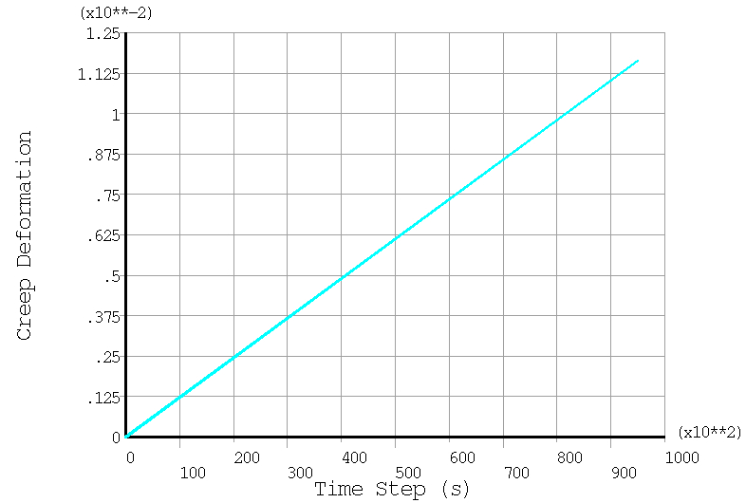
The Results of the Sample
~3.0 %
~1.3 %
Experimental Results
ANSYS FEA Results
Observation 1: The discrepancy is observed between Experimental and ANSYS results:
ANSYS average creep deformation=~1.25%
Experimental creep deformation=~1.7%
Observation 2: The discrepancy is observed between Experimental and hand results:
Experimental creep deformation=~1.7%
Hand calculated creep deformation= ~5.1%

Slide 11
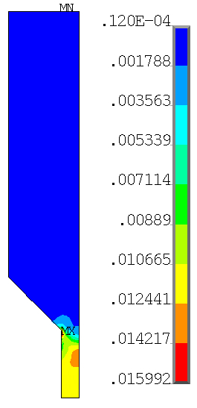
The Creep Strain Results and Conclusion
Conclusions:
Thermal creep analysis was performed to match the
creep experimental data.
Discrepancy among hand calculation, ANSYS, and experimental results were observed.
It will be continued to look for the reason of the mentioned discrepancy.

