Slide 1
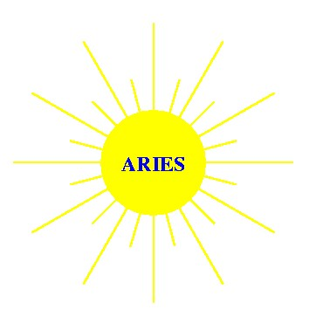
Overview of the ARIES Program
Mission: Perform advanced integrated design studies of the long-term fusion energy embodiments to identify key R&D directions and provide visions for the program.
Farrokh Najmabadi
UC San Diego
Presentation to ARIES Program Peer Review
August 29, 2013, Washington , DC

Slide 2
ARIES Research Bridges the Science and Energy Missions of the US Fusion Program
Progress in
Plasma Physics and Fusion Nuclear Sciences
What has been achieved
Experiments
What to demonstrate
Models & concepts
Theory/Modeling
Stimulus for new ideas
What is important
ARIES Program
What is possible
“Commercial fusion energy is the most demanding of the program goals, and it provides the toughest standard to judge the usefulness of program elements.” (FESAC chair letter to Head of Office of Science)

Slide 3
ARIES Research Framework: Assessment Based on Attractiveness & Feasibility
Periodic Input from
Energy Industry
Goals and
Requirements
Scientific & Technical
Achievements
Projections and
Design Options
Evaluation Based on
Customer Attributes
Attractiveness
Characterization
of Critical Issues
Feasibility
No: Redesign
Yes
Balanced Assessment of
Attractiveness & Feasibility
R&D Needs and
Development Plan
Energy Mission
ARIES
Science Mission

Slide 4
The ARIES Team has examined many fusion concept as power plants
ARIES-I first-stability tokamak (1990)
ARIES-III D-³He-fueled tokamak (1991)
ARIES-II and -IV second-stability tokamaks (1992)
Pulsar pulsed-plasma tokamak (1993)
SPPS stellarator (1994)
Starlite study (1995) (goals & technical requirements for power plants & Demo)
ARIES-RS reversed-shear tokamak (1996)
ARIES-ST spherical torus (1999)
Fusion neutron source study (2000)
ARIES-AT advanced technology and advanced tokamak (2001)
ARIES-IFE assessment of integrated IFE chambers (2004)
ARIES-CS compact stellarator (2007)
ARIES Pathway Study (2009)
ARIES-ACT Power plants (present)
This review

Slide 5
Goals & results of ARIES Pathways
What are the data bases needed to field a fusion power plant?
  Formed an Industrial Advisory Committee to help define R&D issues which are not usually considered by the scientific community (e.g., data base needed for licensing, operation, reliability, etc.)
What are useful quantitative measures to assess fusion development needs and pathways?
  Developed “Technical Readiness Levels” as a quantitative measure of maturity and R&D needs in each technical area.
  Used TRLs to identify “global” readiness levels for fusion systems (“An Evaluation of Fusion Energy R&D Gaps using Technology Readiness Levels,” Fusion Science and Technology 56 949-956, 2009).
What are the possible embodiments for CTF and what are the their cost/performance attributes?
  OFES directed us to terminate the program and participate in the RENEW process.

Slide 6
ARIES ACT Study: A Re-examination of tokamak power plants
  Background:
Over a decade since last tokamak study : ARIES-1 (1990) through ARIES-AT(2000).
  Substantial progress in understanding in many areas. Also, new issues: e.g., edge plasma physics, PMI, PFCs, and off-normal events.
Evolving needs in the ITER and FNSF/Demo era:
  Risk/benefit analysis among extrapolation and attractiveness.
  Goals:
What would ARIES designs look like if we use current predictions?
How can we use “point” design studies to clarify risk/benefit of various R&D issues.

Slide 7
Frame the “parameter space for attractive power plants” by considering the “four corners” of parameter space
Higher power density
Higher density
Lower current-drive power
Reversed-shear
(β_{N}=0.04-0.06)
DCLL blanket
Reversed-shear
(β_{N}=0.04-0.06)
SiC blanket
ARIES-RS/AT
SSTR-2
EU Model-D
ACT-1
Physics Extrapolation
Decreasing P/R
ACT-2
Lower power density
Lower density
Higher CD power
1st Stability
(no-wall limit)
DCLL blanket
1st Stability
(no-wall limit)
SiC blanket
ARIES-1
SSTR
Lower thermal efficiency
Higher Fusion/plasma power
Higher P/R
Metallic first wall/blanket
Engineering performance (efficiency)
Higher thermal efficiency
Lower fusion/plasma power
Lower P/R
Composite first wall/blanket

Slide 8
Status of the ARIES ACT Study
Project Goals:
  Detailed design of advanced physics, SiC blanket ACT-1 (ARIES-AT update).
  Detailed design of ACT-2 (conservative physics, DCLL blanket).
  System-level definitions for ACT-3 & ACT-4.
ACT-1 research is completed.
ACT-2 Research will be completed by December 2013.

Slide 9
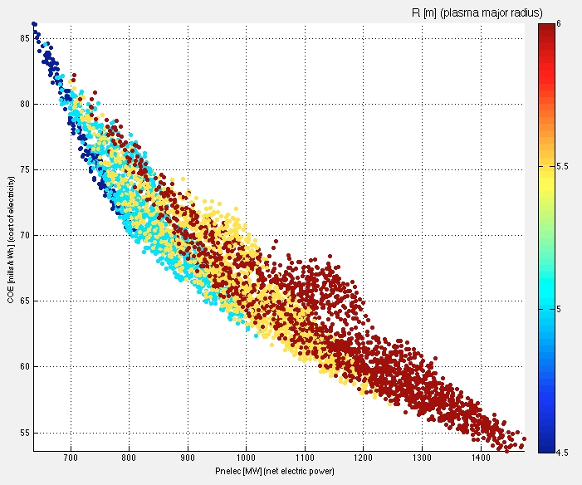
ARIES Systems Code – a new approach to finding operating points
Systems codes find a single operating point through a minimization of a figure of merit with certain constraints
  Very difficult to see sensitivity to assumptions.
Our new approach to systems analysis is based on surveying the design space and finding a large number of viable operating points.
A GUI is developed to visualize the data. It can impose additional constraints to explore sensitivities
Example: Data base of operating points with
f_{bs} ≤ 0.90, 0.85 ≤ f_{GW} ≤ 1.0, H₉₈ ≤ 1.75

Slide 10
The new systems approach underlines robustness of the design point to physics achievements
Major radius (m) | 6.25 | 6.25
Aspect ratio | 4 | 4
Toroidal field on axis (T) | 6 | 7
Peak field on the coil (T) | 11.8 | 12.9
Normalized beta* | 5.75% | 4.75%
Plasma current (MA) | 10.9 | 10.9
H98 | 1.65 | 1.58
Fusion power (MW) | 1813 | 1817
Auxiliary power | 160 | 169
Average n wall load (MW/m²) | 2.5 | 2.5
Peak divertor heat flux (MW/m²) | 13.5 | 13.5
Cost of Electricity (mills/kWh) | 67 | 69
* Includes fast α contribution of ~ 1%

Slide 11
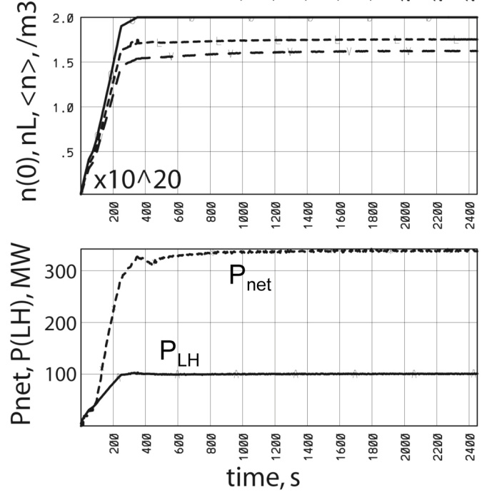
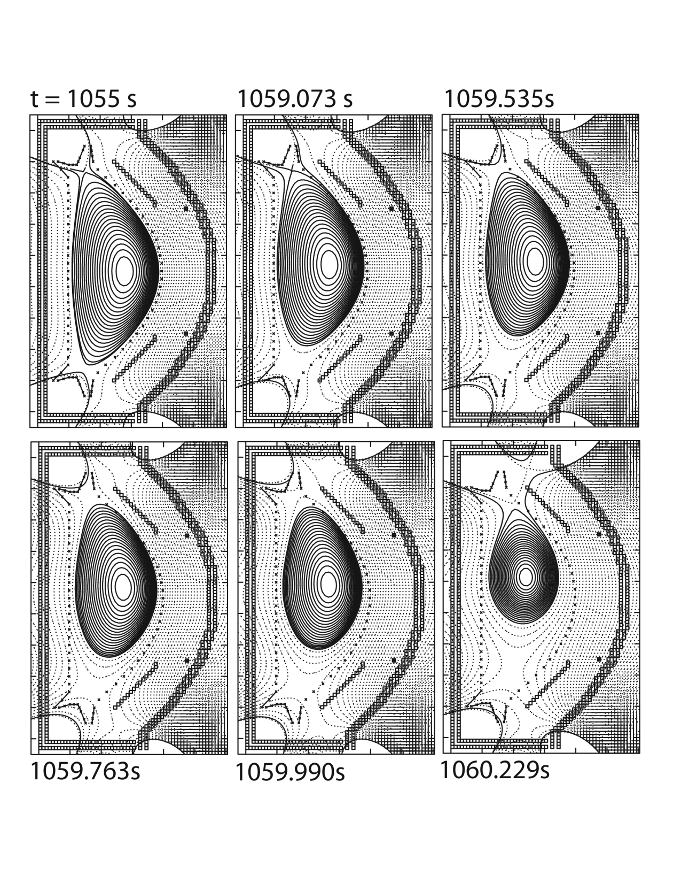
Detailed Physics analysis has been performed using the latest tools
New physics modeling
  Energy transport assessment: what is required and model predictions
  Pedestal treatment
  Time-dependent free boundary simulations of formation and operating point
  Edge plasma simulation (consistent divertor/edge, detachment, etc)
  Divertor/FW heat loading from experimental tokamaks for transient and off-normal
  Disruption simulations
  Fast particle MHD

Slide 12
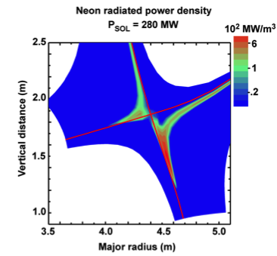
Impact of the Divertor Heat load
Divertor design can handle > 10 MW/m² peak load.
UEDGE simulations (LLNL) showed detached divertor solution to reach high radiated powers in the divertor slot and a low peak heat flux on the divertor (~5MW/m² peak).
  Leads to ARIES-AT-size device at R=5.5m.
  Control & sustaining a detached divertor?
Using Fundamenski SOL estimates and 90% radiation in SOL+divertor leads to a 6.25-m device with only 4 mills cost penalty (current reference point).
  Device size is set by the divertor heat flux

Slide 13
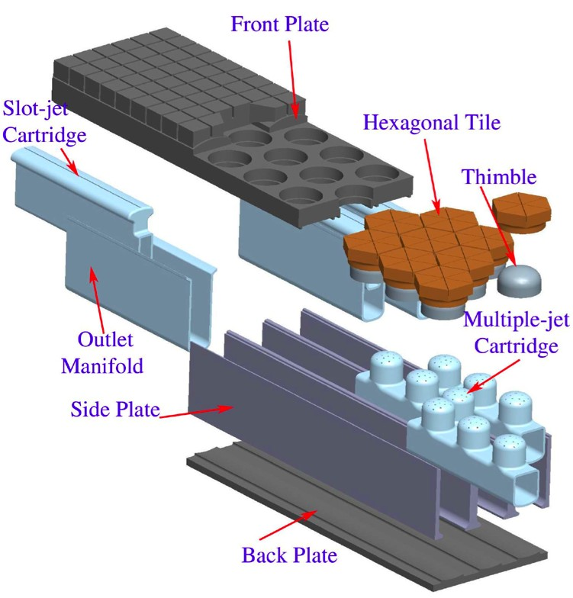
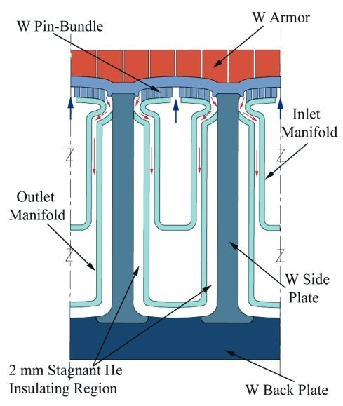
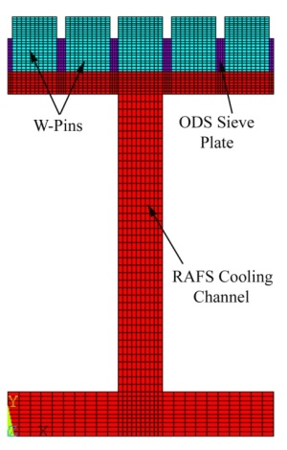
Overview of engineering design:
1. High-hest flux components
Design of first wall and divertor options
  High-performance He-cooled W-alloy divertor, external transition to steel
  Robust FW concept (embedded W pins)
FPC heat transfer experiments
Inelastic analysis of first wall and divertor options
  Birth-to-death modeling
  Yield, creep, fracture mechanics
  Failure modes
ELM and disruption loading responses
  Thermal, mechanical, EM & ferromagnetic

Slide 14
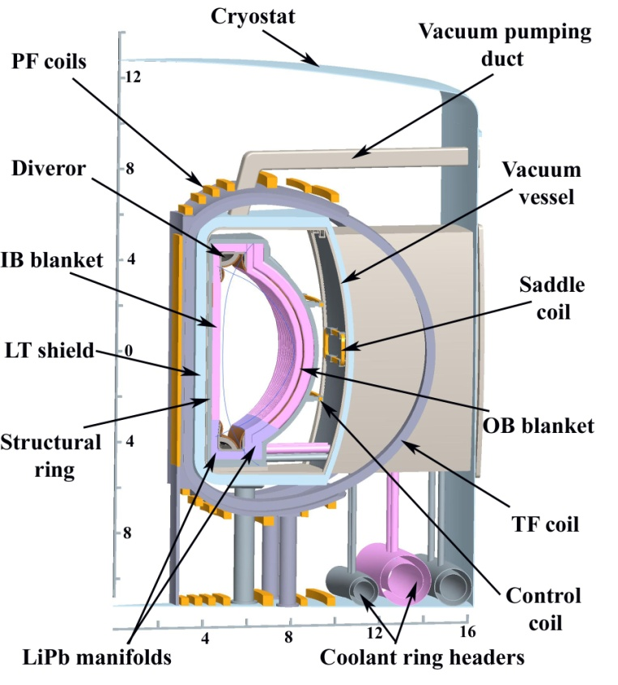
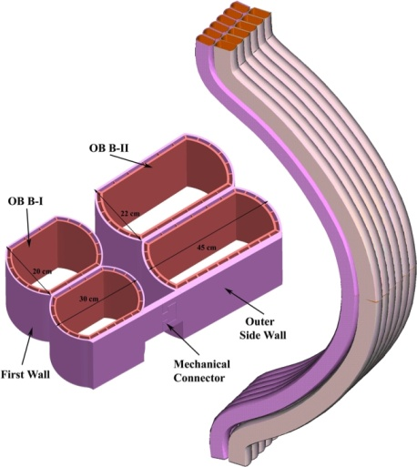
Overview of engineering design:
2. Fusion Core
Features similar to ARIES-AT
  PbLi self-cooled SiC/SiC breeding blanket with simple double-pipe construction
  Brayton cycle with η~58%
Many new features and improvements
  He-cooled ferritic steel structural ring/shield
  Detailed flow paths and manifolding for
  PbLi to reduce 3D MHD effects
  Elimination of water from the vacuum vessel, separation of vessel and shield
  Identification of new material for the vacuum vessel

Slide 15
Detailed safety analysis has highlighted impact of tritium absorption and transport
Detailed safety modeling of ARIES-AT (Petti et al) and ARIES-CS (Merrill et al, FS&T, 54, 2008 ) have shown a paradigm shift in safety issues:
  Use of low-activation material and care design has limited temperature excursions and mobilization of radioactivity during accidents. Rather off-site dose is dominated by tritium.
  For ARIES-CS worst-case accident, tritium release dose is 8.5 mSv (no-evacuation limit is 10 mSV)
Major implications for material and component R&D:
  Need to minimize tritium inventory (control of breeding, absorption and inventory in different material)
  Design implications: material choices, in-vessel components, vacuum vessel, etc.

Slide 16
Revisiting ARIES-AT vacuum vessel
AREIS-AT had a thick vacuum vessel (40 cm thick) with WC and water to help in shielding. (adoption of ITER vacuum vessel).
  Expensive and massive vacuum vessel.
  ITER Components are “hung” from the vacuum vessel. ARIES sectors are self supporting (different loads).
ARIES-AT vacuum vessel operated at 50ºC
  material?
  Tritium absorption?
  Tritium transfer to water?
Vacuum vessel temperature exceeded 100ºC during an accident after a few hours (steam!)

Slide 17
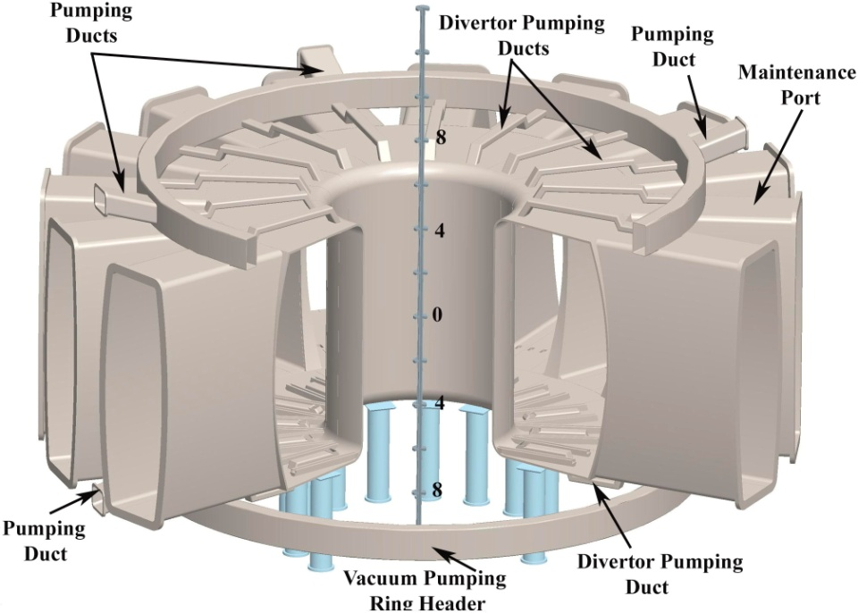
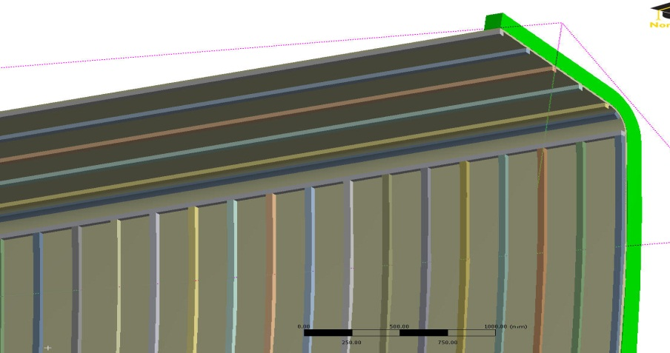
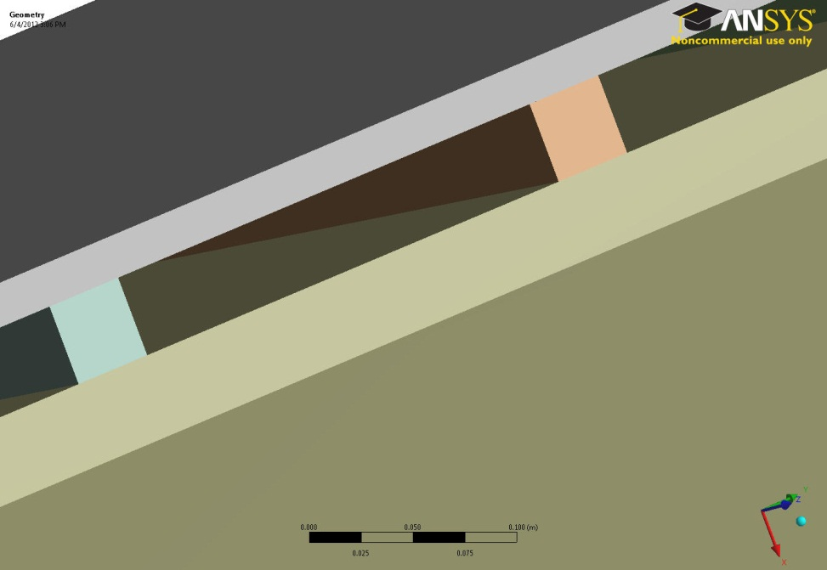
New Vacuum Vessel Design
Contains no water
  Can run at high temperature: 300-500ºC. (350 ºC operating temperature to minimize tritium inventory)
He (at 1 atm) flows between ribs.
  Tritium diffused through the inner wall is recovered from He coolant (Tritium diffusion to the cryostat and/or building should be reduced significantly).
Made of low-activation 3Cr-3WV baintic steel (no need for post-weld heat treatment).

Slide 18
In summary …
ARIES-ACT study is re-examining the tokamak power plant space to understand risk and trade-offs of higher physics and engineering performance with special emphasis on PMI/PFC and off-normal events.
  ARIES-ACT1 (updated ARIES-AT) is near completion.
  Detailed physics analysis with modern computational tools are used. Many new physics issues are included.
  The new system approach indicate a robust design window for this class of power plants.
  In-elastic analysis of component including Birth-to-death modeling and fracture mechanics indicate a higher performance PFCs are possible. Many issues/properties for material development & optimization are identified.
  Many engineering improvements: He-cooled ferritic steel structural ring/shield, Detailed flow paths and manifolding to reduce 3D MHD effects, Identification of new material for the vacuum vessel …

Slide 19
Systems Code & Optimization

Slide 20
Issues with “Point-Optimization”
Experience indicates that the power plant parameter space includes many local minima and the optimum region is quite “shallow.”
The systems code indentifies the “mathematical” optimum. There is a large “optimum” region when the accuracy of the systems code is taken into account. requiring “human judgment” to choose the operating point.
Previously, we used the systems code in the optimizer mode and used “human judgment” to select a few major parameters (e.g., aspect ratio, wall loading).
“Mathematical” minimum
Optimum region
Systems code accuracy

Slide 21
Identifying “optimum region ” as opposed to the optimum point
  We developed a new systems code approach that solves for a large number of viable operating points, i.e., surveying the design space instead of finding only an optimum design point (e.g., lowest COE).
  Variations in the solution for changes to parameters and constraints become evident.
  This approach requires generation of a very large data base of self-consistent physics/engineering points.
  Modern visualization and data mining techniques should be used to explore design space.
Physics operating points
Viable engineering points
Full device build-out and costing

Slide 22
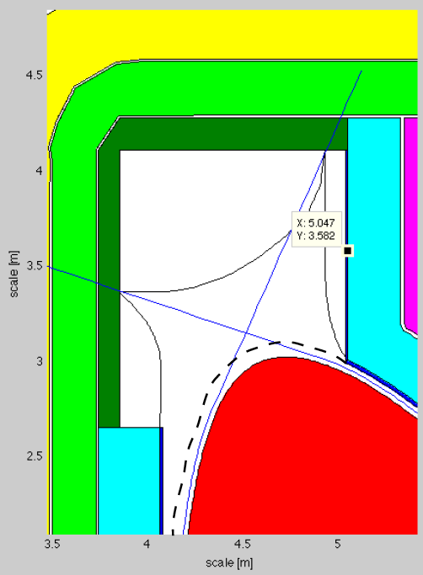
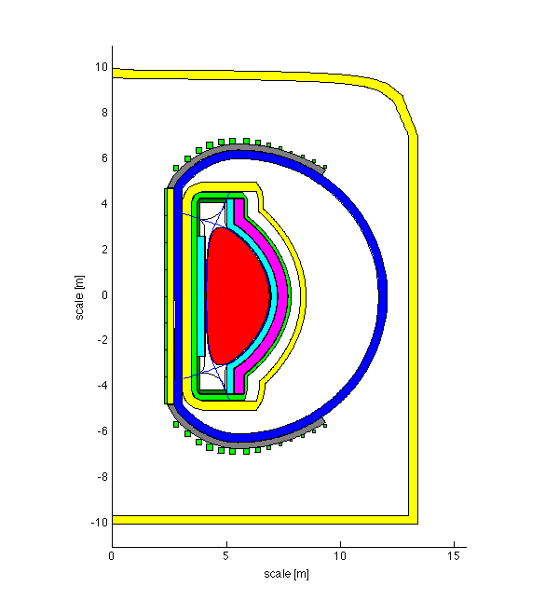
Major Features of the new ARIES Systems Code
Physics module:
  Plasma geometry (R, a, κ, δ, ζ_{o}, ζ_{I})
  Power and particle balance
  Bremsstrahlung, cyclotron, line radiation
  Up to 3 impurities beyond e, DT, and He
  Bootstrap current, flux consumption, fast beta, …
Device buildup & costing module
2-D axisymmteric geometry.
TF Magnet algorithm bench-marked against finite-element analysis of ARIES magnets.
Distributed PF algorithm which produces accurate description of stored energy, cost, &VS of a free-boundary equilibrium-based PF system.
Detailed radial build, power flow and blanket/divertor modules.
Updated costing algorithm (based on Gen-IV costing rules).

Slide 23
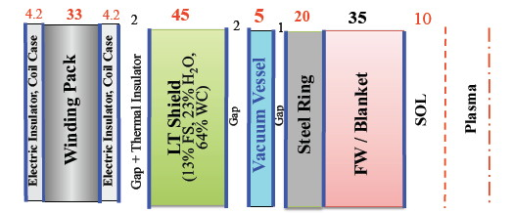
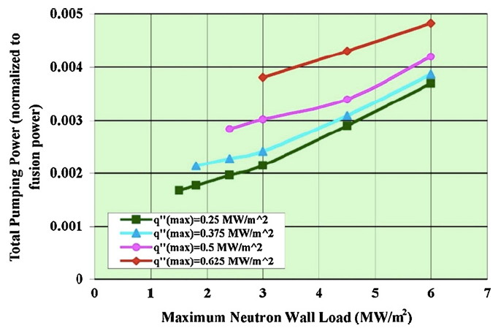
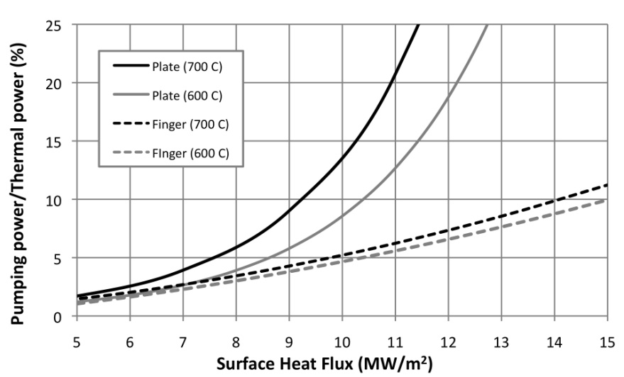
Radial builds, thermal efficiency, pumping powers, etc are derived from detailed analysis
Radial builds (inboard, outboard, vertical) obtained from nuclear analysis, with scaling of some elements with wall load
SCLL blanket pumping power vs. wall load and surface heat flux
W/He divertor pumping power vs. heat flux for different designs

Slide 24
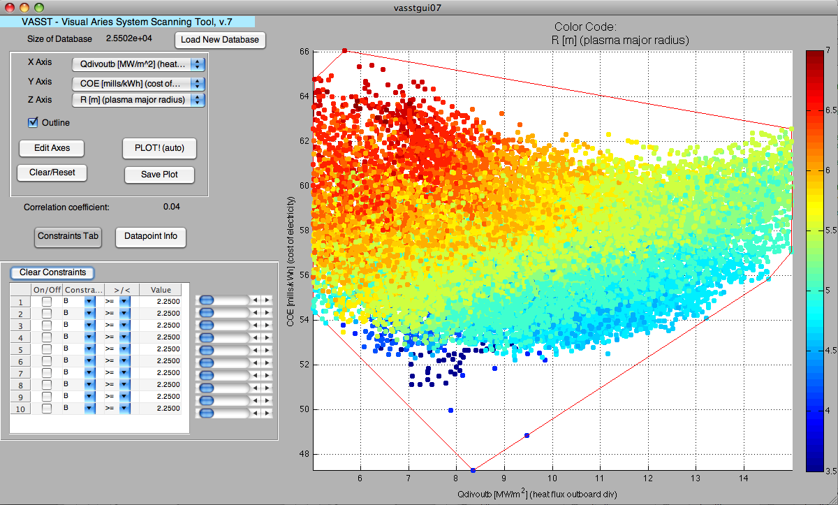
“Lots of numbers don’t make sense to ‘low-bandwidth’ humans, but visualization can decode large amounts of data to gain insight.”
Matlab-based Visualization tool (VASST)

Slide 25
Operating space for ACT-1
(Advanced Physics, SiC Blanket)
Scanned Parameters:
  4.75 ≤ R ≤ 7 m 4.5 ≤ B_{T} ≤ 7.5 T
  4.0% ≤ β_{Nth} ≤ 5.0%, 0.8 ≤ f_{Gr} ≤ 1.0
  3.25 ≤ q ≤ 5.75
Limiting data to H98 ≤ 1.7 & f_{BS} ≤ 0.925 produces ~500k points.
Device & costing modules applied to the above points.
Resulting data points were filtered with
  Divertor heat flux < 15 MW/m²
  990 ≤ P_{net} < 1010 MW
  COE within 5% of the minimum

Slide 26
Operating space for ACT-1
(Advanced Physics, SiC Blanket)
 | 182786 ref pt | 324144 β_{N}/Bt tradeoff | 358136 low β_{N} + COE | 259637 low COE | 253772 low qdiv | 146585 low B_{T}max | 356451 low f_{BS} |  | min value | max value
R (m) | 6.25 | 6.25 | 6.0 | 6.0 | 6.75 | 6.5 | 6.75 |  | 6.0 | 7.0
β_{Nt}+β_{Nf} | 5.64 | 4.75 | 4.73 | 5.33 | 5.02 | 6.00 | 4.74 |  | 4.72 | 6.00
f_{BS} | 0.91 | 0.89 | 0.89 | 0.91 | 0.90 | 0.90 | 0.805 |  | 0.805 | 0.905
I_{p} (MA) | 10.93 | 10.93 | 10.86 | 10.77 | 11.51 | 11.53 | 13.51 |  | 10.77 | 13.51
B_{T} on axis (T) | 6 | 7 | 7.25 | 6.5 | 6.5 | 5.75 | 7.25 |  | 5.75 | 7.5
B_{T} on coil (T) | 11.83 | 13.80 | 14.6 | 13.1 | 12.35 | 11.13 | 13.8 |  | 11.13 | 15.12
P_{recirc} (MW) | 160 | 176 | 177 | 155 | 161 | 229 | 320 |  | 149 | 320
Fusion gain | 42.5 | 37.5 | 37.5 | 45.0 | 40 | 27.5 | 20.0 |  | 20 | 45
<P_{n}> n @FW | 2.45 | 2.46 | 2.68 | 2.65 | 2.1 | 2.35 | 2.42 |  | 2.01 | 2.83
Peak q_{FW} | 0.27 | 0.28 | 0.34 | 0.30 | 0.29 | 0.27 | 0.45 |  | 0.25 | 0.45
Peak q_{div} | 13.3 | 13.8 | 14.1 | 13.8 | 11.0 | 14.7 | 14.5 |  | 11.0 | 15.0
COE (mill/kWh) | 64.32 | 66.06 | 65.17 | 63.83 | 67.19 | 66.46 | 71.09 |  | 63.8 | 71.4

Slide 27
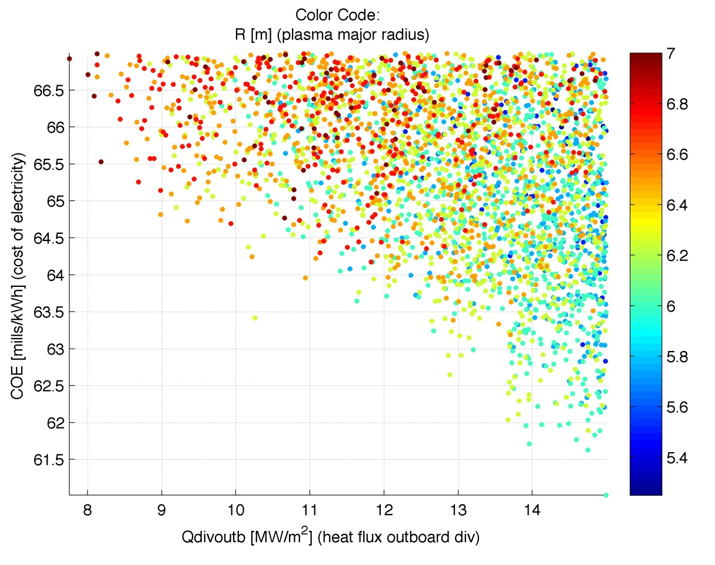
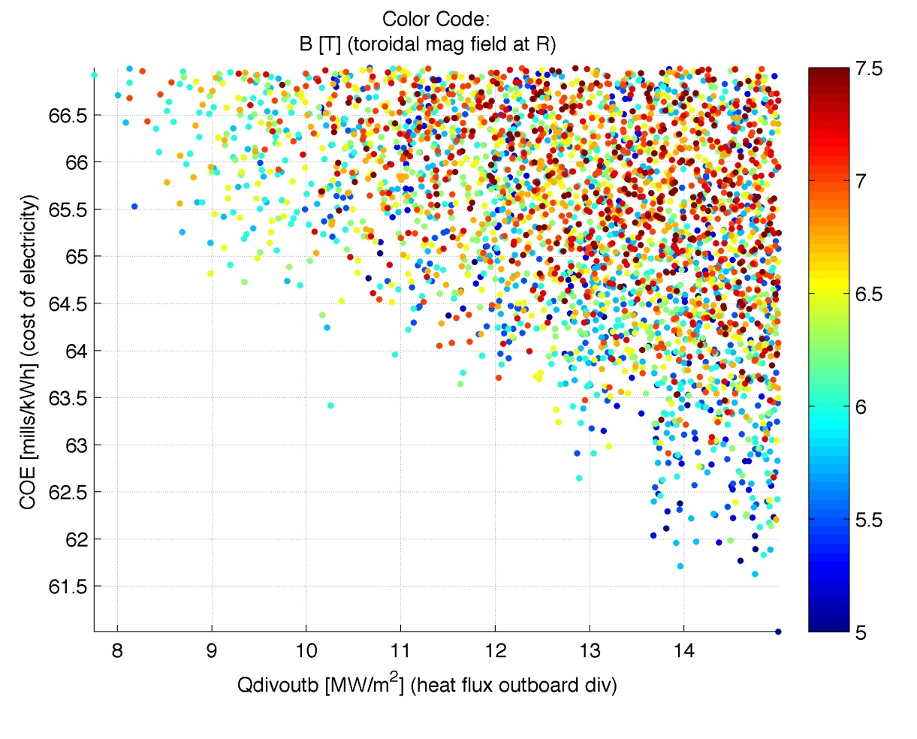
Sensitivity Scans for ARIES-ACT1
(COE vs outboard divertor heat flux)
Color Code: R (m)
Color Code: B (T)
At a COE of 64 mills/kWh (slightly higher than minimum of 62), a range of machines sizes will give the same COE with larger machine having a lower Q_{div} (indicative of “saturation” of decrease in COE with power density).

Slide 28
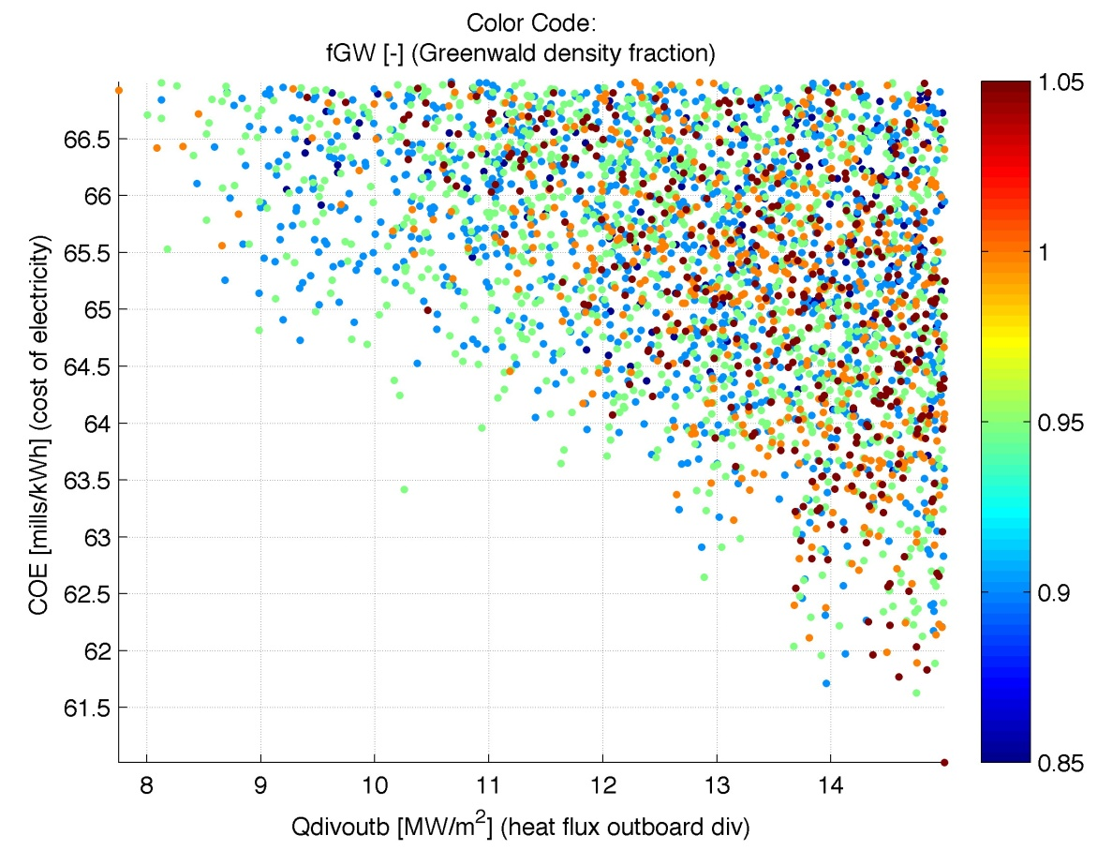
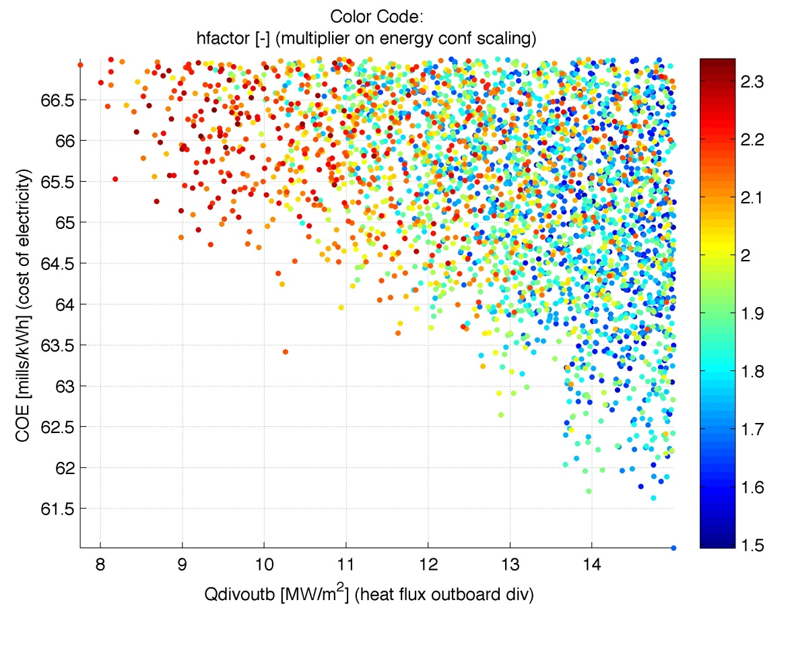
Sensitivity Scans for ARIES-ACT1
(COE vs outboard divertor heat flux)
Color Code: f_{GW}
Color Code: H98
Design point appears not to be sensitive to f_{GW} but requires H98 > 1.5

Slide 29
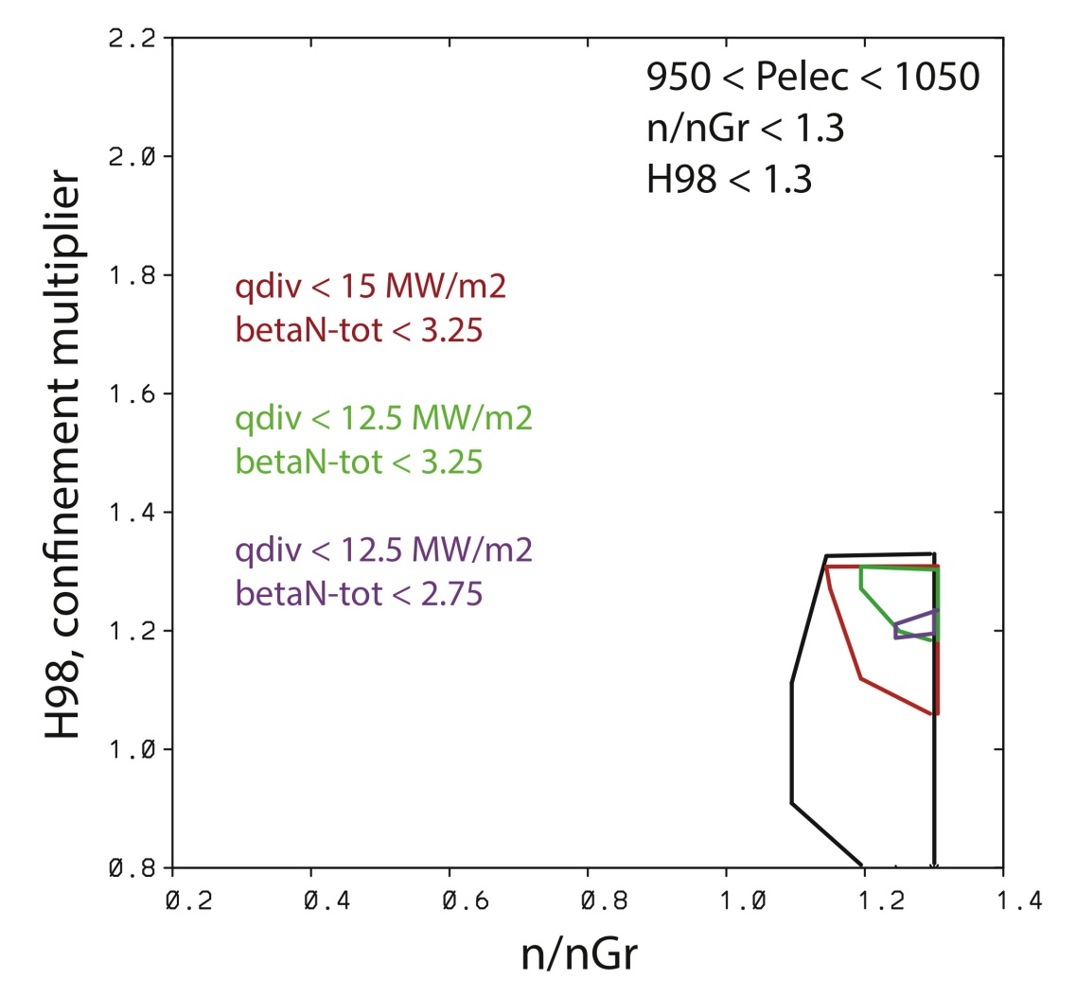
Operating space for ACT-2
(Conservative Physics, DCLL Blanket)
Scanned Parameters:
  8 ≤ R ≤ 12 m 7.25 ≤ B_{T} ≤ 8.75
  2.0% ≤ β_{Nth} ≤ 3.25%, 0.9 ≤ f_{Gr} ≤ 1.4
  6.5 ≤ q ≤ 9.0
Limiting data to H98 ≤ 2.65 produces ~3.5M points.
Large machines due to simultaneous constraints on H98, f_{Gr}, β_{N}, q_{div}, etc.
Allowing smaller P_{e} (~500 MW) relaxes constraints, but drives up COE substantially.
  For 1000 MW, a finite parameter space is identified.

Slide 30
Operating space for ACT-2
(Conservative Physics, DCLL Blanket)
 | 2216814 ref pt | 581333 q_{div}<10, min R | 2216810 min β_{N}, min R, min q_{div} | 60930 min B_{T}, min R, max Q | 1534347 min COE | 1975083 q_{div}<12.5 min COE | 2837974 q_{div}<12.5 min β_{N}, min COE
R (m) | 9.75 | 9.5 | 9.25 | 9.5 | 8.0 | 8.75 | 8.75
β_{Nt}+β_{Nf} | 0.026 | 0.029 | 0.026 | 0.032 | 0.032 | 0.032 | 0.029
q₉₅ | 8.0 | 7.5 | 8.0 | 7.0 | 7.25 | 7.0 | 7.75
I_{p} (MA) | 13.98 | 13.7 | 13.3 | 12.9 | 12.7 | 13.1 | 12.95
B_{T} on axis (T) | 8.75 | 8.25 | 8.75 | 7.25 | 8.75 | 8.0 | 8.75
B_{T} on coil (T) | 14.38 | 13.65 | 14.56 | 11.98 | 15.2 | 13.5 | 14.8
P_{recirc} (MW) | 321 | 290 | 328 | 263 | 281 | 268 | 267
Fusion gain | 25.0 | 27.5 | 25.0 | 32.5 | 32.5 | 32.5 | 32.5
<P_{n}> n @FW | 1.47 | 1.51 | 1.62 | 1.50 | 2.20 | 1.82 | 1.81
Peak q_{FW} | 0.28 | 0.29 | 0.25 | 0.18 | 0.33 | 0.29 | 0.29
Peak q_{div} | 10.0 | 9.55 | 12.9 | 12.5 | 15.0 | 12.3 | 12.3
COE (mill/kWh)* | 86.2 | 81.8 | 82.7 | 76.7 | 71.6 | 73.6 | 75.8
* COE numbers not validated.

Slide 31
Summary
Exploring the “optimum region” as opposed to the “optimum point” has many desirable features:
  Prevents the design point to be pushed into a “constraint corner” and allows for a more robust design point.
  Clearly identifies the trade-offs and the “weak” and “strong” constraints, helping the R&D prioritization.
ARIES-ACT1 design point is quite robust because of its relatively high power density, low recirculating power fraction and high blanket efficiency.
In contrast, ARIES-ACT2 design space is somewhat limited. Simultaneous constraints on H98, f_{Gr}, β_{N}, q_{div}, etc. leads to substantially larger machines.

Slide 32
ARIES-ACT Program Participants
Systems code: UC San Diego, PPPL, Boeing
Plasma Physics: PPPL , GA, LLNL
Fusion Core Design & Analysis: UC San Diego, FNT Consulting
Nuclear Analysis: UW-Madison
PFC (Design & Analysis): UC San Diego, UW-Madison
PFC (experiments): Georgia Tech
Design Integration: UC San Diego, Boeing
Safety: INEL
Contact to Material Community: ORNL

