Slide 1


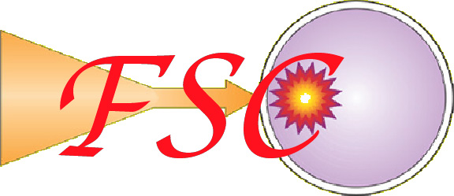

High Energy Density Physics Program at UCSD
Farhat Beg
University of California, San Diego
This work was performed under the auspices of the U.S. DOE under contracts No.DE-FG02-05ER54834, DE-FC0204ER54789 and DE-AC52-07NA27344. We greatly acknowledge support of Institute for Laser Science Applications, LLNL.
Feb. 10, 2009

Slide 2
Outline of HEDP Program
  Fast Ignition
  – Relativistic electron transport in solid and warm dense targets
  – Proton production and conversion efficiency
  – Modeling with LSP
  Wire Array Z-pinches
  – Wire ablation studies
  – Supersonic jet formation
  X-pinch
  – Point projection radiography
  – Micro-pinch formation
  Pulsed neutron sources
  – High rep. rate plasmas focus
  – short pulse lasers

Slide 3
Fast Ignition requires injection of energetic electrons
M. Tabak Phys of Plasmas 1 16 (1994)
R. Kodama et al., Nature 418, 936 (2002)
M. Key et al. Phys of Plasmas 14 055502 (2007)
Short pulse laser
aimed and timed to implosion
Efficient deposition of electron energy in region of ρR~0.6 g cm⁻² (α range), heating it to 5-10 keV
Efficient conversion:
E_{laser} “beam” of ~MeV electrons aimed at assembled fuel
Efficient transport of hot electron energy to fuel
Coupling efficiency is one crucial parameter for fast ignition

Slide 4
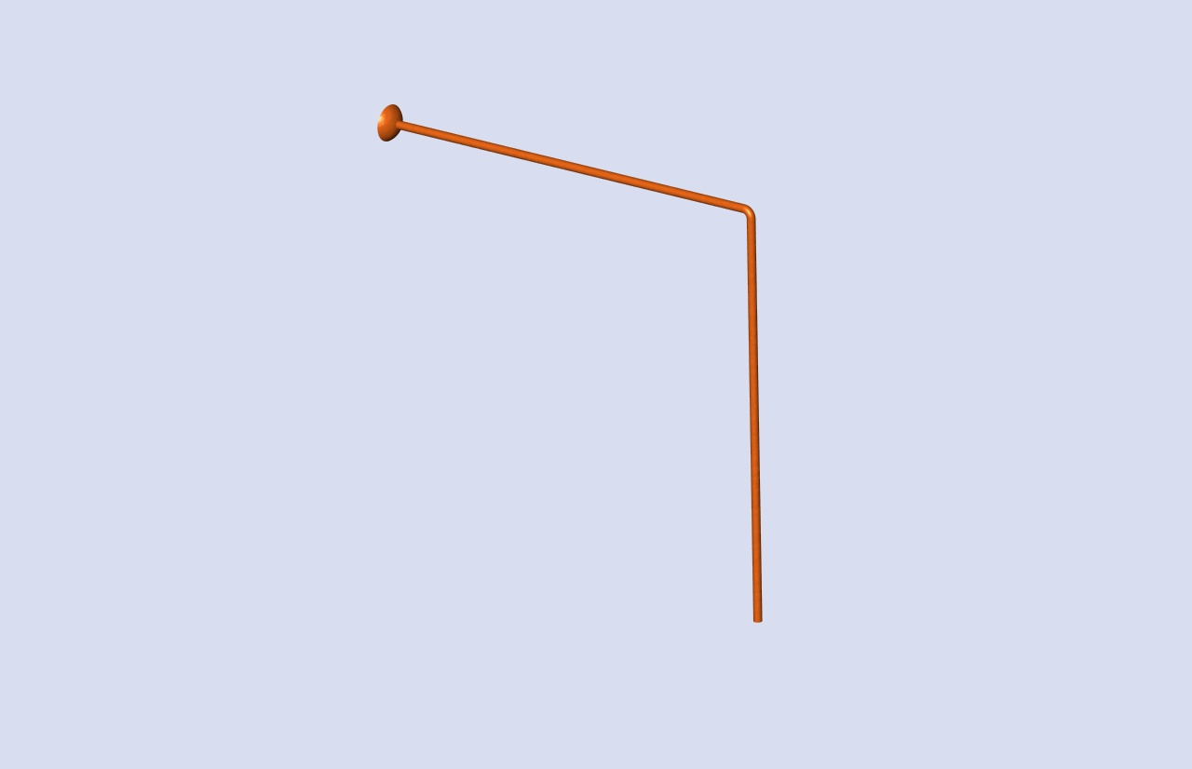
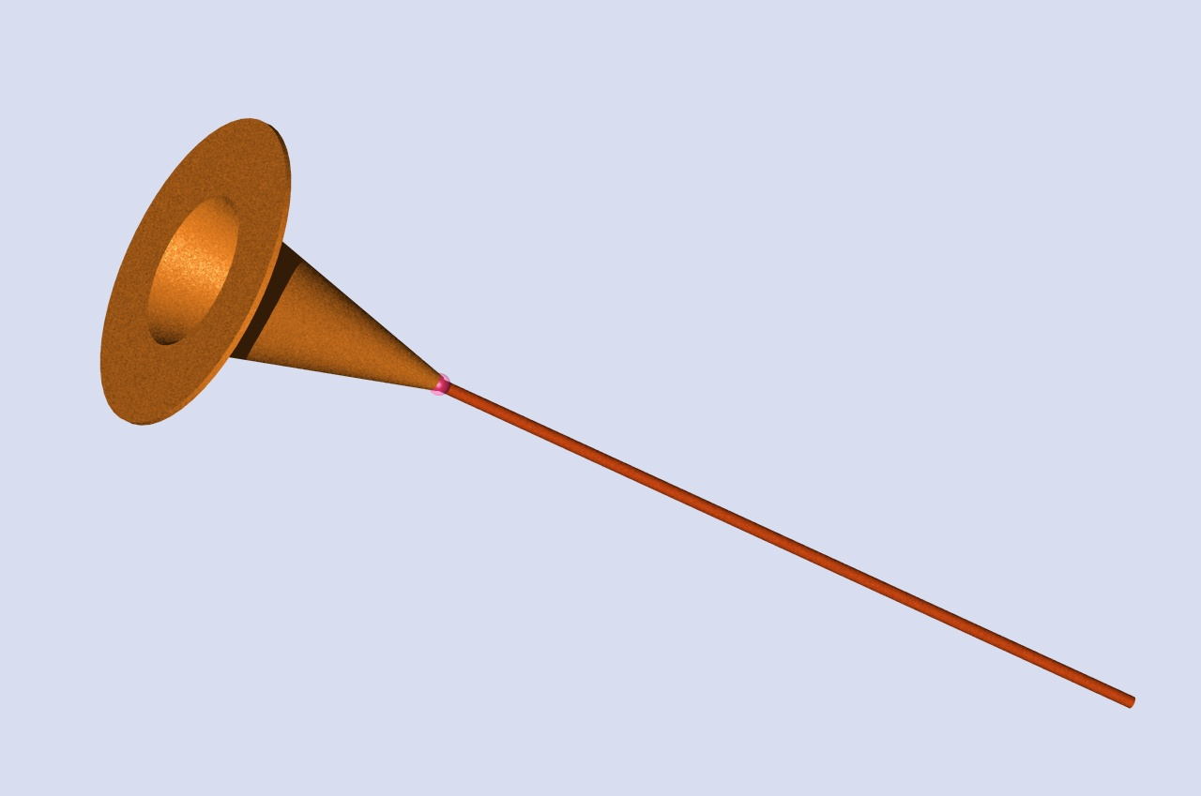
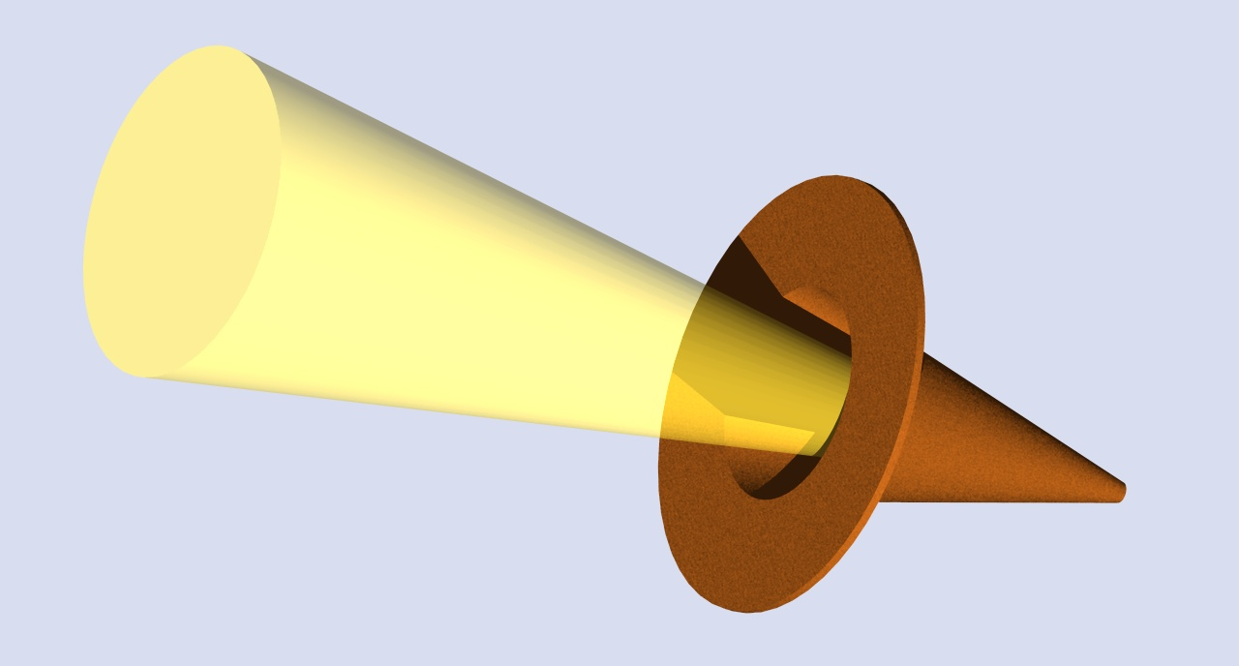
Surrogate targets were used to examine the underlying physics
1D wire geometry for current diagnosis and analysis
  Experiments: Easy view of electrons (Cu-K_{α} fluorescence)
  Modeling: 2D effects can be neglected
Thin and thick cones for electron generation
Cu Kα imager

Slide 5
Maximizing coupling efficiency is a challenge for full scale fast ignition
S. Atzeni, Phys. Plas. 8, 3316 (1999)
M Tabak et al Fus. Sci. Tech. (2006)
Optimal ignition criteria:
T = 12keV, ρR = 0.6 g/cm²
Fast Ignition region
ρ
E
For ρ = 300 g/cm³ assembly
we need to deliver to the fuel:
2r
DT
z
τ
E = 18kJ in <2MeV> electrons
P = 0.9 PW => t = 20ps
I = 6.8x10¹⁹ W/cm² => r = 20μm
  Coupling efficiency depends on:
  – laser conversion to electrons
  – energy spectrum of electrons
  – collimation of electron transport
  – cone tip to dense plasma separation

Slide 6
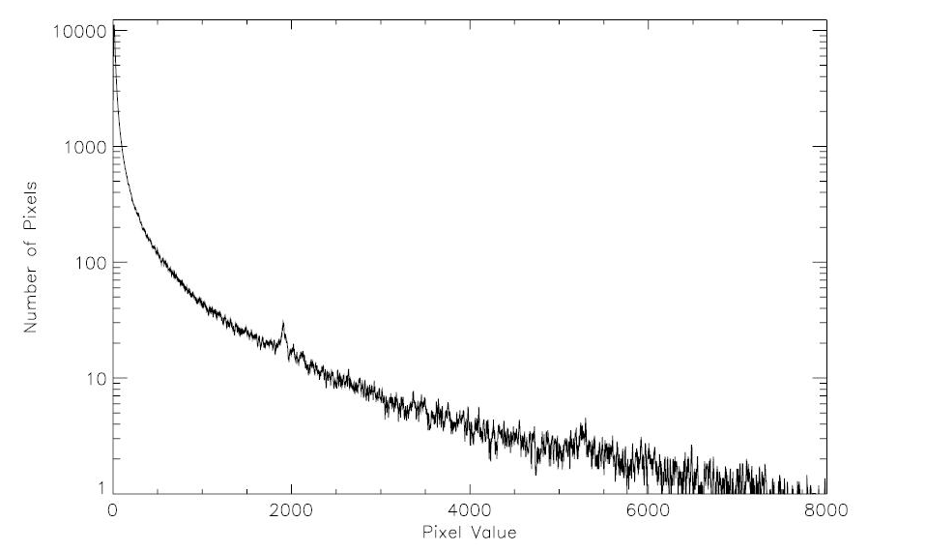
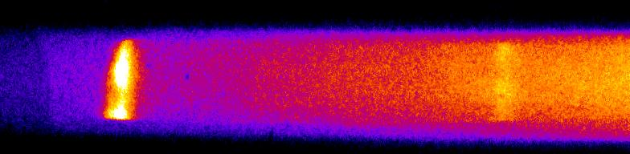
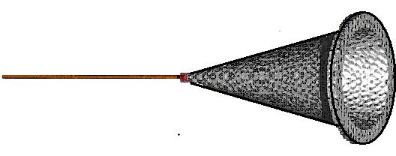

Multiple diagnostics needed for current measurement
Cu Kα line
HOPG
spectrometer
(accurate)
Cu Kα signal
Increasing λ
No. of Pixels
Pixel Value
X-ray
Imager
52°
29.4°
Single hit
Spectrometer
(absolute)
29.8°
Kα image of Cu wire
1mm
cone
40µm Ø wire
CPA laser
Resolution = 20µm ≈ wire diam’s so, images vertically integrated into 1D emission profiles.
Targets: Hollow Al cones
joined to 1mm long Cu wires
of diameters 10, 20 and 40µm
500J, 1ps @1053nm
RAL PW laser focused
at f/3 into the cone

Slide 7



Electron coupling efficiency
scales as the cross sectional wire area
Kα emission profiles
10µm Ø, η = 1.0±0.5%
10⁻⁴
10⁻⁵
10⁻⁶
10⁻⁷
Peak=4.5E-6 J/sr/µm
Copper wire
Kα (J/sr/µm)
~1mm
Cone tip region
~1mm
Cone tip region
20µm Ø, η = 5±3%
10⁻⁴
10⁻⁵
10⁻⁶
10⁻⁷
Peak=1.5E-5 J/sr/µm
40µm Ø, η = 15±8%
10⁻⁴
10⁻⁵
10⁻⁶
10⁻⁷
Peak=7.2E-5 J/sr/µm
Consistent -previous integrated experiments showed ~20% coupling
  R. Kodama et al., Nature 418, 936 (2002), M.H. Key et al., PoP 15, 22701 (2008)
Electron penetration scalelengths (1/e ~ 100µm) indicate strong resistive
inhibition! (collisional stopping alone gives scalelengths ~ 1 mm)

Slide 8
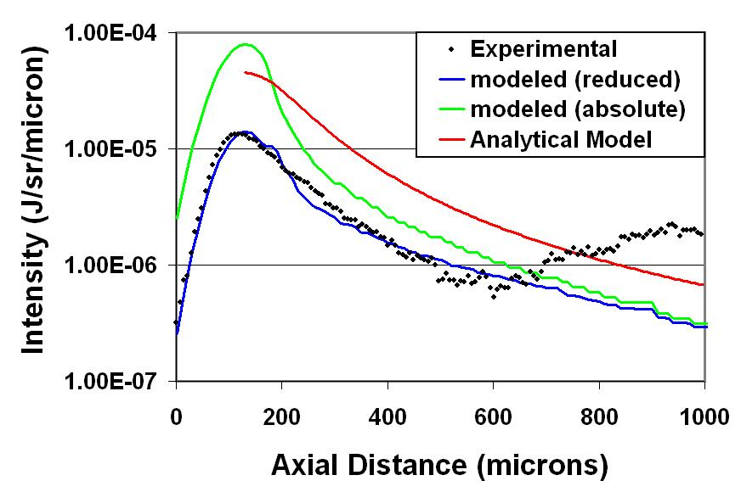
Comparison of emission profile with 1-D
numerical model gives hot electron temperature
Comparison with modeling
(40µm diameter wire case)
Experimental scalelengths and K_{α}
yields matched by varying T_{hot} and η
in a numerical model (blue).
Temperature-corrected absolute
K_{α}/sr/µm profile generated (green)
Analytical Bell’s model profiles
generated using numerical T_{hot} and
η values (red)
The emission profiles were compared to 1-D
numerical and analytical transport models
Scalelength ~ 100µm
*K. U. Akli et al., Phys. Plasmas 14, 023102 (2007)
†A. Bell et al., PPCF 39, 653 (1997)
*S. Wilks et al., PRL 69, 1383 (1992)
Resulting T_{hot} (~670 KeV) values significantly lower than that predicted by
ponderomotive scaling*: T_{e}(MeV) ~0.511{(1+I₁₈)^{1/2}-1}

Slide 9
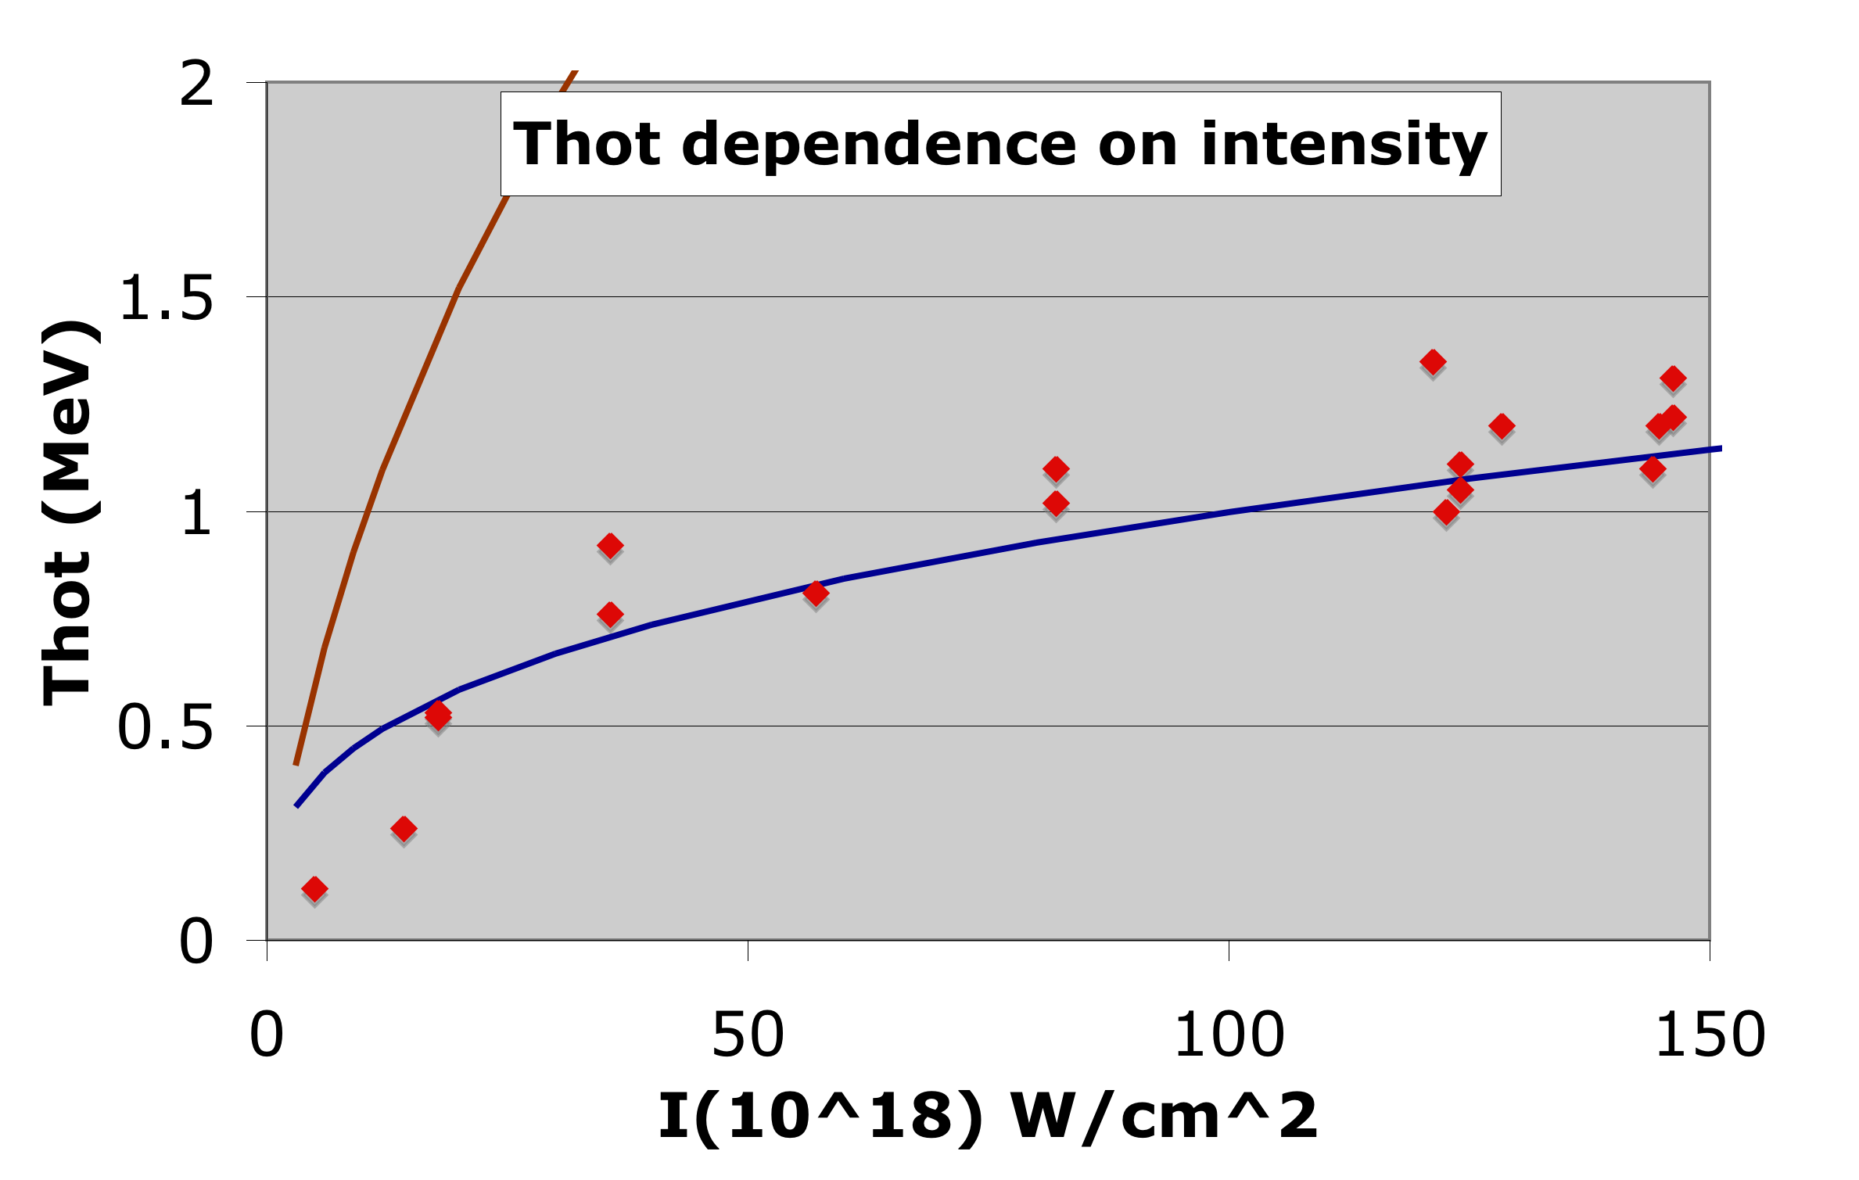
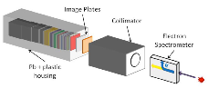
Indeed, recent experiments on Titan laser confirm lower hot electron temperature
*C. Chen et al., presented at 17th High Temperature Plasma Diagnostic Conf., Albuquerque, NM May 2008
Single temperature fit shows hot electron temperature follows Beg’s
scaling*: T(MeV) = 0.215(I₁₈λ²)^{1/3}
More sophisticated modeling is underway to understand the
underlying physics
*F.N. Beg et al., Phys. Plasmas 4, 447 (1997)

Slide 10
Understanding of Cone Physics is
Extremely Important
Two key elements were investigated to study coupling
- laser prepulse
- Cone wall thickness

Slide 11
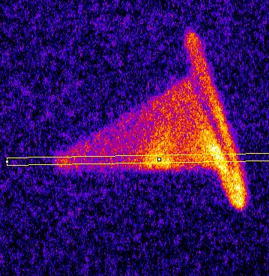
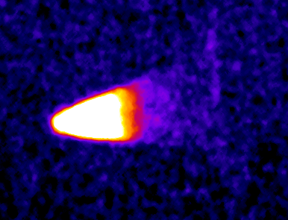
Kα Imaging showed that a 1J, 3ns prepulse strongly inhibited energy coupling to cone tip
Cone tip 30μm
30° full angle Copper cone 25μm thick wall
Titan Laser
150J, 0.7ps
I = 0.5-1x10²⁰ W cm⁻²
Prepulse: 1J,527nm, 3ns,I=1x10¹³ Wcm⁻²
Kα
Kα
High contrast
1J prepulse
800μm
1J,3ns prepulse ~ consistent with 10⁻⁴ energy contrast for >10kJ integrated experiments
Inherent, 14mJ prepulse (10⁸ Intensity contrast): Good coupling to cone tip
1J prepulse (10⁶ Intensity contrast) - no coupling to cone tip
Courtesy of Andrew MacPhee

Slide 12
Recent results show decrease in signal with laser prepulse
1/e length is similar to earlier experiments
Decrease in integrated K_{alpha} signal as function of prepulse

Slide 13
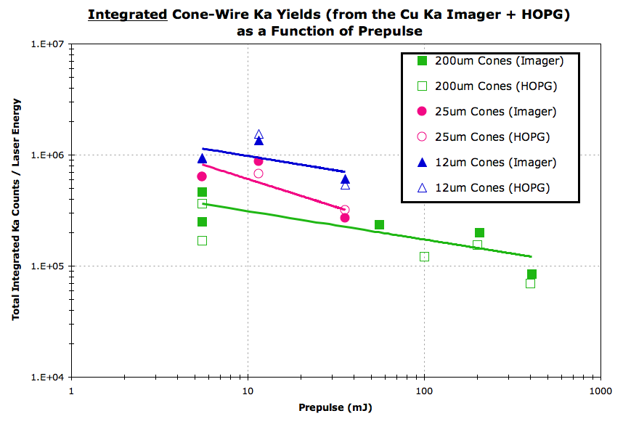
Prepulse snd Cone thickness makes a difference on a coupling efficiency!
Role of laser prepulse and cone wall thickness needs to be further investigated.

Slide 14
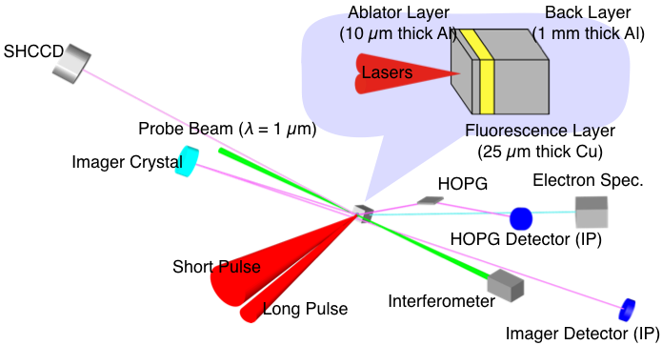
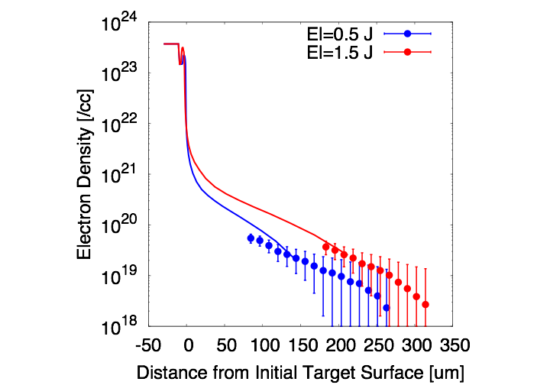
K-alpha emission is measured with long pulse laser created preplasma.
Short Pulse Laser Spec. (λ = 1 µm)
12 J, 0.4-0.6 ps, 20 µmΦ, 2x10¹⁸ W/cm²
Long Pulse Laser Spec. (λ = 1 µm)
~1.5 J, 500 ps, ~150 µmΦ, 1x10¹³ W/cm²

Slide 15
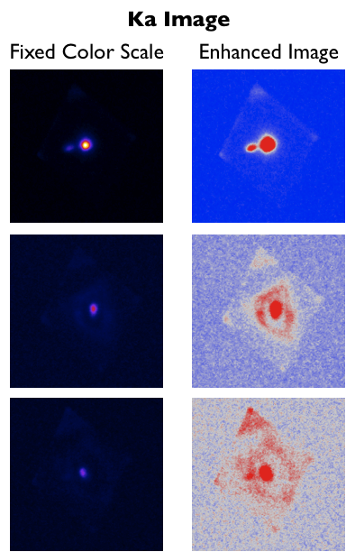
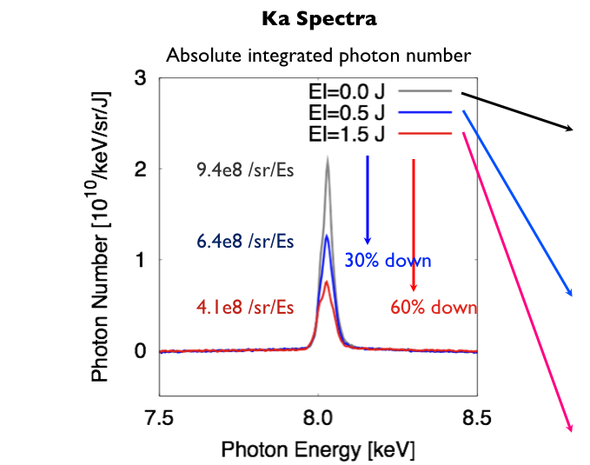
Preplasma reduces Ka yield and produces ring pattern on Ka emission.
Fast electron transport is inhibited in preplasma and cannot
reach Cu layer

Slide 16
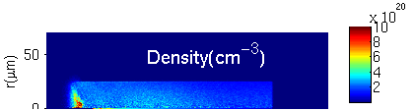
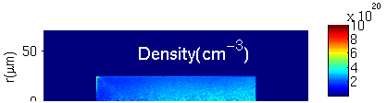

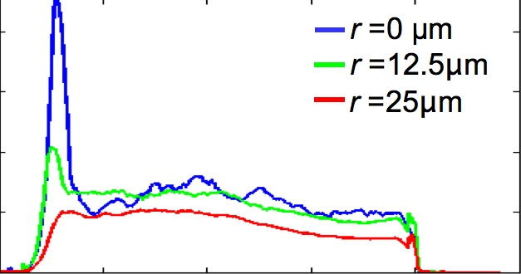
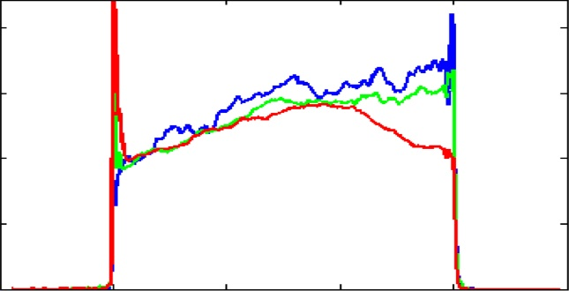
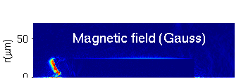

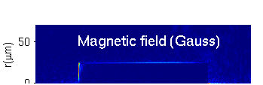

LSP simulations suggest bottleneck can be reduced with sharp interface
With Preplasma:
N=n₀exp(-0.28×z-z₀, z<z₀, z₀=50 µm
Without preplasma
1 ps
6
6
Radius =
——0 μm
——12.5 μm
——25 μm
4
4
Density (10²⁰ cm⁻³)
Density (10²⁰ cm⁻³)
2
2
0
0
0
50
100
150
200
250
0
50
100
150
200
250
Z (μm)
Z (μm)
Magnetic inhibition plays a major role
M.S. Wei et al., Phys Plasmas 15, 083101 (2008)

Slide 17
Research goals and direction focus on FI conditions
Electron energy deposition and divergence
  As a function of plasma density and temperature
  External magnetic field to reduce divergence
Relevant parameter range
  Cone tip conditions: 1-20g/cc, 1-20eV - shocked cone tip
  Entry to dense blob: CD or DT at 1-100g/cc and 50-200 eV
Access these conditions using
  Shocked solids
  Laser heated foams
  Liner implosion
Design and analyze experiments using
  Hybrid-PIC
  Hydro
  atomic spectroscopic

Slide 18
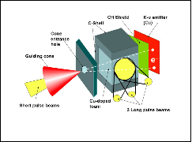
Warm dense matter experiment planned
for OMEGA-EP
CH foam (ρ~0.2 g/cc) and solid (ρ ~ 0.2 g/cc)
Three long pulse beams: E_{L}^{tot}~1 kJ, t_{L}~4 ps
  Generates a shock in the foam
  That reflects off far walls
One short pulse laser: E_{S}~1 kJ, t_{S}~10 ps
  Injects electron beam into foam
Cu foil detector
  Detect current and spread

Slide 19
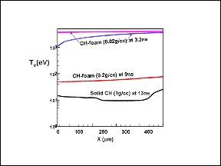
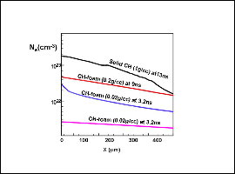
The reflected shocks produce large, uniform plasmas
1 g/cc ==> 20 eV
0.2 g/cc ==> 50 eV

Slide 20
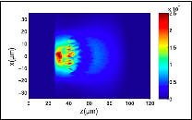
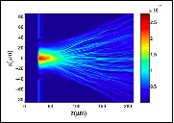
LSP simulations indicate instabilities
& divergence
0.25 ps
2 ps
Background density ~ 1.5 x 10²¹ cm⁻³
Background density ~ 10²³ cm⁻³
Weibel instability dominant for ρ_{background} ~10²¹ cm⁻³
Resistive filamentation dominant at higher ρ_{background}
The beam tends to diverge after a short distance
  (this can be reduced using external magnetic fields)

Slide 21
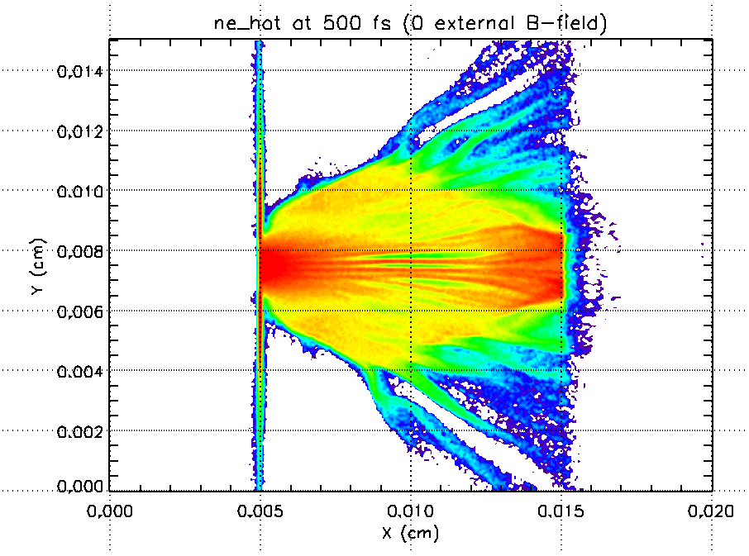
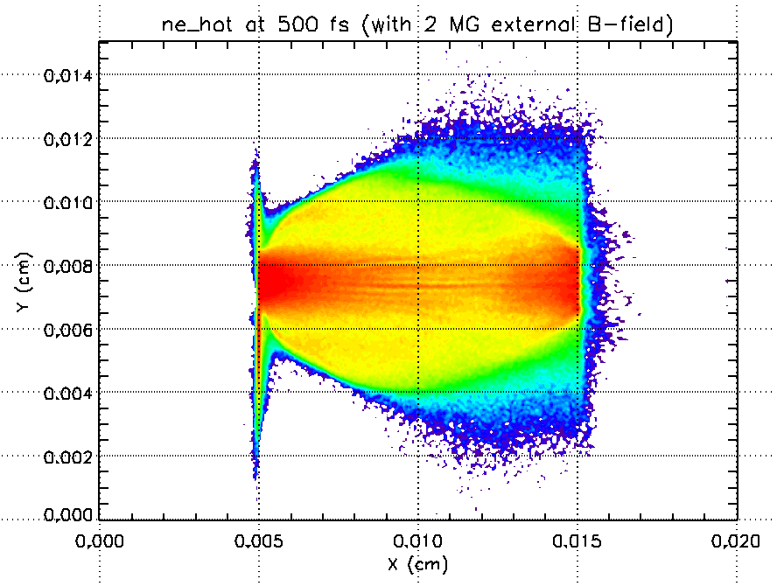

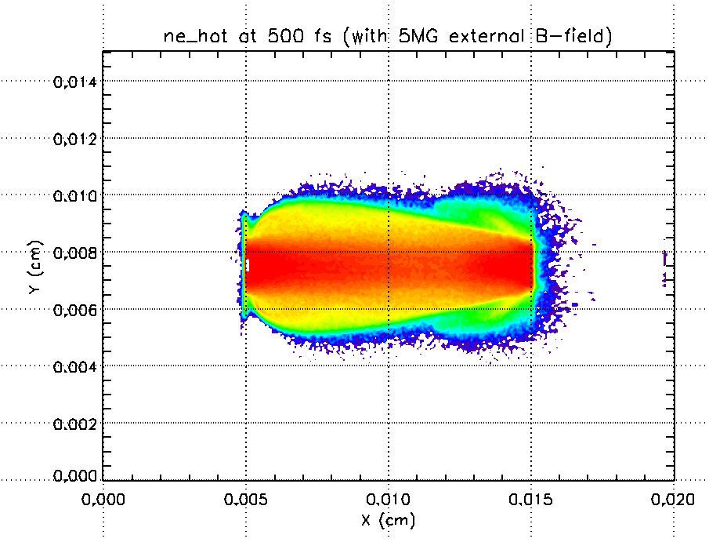
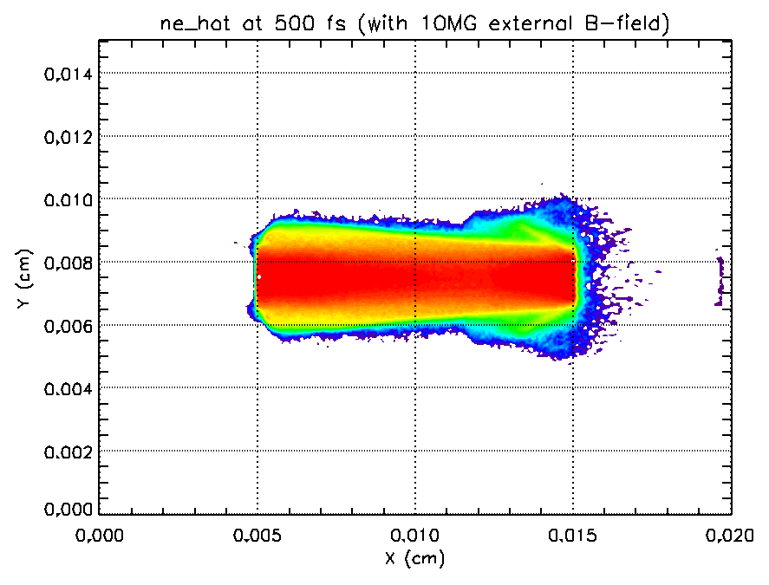
Beam collimation can be achieved with several MG B-fields
No external B
2MG external B_{X}
5MG external B_{X}
10MG external B_{X}

Slide 22
Summary
  Coupling efficiency increases with a diameter of the wire
  15% for 40 µm diameter is wire consistent with integrated fast ignition experiments
  1% for 10 µm diameter wire is in contradiction with Kodama et al. (Nature 432, 1005 (2004).
  1/e scalelength of 100 µm is consistent with ohmic stopping
  Hot electron temperature is lower than predicted by the penderomotive scaling
  Laser prepulse significantly changes the cone physics
  Electron coupling into the wire deceases with increase in prepulse level
  Electron coupling into the wire decreases for thicker cone walls

Slide 23
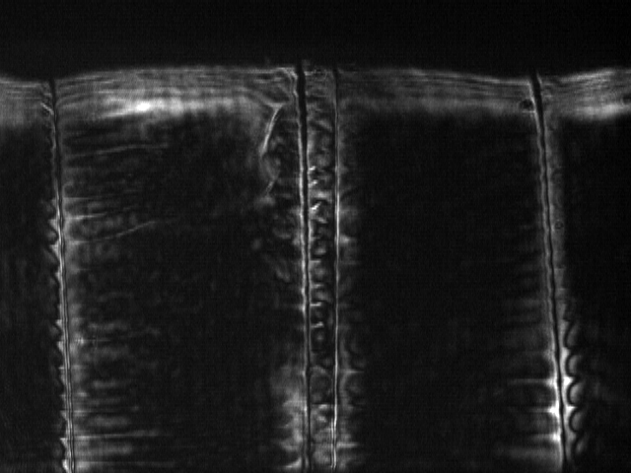
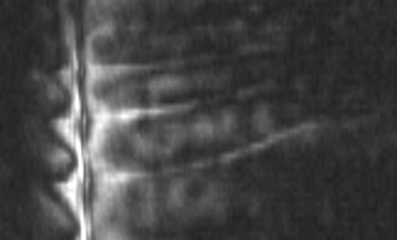
GenASIS: Generator for Ablation Structure
and Implosion Studies
New compact Linear Transformer Driver (LTD) technology - candidate for ICF ignition scale driver
250 kA in 150 ns – simple, reliable, repeatable
Extends capabilities to allow in-house scaling of present x-pinch experiments to higher current
Wire arrays, novel configurations, and kinetic drive experiments
Combine with x-pinch driver to develop new set-ups
10 mm

Slide 24
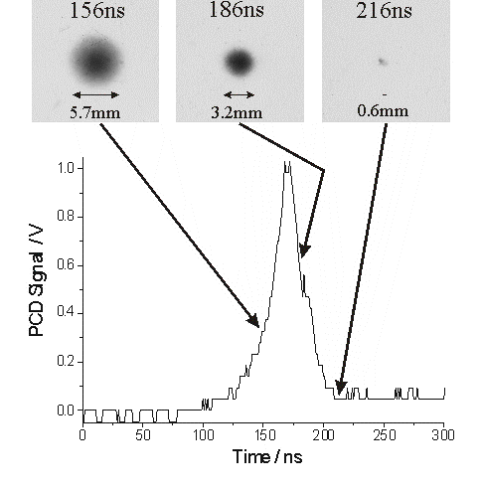
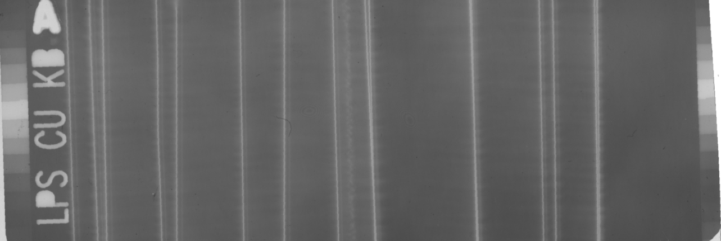
Collaborative Wire Array Experiments at
Larger Current Machines
We perform wire array experiments on large current machine:
Allows us to investigate scaling of plasma properties with higher currents and different rise rates
Recent experiments to study wire ablation physics
Cornell University: 1MA, 100ns
Imperial College London: 1MA, 250ns

Slide 25
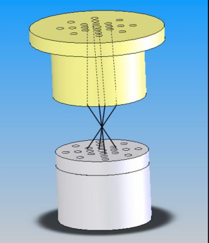
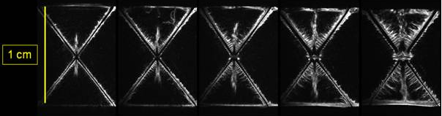
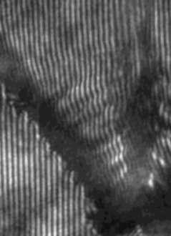
X-pinch is a rich source of HEDP study
X-rays are generated by the magnetic compression of two or more wires at a cross-point to high temperature (T_{e} > 1keV) and density (~solid density) giving a < 1ns burst of x-rays in a 1 µm scale hotspot - a unique HEDP environment
  - Energy density >>10¹¹ Jm⁻³
  - Radiation dominated plasma
UCSD pulser: 80 kA in 50 ns (Marx bank driven)
Many applications, including wire ablation studies, high spatial and temporal resolution radiographic imaging, and laboratory astrophysics

